Slide 1
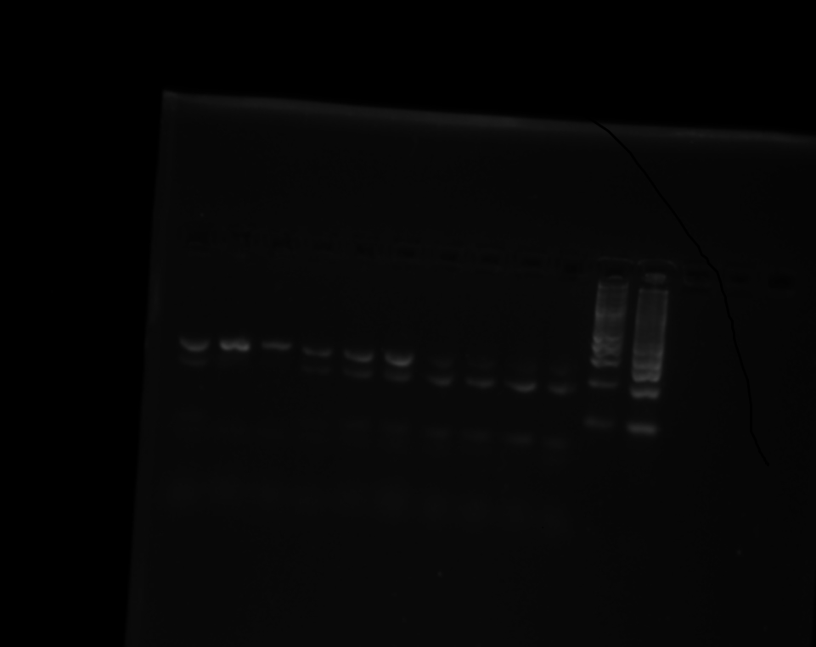
Figure 1 (original gel)

Slide 2
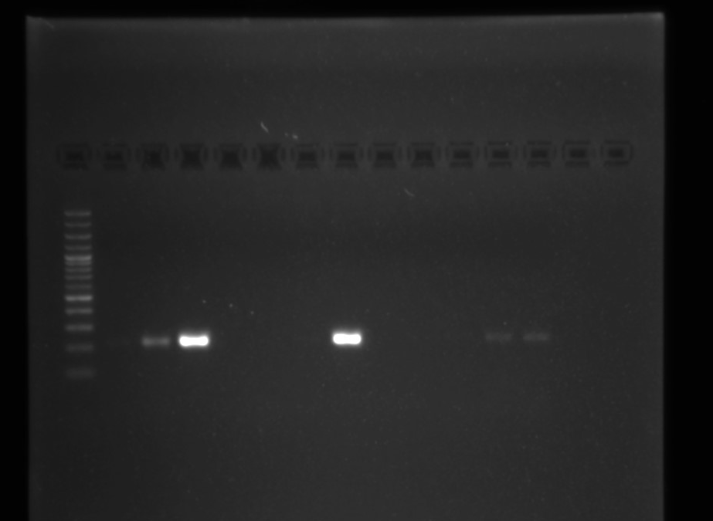
Figure 2 (original gel)

Slide 3
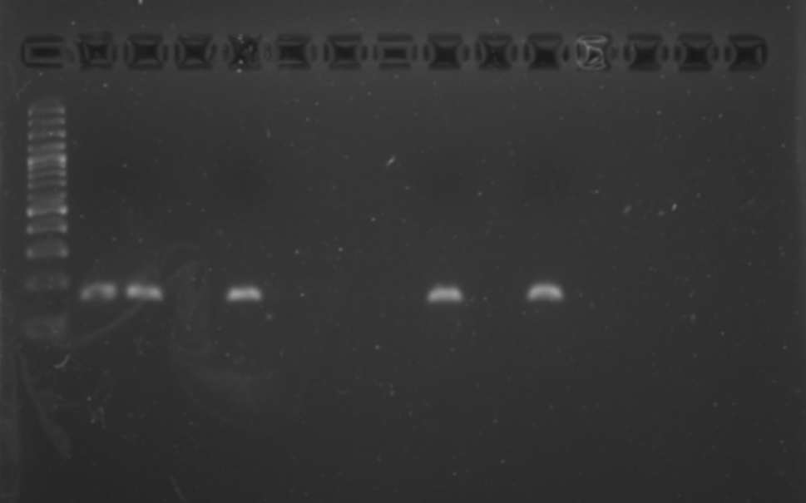
Figure 3 (original gel)

