Slide 1
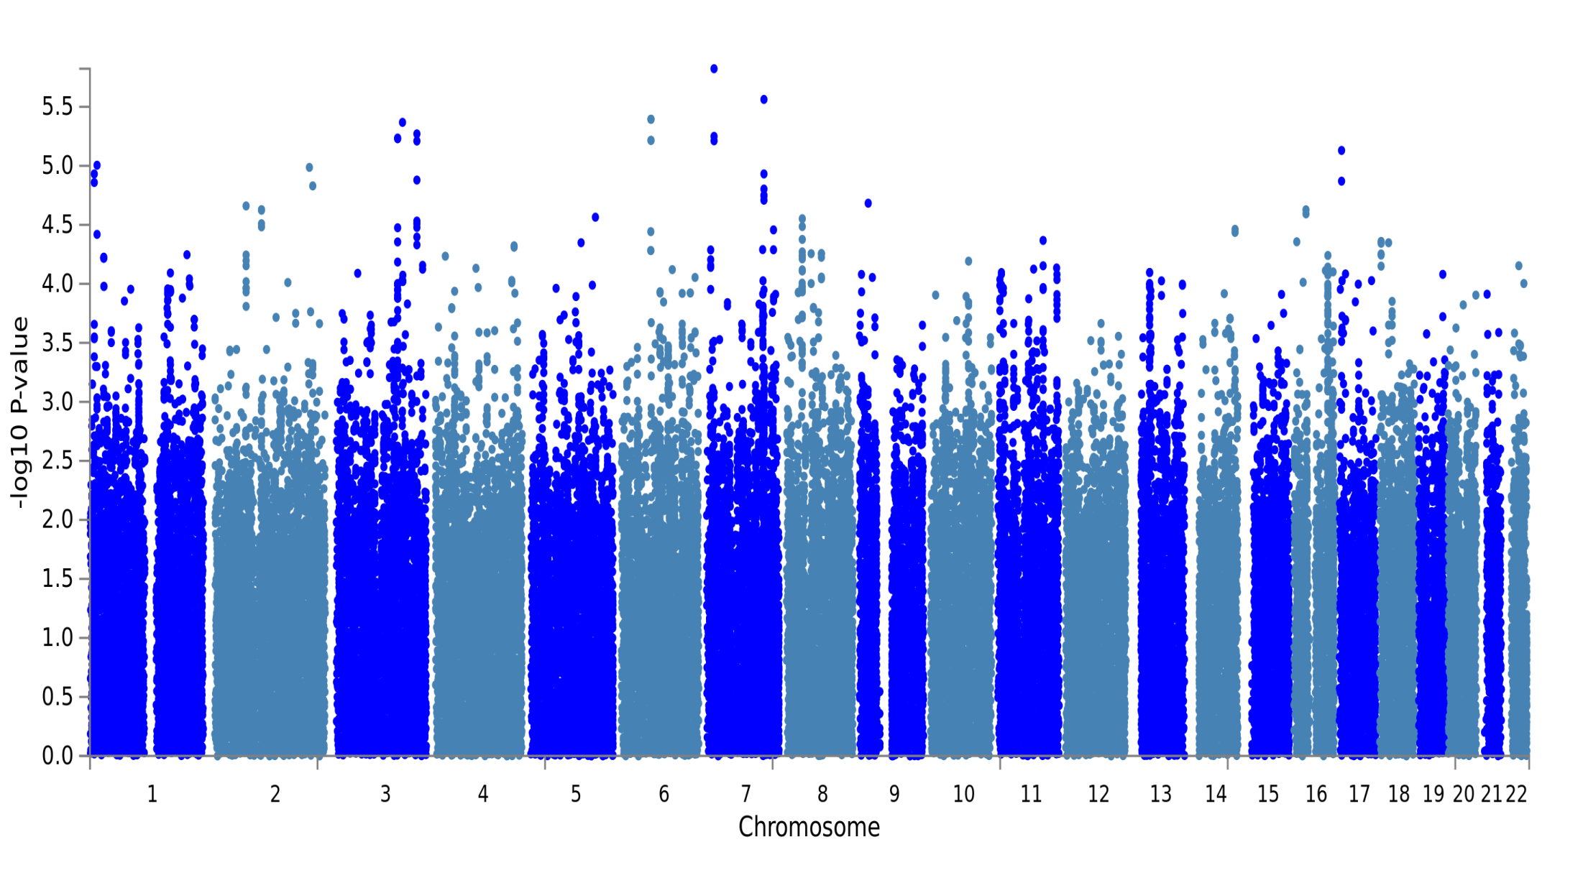
Supplementary Figure S1: the Manhattan plot of a GWAS on neck or shoulder pain using GS:SFHS (N=19,632)

