Slide 1
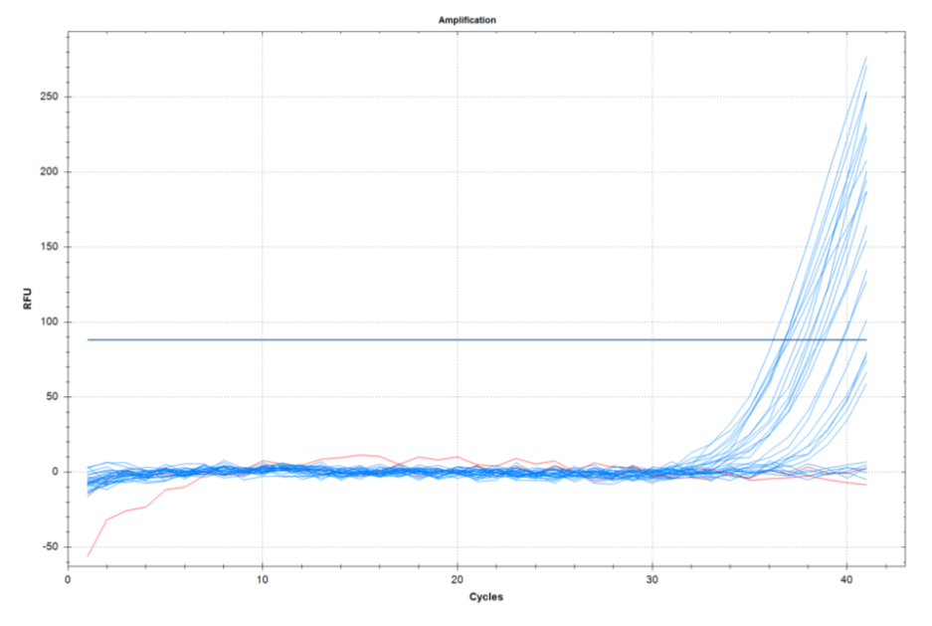
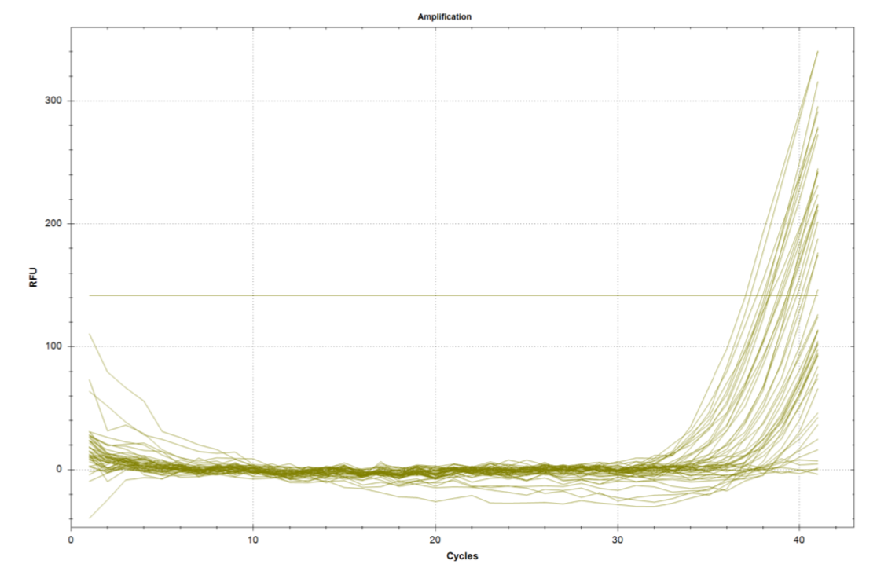
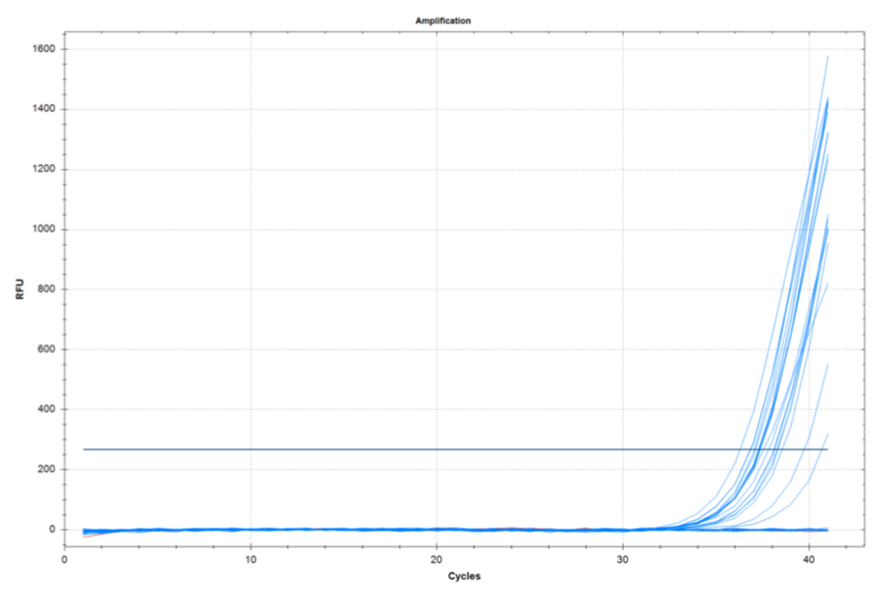
IS2404
IS2606
KR-B
Figure S1. Real-time PCR graphs of plant root samples collected in Buruli ulcer endemic area of Côte d’Ivoire.

