Slide 1
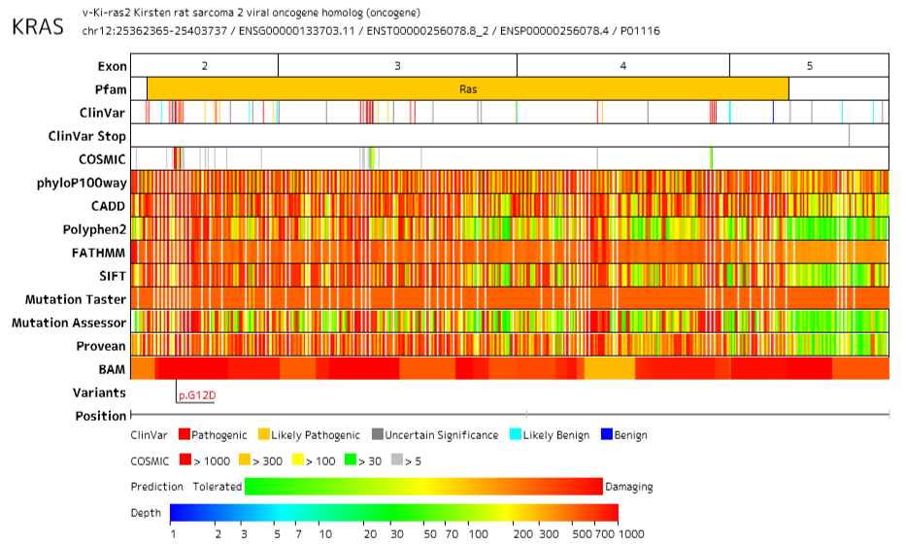
Supplemental Figure 1

Slide 2
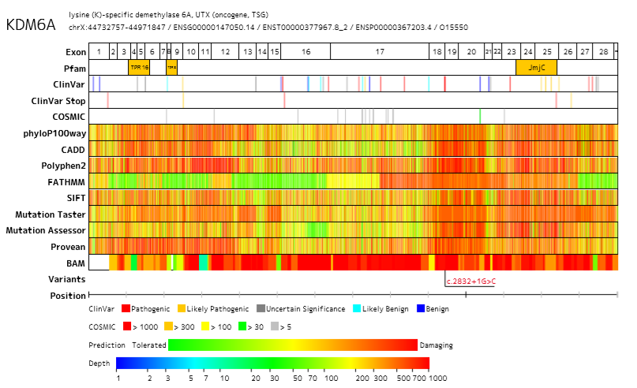
Supplemental Figure 2

Slide 3
A
B
Supplemental Figure 3

Slide 4
A
B
Supplemental Figure 4

