Slide 1
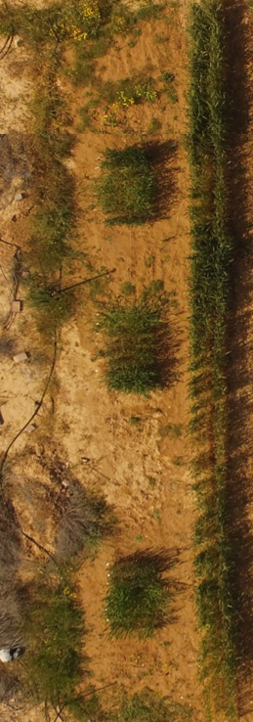
Supplemental Figure S1
A)
B)
C)
Margin natural resource vegetation
Margin wheat
resource vegetation
0.45 m
11
12
13
14
15
16
17
18
Block I
Block II
Block III
West
11.0 m
focal plants
East
21
22
23
24
25
26
27
28
1.5 m
Block
I
0.9 m
0.8 m
1.9 m
17.7 m
0.56 m
1.5 m
Block
II
0.9 m
31
32
33
34
35
36
37
38
0.8 m
4.0 m
2.7 m
1.5 m
Block
III
0.9 m
0.8 m
Svevo
Zavitan
Rotem
Chinese Spring
0.75 m
0.45 m
Supplementary Figure S1: A field setup. A) A schematic illustration of the three blocks and the division into four genotypes. B) A photo of the filed. C) A schematic illustration of the field setup.

Slide 2
Supplemental Figure S2
Supplementary Figure S2: Aphid abundance in the experimental blocks. Number of aphids from the focal wheat plants were counted twice: on March 20th and April 1st, 2018 (mean ± SE, number of replicates Block1-92; Block2-88, and Block3-87). No significant differences were found within blocks for same counting date, using the one-way ANOVA (Tukey-Kramer HSD post-hoc tests).

Slide 3
Supplemental Figure S3
Svevo | SV
Zavitan | ZT
Rotem | RM
Chinese Spring | CS
Number of aphids
The developmental stages (presented as a continues values)
Supplementary Figure S3: A scatter plot between the average of phenology and aphid performance of the four wheat genotypes in two counting dates. CS, Chinese Spring, RT, Rotem, SV, Svevo, ZT, Zavitan. Counting #1, on March 20th, 2018 and counting #2 on April 1st, 2018. The developmental stages presented as continues values. The Pearson correlation coefficient r value = 0.64.

Slide 4
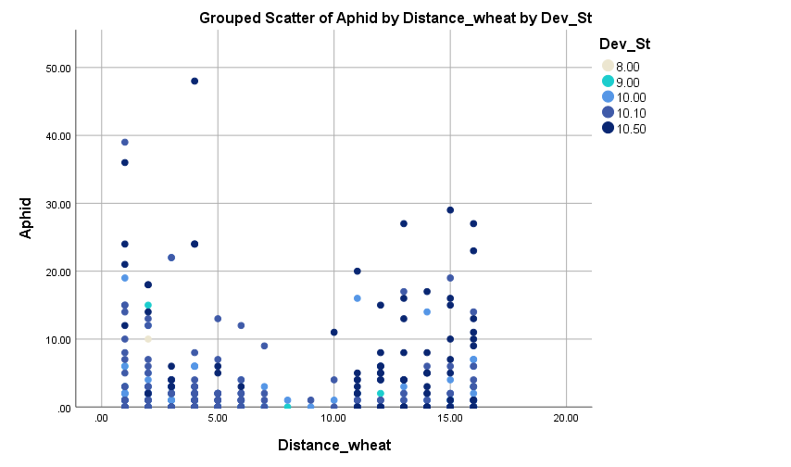
Supplemental Figure S4
Supplementary Figure S4: Effect of phenology and position in relation to the margin wheat resource vegetation on aphid numbers counted on the four wheat genotypes (combined data).

