Slide 1
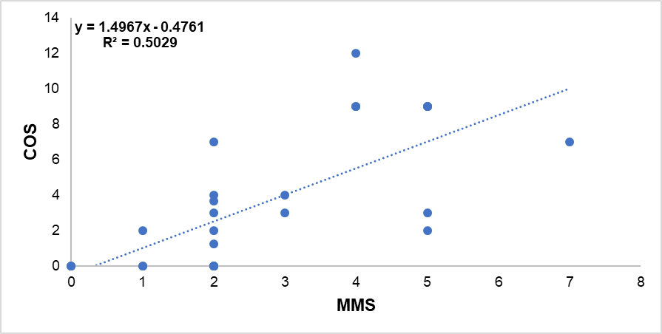
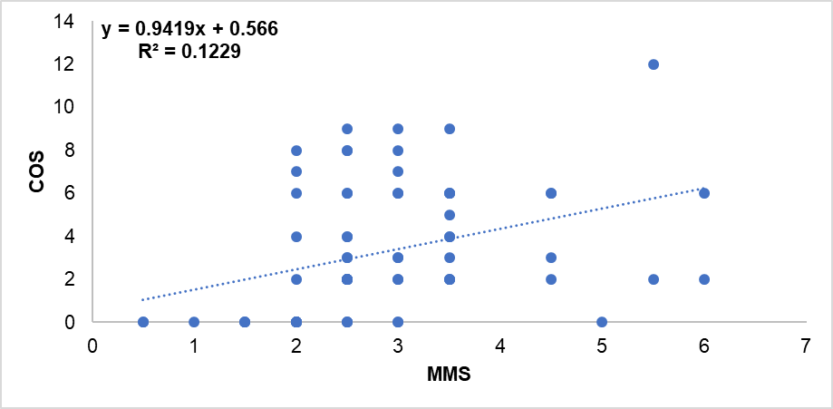
A
Homozygous MMS vs COS
S3 Figure. [A] MMS vs COS for homozygous patients and nonpathogenic controls. There is a positive correlation (R2 = 0.50) between the MMS and COS. [B] MMS vs COS for compound heterozygous patients and nonpathogenic controls. There is a very weak positive correlation (R2 = 0.12) between the MMS and COS.
B
Compound Heterozygous MMS vs COS

