Slide 1
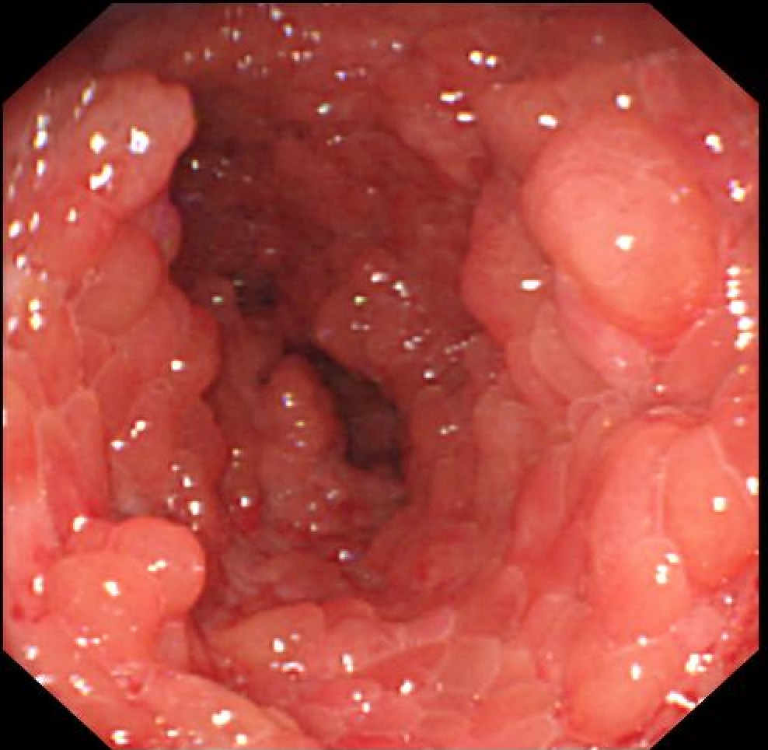
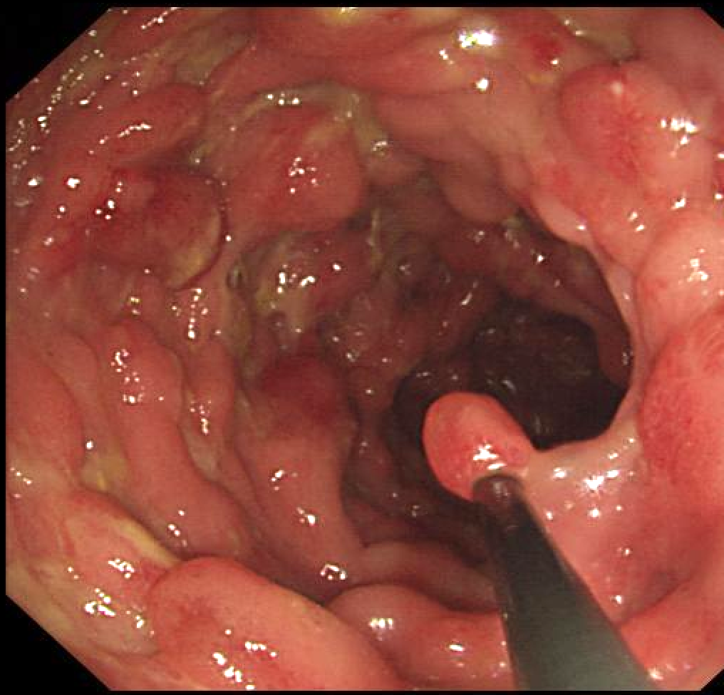
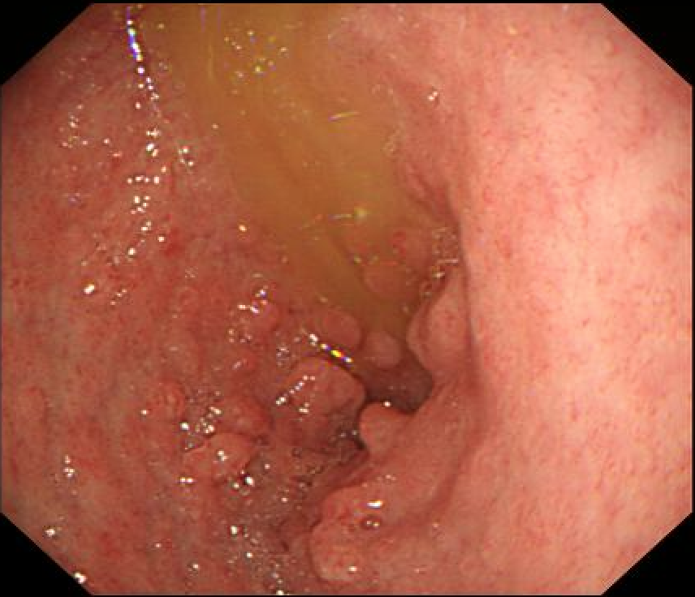
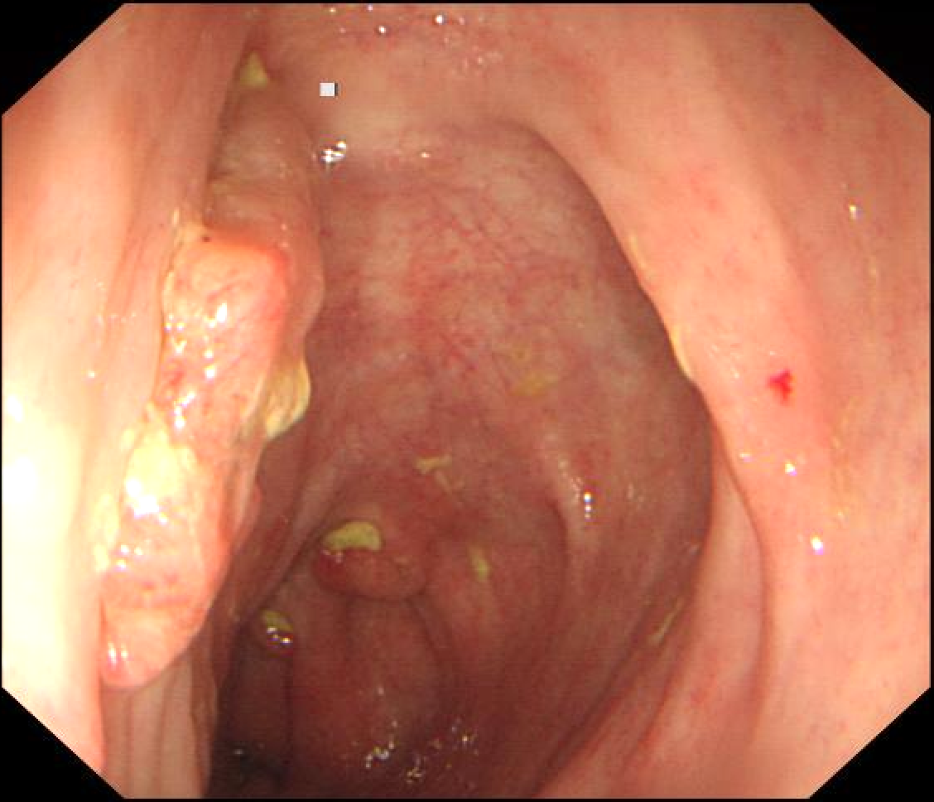
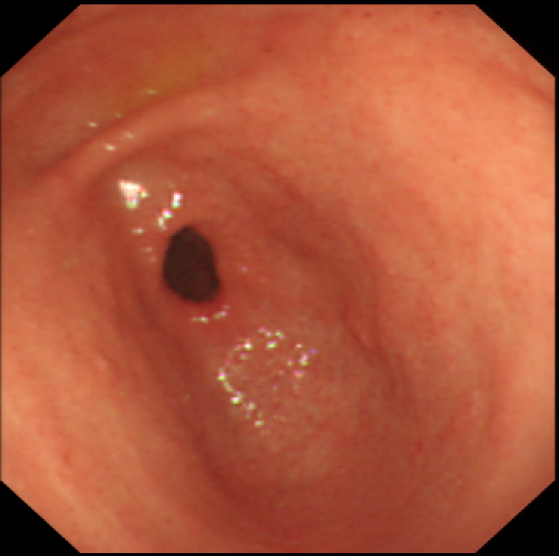
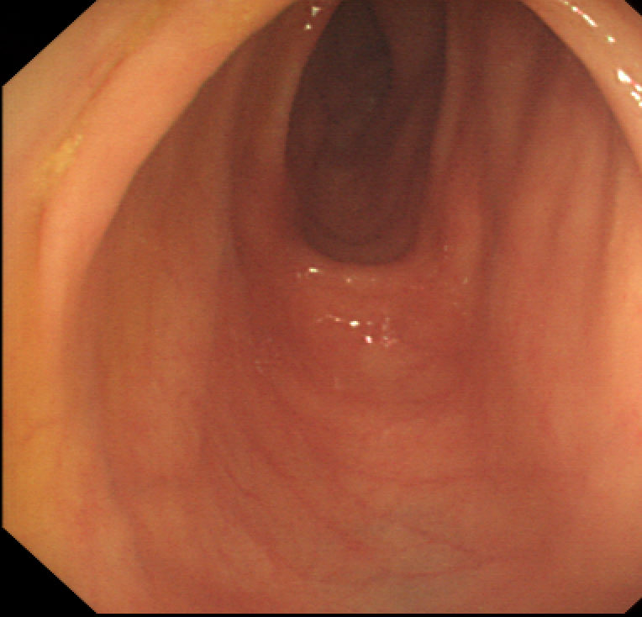
A
B
C
D
E
F
Supplementary File 4. Diffuse gastrointestinal polyps gradually attenuate and eventually disappear along with the glucocorticoid therapy.
Dense polyps without spared mucosa under gastroscopy (A) and colonoscopy (B) before treatment. After 4 months’ prednisone treatment, the number and size of polyps reduced dramatically under gastroscopy (C) and colonoscopy (D). Normal mucosal appearance was detected under gastroscopy (E) and colonoscopy (F) after 2 years‘ low-dose glucocorticoid maintenance.

