Slide 1
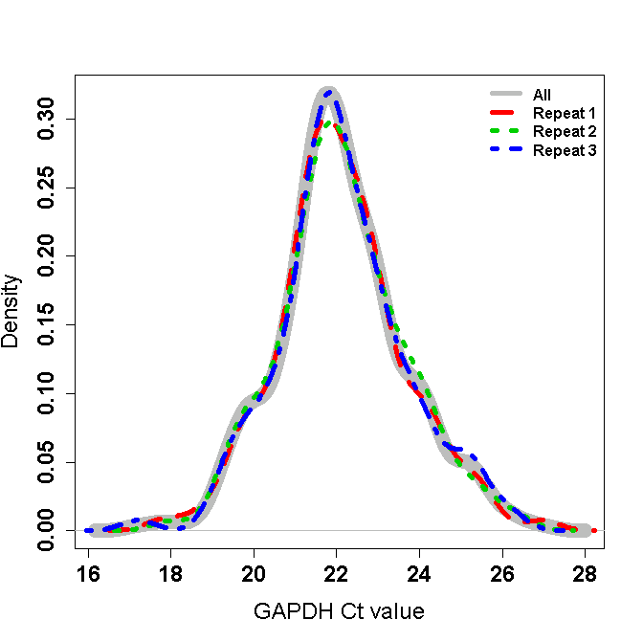
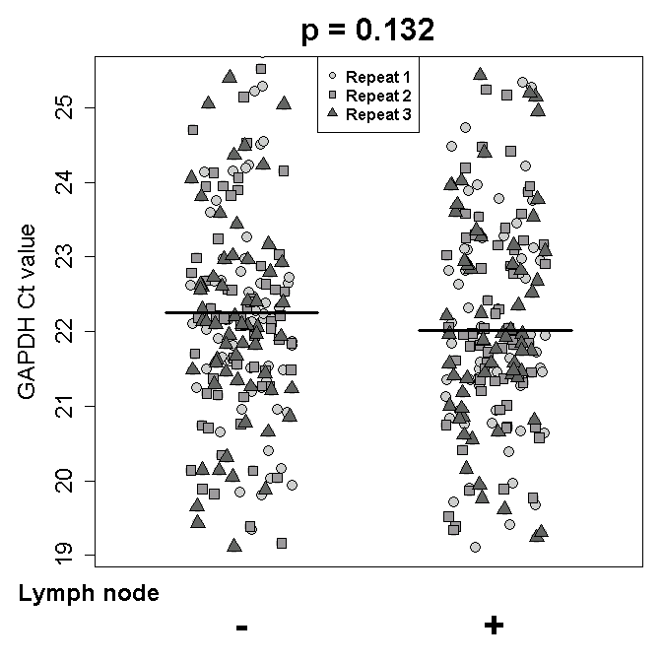
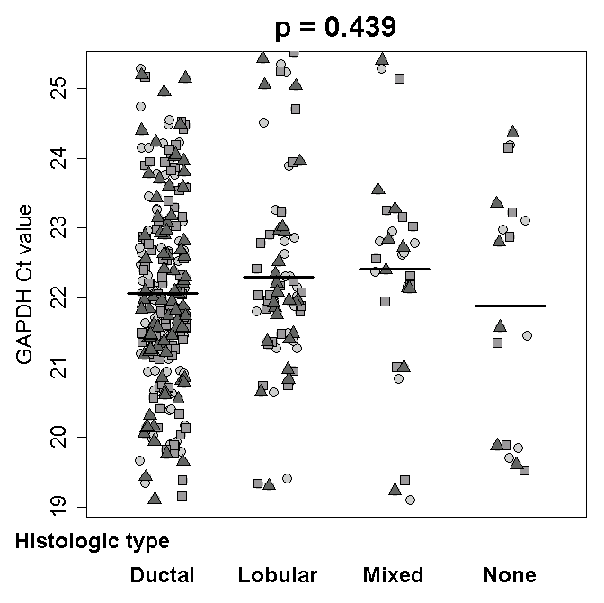
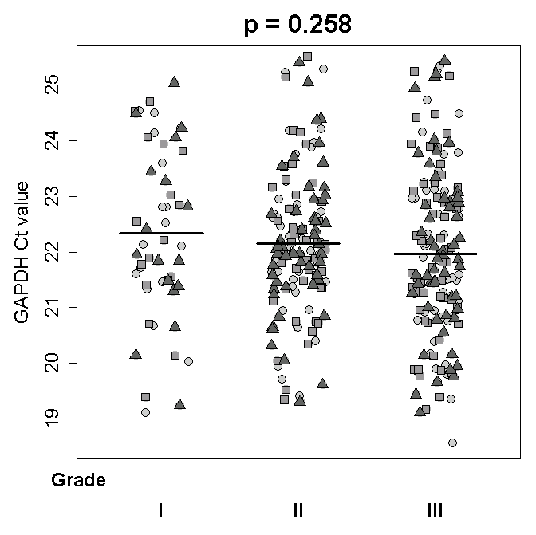
Supplementary Figure S1.
(a)
(b)
(c)
(d)
Supplementary Figure S1. The distribution of GAPDH Ct values (a) and the associations between GAPDH Ct value and each of lymph node (b), histologic type (c), and grade (d). In (c)-(d), the horizontal bars indicate a mean value and the p-value was calculated using repeated measures two-sample t-test and one-way ANOVA under linear mixed-effects models.

