Slide 1
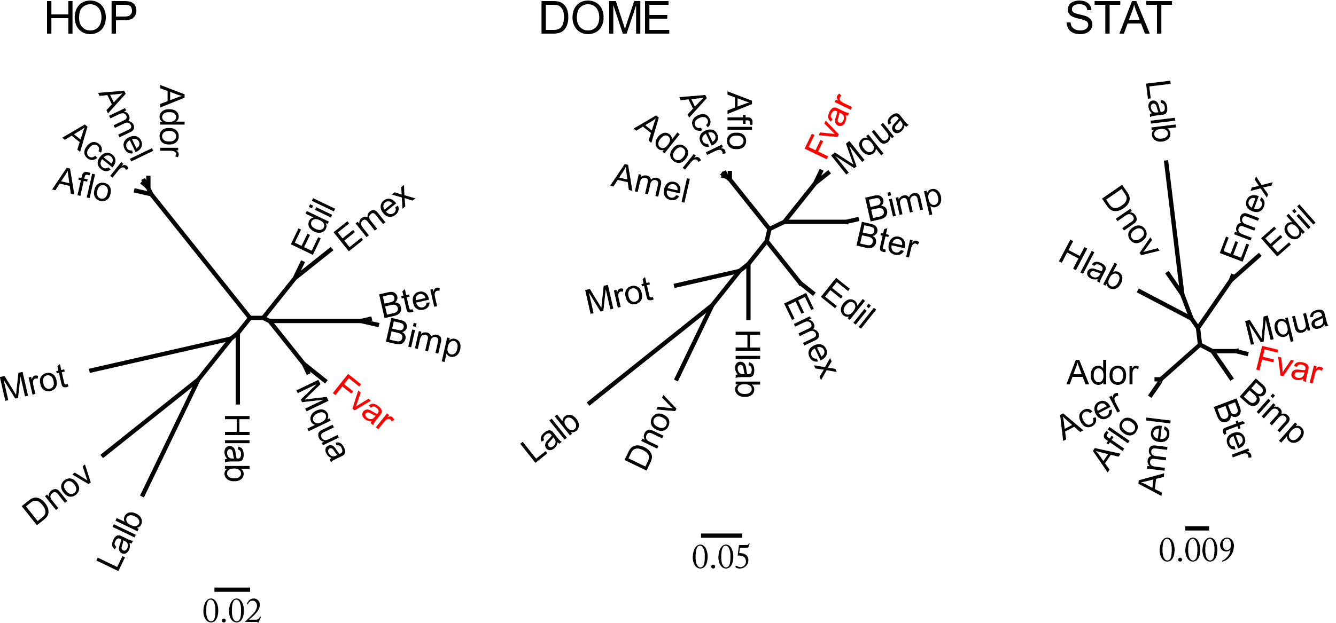
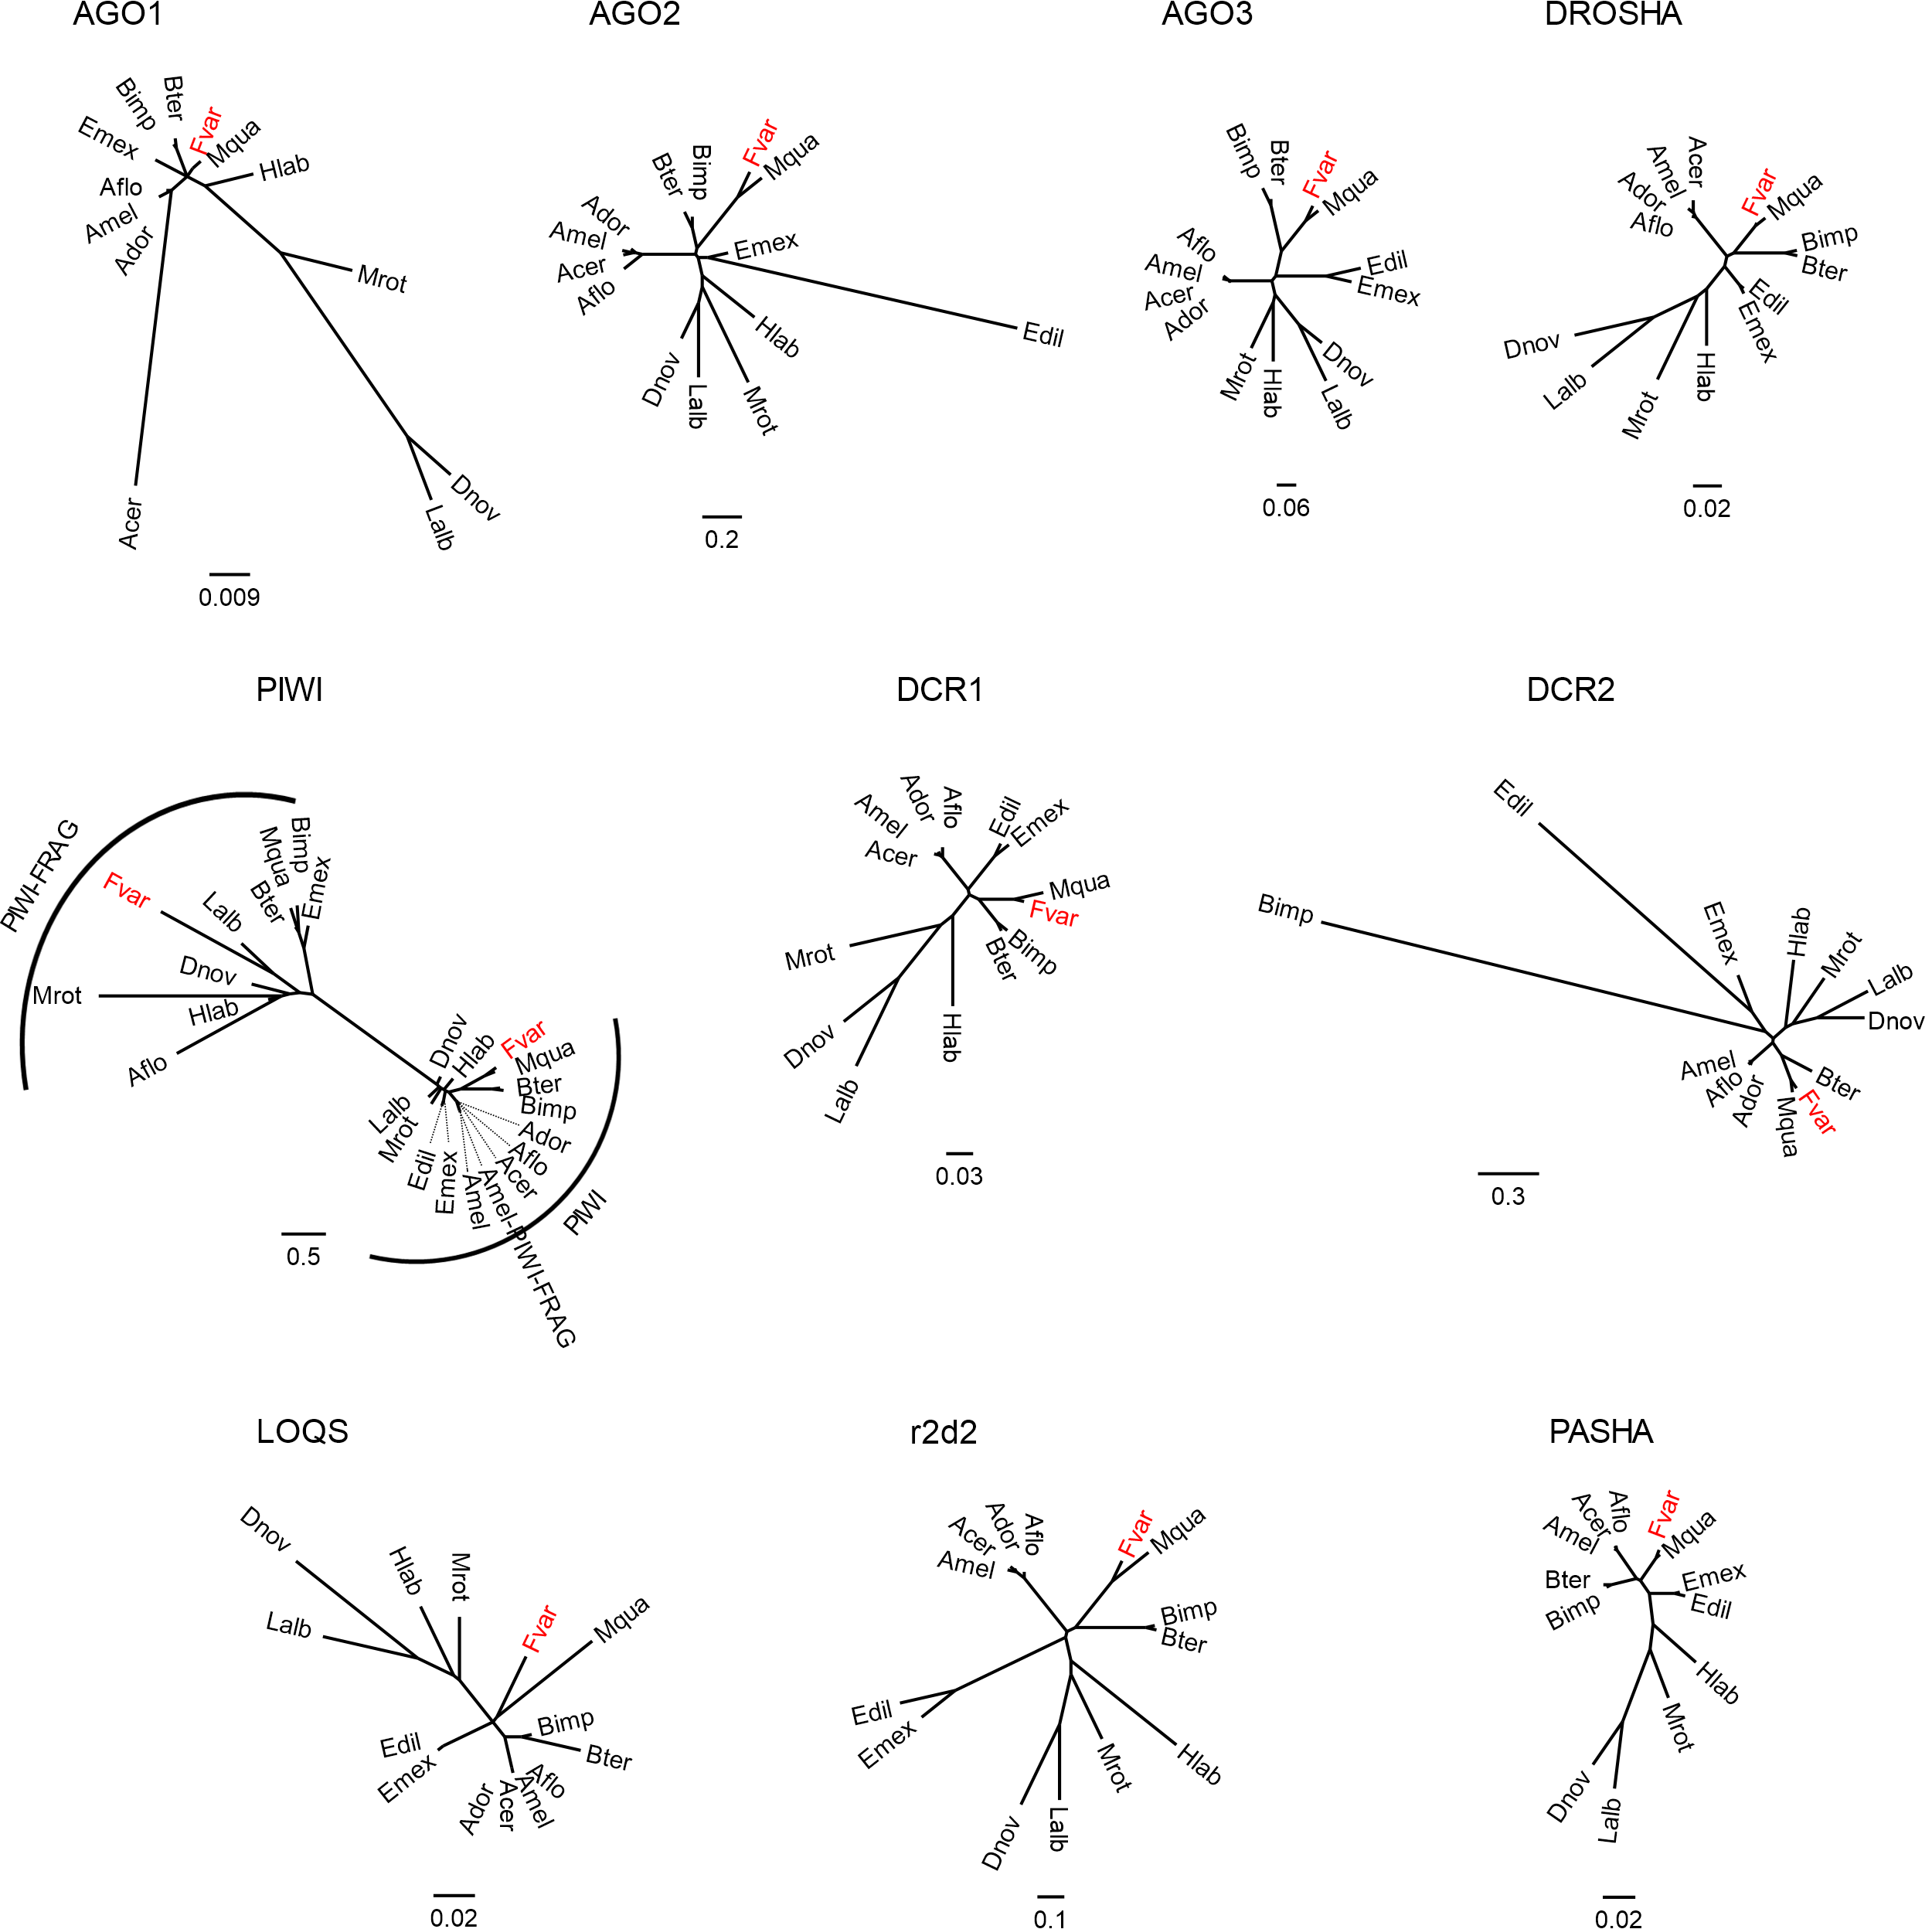
A
B
Figure S3: Unrooted phylogenetic trees for core genes of the JAK/STAT (A) and RNAi pathway (B). Amino acid sequences were aligned using MAFFT and the tree was generated in an ML approach (1000 replicates). In red are the orthologs of Frieseomelitta varia. Gene names are abbreviated. Species names are in three letters acronyms, Acer: Apis cerana, Ador: Apis dorsata, Aflo: Apis florea, Amel: Apis mellifera, Bter: Bombus terrestris, Bimp: Bombus impatiens, Dnov: Dufourea novaengliae, Edil: Euglossa dilemma, Emex: Eufriesea mexicana, Fvar: Frieseomelitta varia, Lalb: Lasioglossum albipes, Mrot: Megachile rotundata, Mqua: Melipona quadrifasciata, Hlab: Habropoda laboriosa.

