Slide 1
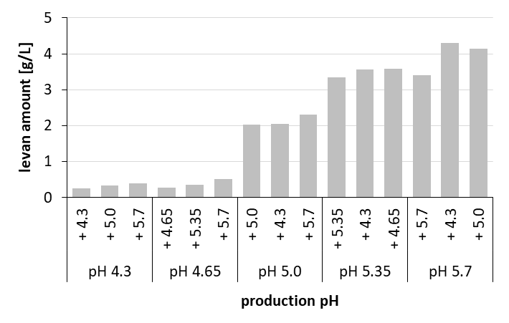
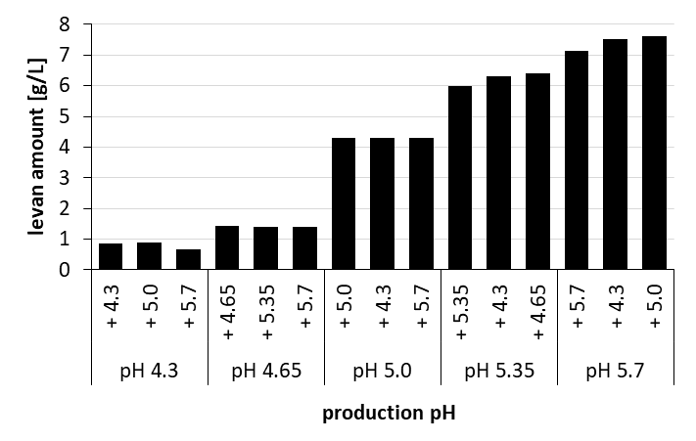
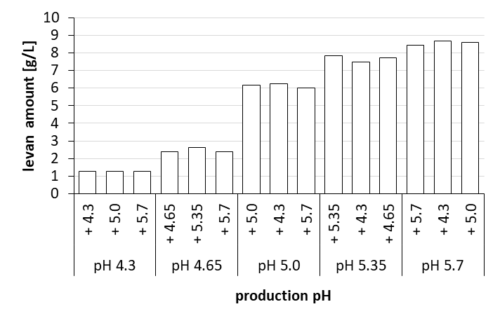
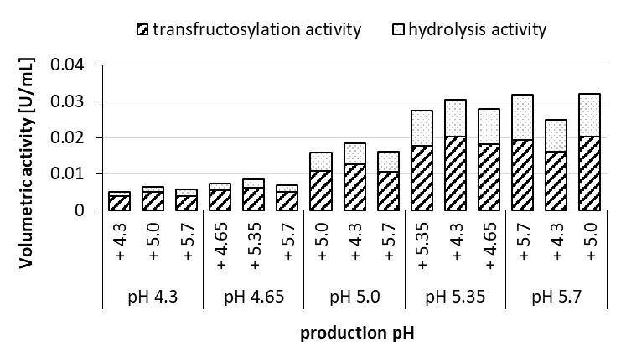
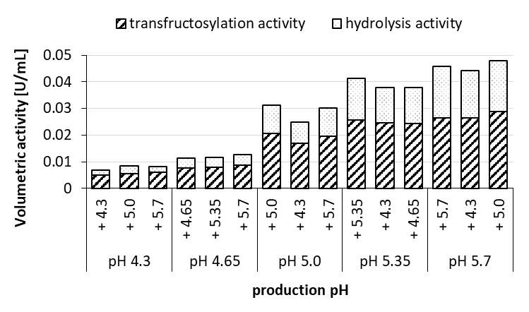
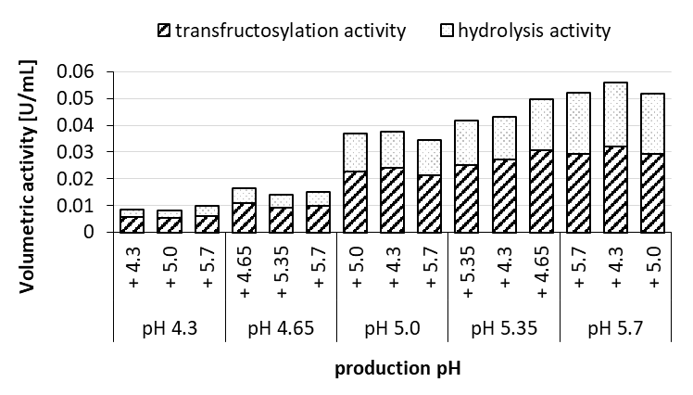
Supplementary File 1
A
OD 2.2
B
OD 2.58
C
OD 2.84
D
OD 2.2
E
OD 2.58
F
OD 2.84
Notes:
Fig. 3: Produced levan amounts at different pH and initial OD₆₀₀ of the cell culture of G. albidus TMW 2.1191 (A-C) and the corresponding volumetric activities (D-F) determined after levan production. The experimentally determined production pH values derived from the respective buffer mixtures are depicted in brackets in Fig. 1.

