Slide 1
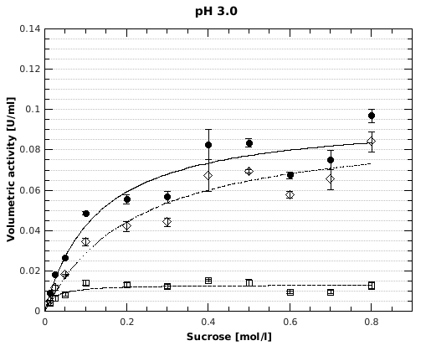
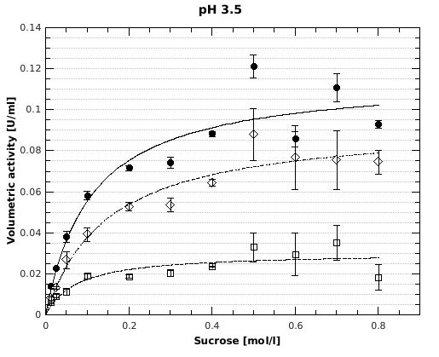
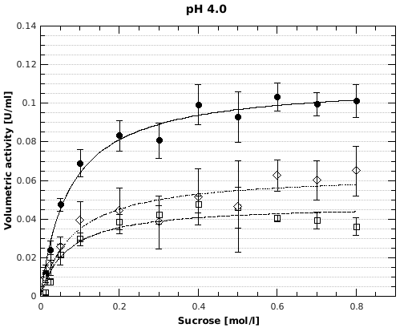
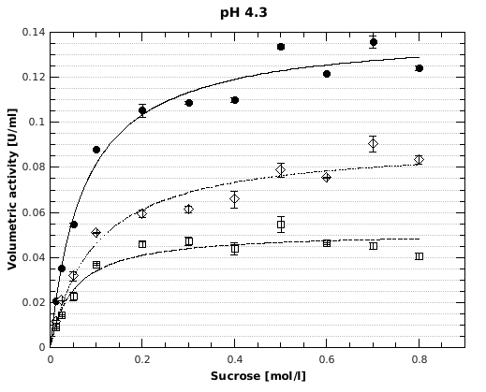
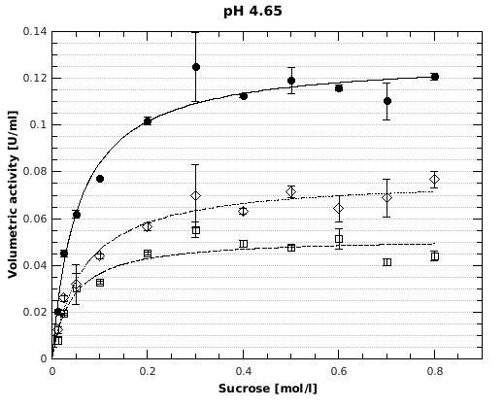
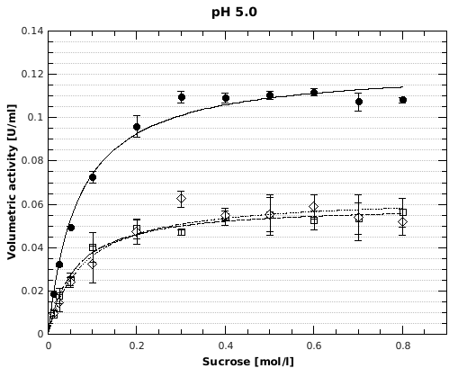
Supplementary File 2
Notes:
Supplementary File 1: Volumetric activities of the heterologously expressed levansucrase of G. albidus TMW 2.1191 at different pH and sucrose concentrations. Black dot: overall activity; white square: hydrolysis activity; white rhomb: transfructosylation activity.

Slide 2
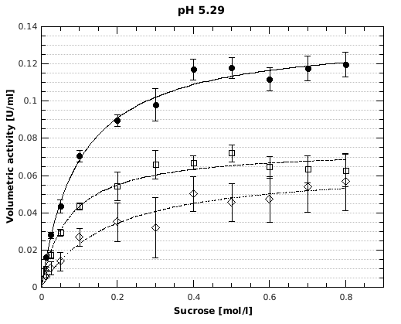
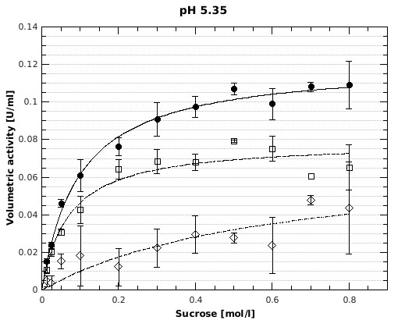
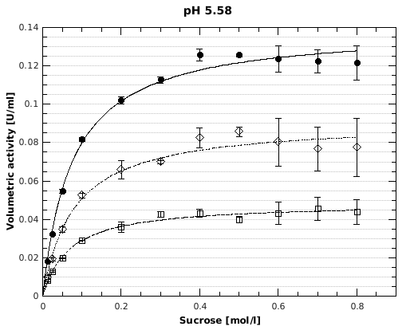
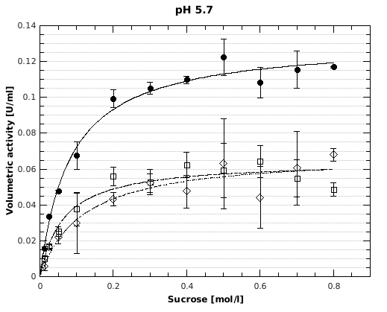
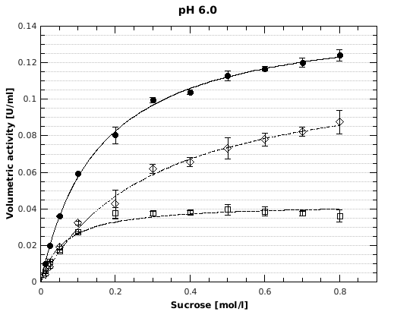
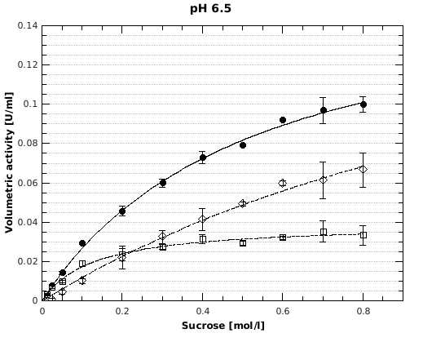
Supplementary File 2 continued
Notes:
Supplementary File 1: Volumetric activities of the heterologously expressed levansucrase of G. albidus TMW 2.1191 at different pH and sucrose concentrations. Black dot: overall activity; white square: hydrolysis activity; white rhomb: transfructosylation activity.

Slide 3
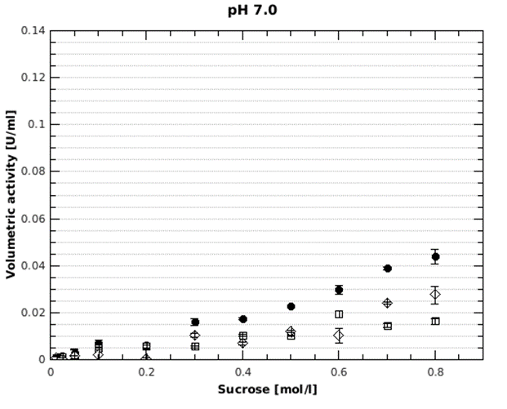
Supplementary File 2 continued
Notes:
Supplementary File 1: Volumetric activities of the heterologously expressed levansucrase of G. albidus TMW 2.1191 at different pH and sucrose concentrations. Black dot: overall activity; white square: hydrolysis activity; white rhomb: transfructosylation activity.

