Slide 1

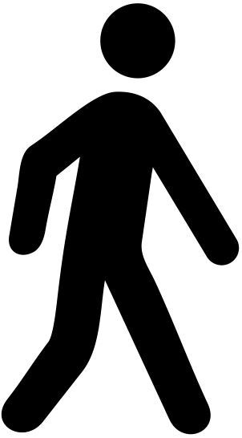
Appendix 1. Diagram of the walkway setup
12 meters
6-meter active walkway
1
2
4
3
Force plate N° 1-3: AMTI type OR 6-7
Force plate N° 4: AccuGait
This diagram is part of the manuscript “An investigation of the Spatiotemporal Parameters of Gait and Margins of Stability throughout Adulthood.” by Herssens et al. (2020) published in Journal of the Royal Society Interface.

