Slide 1
Supplementary Figure 1
Supplementary Figure 1. The option of optimal doses of MSC-Exo in vitro. EC were incubated with MSC-Exo of different concentration for 24h, 48h and 72h. Cell growth was then assessed by CCK8 kit. * P < 0.05. All figures represent the average of three sets of independent experiments.

Slide 2
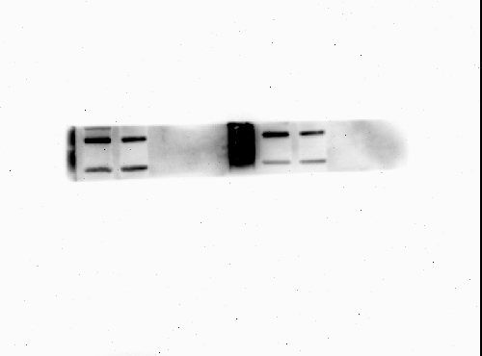
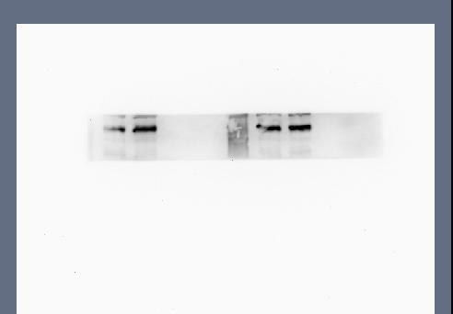
Supplementary Fig2
MSC-Exo
Medium
MSC
CM-Exo-free
Fig 2C-CD63
Fig 2C-TSG101

Slide 3
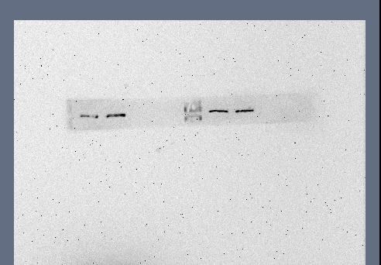
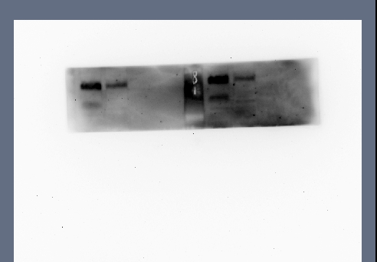
Fig 2C-HSP70
Fig 2C-CD81

Slide 4
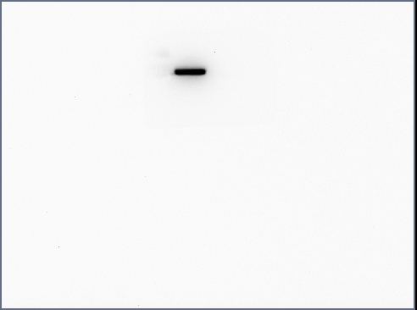
MSC-Exo
Medium
MSC
CM-Exo-free
Fig 2C-Calnexin

Slide 5
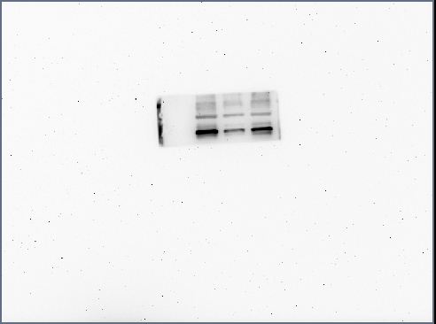
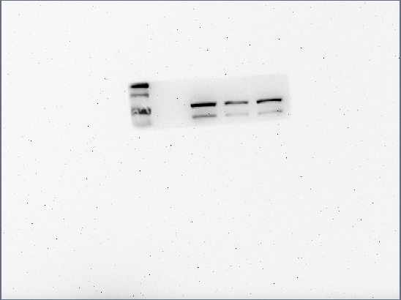
Supplementary Fig3
Positive Control (Delete)
Control
MSC-Exo
Fig 3C-PCNA
Fig 3C-Cyclin D1

Slide 6
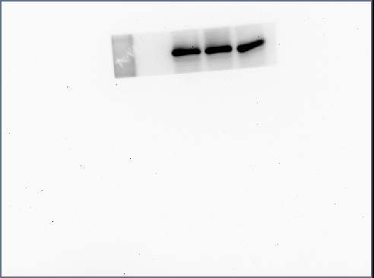
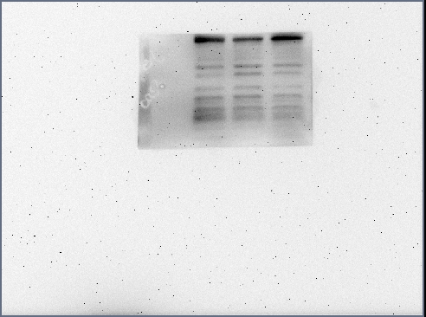
Fig 3C-GAPDH
Fig 3H-Vimentin

Slide 7
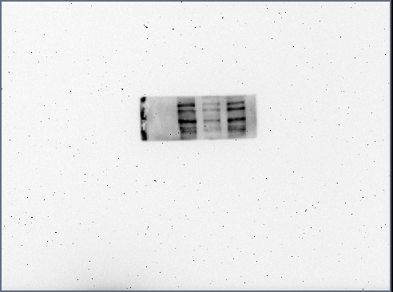
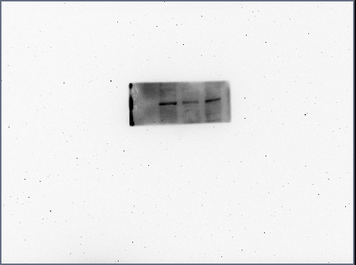
Fig 3H-MMP9
Fig 3H-MMP2

Slide 8
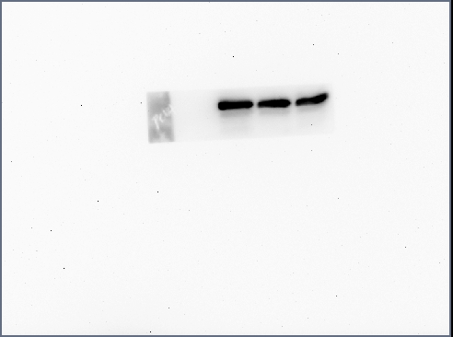
Fig 3H-GAPDH

Slide 9
Supplementary Fig4
Positive Control (Delete)
Control
MSC-Exo
Fig 4A-Erk1/2
Fig 4A-P-Erk1/2

Slide 10
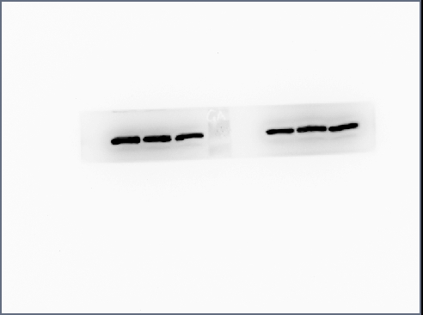
Fig 4A-GAPDH

Slide 11
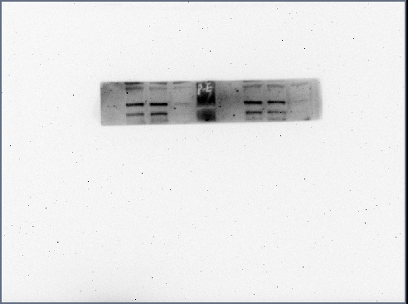
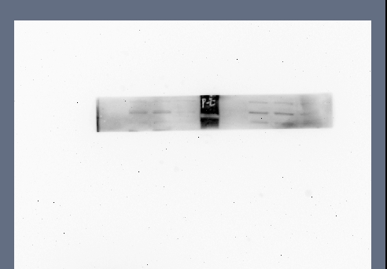
MSC-Exo/DMSO
MSC-Exo
MSC-Exo/SCH
Fig 4G-P-Erk1/2
Fig 4G-Erk1/2

Slide 12
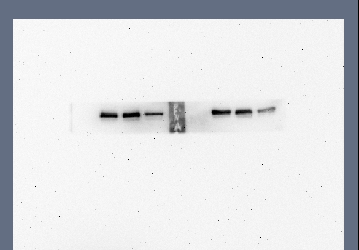
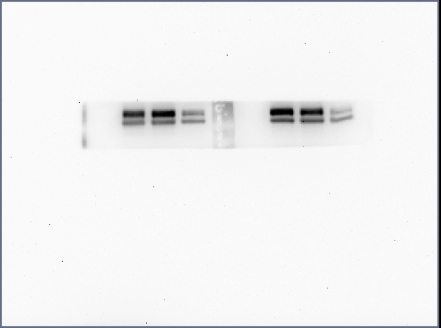
Fig 4G-PCNA
Fig 4G-Cyclin D1

Slide 13
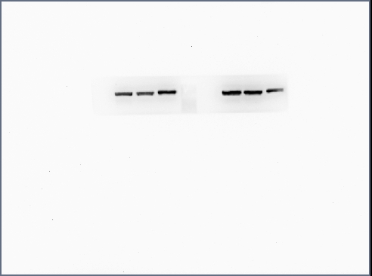
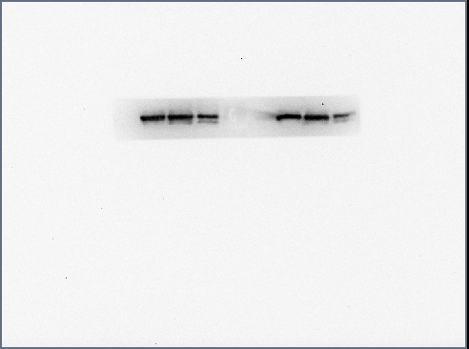
Fig 4G-Vimentin
Fig 4G-MMP9

Slide 14
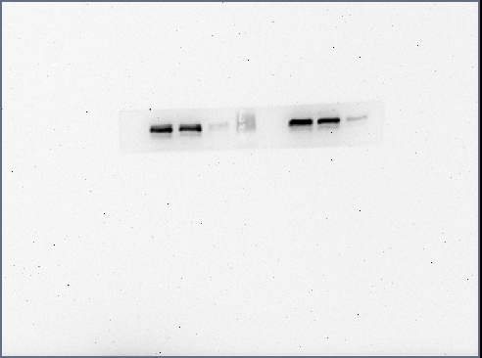
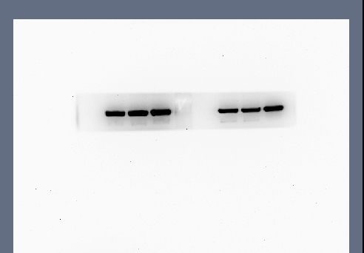
Fig 4G-MMP2
Fig 4G-GAPDH

