Slide 1
22RV1
C4-2
48h
24h
DMSO
48h
72h
24h
48h
DAPT
72h
24h
48h
RO4929097
72h
NICD1
1744
NOTCH1
NICD3
NICD1
1744
NOTCH1
NICD3
Supplementary Figure 1. Quantification of immunoblotting in Figure 1. Western blot images were inverted and densitometry performed in ImageJ dividing value of each band over its GAPDH loading control. Figures correspond to Figure 1A and Figure 1B.

Slide 2
22RV1
C4-2
22Rv1
Supplementary Figure 2. Animal weights from Figure 3 xenografts. Animals were weighed every third day to monitor any toxicity of inhibitors. Toxicity was determined by 20 % or higher loss of body weight or signs of distressed behavior including hunched posture, loss of appetite and activity. Animal weights were averaged per group, graphed as percent of animal start weight. Error bars= SEM. Student's t-test was performed on each time point in all three studies. There was no statistically significant difference (p>0.05) between the control and treatment or Delta-Notch1 experimental arms at each time point. We observed no measurable toxicity in animals treated with RO4929097 when compared to the vehicle treated arm.

Slide 3
22RV1
3
C4-2
3
Vehicle
Vehicle
2
RO4929097
2
RO4929097
Fold Change over GAPDH
*
Fold Change over GAPDH
1
1
****
*
****
0
0
AR
AR
NICD1 1744
NOTCH1
AR V7
NICD1 1744
NOTCH1
3
22RV1
2
Delta-Notch1
Fold Change over GAPDH
1
0
****
***
AR
NICD1 1744
NOTCH1
AR V7
Supplementary Figure 3. Quantification of immunoblotting from xenograft tissues in Figure 3. Densitometry was performed in ImageJ (FIJI) for each band of immunoblots in Figure 3 corresponding with staining for Notch1 1744, Notch1, AR and AR V7. Each treatment group was averaged together, error bars representing SD. Student’s t-test was used to analyze changes in protein expression. *=P<0.05; ***=P<0.005; ****=P<0.001. Figures correspond to Figure 3B.

Slide 4
Viability
Viability
1.5
22RV1
1.5
C4-2
1.0
1.0
*
0.5
*
0.5
Fold Change over Vehicle
Fold Change over Vehicle
0
ABI
RO4
0
ABI
RO4
ENZ
DAPT
ENZ
DAPT
DMSO
RO4 + ABI
DMSO
RO4 + ABI
RO4 + ENZ
DAPT + ABI
RO4 + ENZ
DAPT + ENZ
DAPT + ABI
DAPT + ENZ
Supplementary Figure 4. Viability of GSI combination therapy with anti-androgens Enzalutamide or Abiraterone. Cell viability assay. 1x10⁴ 22RV1 or C4-2 cells were plated per well in a 96 well plate with defined drug concentrations. 72 hours later, 100 μl fresh media was added + 20 μl viability reagent and incubated for 2 hours, followed by fluorescence reading. Values were graphed as fold change over Vehicle (DMSO).

Slide 5
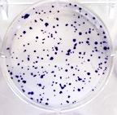
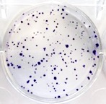
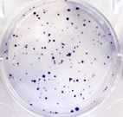
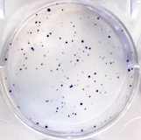
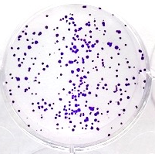

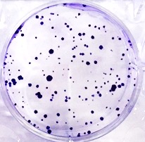
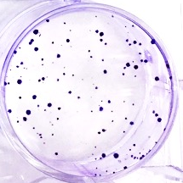
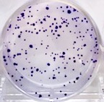
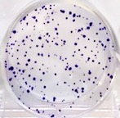
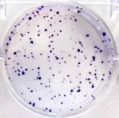
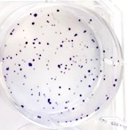
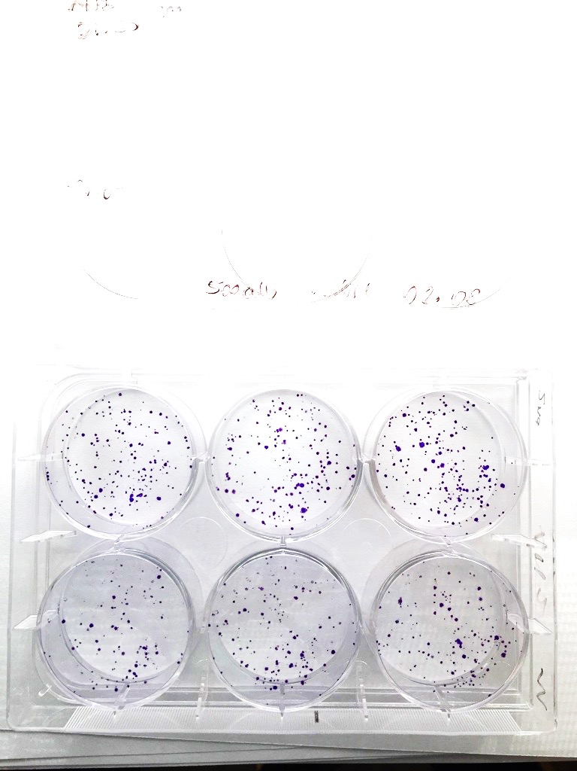
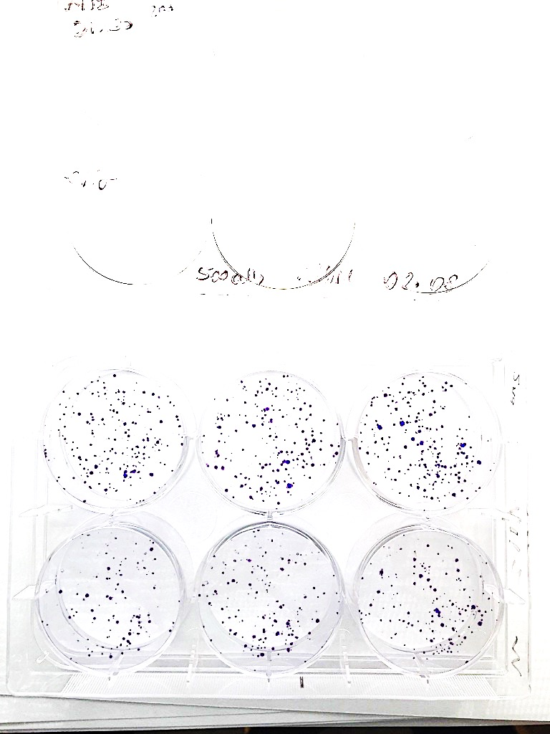
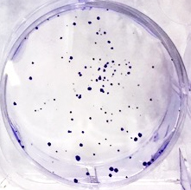
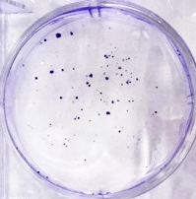
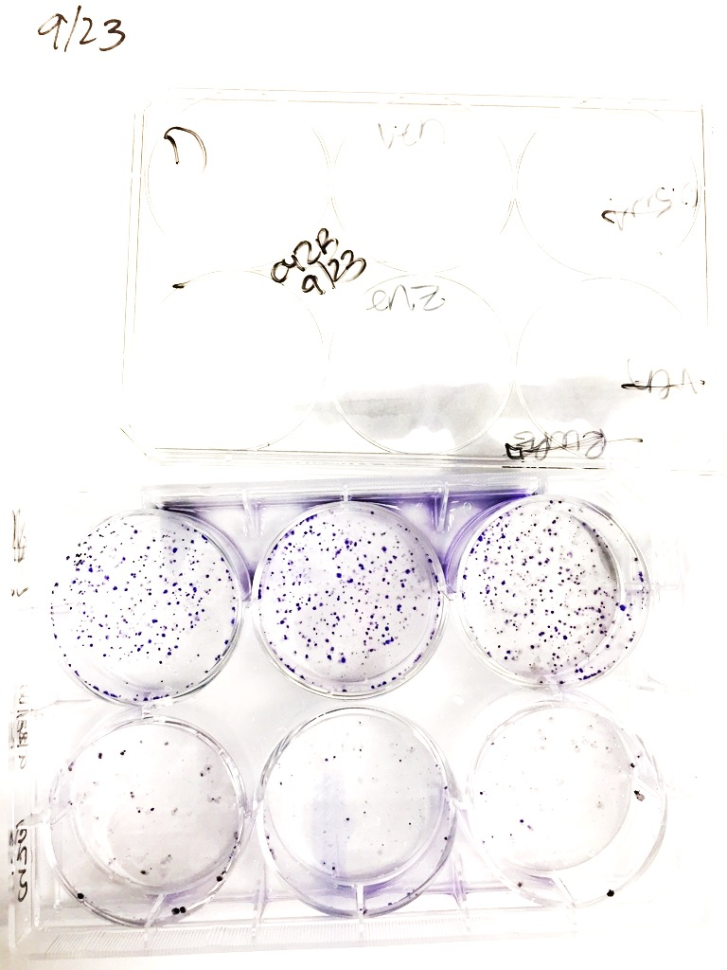
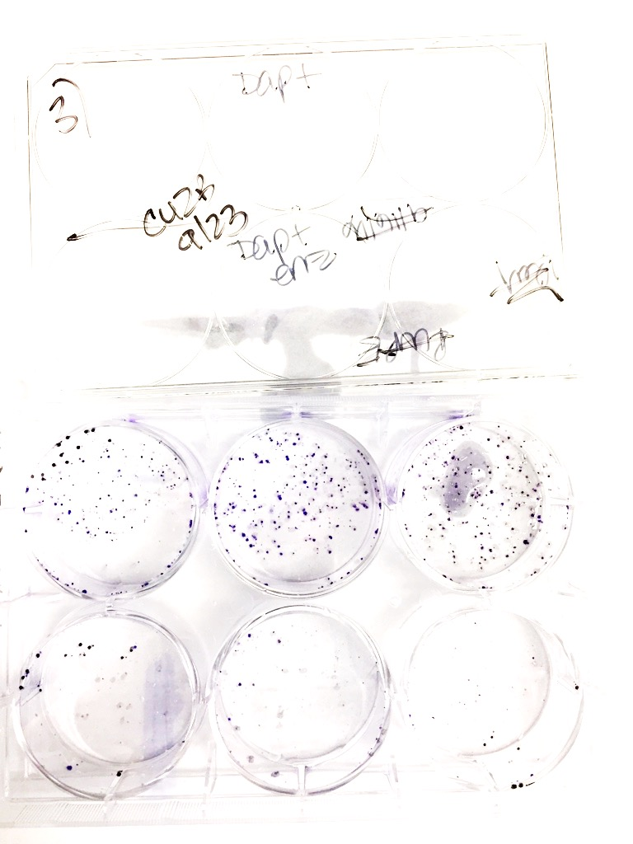
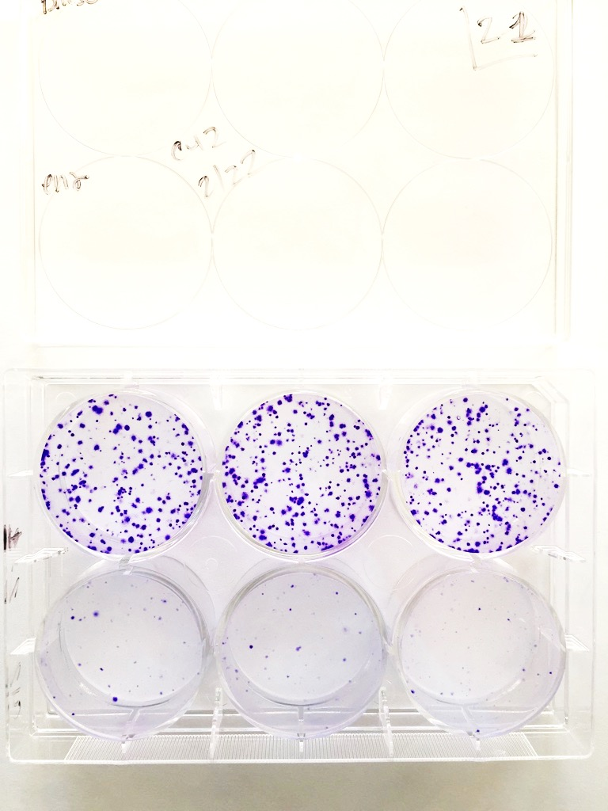
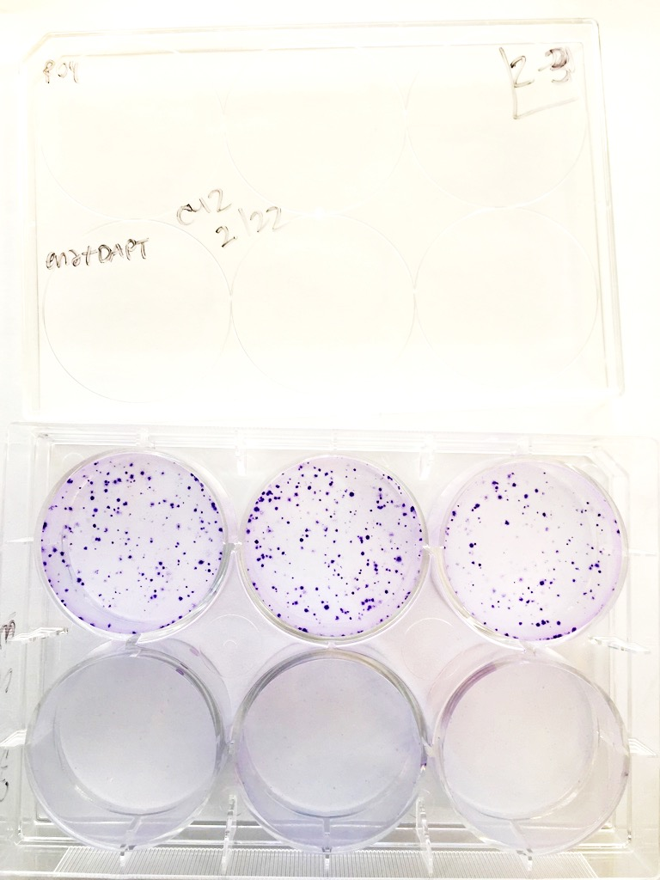
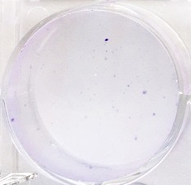
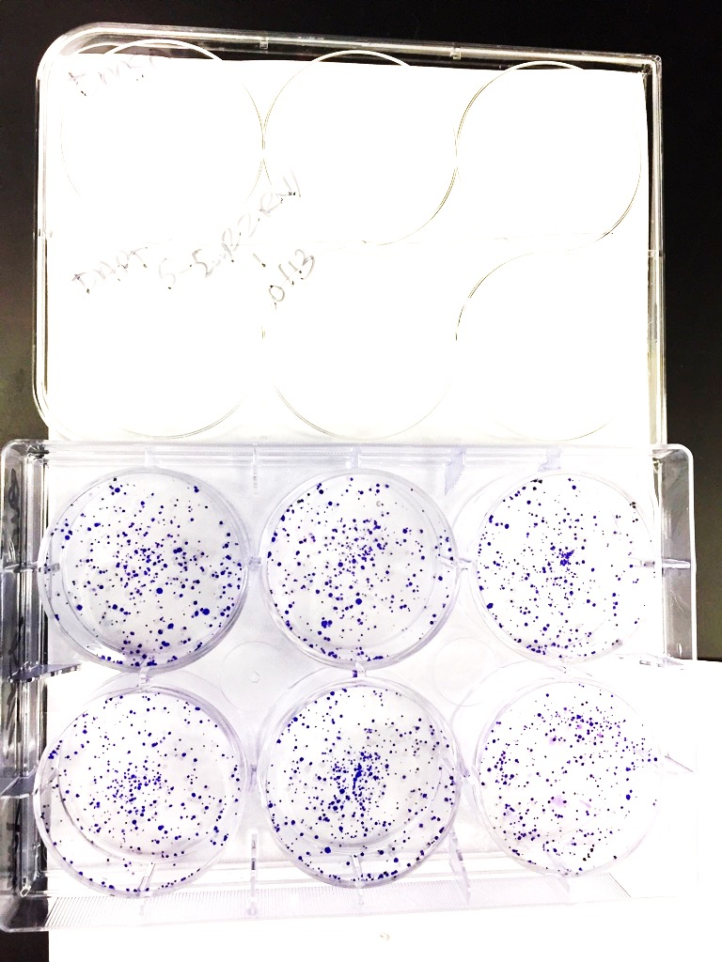
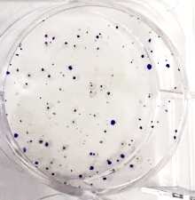
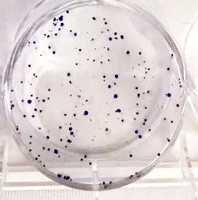
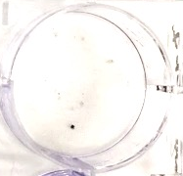
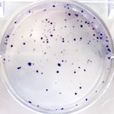
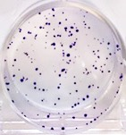
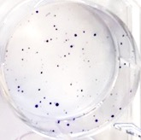
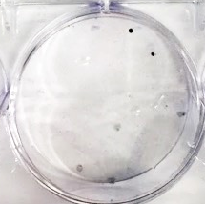
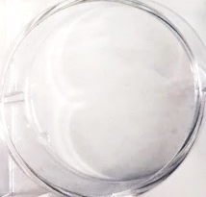
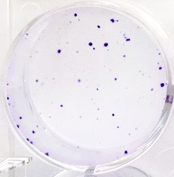
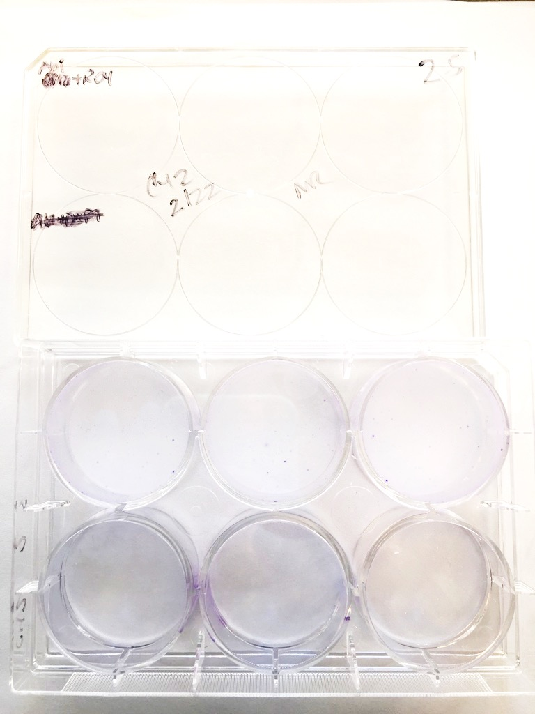
DMSO
ENZ
DAPT
ENZ + DAPT
DMSO
ENZ
DMSO
ABI
22RV1
22RV1
DMSO
ENZ
RO4
ENZ + RO4
Delta-
Notch1
DMSO
ENZ
DAPT
ENZ + DAPT
C4-2
DMSO
ENZ
RO4
ENZ + RO4
DMSO
ABI
DAPT
ABI + DAPT
22RV1
DMSO
ABI
RO4
ABI + RO4
DMSO
ABI
DAPT
ABI + DAPT
C4-2
DMSO
ABI
RO4
ABI + RO4
Supplementary Figure 5. GSI and anti-Androgen therapies synergize to decrease colony formation of CRPC cells. Representative images of colony formation experiments in Figure 5 are shown here. In all experiments, 500 cells were plated per well of a 6-well dish. All experiments were performed in triplicate with n=3. Cells were grown 9 days, with media and drugs changed every third day. Colonies were fixed with ice cold methanol, and stained with 0.1% crystal violet. Scale bar represents 50mm.

Slide 6

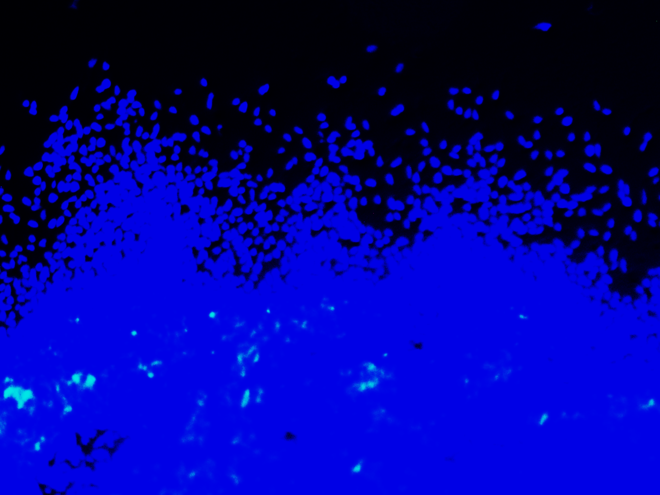

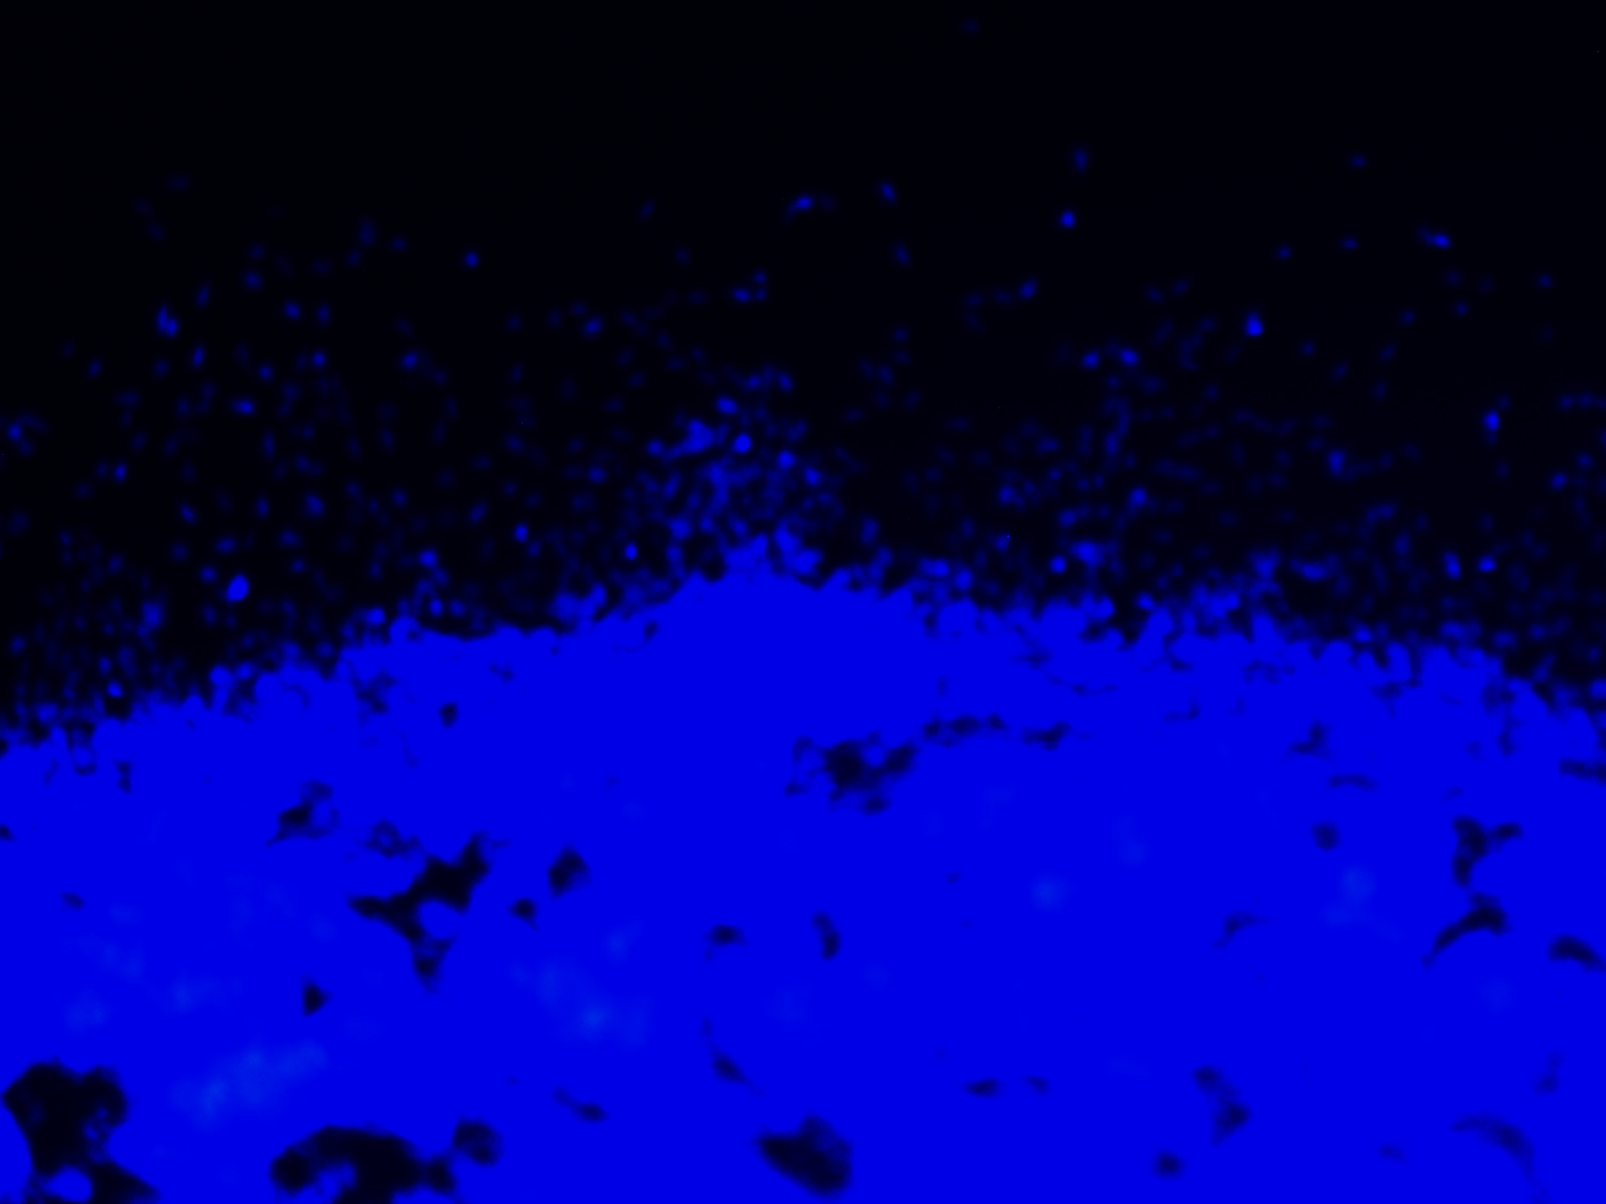
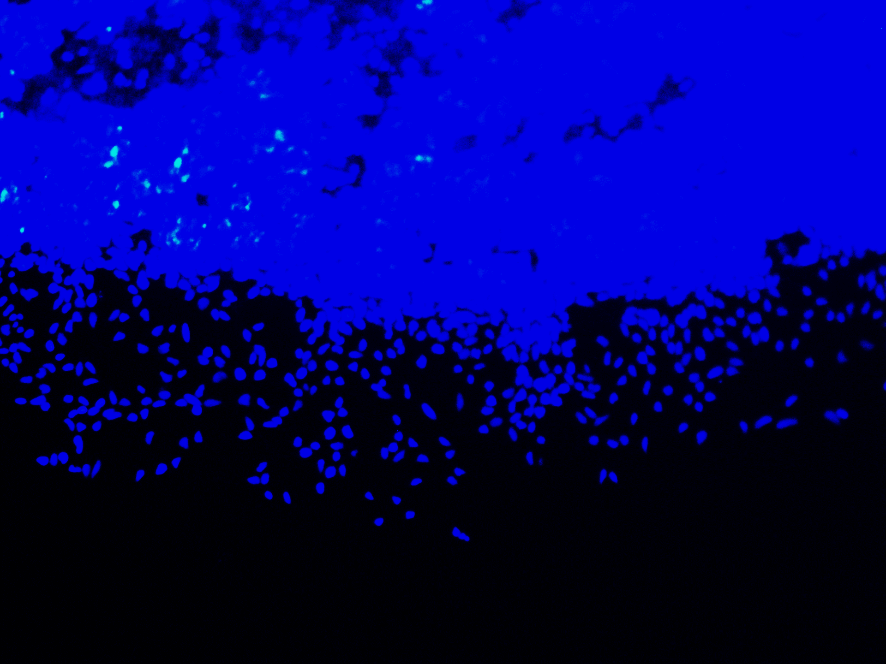
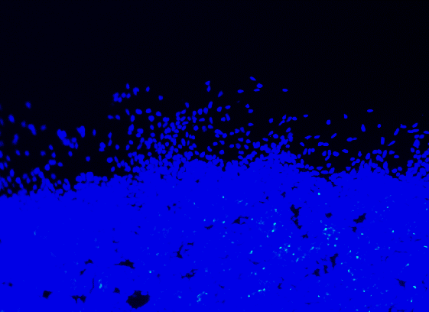
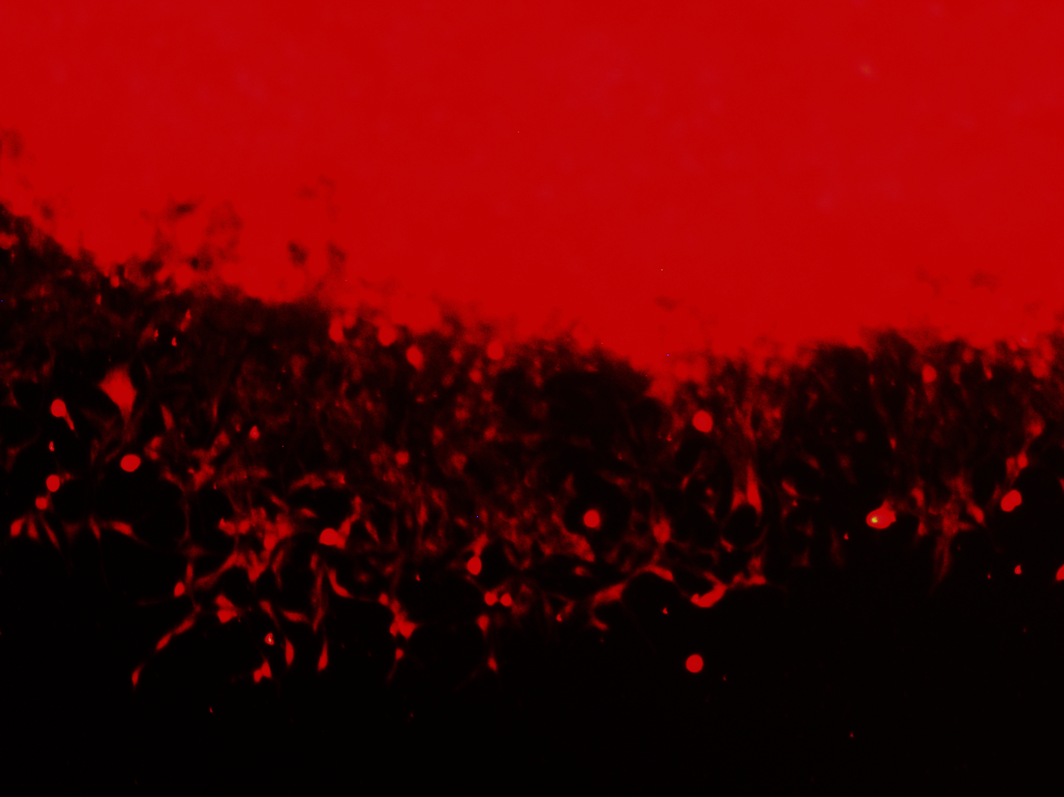
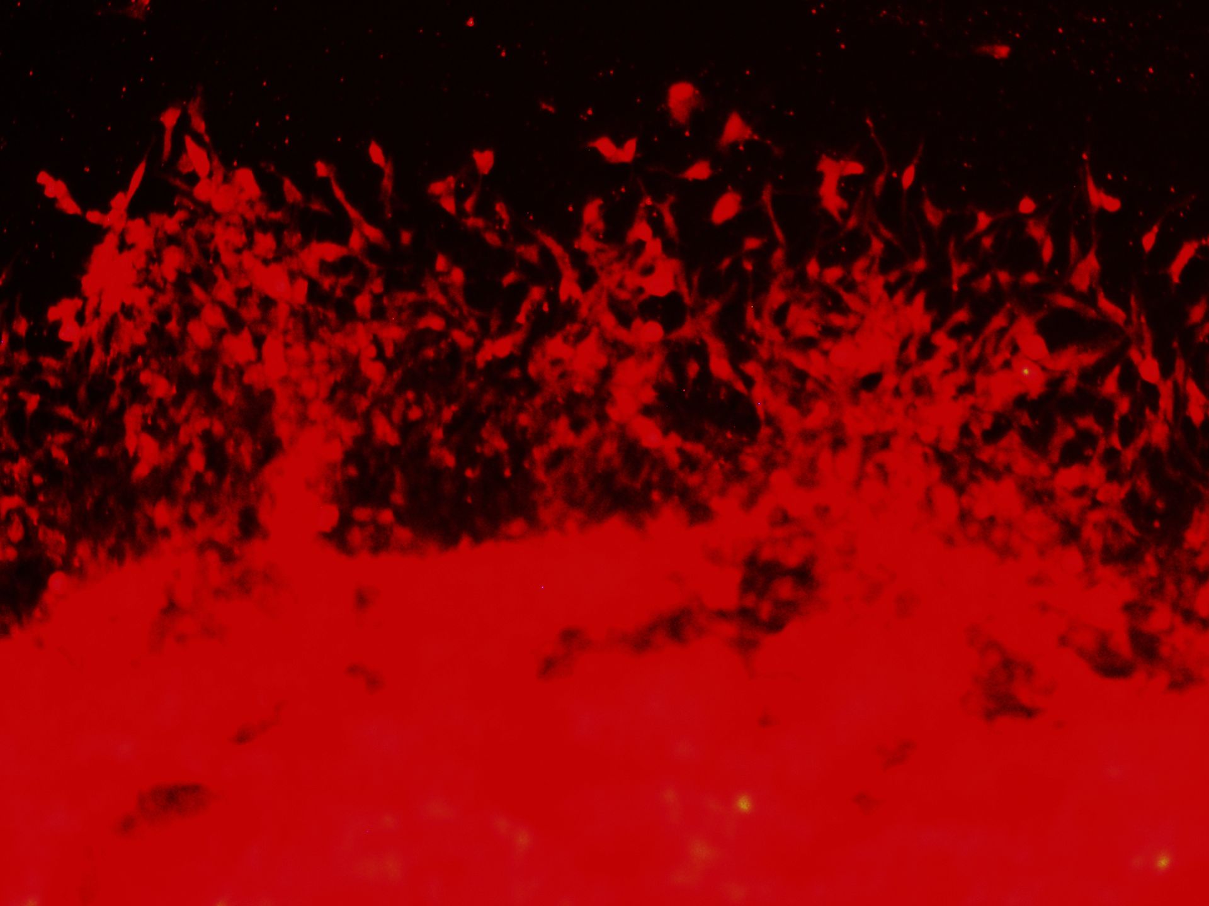
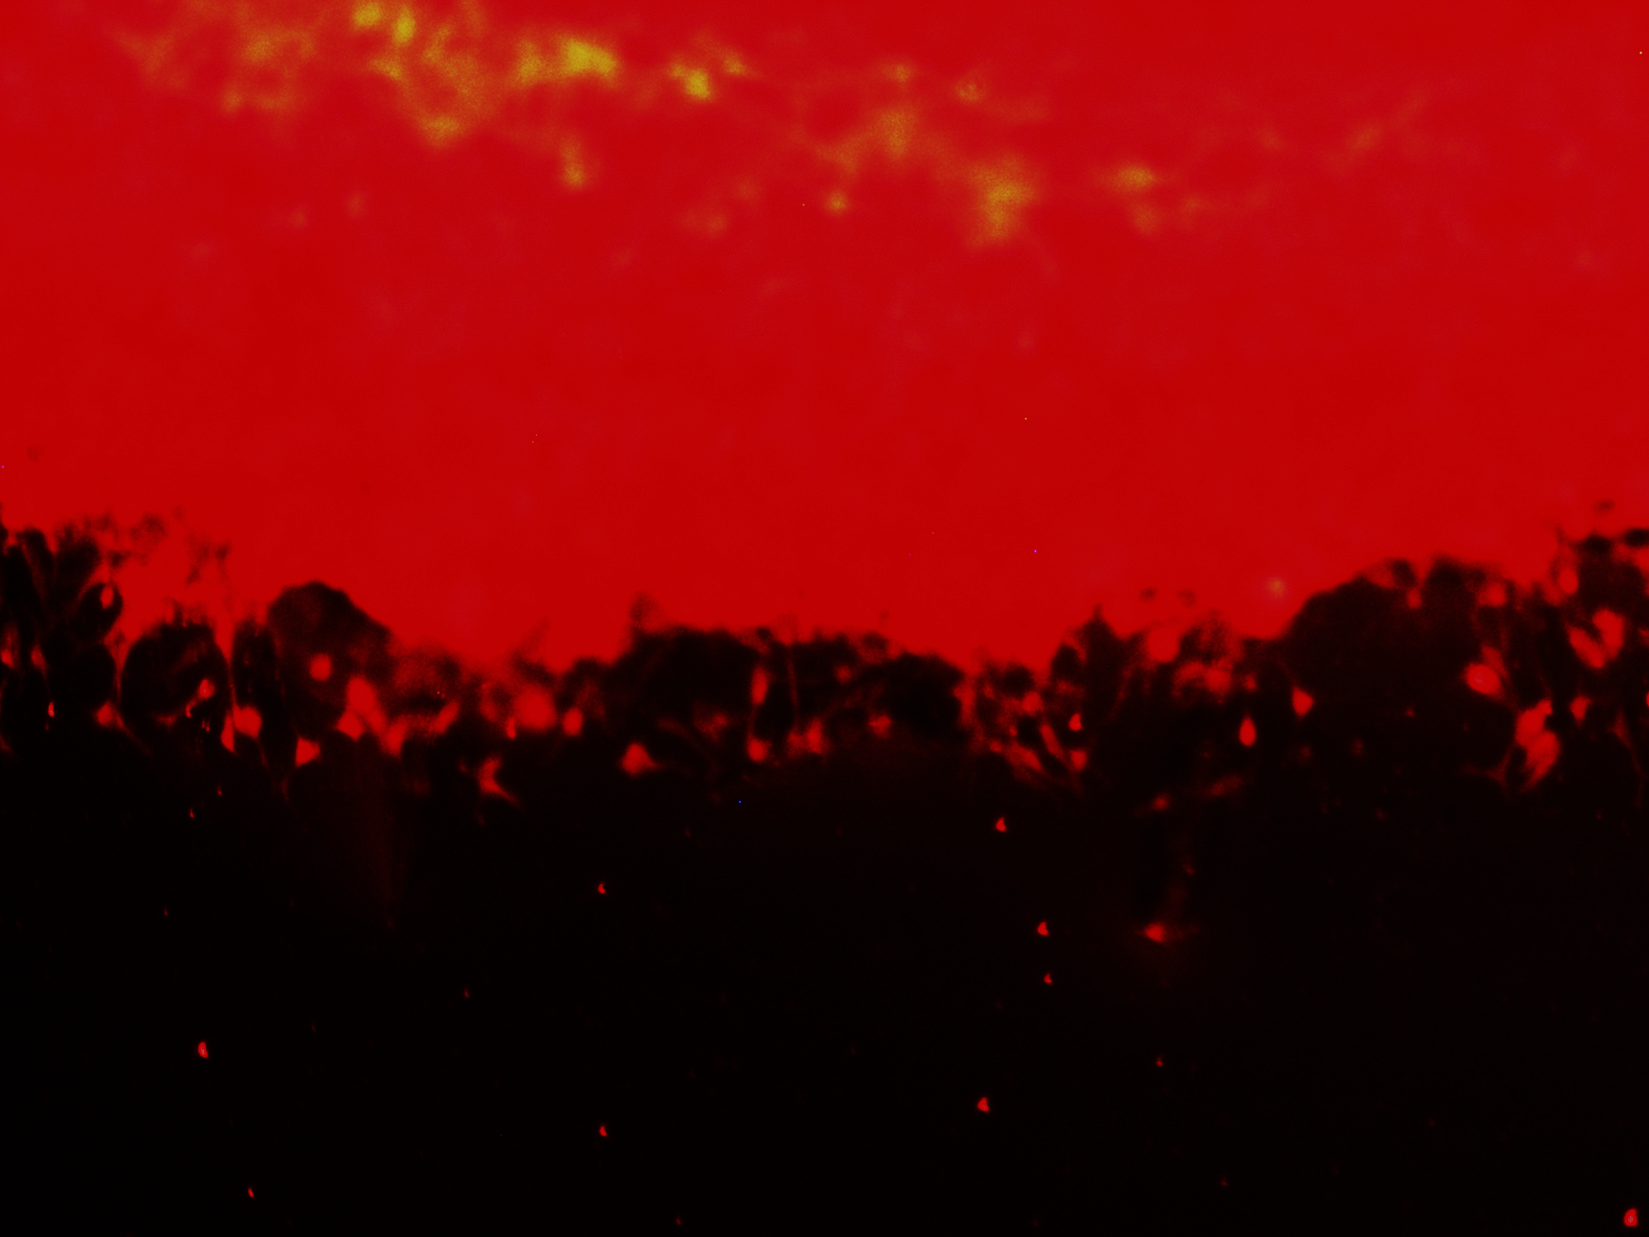
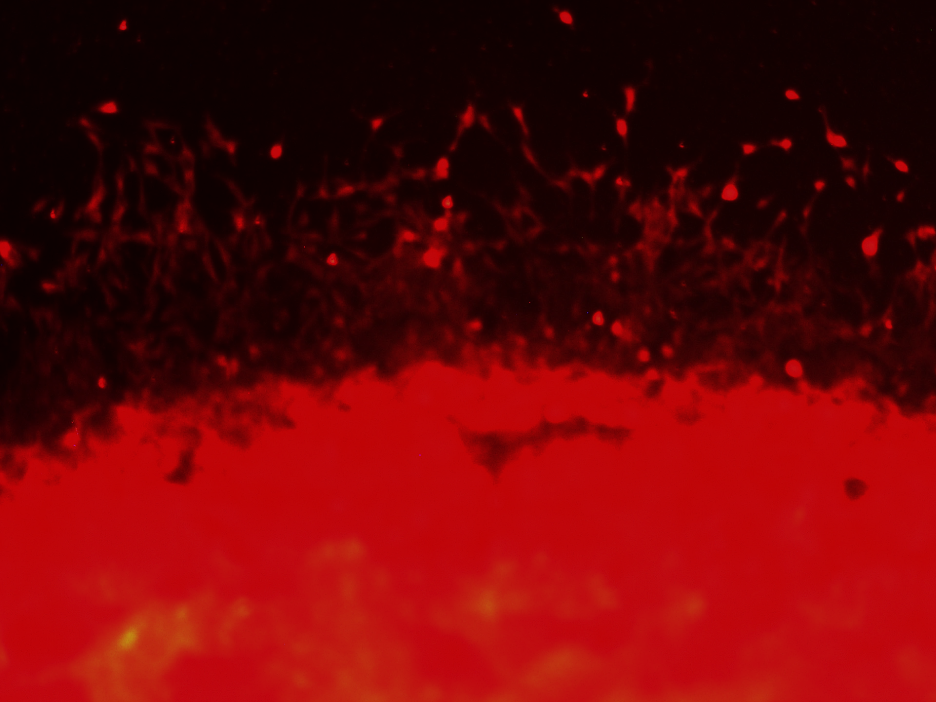
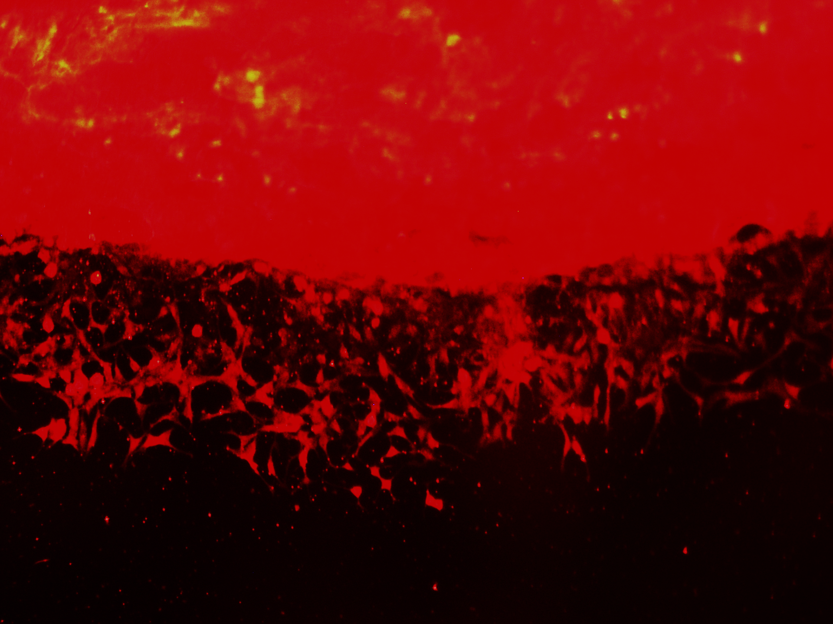
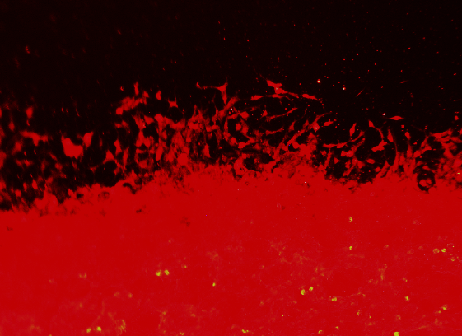
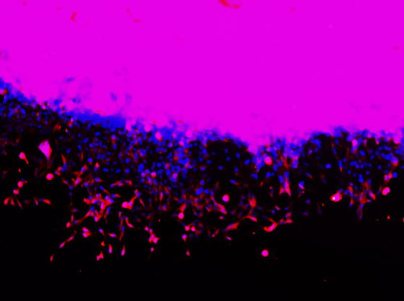
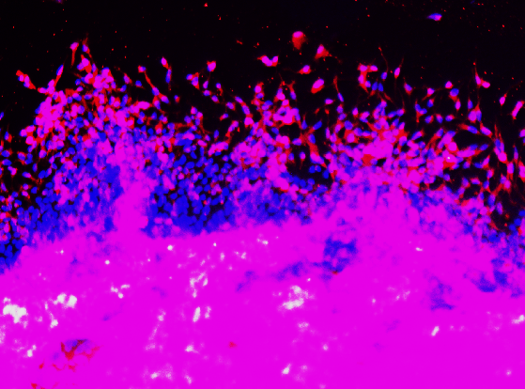

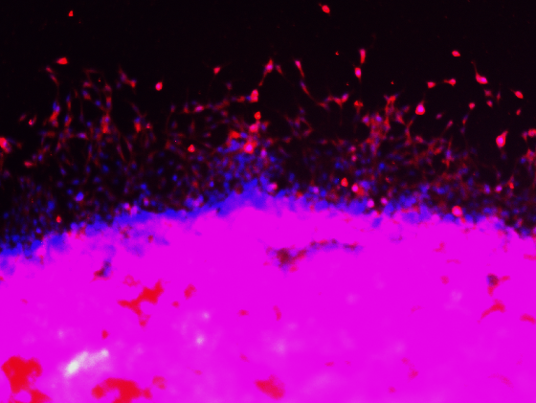
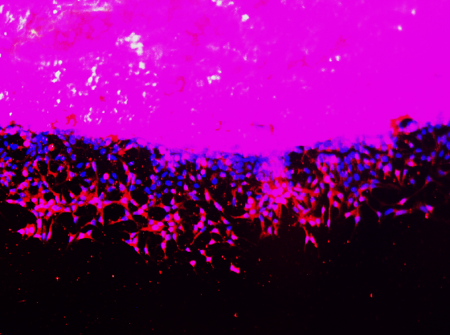
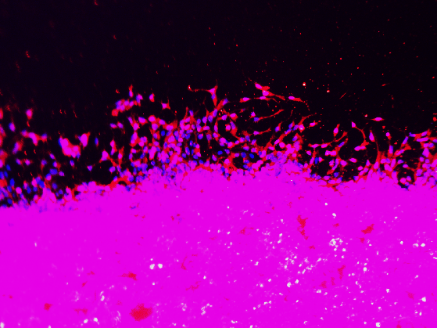
DMSO
ENZ
DAPT
ENZ + DAPT
RO4
ENZ + RO4
DAPI
ACTIN
MERGE
DMSO
ABI
DAPT
ABI + DAPT
RO4
ABI + RO4
DAPI
ACTIN
MERGE
Supplementary Figure 6. GSIs synergize with anti-androgens Enzalutamide and Abiraterone to inhibit prostate cancer cell migration in vitro. C4-2 Matrigel dot experiments were used to perform immunofluorescence following image capture. Cells were fixed with 2% paraformaldehyde, then permeabilized with 0.1% Triton-X 100 in PBS. Cells were blocked with BSA, stained overnight with anti-Actin antibody. The next day, Alexa Fluor 594 was added, and counter-stained with DAPI. Matrigel dots were imaged for fluorescence at 100X. Scale bars = 250 μm.

Slide 7
Supplementary Figure 7. Matrigel Dot assay performed on 22RV1 cells was not able to assay migration. 22RV1 Matrigel dot experiments were performed in parallel with the C4-2 assay displayed in Figure 6. Matrigel dots were cultured 5 days with media and compounds changed every other day. Matrigel dots were imaged in brightfield on a Leica stereomicroscope at 100X. Instead of migrating, 22RV1 cells exhibited a budding proliferative phenotype, making them unsuitable candidates to assay migration. Scale bars = 250 μm.

