Slide 1
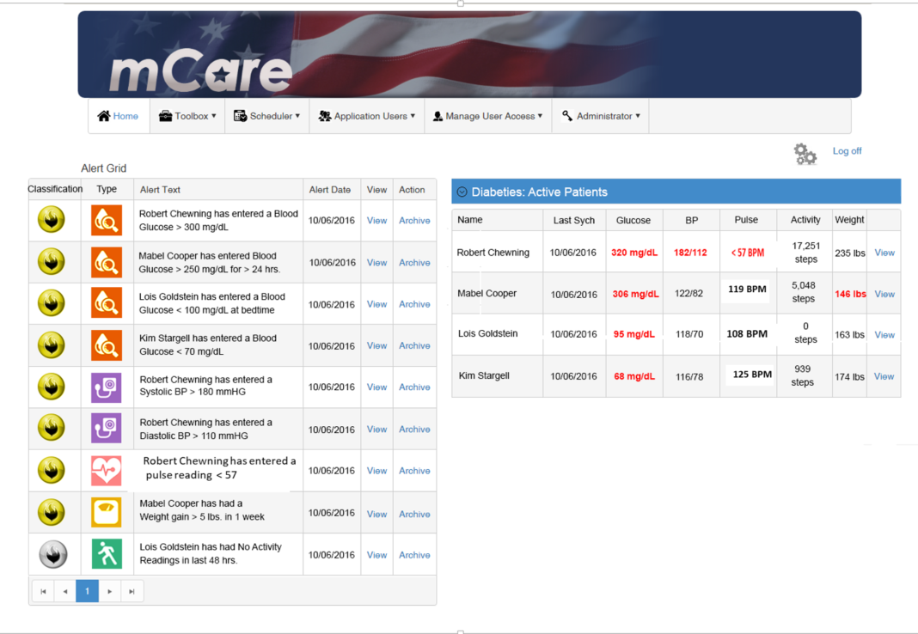





Upon login the provider sees alerts based on pre-determined thresholds. *note: all names are team members or manufactured and are artificial data for demonstration purposes only

Slide 2
The clinician can see individual patients' dashboards which demonstrate graphically patient reading trends. They are sortable by time period in increments of 1, 7 or 30 days.

Slide 3
This is an example of a patient’s blood glucose readings over a seven-day period, showing the trend values for “Before Meal”, “After Meal”, “Bedtime”, “Fasting” or “Unclassified”.

Slide 4
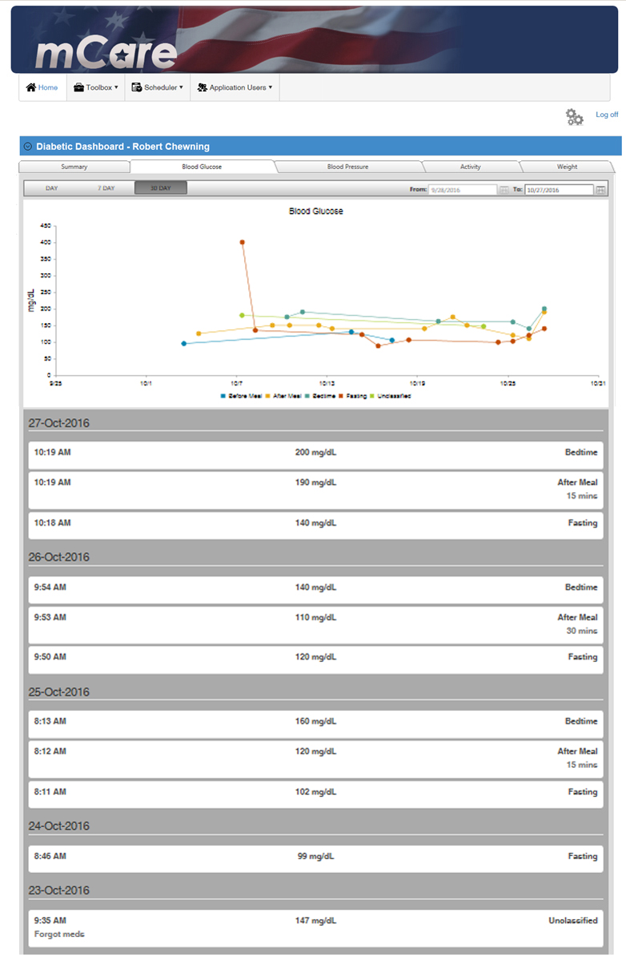
This is an example of a patient’s blood glucose readings over a 30-day period, showing the trend values for “Before Meal”, “After Meal”, “Bedtime”, “Fasting” or “Unclassified”.

Slide 5
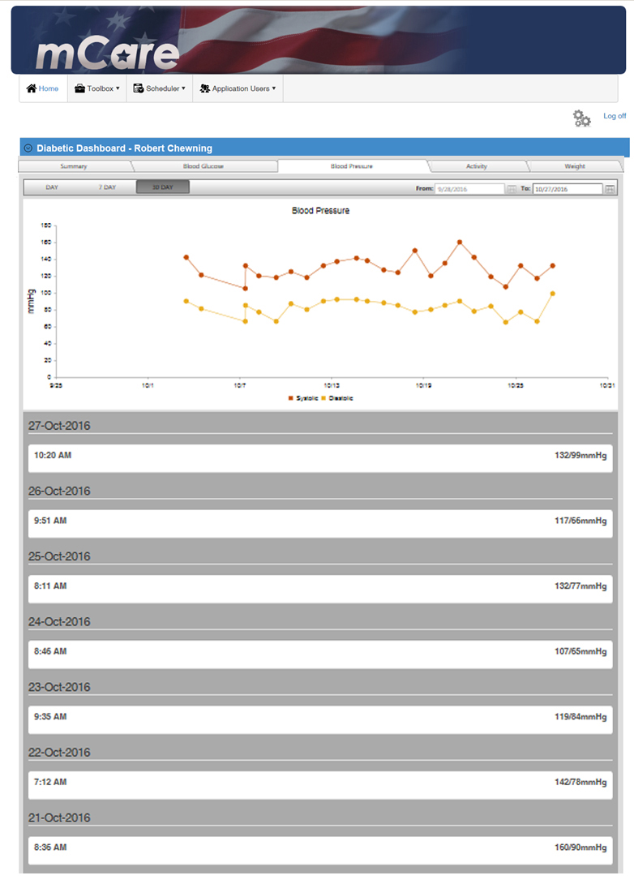
This is an example of a patient’s blood pressure readings over a 7-day period, showing the trend values for “Systolic” and “Diastolic” readings.

Slide 6
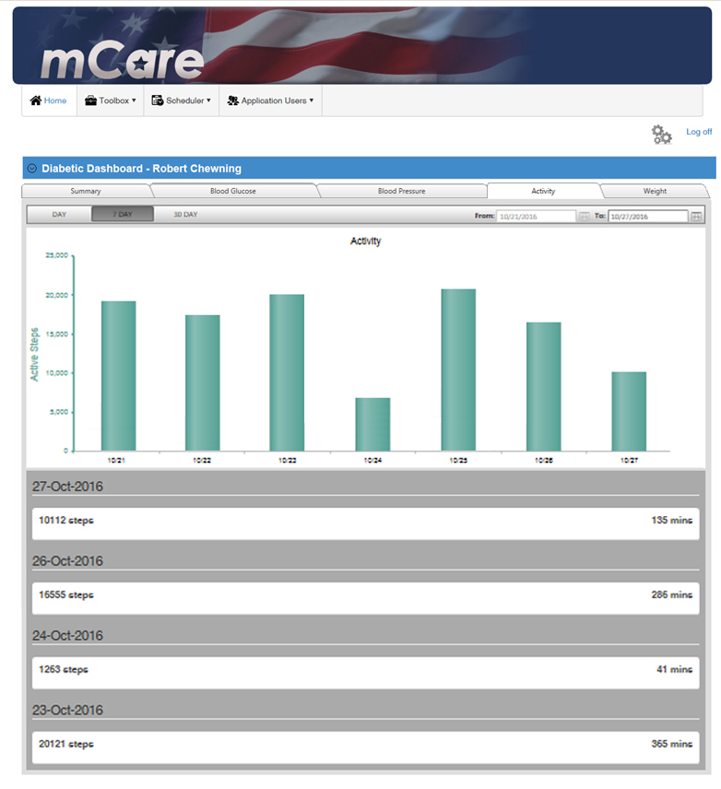
This is an example of a patient’s activity level (by step count) over a seven-day period.

Slide 7
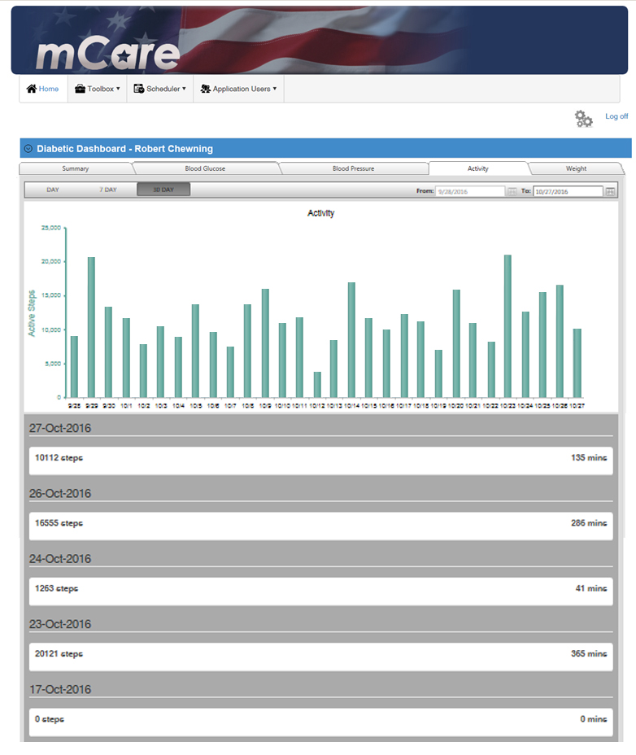
This is an example of a patient’s activity level (by step count) over a 30-day period.

Slide 8
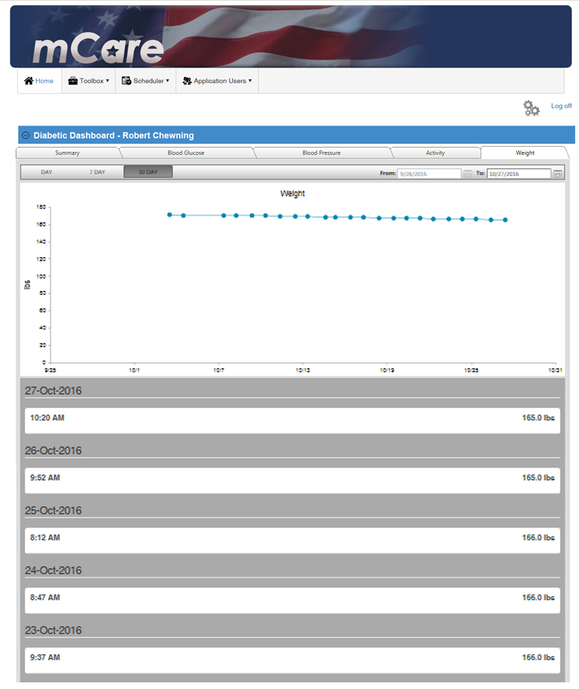
This is an example of a patient’s weight values (in pounds) over a 30-day period.

Slide 9
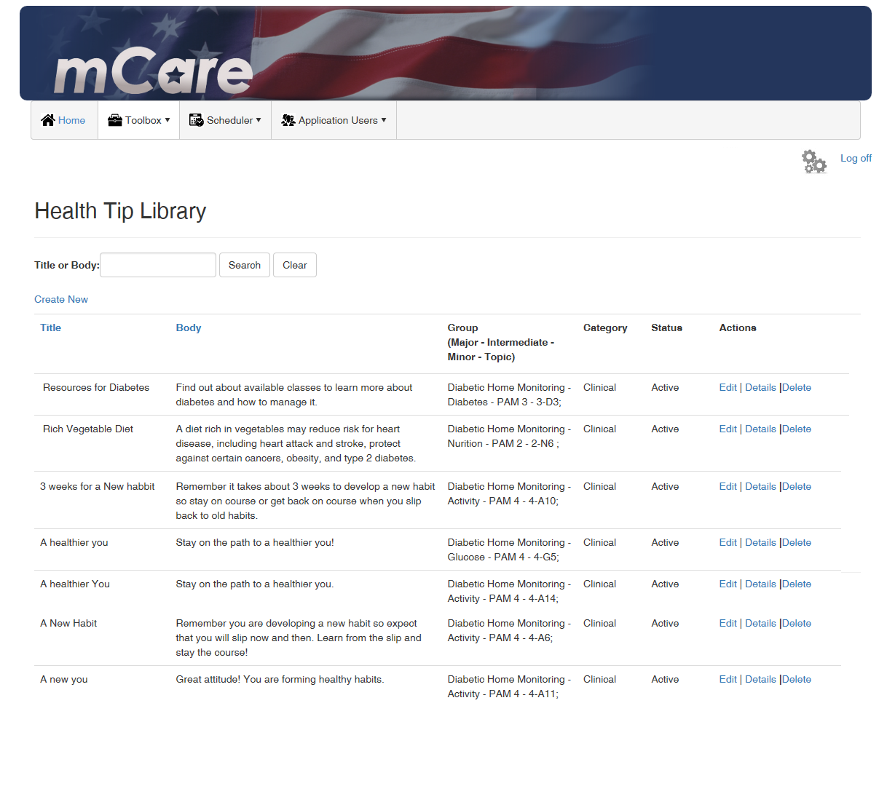
Sample of health tips sortable by PAM scores to schedule for patients.

