Slide 1
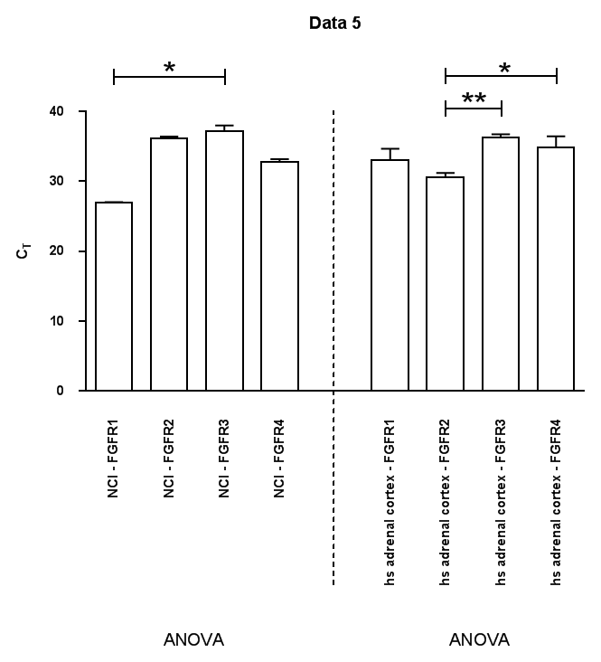
40
30
C_{T}
20
10
0
FGFR1
FGFR2
FGFR3
FGFR4
FGFR1
FGFR2
FGFR3
FGFR4
NCI-H295R
adrenal cortex
Additional file 2

