Slide 1
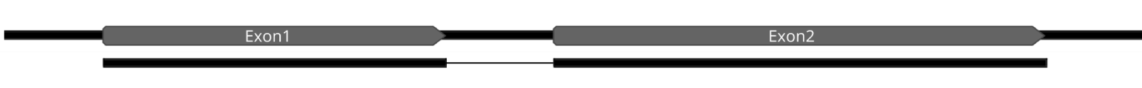
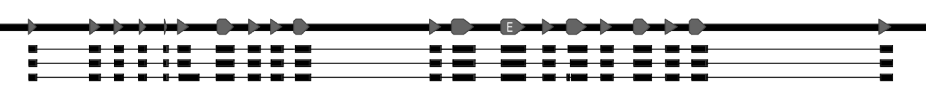
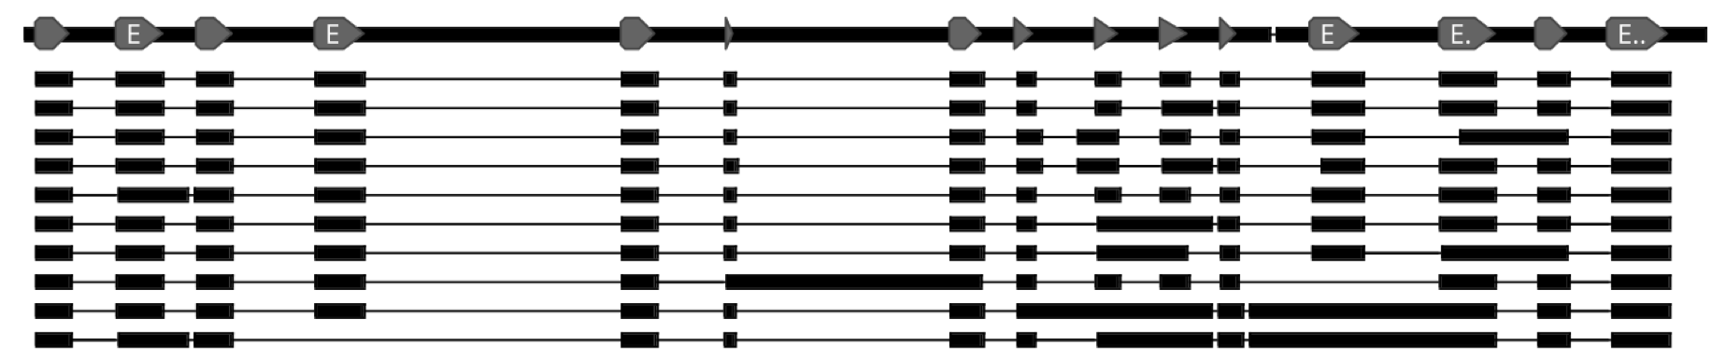
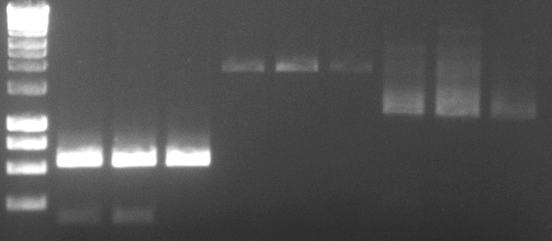
a
Vigun01g121100 (OSD1)
b
Vigun08g163400 (REC8)
c
Vigun08g209400 (SPO11-1)
d e
MES
MES
MES
fTET
MMC
MMC
fTET
MMC
fTET
bp
Gene | # clones analyzed | Splicing variants
OSD1 | 16 | 1
REC8 | 6 | 3
SPO11-1 | 11 | 10
3000
2500
2000
1500
1000
800
600
OSD1
REC8
SPO11-1
400

