Slide 1
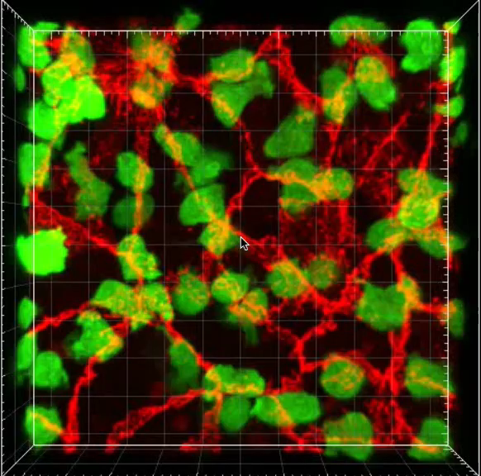
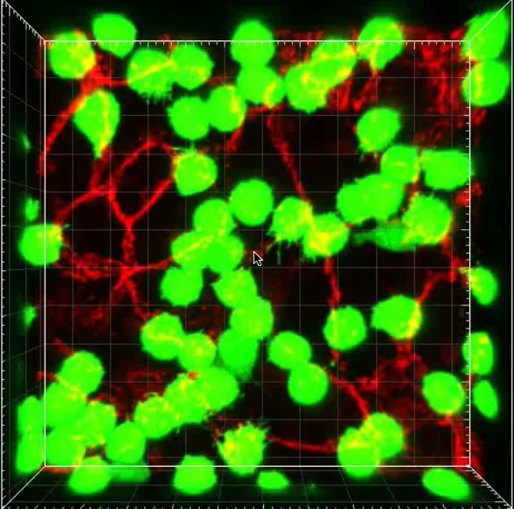
Ctrl
CD5-2
Neutrophils/VE-cadherin

