Slide 1
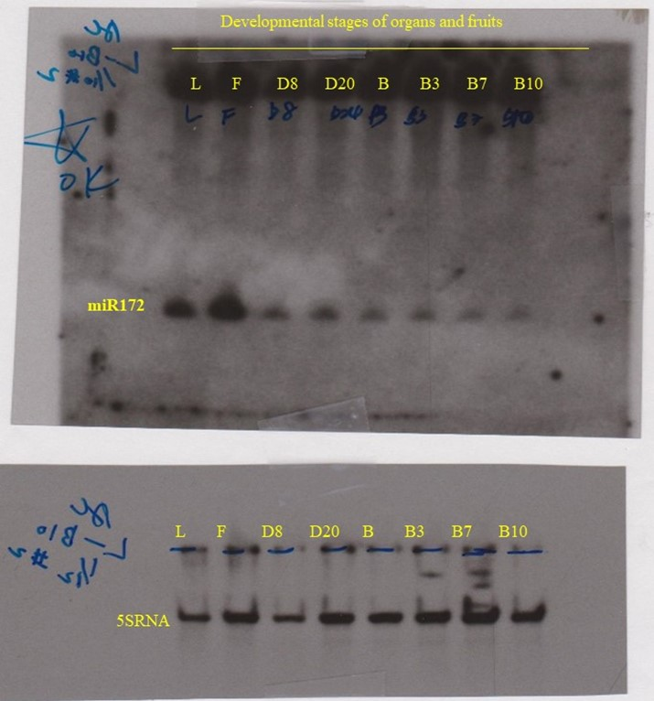
Figure 1(A). Gel electrophoresis images of Northern blot of organs and fruits

Slide 2
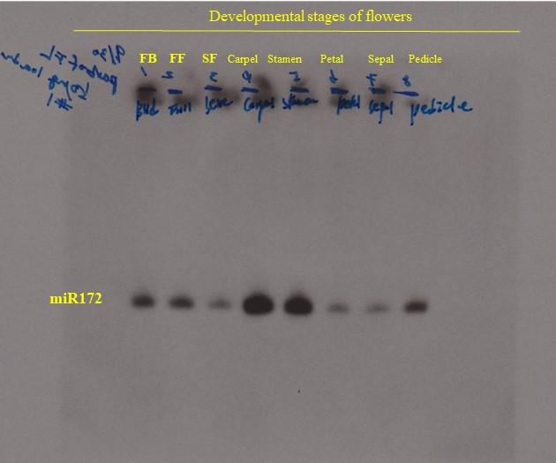
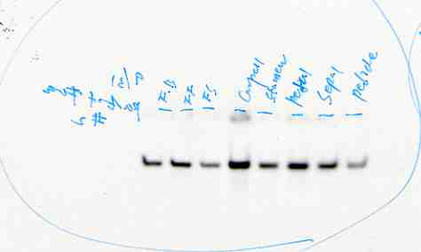
5SRNA
Figure 1(B). Gel electrophoresis images of Northern blot of miR172 in different flower parts

Slide 3
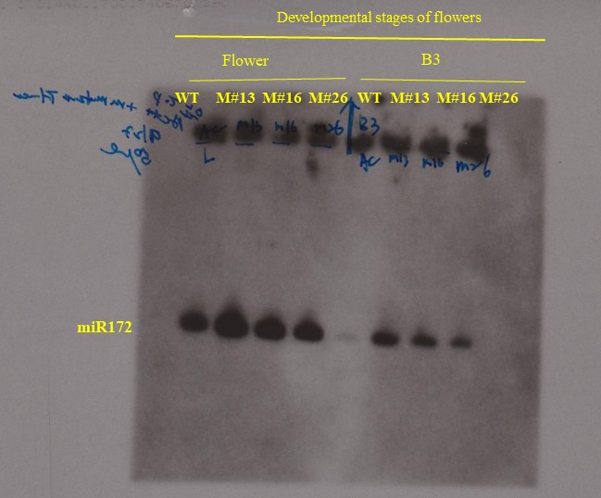
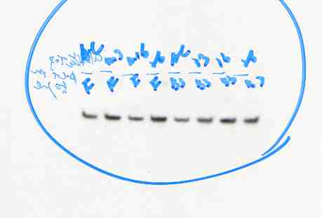
5SRNA
Figure 2. Gel electrophoresis images of Northern blot of miR172 in flower and B3 stage of fruit

Slide 4
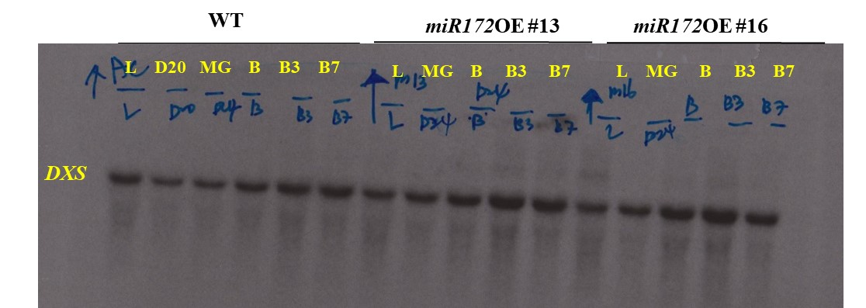
Figure 7. Gel electrophoresis image of Northern blot of DXS

Slide 5
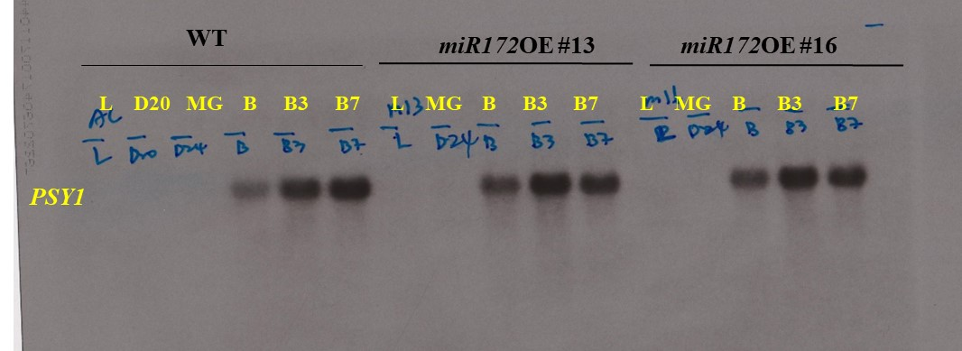
Figure 7. Gel electrophoresis image of Northern blot of PSY1

Slide 6
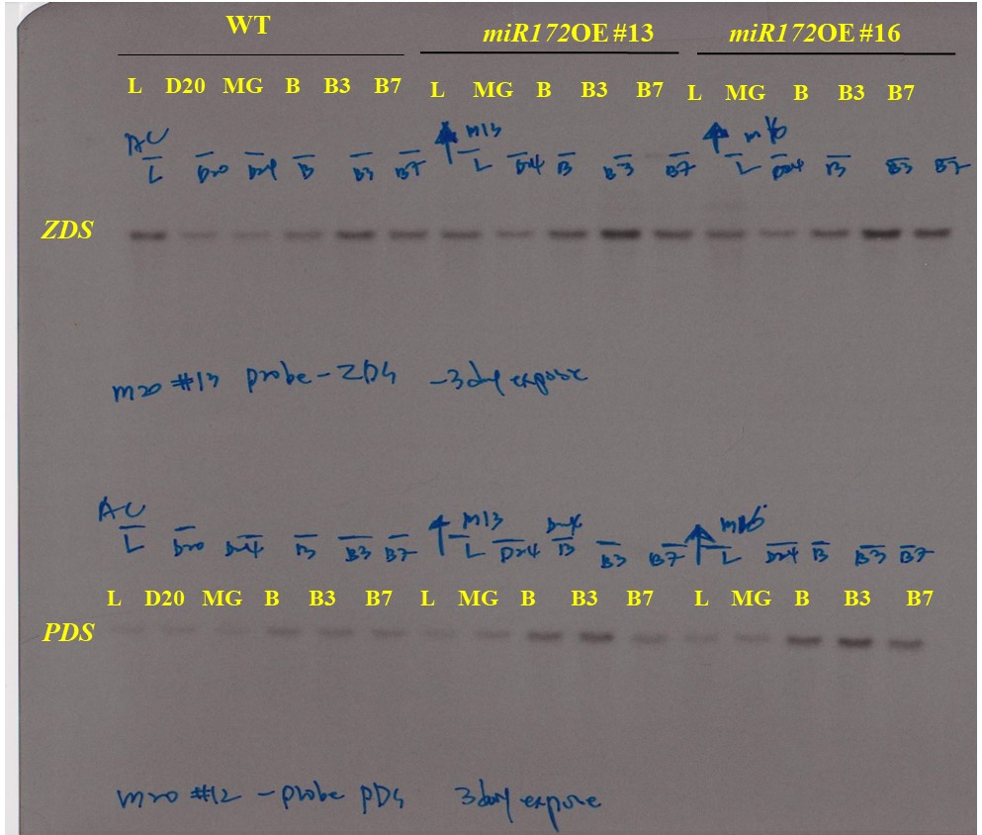
Figure 7. Gel electrophoresis images of Northern blot of ZDS and PDS

Slide 7
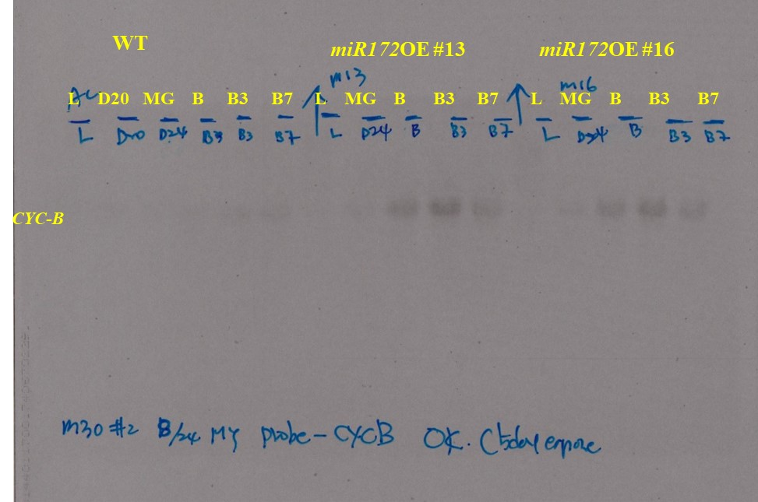
Figure 7. Gel electrophoresis image of Northern blot of CYC-B

Slide 8
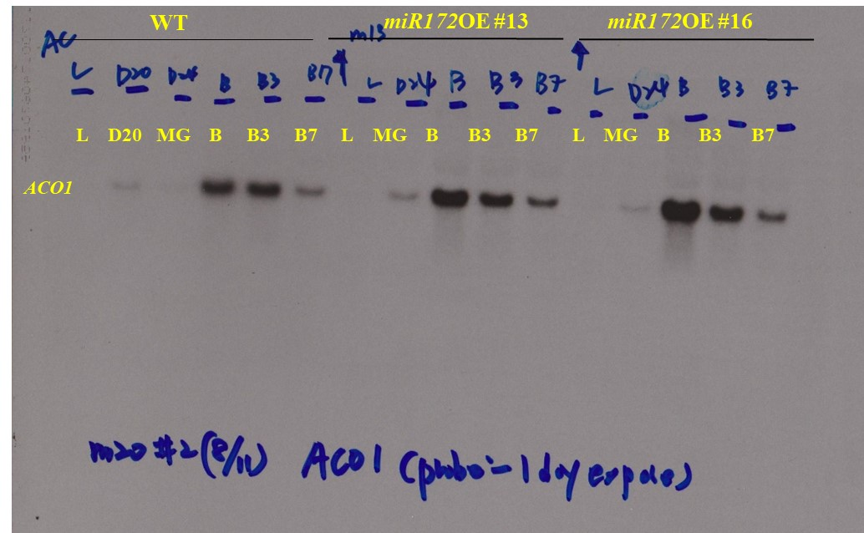
Figure 9. Gel electrophoresis image of Northern blot of ACO1

Slide 9
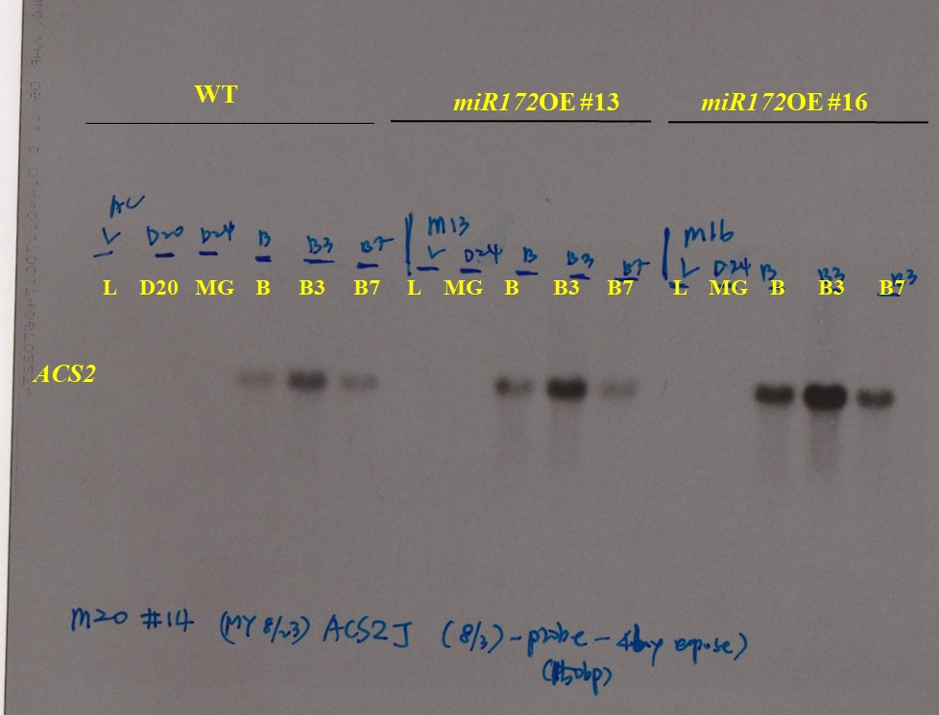
Figure 9. Gel electrophoresis images of Northern blot of ACS2

Slide 10
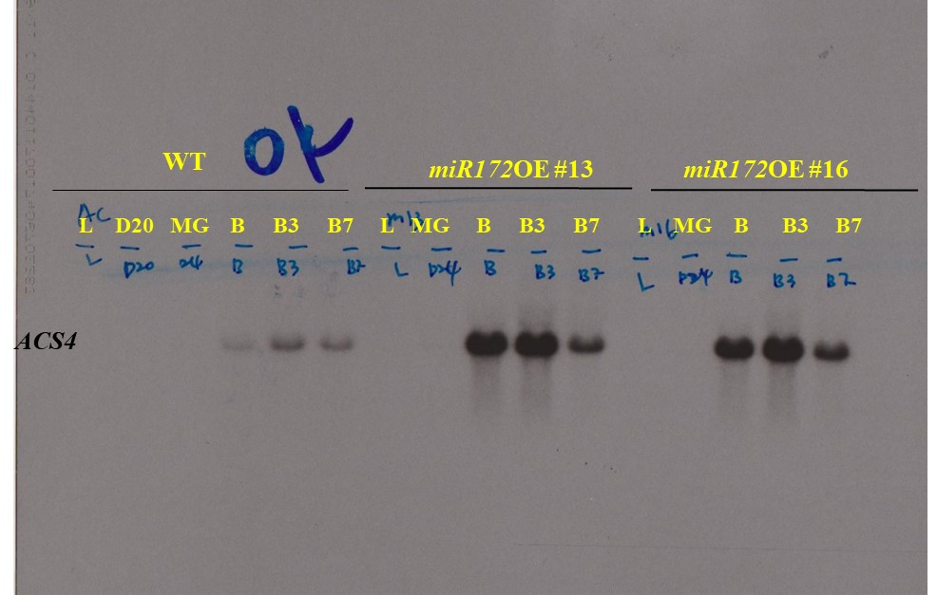
Figure 9. Gel electrophoresis images of Northern blot of ACS4

Slide 11
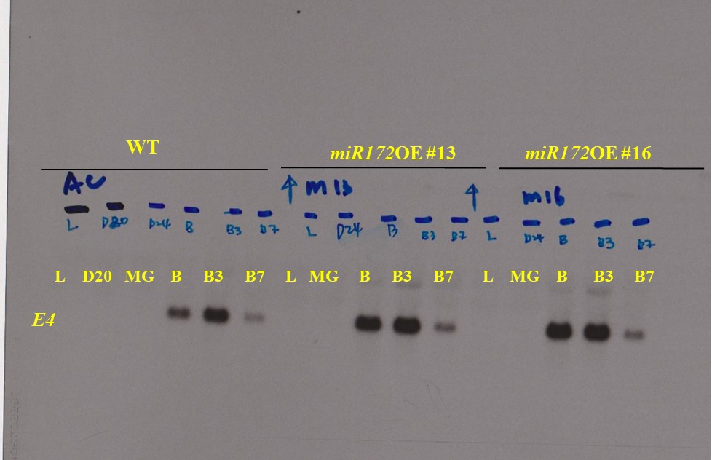
Figure 9. Gel electrophoresis image of Northern blot of E4

Slide 12
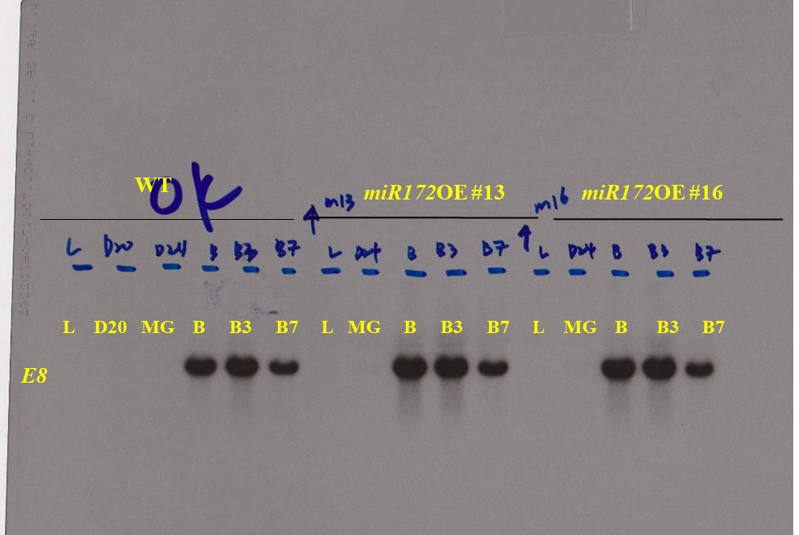
Figure 9. Gel electrophoresis image of Northern blot of E8

Slide 13
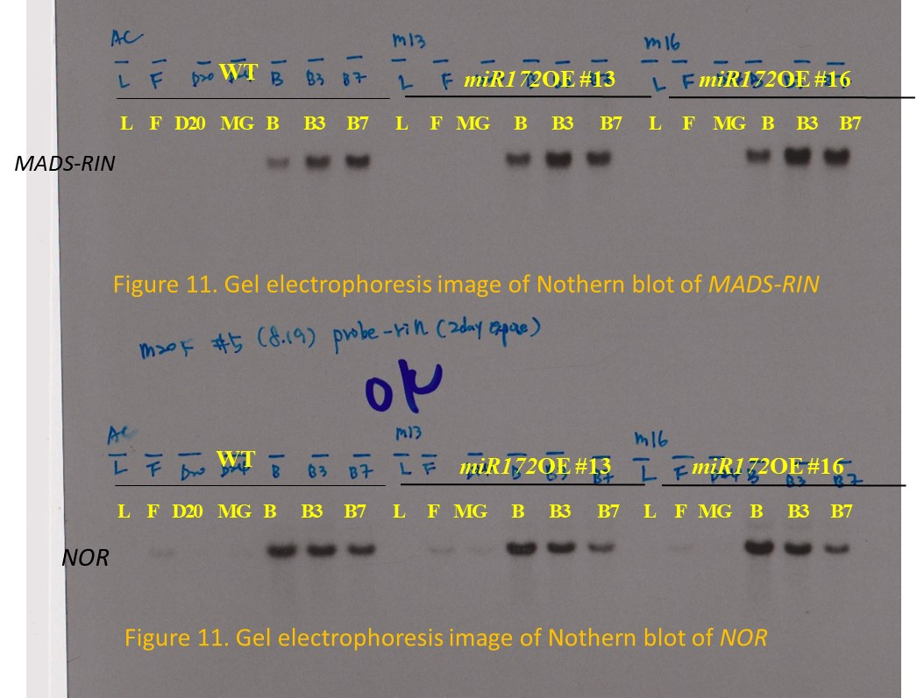

Slide 14
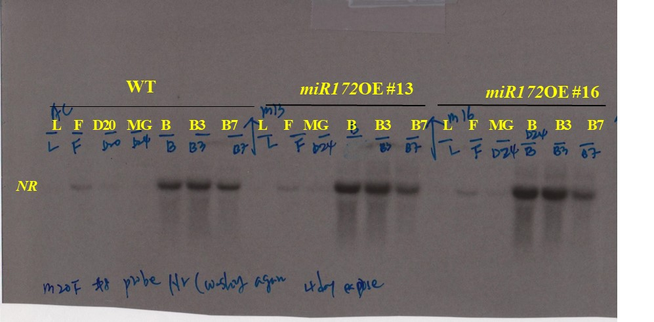
Figure 11. Gel electrophoresis image of Northern blot of NR

Slide 15
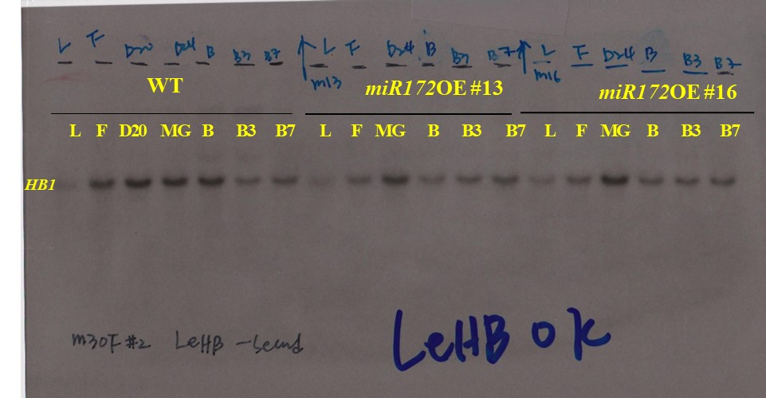
Figure 11. Gel electrophoresis image of Northern blot of HB1

Slide 16
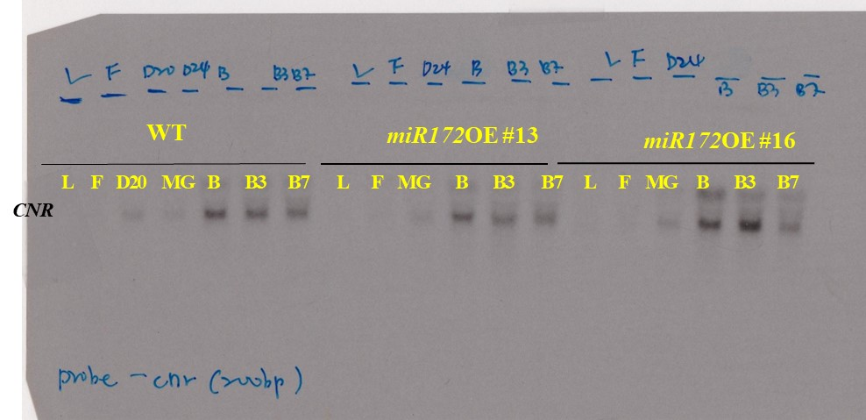
Figure 11. Gel electrophoresis image of Northern blot of CNR

Slide 17
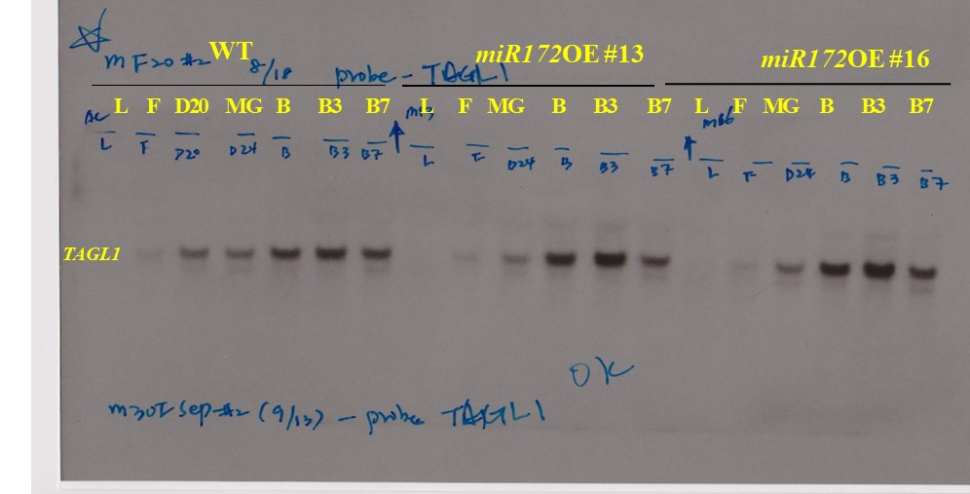
Figure 11. Gel electrophoresis image of Northern blot of TAGL1

Slide 18
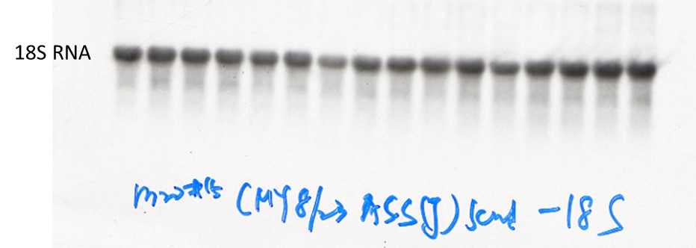
Figure. Gel electrophoresis image of Northern blot of 18S RNA used in Figure 7, 9 and 11

Slide 19
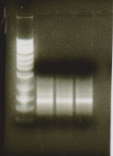
B3 stage
WT miR172 OE
#13 #16
SlEF1-α
(control)
SlAP2a
Flower
WT miR172 OE #13
SlAP2c
SlEF1-α
(control)
SlAP2b
Target 4
Supplementary Fig 1. RACE-PCR image of cleaved products of miR172 targets in wild type and miR172 OE lines
Target 5

Slide 20
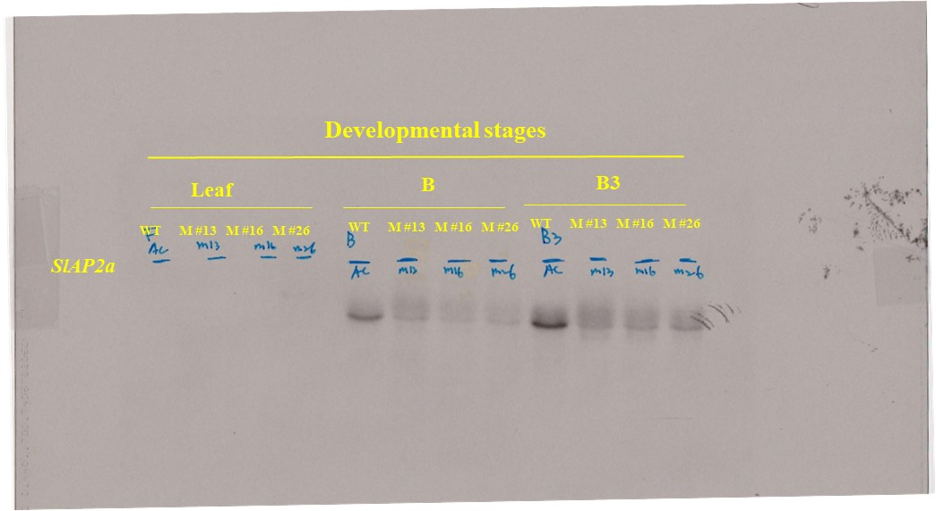
Supplementary Fig 2. Gel image of original Northern blot of SlAP2a

Slide 21
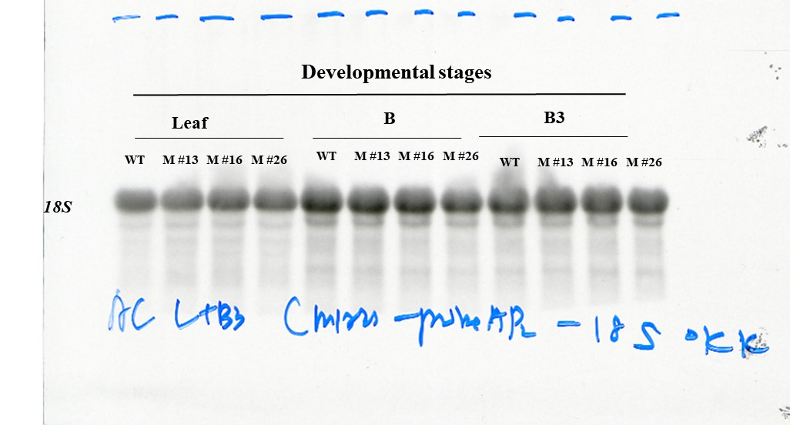
Supplementary Fig 2. Gel image of original Notherrn blot of 18S

Slide 22
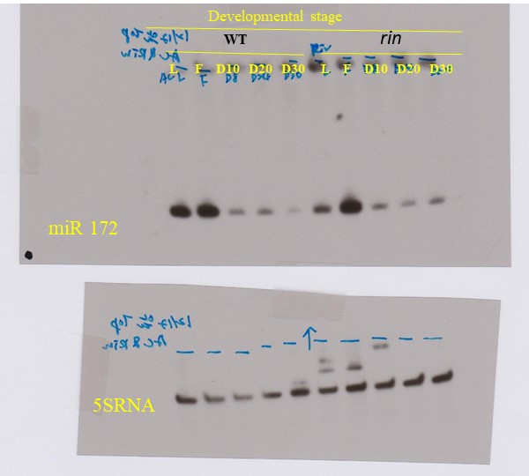
Supplementary Fig 3. Gel image of original Northern blot of rin

Slide 23
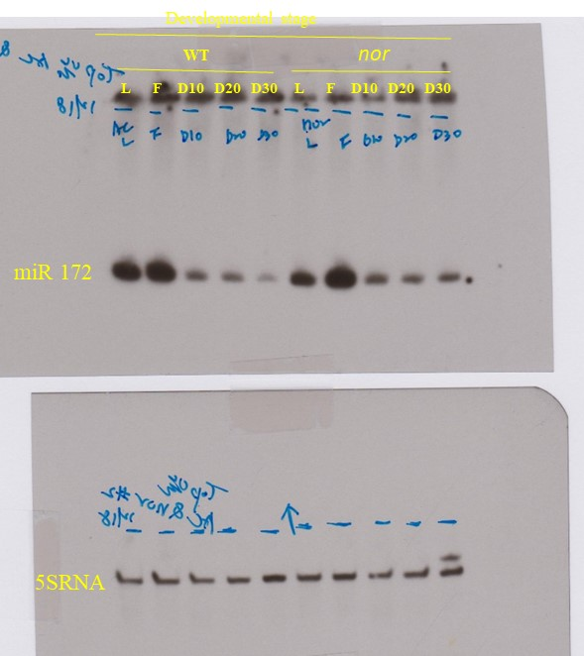
Supplementary Fig 3. Gel image of original Northern blot of nor

Slide 24
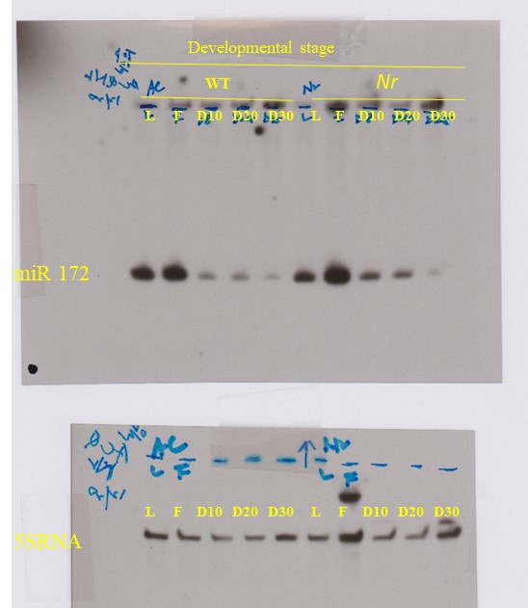
Supplementary Fig 3. Gel image of original Northern blot of Nr

Slide 25
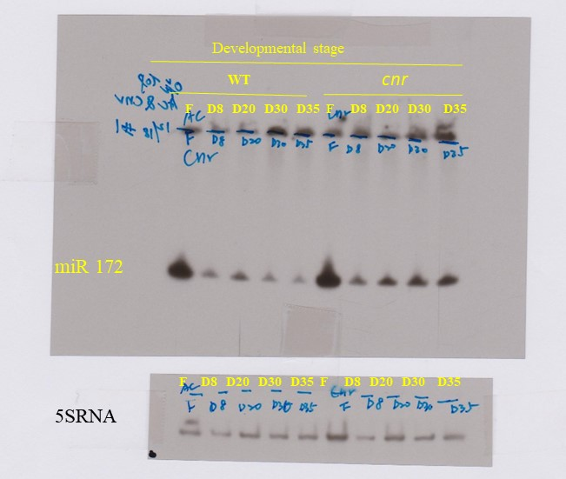
Supplementary Fig 3. Gel image of original Northern blot of cnr

