Slide 1
Sanguisorba officinalis L. derived from herbal medicine prevents intestinal inflammation by inducing autophagy in macrophages
Asuka Yasueda¹, Hisako Kayama^{2,3}, Michiko Murohashi⁴, Junichi Nishimura¹, Koji Wakame⁵, Ken-ichi Komatsu⁵, Takayuki Ogino¹, Norikatsu Miyoshi¹, Hidekazu Takahashi¹, Mamoru Uemura¹, Chu Matsuda¹, Toru Kitagawa¹, Kiyoshi Takeda^{2,6}, Toshinori Ito⁷, Yuichiro Doki¹, Hidetoshi Eguchi¹, Shigeomi Shimizu⁴, *Tsunekazu Mizushima^{1,6}
Department of Gastroenterological Surgery, Graduate School of Medicine, Osaka University Graduate School of Medicine, 2-2 Yamadaoka, Suita, Osaka, 565-0871, Japan
Laboratory of Immune Regulation, Department of Microbiology and Immunology, Graduate School of Medicine, Osaka University Graduate School of Medicine
Institute for Advanced Co-Creation Studies, Osaka University
Department of Pathological Cell Biology, Medical Research Institute, Tokyo Medical and Dental University, 1-5-45, Yushima, Bunkyo-ku, Tokyo, 113-8510, Japan
Department pharmacology, Hokkaido University of Science, 15-4-1, Maeda shichi-jyo, Teine, Sapporo City, Hokkaido, Japan, 006-8590
Integrated Frontier Research for Medical Science Division, Institute for Open and Transdisciplinary Research Initiatives, Osaka University, 1-1 Yamadaoka, Suita, Osaka, 565-0871, Japan
Osaka Center for Cancer and Cardiovascular Disease Prevention, 1-6-107, Morinomiya, Jyoto-ku, Osaka City, Osaka, Japan, 536-0025

Slide 2
Supplemental data and legends
Supplemental Figure S1.
A high-throughput assay system that can monitor excessive autophagy using GFP-LC3 expressing mouse embryonic fibroblasts (MEFs) was used for the screening. We screened 3922 natural extracts, and successfully identified 33 candidates. Negative control: H₂O, positive control: 20μM of Raloxifene, SO: 10 μg/ml.
Supplemental Figure S2.
(a) C57BL/6J mice were co-administered 2% DSS with 0.01, 0.1, and 1 mg/ml of SO in drinking water for 7 days. n = 6 in each group. Weight changes (left) and colon length (right) were measured 7 days after the start of DSS administration. (b-c) C57BL/6J mice were co-administered 2% DSS with or without 1 mg/ml of SO in drinking water for 7 days. Representative H&E staining of the heart, kidney and liver. Concentration of alanine transaminase in plasma (c). n = 6 in each group. Data are generated from three independent experiments (mean values ± SD). *p< 0.05, n.s., not significant.
Supplemental Figure S3.
(a) C57BL/6J mice were administered 3% DSS for 7 days and post-treated with SO for additional 7 days. Weight changes were measured. n = 5 in each group. (b) C57BL/6J mice pretreated with SO for 2 weeks were administered 2% DSS for 7 days. Weight changes were measured. n = 5 in each group. Data are generated from three independent experiments (mean values ± SD). n.s., not significant.
Supplemental Figure S4.
C57BL/6J mice administered 2% DSS with or without SO in drinking water for 7days and colonic lamina propria cells were isolated. (a-d) The flow cytometric gating strategy to the indicated cell populations. Data are representative of two independent experiments.
Supplemental Figure S5.
CD11b⁺innate myeloid cells isolated from large intestinal lamina propria were cultured in the presence or absence of SO for 24 hours and analyzed expression of the indicated genes. Data are mean ± SD of the three independent experiments. *p < 0.05. n.s.: not significant.
Supplemental Figure S6.
(a-b) Flow cytometric blot (left) and the number (right) of CX₃CR1^{high} CD11b⁺ macrophages (a) and Ly6C⁺ CD11b⁺ monocytes (b) in the colon from mice administered with 2% DSS with or without SO for 7 days. n = 3 in each group. All graphs show mean ± SD from three independent experiments. n.s., not significant.
Supplemental Figure S7.
Atg7^{f/f} and Atg7^{ΔIEC} mice were administered 2% DSS with or without catechin acid (CA), ellagic acid (EA), gallic acid (GA), ziyuglycoside II (ZY), mix of the four compounds (Mix₄) and SO in drinking water for 7 days. Representative colon sections (left), and histological score of the colon (right) (mean values ± SD). Data were analyzed by unpaired t-test, *p < 0.05. n.s., not significant. n = 5 in each group. Bars; 100 μm. Data are of two independent experiments.
Supplemental Figure S8.
(a-b) CD11b⁺ cells from the large intestinal lamina propria of Atg7^{f/f} and Atg7^{LysM-cre} mice administered 2% DSS with or without the mixtures of the four compounds including CA, GA, EA and ZY (Mix₄) were analyzed expression the indicated genes. Data are mean ± SD of three independent experiments. Data were analyzed by unpaired t-test, *p < 0.05. n.s., not significant.

Slide 3
Supplemental Figure S9.
BMMφ prepared from Atg7^{f/f} or Atg7^{LysM-cre} mouse were cultured in the presence of SO (200 μg/ml) , CA, EA, GA, or ZY (20 μM/ml) For 24 hours and the cells were stained with CYTO-ID. Bars; 50 μm.
Supplemental Figure S10.
Uncropped blots indicated in (a) figure 2a and (b) figure 2d. Uncropped blots and low contrast blots indicated in (c) figure 4c.

Slide 4


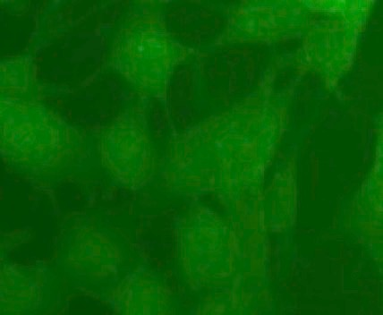
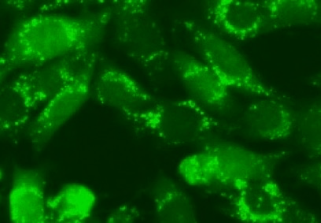
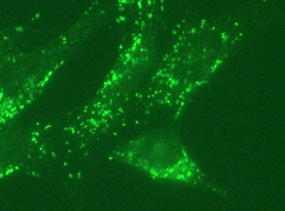
Natural extracts
3,922
33
Supplemental Figure S1
Arbitrary unit
GFP-LC3-expressing
MEFs
Screened extracts
3922
High-throughput Screening
using GFP-LC3-expressing MEFs
Negative control
Positive control
SO
Autophagy-inducing natural extracts
33
GFP-LC3

Slide 5
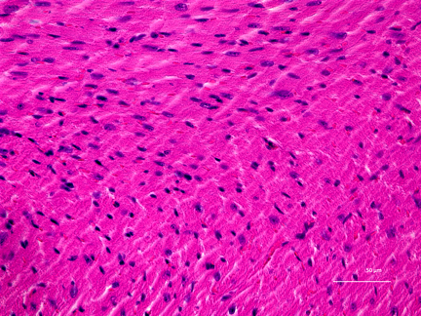
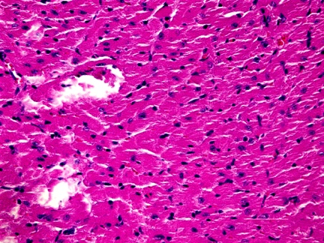
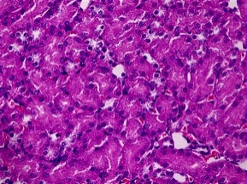
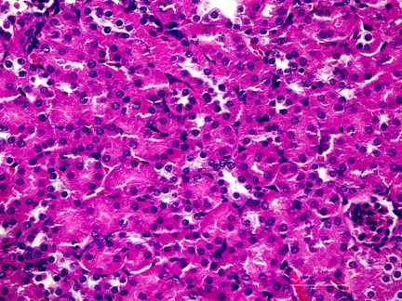
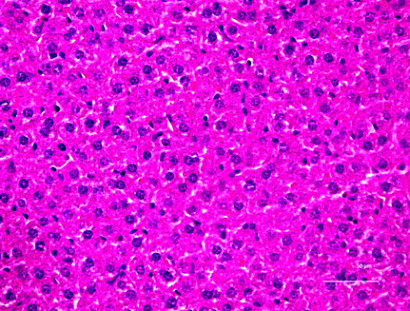
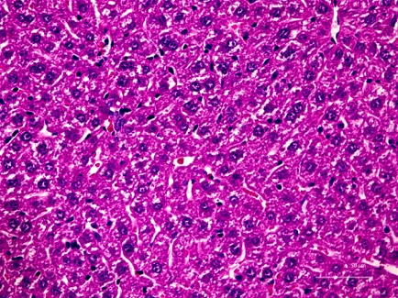
Supplemental Figure S2
a
b
DSS
c
(-)
SO
Heart
Kidney
Liver

Slide 6
a
Supplemental Figure S3
b

Slide 7
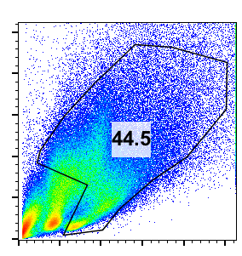
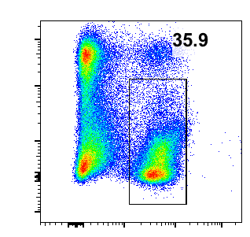
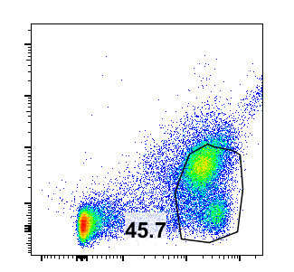
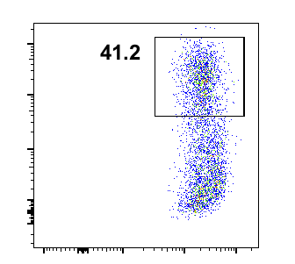
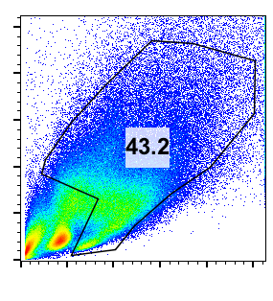
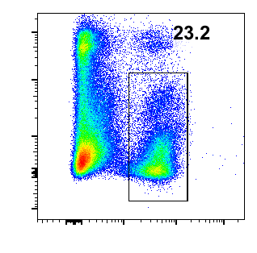
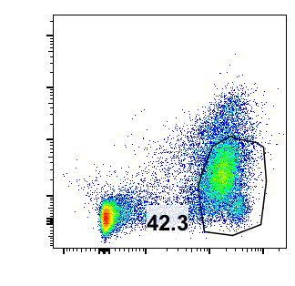
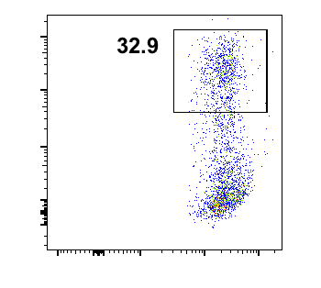
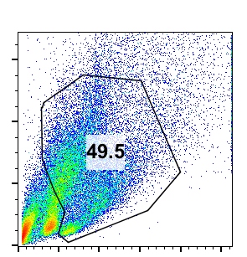
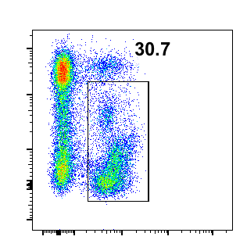
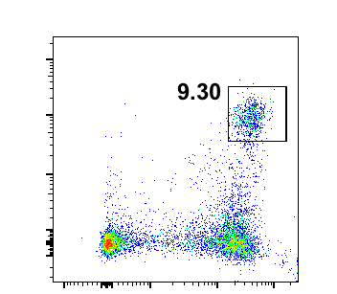
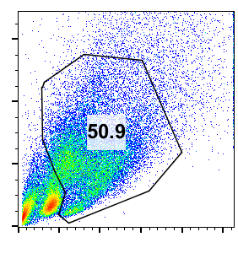
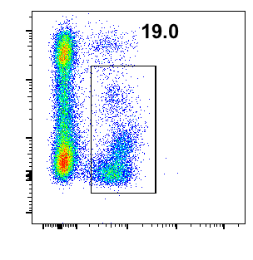
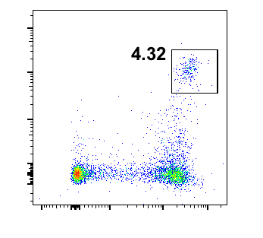
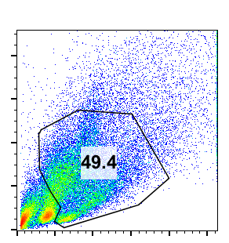
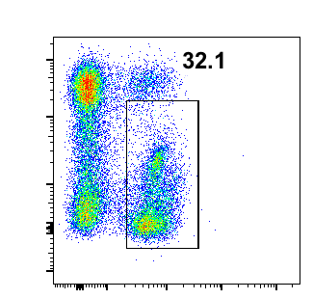
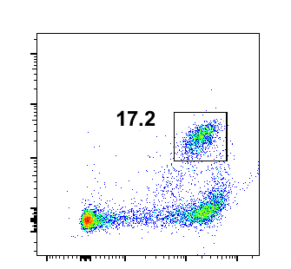
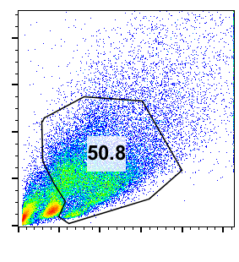
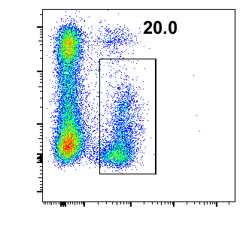
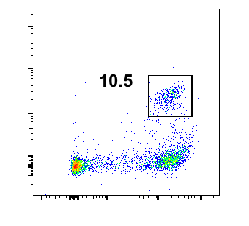
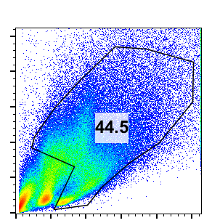
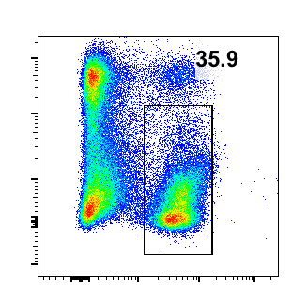
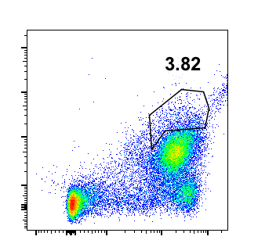
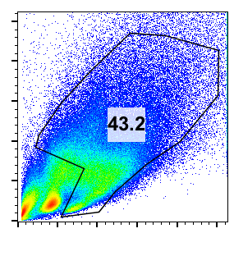
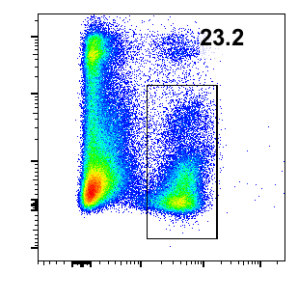
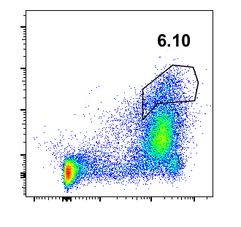
a
Dendritic cell
Supplemental Figure S4
SO
(-)
SSC
7AAD
F4/80
MHCⅡ
FSC
CD45
CD11b
CD11b
b
Neutrophil
SO
(-)
7AAD
Ly6G
SSC
FSC
CD45
CD11b
c
Eosinophil
SO
(-)
SSC
7AAD
Siglec-F
FSC
CD45
CD11b
d
Macrophage
SO
(-)
CX₃CR1
SSC
FSC
7AAD
FSC
CD45
CD11b

Slide 8
Supplemental Figure S5

Slide 9
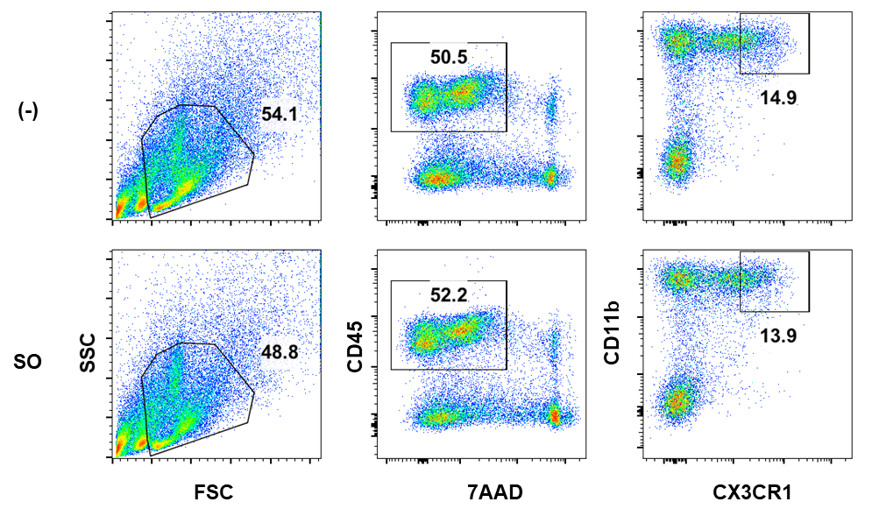
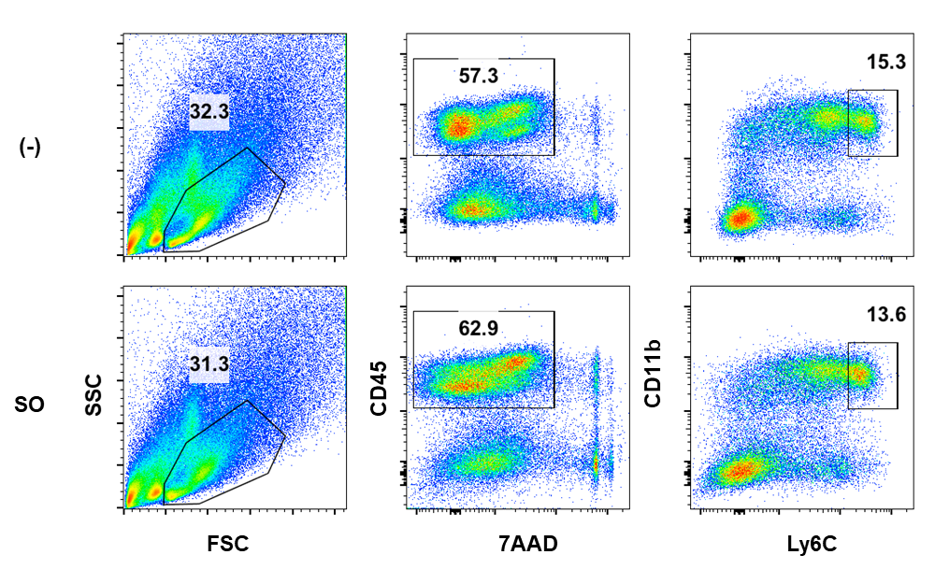
Supplemental Figure S6
a
SO
CX3CR1^{high}CD11b⁺CD45⁺ cells
(-)
SSC
CD45
CD11b
FSC
7AAD
CX3CR1
b
SO
Ly6c^{high}CD11b⁺CD45⁺ cells
(-)
SSC
CD45
CD11b
FSC
7AAD
Ly6c

Slide 10
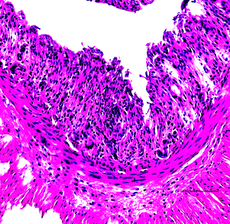
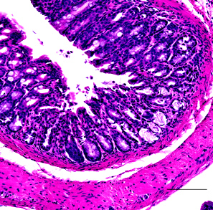
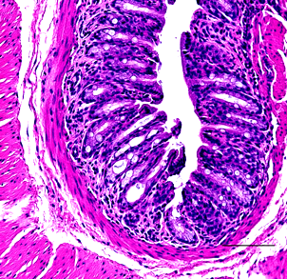
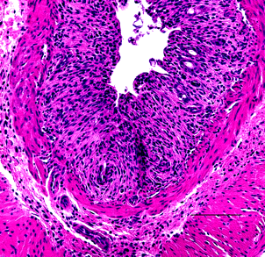
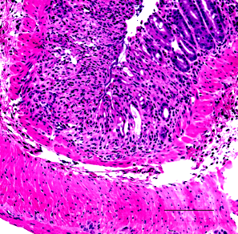
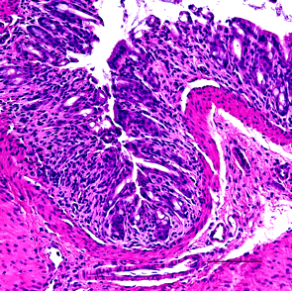
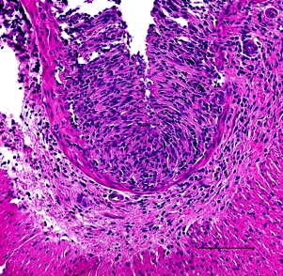
Supplemental Figure S7
(-)
SO
Mix₄
CA
GA
EA
ZY

Slide 11
a
Supplemental Figure S8
b

Slide 12
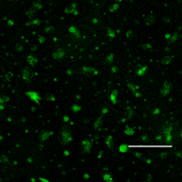
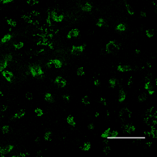
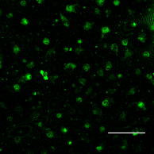
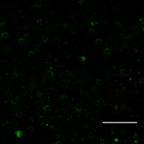
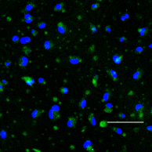
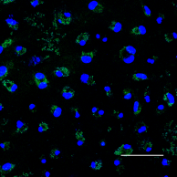










Supplemental Figure S9
SO
Catechin acid
Ellagic acid
Gallic acid
Ziyuglycoside II
Atg7^{f/f}
Atg7 ^{LysM-cre}
CYTO-ID / Hoechest33342

Slide 13





a
Supplemental Figure S10
β-actin
LC3-Ⅰ
LC3-Ⅱ
b
β-actin
LC3-Ⅰ
LC3-Ⅱ
C
GAPDH
LC3-Ⅰ
LC3-Ⅱ

