Slide 1
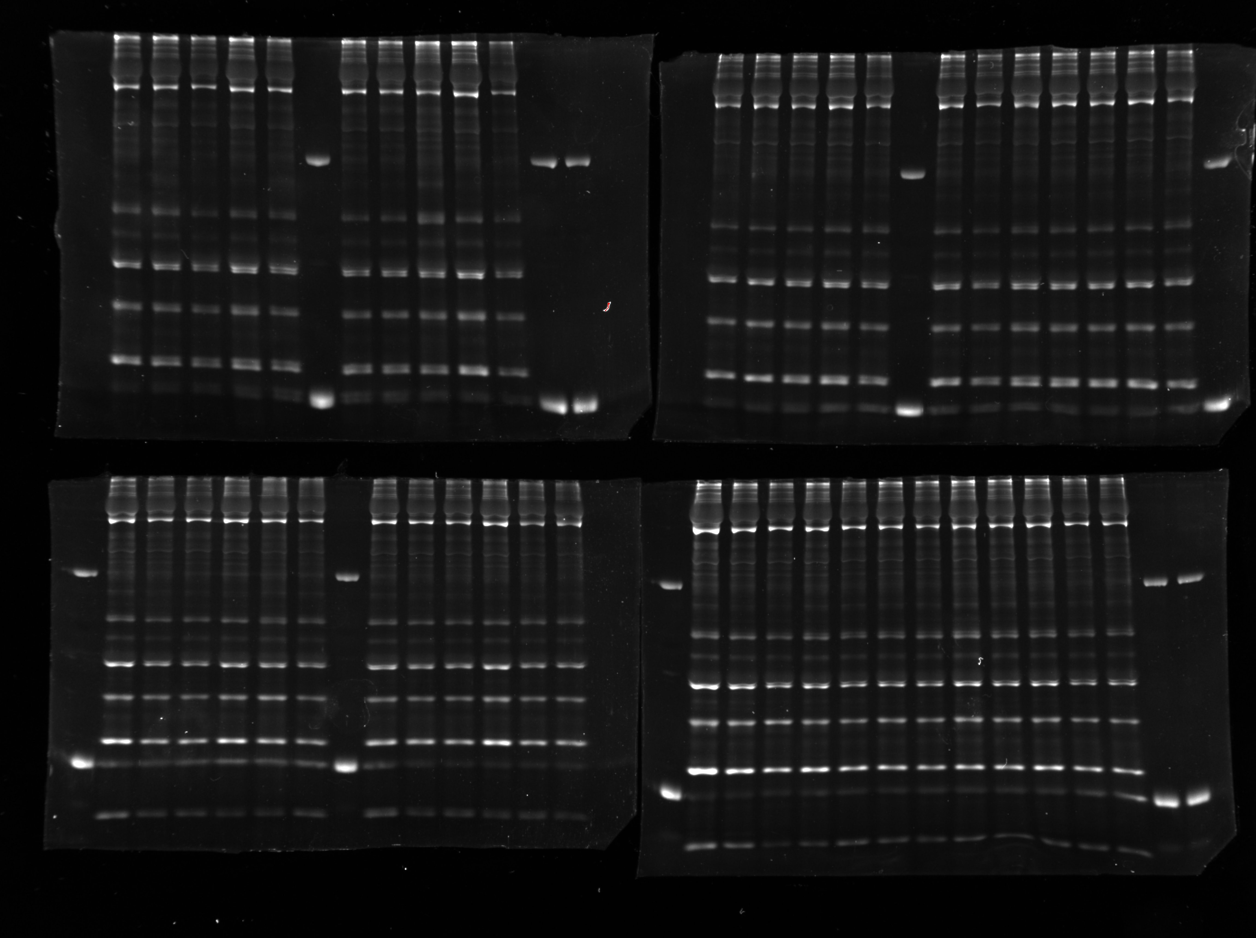

Supplementary Information File 1 – Uncropped ProQ Gels
Middle-aged
male
Unrelated project
Middle-aged
male
Unrelated project
Older
male
Unrelated project
Older
female
Unrelated project

Slide 2
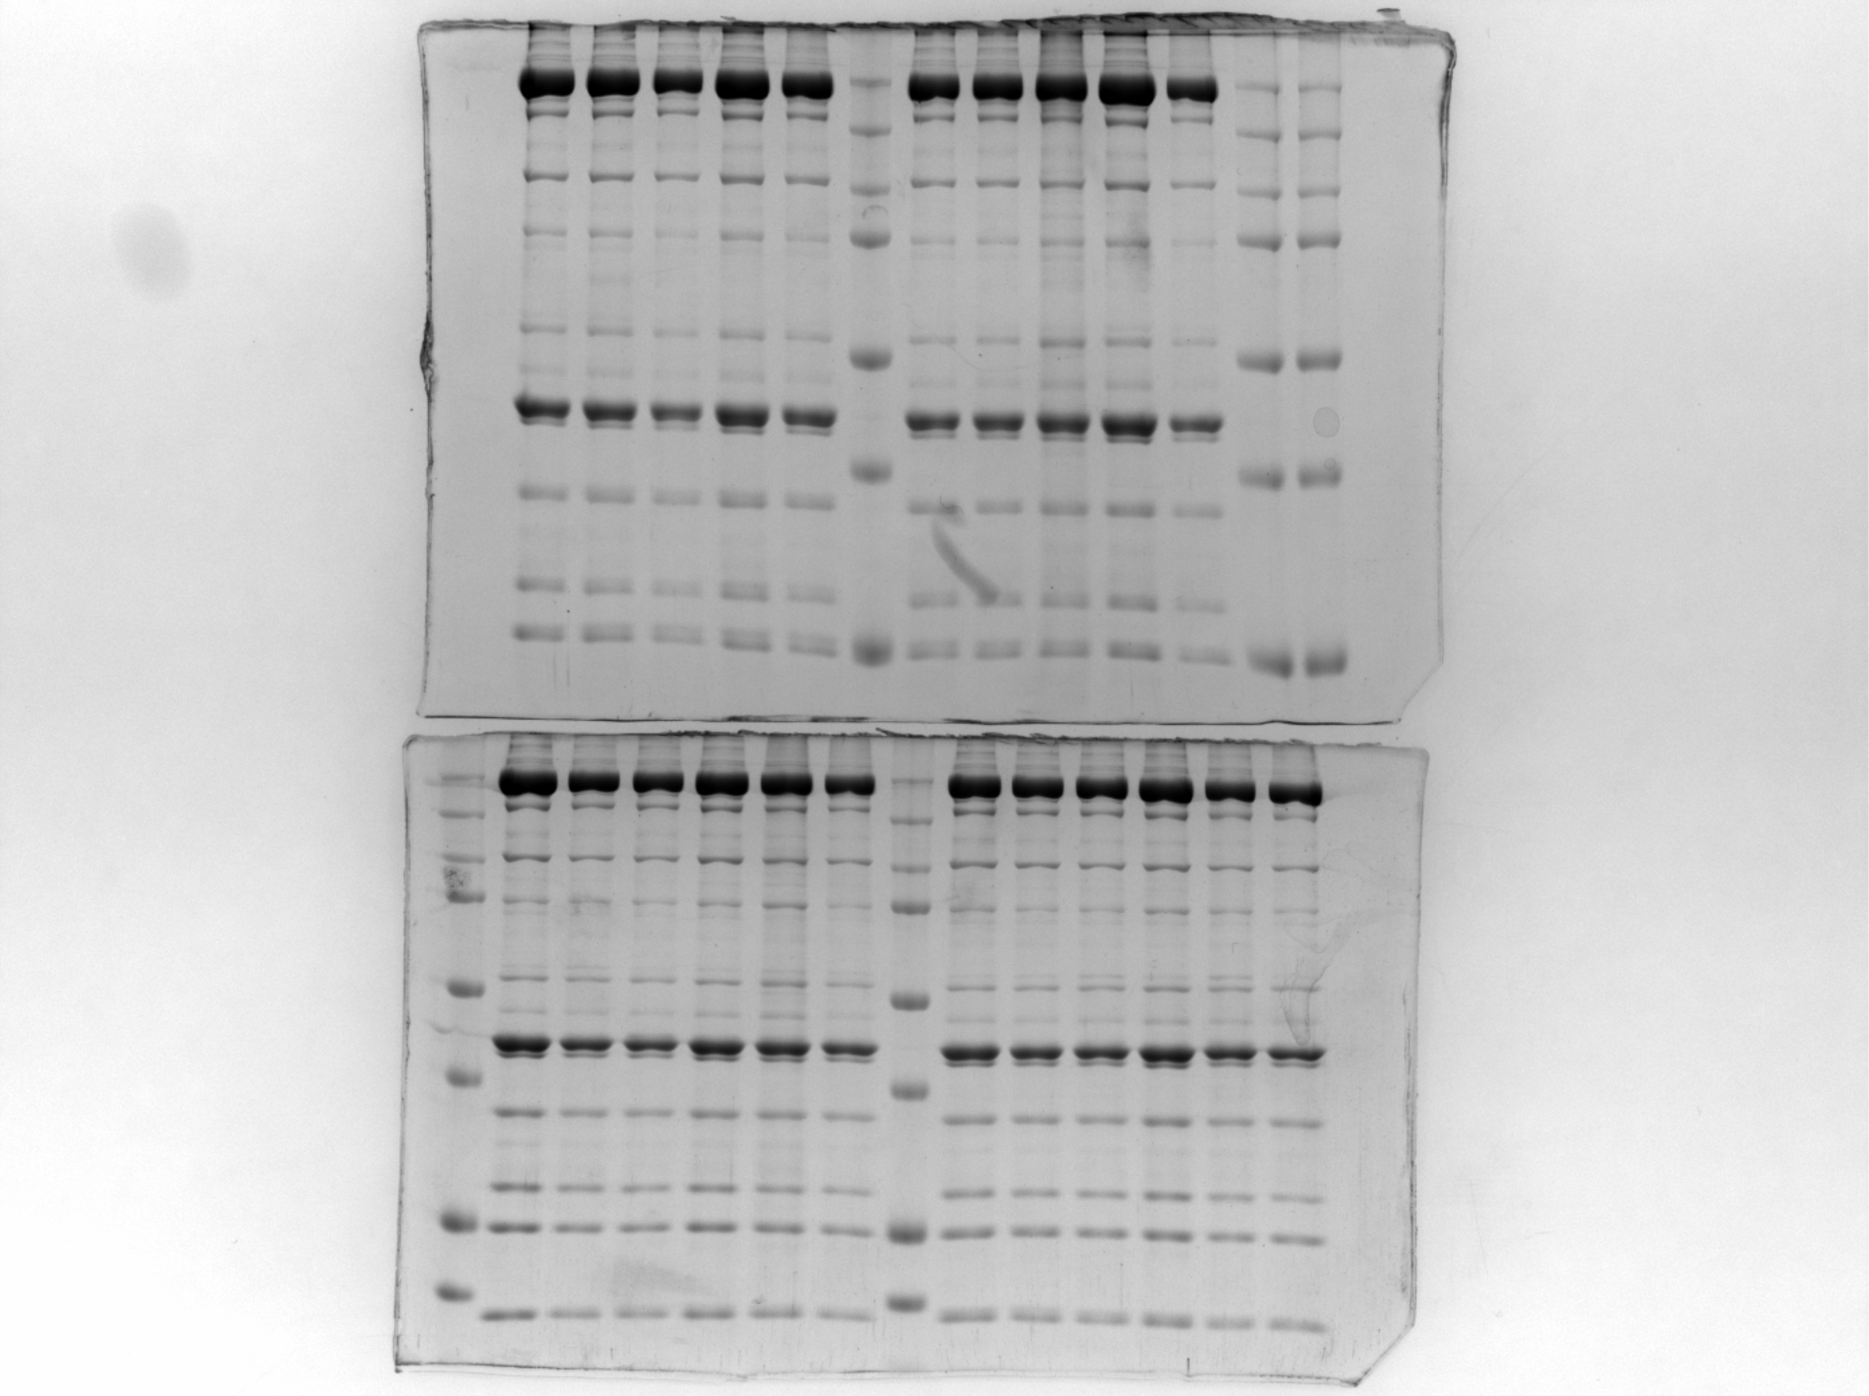
Supplementary Information File 2 – Uncropped Coomassie Gels
Middle-aged
male
Unrelated project
Old
male
Unrelated project

Slide 3
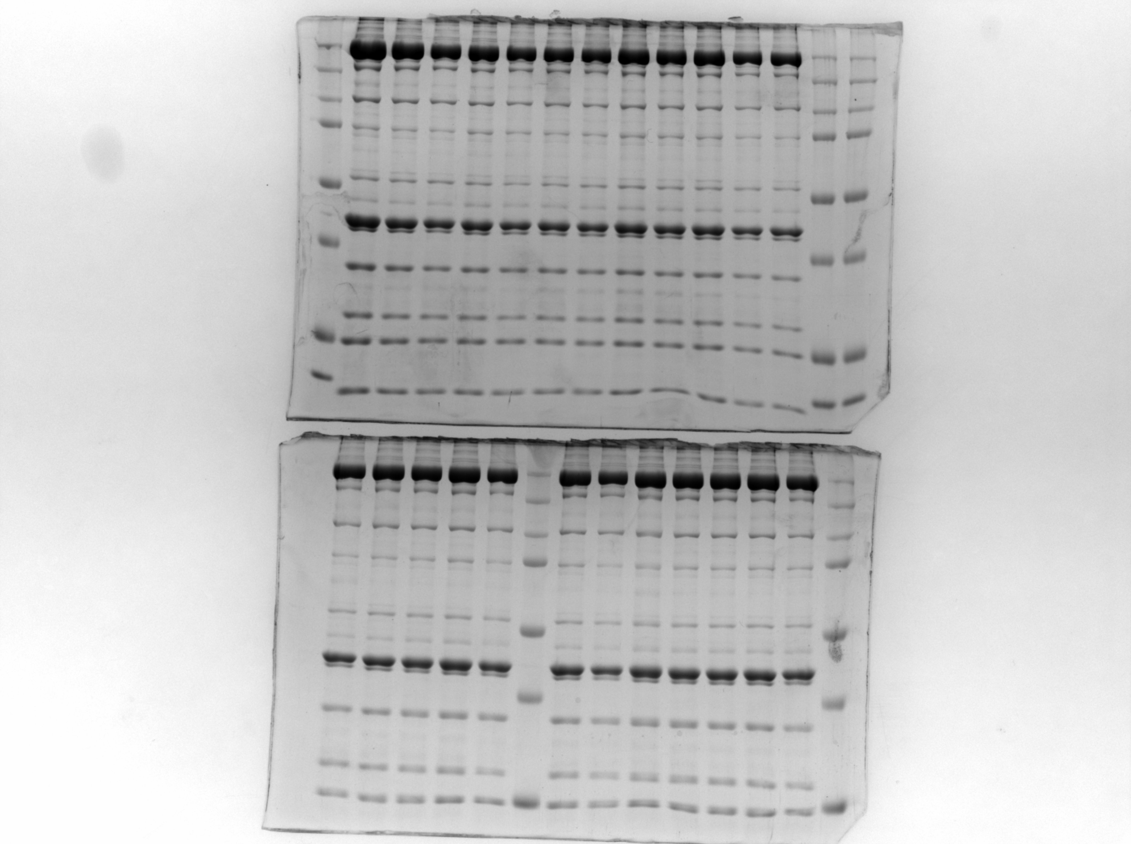
Supplementary Information File 3 – Uncropped Coomassie Gels
Old
female
Unrelated project
Middle-aged
female
Unrelated project

