Slide 1
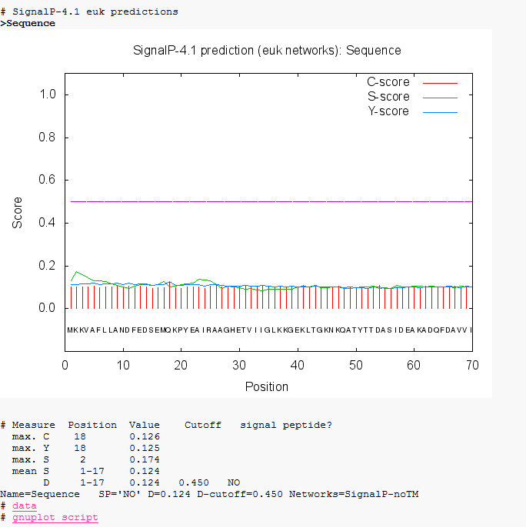
Fig S1. SignalP software suggested no signal peptide for protease 1147.

