Slide 1
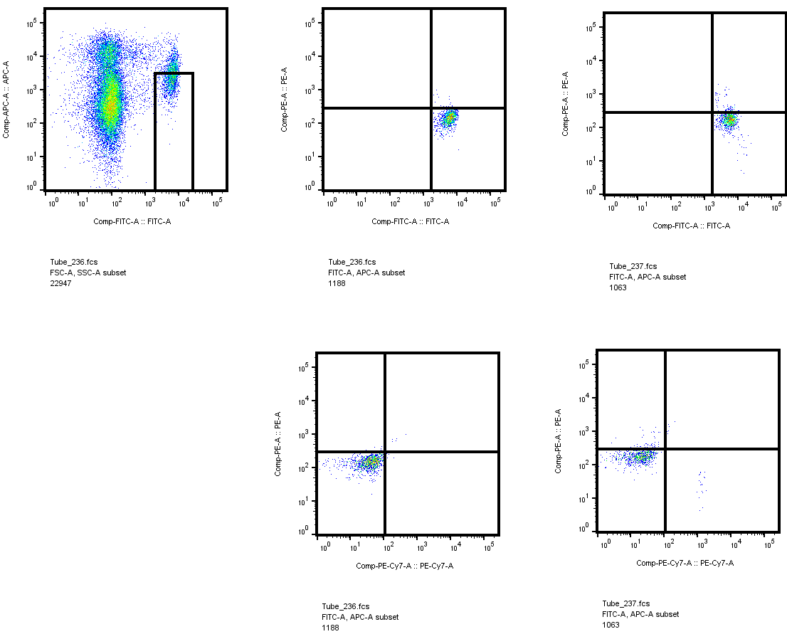
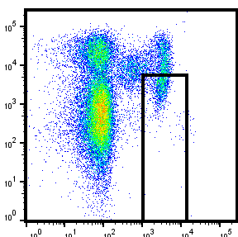
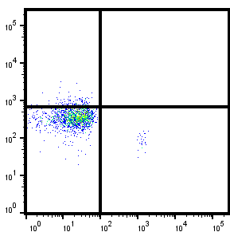
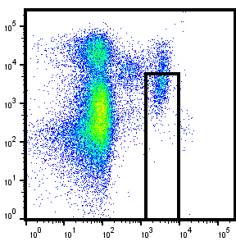
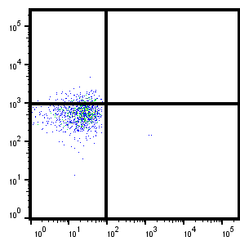
Supplementary Fig. S1
PBMC
MDSC
8
0
CO#104
2
2
12
0
CO#105
4
3
15
0
CO#106
HLA-DR
3
DC-HIL
0
CD14
PDL-1
Supplementary Fig. S1. Early stages CRC patients expressed very low DC-HIL expression on MDSCs. Blood samples of three patients with cancer stage I/II (CO#104, 105, and 106) were determined by flow-cytometry for expression of DC-HIL and PDL1 on monocytic MDSCs, which are shown in the window of dot-plots of HAL-DR and CD14 expression. These patients exhibited 2-4% MDSC among total PBMC, 8-15% DC-HIL-positivity among total MDSC, and 0.16-0.48% DC-HIL⁺ MDSC/PBMC

Slide 2
Supplementary Fig. S2
A
300
B
25000
C
4
250
3D5 mAb
20000
anti-CD14
3
200
IgG
IgG
IFN-γ (ng/ml)
MFI
MFI
15000
2
ns
ns
150
100
10000
1
50
5000
0
20
50
20
50
20
50
(μg/ml)
0
0
1:0
1:1
αDCH
αCD14
αKLH
0.1
1
10
100
0.1
1
10
100
T cells to MDSCs
Ab concentration (μg/ml)
Ab concentration (μg/ml)
Supplementary Fig. S2. No effect of anti-CD14 mAb on T cell suppressor function of MDSCs. A and B, Occupancy of DC-HIL or CD14 receptors with specific mAb. PBMCs (1 × 10⁶ cells/reaction) freshly isolated from blood samples of a bladder cancer patient were fluorescently stained with anti-HLA-DR and (A) with increasing doses of 3D5 anti-DC-HIL mAb (2-fold-serial dilution from 100 μg/ml) and the constant dose of anti-CD14 mAb or (B) with increasing doses of anti-CD14 mAb, followed by flow-cytometric analysis: CD14⁺HLA-DR^{no/lo} MDSCs were gated and assayed or expression of DC-HIL (A) or CD14 (B) and expressed as mean fluorescence intensity (MFI). C, Effect of anti-CD14 mAb on MDSC function. MDSCs and T-cells were purified from the blood sample of a prostate cancer patient and set for cocultures with varying cell ratios in the presence of costimulation. To cocultures at a 1:1 cell ratio, 3D5 anti-DC-HIL (αDCH), anti-CD14 (αCD14), or anti-KLH mAb (αKLH) at 20 or 50 μg/ml. Five days after culturing, IFN-γ amounts were determined by ELISA (mean ± SD, n=3). “ns” means not significant, compared to 1:1 cocultures with anti-KLH mAb . Data shown are representative of 5 experiments with different individual patient.

Slide 3
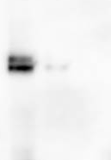
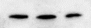
Supplementary Fig. S3
A
B
Ab treatment
B16F10
MC38
CT26
1.6
Ctrl
KDa
1.4
αDC-HIL
1.2
αPDL1
DC-HIL
103
1.0
Comb
77
Tumor volume (Cm³)
50
0.8
34
0.6
28
0.4
β-actin
50
0.2
0
0
3
5
7
9
11
13
15
Days after implantation
Supplementary Fig. S3. DC-HIL^{neg} MC38 and CT26 mouse colon cancer cell lines exhibit high response to anti-DC-HIL treatment. A, Whole extracts of B16 melanoma, MC38, and CT26 cells (20 μg/lane) were applied to SDS-PAGE and immunoblotting with anti-DC-HIL mAb. B16 melanoma expressed DC-HIL at very high-levels, whereas MC38 and CT26 colon cancer lines were absent of DC-HIL expression. B, Day 6 post-implantation of CT26 cells s.c. into BALB/c mice, all mice were given i.p. injection of control IgG, anti-DC-HIL, anti-PDL1, or combined mAb (Comb) at dose of 200 μg/mouse. Tumor volume was measured every other day. All three mAb treatment showed significant attenuation in growth of CT26 tumor, compared to control IgG-treated mice; P<0.01.

Slide 4
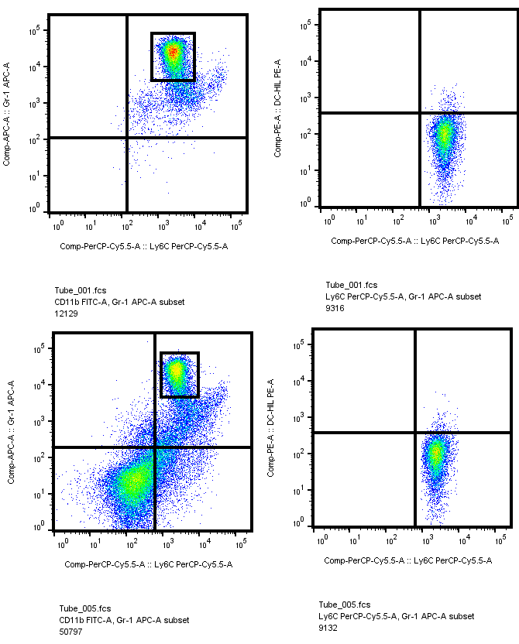
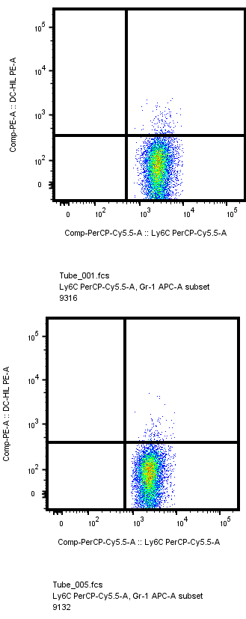
Supplementary Fig. S4
CD45⁺CD11b⁺
Ly6C⁺Gr1⁺
24%
Spleen
3%
77%
DLN
5%
Gr1
DC-HIL
Ly6C
Ly6C
Supplementary Fig. S4. MDSCs in spleen and draining lymph nodes did not express DC-HIL. C57BL/6 mice were s.c. implanted with MC38 cells (1 × 10⁶/mouse). On day 13, mice were sacrificed. Cells isolated from spleen and tumor-draining lymph node (DLN) were Ab-stained and gated for CD45⁺CD11b⁺ cells, which sorted into Ly6C⁺Gr1⁺fractions in the left dot-plots and examined by flow-cytometry for DC-HIL expression show in the right.

Slide 5
Supplementary Fig. S5
Ab treatment
1.2
Ctrl
1.0
αDC-HIL
*
αPDL1
*
0.8
Comb
*
*
0.6
Tumor volume (Cm³)
0.4
0.2
*
0
0
7
9
11
13
15
Days after implantation
Supplementary Fig. S5. Combination treatment of anti-DC-HIL/anti-PDL1 mAb did not produce synergistic anti-tumor effects to MC38 colon cancer. Day 6 after implanting s.c. MC38 cells (1 × 10⁶ cells/mouse) into mice, mAb treatment started every 2 days, total of 5 i.p. injections (200 μg/mouse). mAb include control IgG, anti-DC-HIL, anti-PDL1 or combined (Combo) mAb. Tumor volume was measured every other day. *P<0.05 between αDC-HIL and combined treatment and **P<0.05 αPDL1 and combined.

Slide 6
Supplementary Fig. S6
25
14
20
12
10
15
8
Wight (g)
RBC (×10⁶ μl)
10
Ctrl
6
Ctrl
αDC-HIL
4
αDC-HIL
5
Ab injections
2
Ab injections
0
0
0
2
4
6
8
10
12
14
0
2
4
6
8
10
12
14
Days
Days
25
Ctrl
2000
Ctrl
20
αDC-HIL
1500
αDC-HIL
15
WBC (×10³ μl)
PLT (×10³ μl)
10
1000
5
Ab injections
500
Ab injections
0
0
0
2
4
6
8
10
12
14
0
2
4
6
8
10
12
14
Days
Days
Supplementary Fig. S6. Changes in health conditions of mice treated with anti-DC-HIL mAb. Day 1, B6 mice (8-week-old females, n=3) were given i.p. injection of UTX103 anti-DC-HIL mAb or control IgG (200 μg/mouse), every 2 days, total 6 injections. Experiments were ended next day after the last injection (day 11). Starting at day 0, every 4 days mice were collected blood samples (25 μl/mouse) from the retro-orbital veins (days 0, 4, 8, and 12) and tested for levels of RBC, WBC and platelets (PLT) using cytometer counting with/without red blood cell lysis and flow-cytometry, respectively. All mice were also monitored for body weight. All mice exhibited no distinguishable changes in these parameters at 10 days after the last injection.

Slide 7
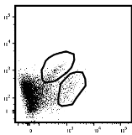
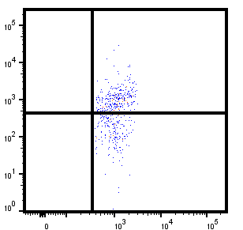
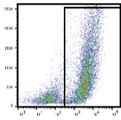
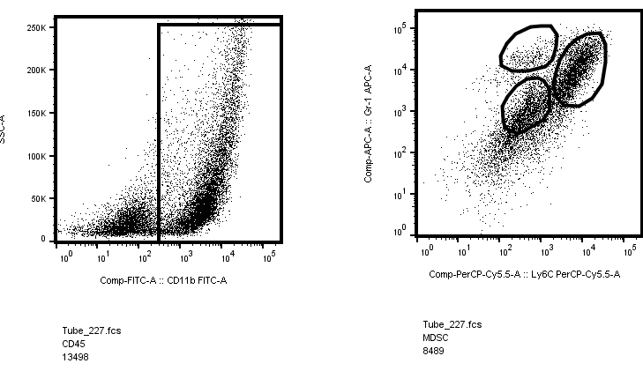
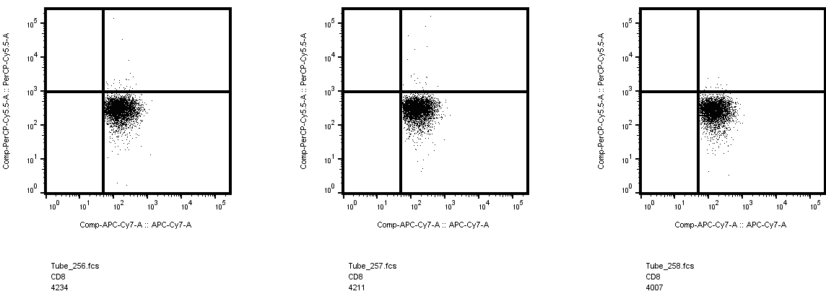
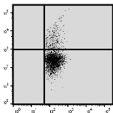
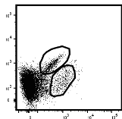
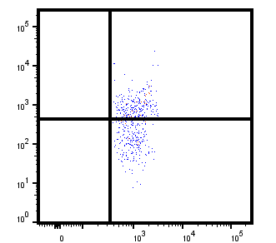


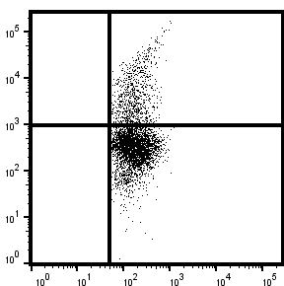
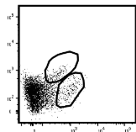
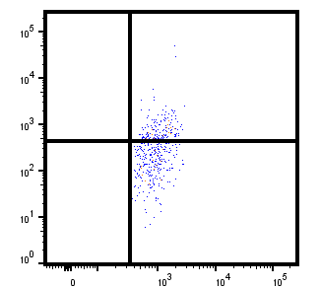
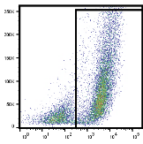
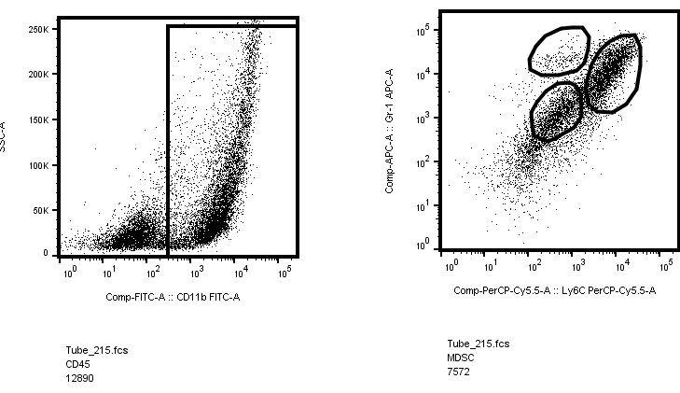

Supplementary Fig. S7
Tumor
DLN
CD45⁺
CD45⁺CD4⁺
CD45⁺
CD45⁺CD11b⁺
CD45⁺CD4⁺
CD45⁺CD8⁺
5%
48%
66%
3%
3%
17%
Ctrl
35%
5%
24%
9%
50%
58%
5%
5%
22%
αDC-HIL
31%
5%
22%
6%
37%
65%
3%
5%
18%
αPDL1
CD8
FOXP3
SSC
Gr1
34%
IFNγ
IFNγ
5%
25%
CD4
CD4
CD11b
Ly6C
CD4
CD8
Supplementary Fig. S7. Representative FACS data showing frequency of immune cells in the tumor microenvironment of mice treated with mAb. On day 18 after treating MC38 tumor-bearing mice with control IgG, anti-DC-HIL, or anti-PDL1 mAb, CD45⁺ cells in the tumor or draining lymph nodes (DLN) were gated by FACS analysis and examined for expression of CD4 vs. CD8, Foxp3 in CD4 T cells, CD11b, or Gr1 vs. Ly6C (tumor), and for expression of IFN-γ in CD4 or CD8 T cells (DLN).

Slide 8
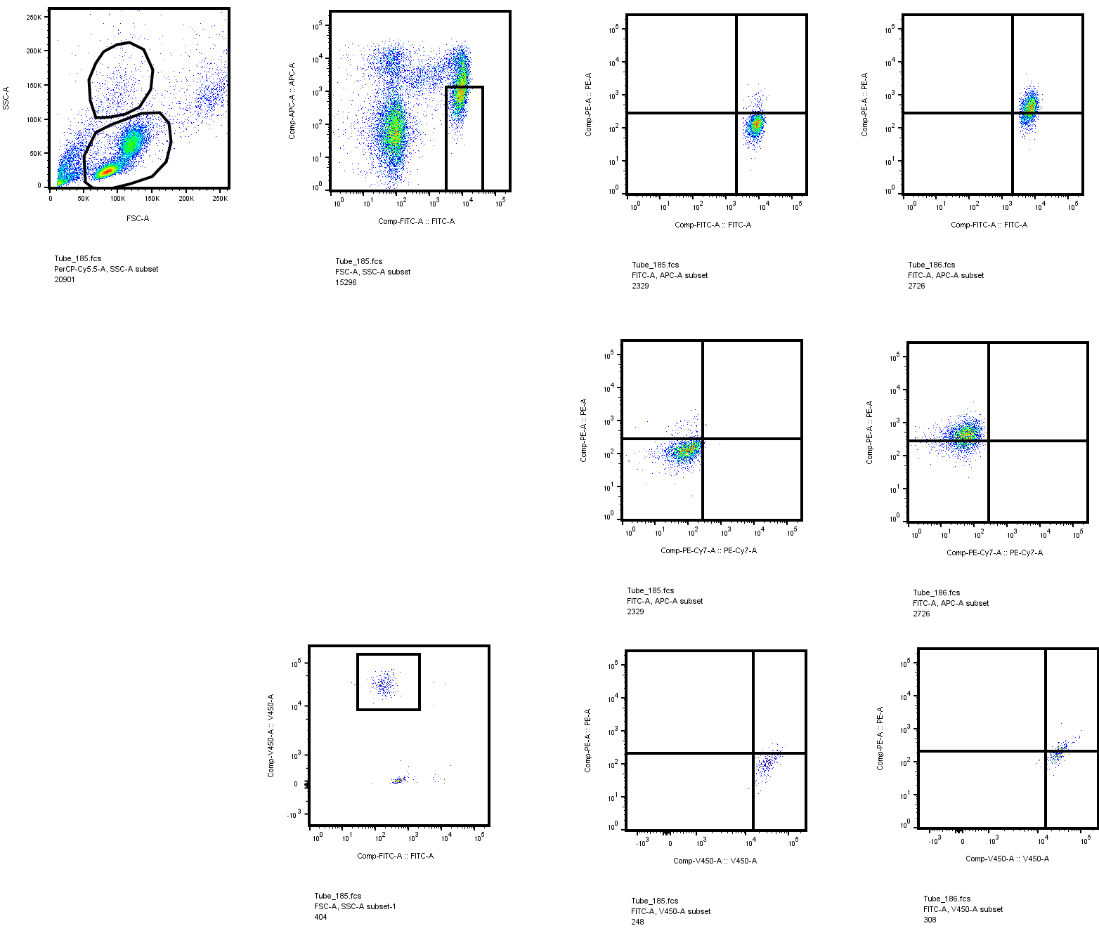
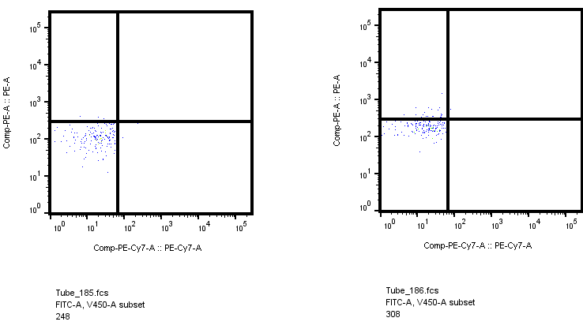
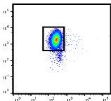
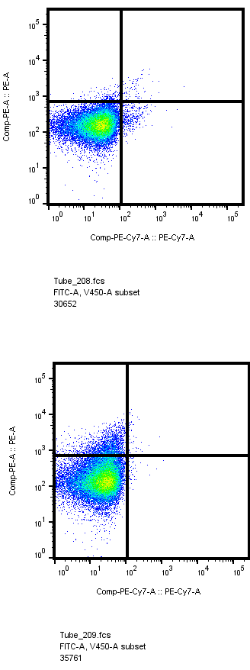
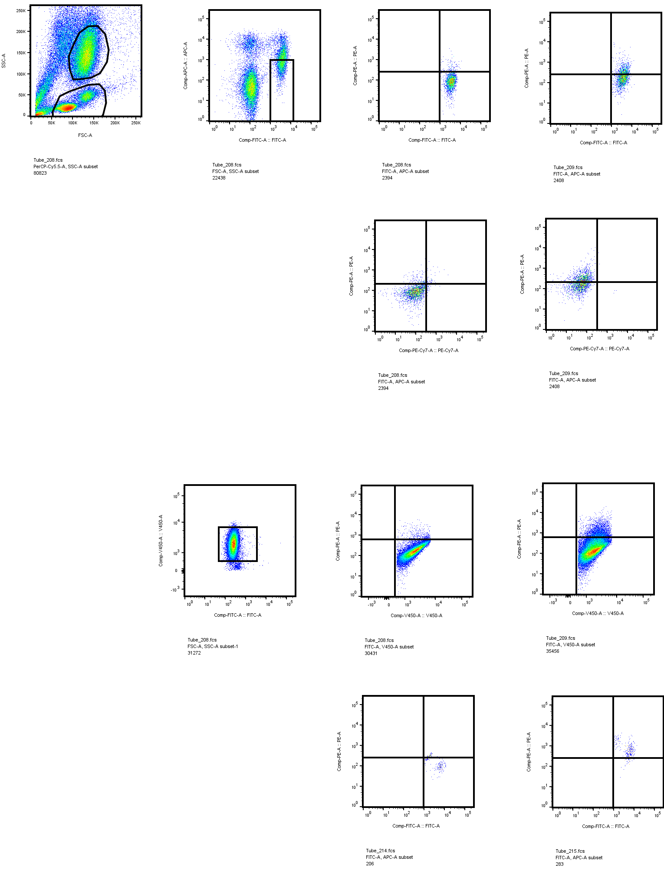
Supplementary Fig. S8
A
CD14⁻/CD15⁺
B
CD14⁻/CD15⁺
C
8
75
33
0
97
8
0
7
Gr-MDSC
CD15
DC-HIL
CD15
DC-HIL
M-MDSC
Gr
38
6
1.9
0
0
5
SSC
CD14
PDL-1
SSC
CD14
PDL-1
INFγ (ng/ml)
*
73
CD14⁺/HLA-DR^{no/low}
27
CD14⁺/HLA-DR^{no/low}
4
Mo
35
0
3
*
FSC
HLA-DR
71
0
FSC
DC-HIL
2
DC-HIL
HLA-DR
1
*
15
0
10
0
0
CD14
PDL-1
CD14
PDL-1
1:0
1:0.25
1:0.5
1:1
T cell : MDSC
Supplementary Fig. S8. Blood granulocytic MDSC of CRC patients expressed low-levels of DC-HIL and were not immunosuppressive in ex vivo cultures. A and B, representative data of CRC patients (n=5) are shown. Blood cells of 2 CRC patients were isolated using different methods: Ficoll-grant purification (A, Patient C#99) and 6% dextran treatment followed by RBC lysis (B, C#103). In SSC/FSC plots, upper and lower fractions represent granulocytes (Gr) and mononuclear cells (Mo), respectively, gated, and examined for expression of their specific markers and DC-HIL/PDL1: 75-97% of total cells in the Gr-fraction showed CD15⁺ CD14^{neg} (Gr-MDSC) and 10-15% in the Mo-fraction showed CD14⁺ HLA-DR^{neg} (Mo-MDSC). Gr-and Mo-MDSC expressed DC-HIL at median of 10% and 35%, respectively, whereas PDL1 was absent of both subsets (<5% by either). C, Gr- and Mo-MDSC were isolated from blood sample of the same patient using CD14-negative followed by CD15-positive selections and HLA-DR-negative, followed by CD14-positive selections, respectively, by magnetic beads. These cells were then mixed with autologous T cells at varying cell ratios. IFN-γ amounts were determined in the supernatant of day 5 cultures (mean ± SD, n=3). *P<0.01 between Gr- and Mo-MDSC.

