Slide 1
Responsiveness of quality of life measures in patients with peripheral vascular malformations: the OVAMA project
M.M. Lokhorst¹, S.E.R. Horbach¹, M. Waner², T.M. O², C.J.M. van der Vleuten³, L.B. Mokkink⁴, C.M.A.M. van der Horst¹ and P.I. Spuls⁵
¹Department of Plastic, Reconstructive and Hand Surgery, Amsterdam University Medical Centers, University of Amsterdam, the Netherlands
²Vascular Birthmark Institute of New York, Department of Otolaryngology, Lenox Hill and Manhattan Eye, Ear, and Throat Hospitals, New York, New York, U.S.A.
³Department of Dermatology, Radboud University Medical Center, Nijmegen, the Netherlands
⁴Department of Epidemiology and Biostatistics and Amsterdam Public Health Research Institute, Amsterdam University Medical Centers, Vrije Universiteit Amsterdam, the Netherlands
⁵Department of Dermatology, Amsterdam University Medical Centers, University of Amsterdam, Amsterdam Public Health, Infection and Immunity, the Netherlands
British Journal of Dermatology. DOI: 10.1111/bjd.18619

Slide 2

Max Lokhorst
PhD student
Department of Plastic, Reconstructive, and Hand Surgery
Amsterdam University Medical Centres
m.m.lokhorst@amsterdamumc.nl

Slide 3
Introduction
What’s already known?
Quality of life is often impaired in patients with vascular malformations.
Quality of life is considered a core outcome domain for evaluating treatment of vascular malformations.
To measure effect of treatment on quality of life, a patient-reported outcome measure is required which is responsive to changes in quality of life.

Slide 4
Objective
To determine if two widely used QoL questionnaires, the SF-36 and Skindex-29, are responsive to changes in QoL in patients with vascular malformations.

Slide 5
Methods (1)
International multicentre prospective study
  2 Dutch centres and 1 US centre
Adult patients with peripheral vascular malformations
Baseline and follow-up: 2 quality of life questionnaires
  SF-36
    8 subscales: (1) physical functioning, (2) social functioning, (3) role physical, (4) role emotional, (5) mental health, (6) vitality, (7) bodily pain and (8) general health
  Skindex-29
    3 subscales: (1) symptoms, (2) functioning and (3) emotions
Conservative treatment
  Watchful waiting, compressive stockings
Invasive treatment
  Sclerotherapy, laser therapy, surgery

Slide 6
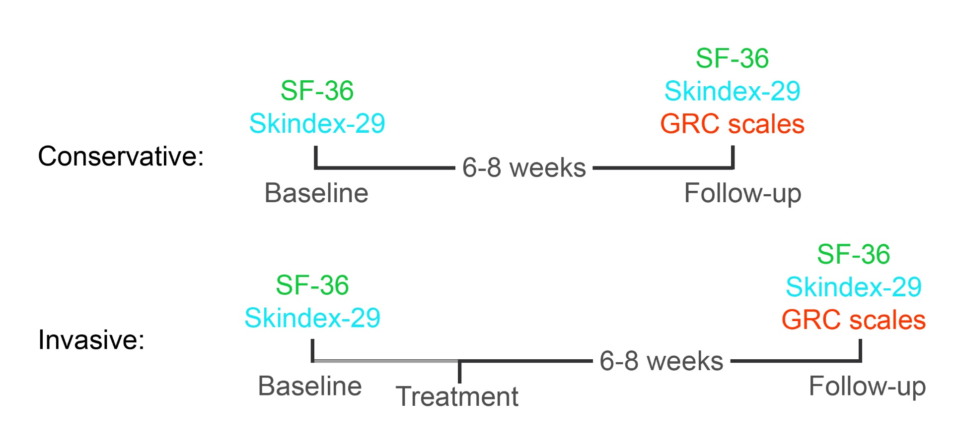
Methods (2)
GRC (global rating of change) scales
Experienced change since baseline in constructs corresponding with the subscales of the SF-36 and Skindex-29
7-point scale:
  -3: very much worse
  -2: worse
  -1: somewhat worse
  0: no change
  +1: somewhat better
  +2: better
  +3: very much better

Slide 7
Methods (3)
Responsiveness:
Method 1:
Per subscale: 7 predefined hypotheses on comparison with the GRC scales
Responsive if >75% hypotheses confirmed
Method 2:
Per subscale: area under the receiver operating characteristics curve (AUC): discrimination between improved and unchanged patients
Responsive if AUC ≥0.7
1. High positive correlation (>0.5) between SF-36 or Skindex-29 change scores and the GRC scale measuring a similar construct
2. Moderate positive correlation (0.3-0.5) between SF-36 or Skindex-29 change score and a GRC scale measuring a related, but dissimilar construct
3. Moderate positive correlation between SF-36 or Skindex-29 change score and a second GRC scale measuring a related, but dissimilar construct
4. Low positive or negative correlation (<0.3) between SF-36 or Skindex-29 change score and a GRC scale measuring an unrelated construct
5. Patients indicating improvement on the associated GRC scale should have a positive mean change score
6. Patients indicating worsening on the associated GRC scale should have a negative mean change score
7. The mean change score of patients indicating improvement should be higher than the mean change score of unchanged patients, which in turn should be higher than the mean change score of worsened patients

Slide 8
Results (1)
Baseline characteristics | Frequency | Percentage
Gender
Female | 43 | 64.2
Type
Venous | 37 | 55.2
Arteriovenous | 8 | 11.9
Venous, capillary | 6 | 9.0
Lymphatic | 5 | 7.5
Venous, lymphatic | 5 | 7.5
Venous, lymphatic, capillary | 3 | 4.5
Arteriovenous, capillary | 1 | 1.5
Capillary | 1 | 1.5
Not specified | 1 | 1.5
Localization
Lower extremity | 21 | 31.3
Head/neck | 19 | 28.4
Trunk, lower extremity | 9 | 13.4
Trunk | 8 | 11.9
Upper extremity | 6 | 9.0
Head/neck, trunk, upper extremity | 2 | 3.0
Head/neck, trunk, upper extremity, lower extremity | 1 | 1.5
Trunk, upper extremity, lower extremity | 1 | 1.5
Size
<5cm | 20 | 29.9
5-10cm | 12 | 17.9
≥10cm | 35 | 52.2
Treatment during study period
Conservative | 42 | 62.7
Invasive | 25 | 37.3
89 patients included
67 (75%) completed baseline and follow-up

Slide 9
Results (2)
Descriptive data
For all SF-36 and Skindex-29 subscales:
No significant change between baseline and follow-up
No significant differences between conservative and invasive management groups in baseline scores and change scores
GRC scale responses
Invasive group:
More experienced improvement in all GRC domains than conservative group
Correlations of SF-36 and Skindex change scores with the GRC scales
No subscale: high correlation with GRC scale for which high was expected
No subscale: moderate correlation with GRC scale for which moderate was expected
All subscales: low correlation with GRC scale for which low was expected

Slide 10
Results (3)
Responsiveness
For all subscales of the SF-36 and Skindex-29:
<75% of the hypotheses confirmed
AUC <0.7
No subscale considered responsive to change
Additional: correlation between SF-36 and Skindex change scores
All low but one: moderate correlation (0.33) between SF-36 ‘social functioning’ and Skindex ‘functioning’

Slide 11
Discussion (1)
Data suggest that all subscales of both the SF-36 and Skindex-29 were unresponsive to changes in QoL in this study population
Responsiveness
Hypotheses were formulated according to COSMIN methodology
Hypotheses will always be somewhat subjective, however, none of hypotheses were confirmed: results seem undisputable
GRC scales
Viewed as best single measure of change from patient’s perspective
Difficult to establish evidence that it is the correct assessment of change
  Impossible to determine responsiveness of a GRC scale: it directly assesses change with single measure
Support of GRC scales in this study:
Invasive group indicated significantly more improvement in the GRC scales
Low correlations between SF-36 and Skindex-29 subscales themselves

Slide 12
Discussion (2)
Study population
Heterogeneous in type and localization? Goal is to find questionnaire suitable for typical (heterogeneous) vascular malformation study populations
Low sample size? >50 is adequate
  Questionnaire must be suitable for studies on vascular malformations which typically have small numbers of patients

Slide 13
Discussion (3)
Possible causes of unresponsiveness
Large measurement error
Items and response options might not be suitable for this population
Questionnaires developed for cross-sectional research in large study populations
Subscales might be measuring multiple constructs of interest (not unidimensional)
Subscales might contain irrelevant questions for patients with vascular malformations
Next steps
Exploring responsiveness of PROMIS computer adaptive tests
  Computer tailors questionnaire to individual: less irrelevant questions
  Unidimensional scales
  Seem to have better measurement properties in other study populations
Development of disease-specific questionnaire
  Disease-specific symptoms and appearance problems

Slide 14
Conclusions
What does this study add?
This is the first study assessing responsiveness of quality of life measures in patients with vascular malformations.
Results seem to indicate that the SF-36 and Skindex-29 are not responsive to changes in quality of life in patients with vascular malformations.

Slide 15
Call for correspondence
Why not join the debate on this article through our correspondence section?
Rapid responses should not exceed 350 words, four references and one figure
Further details can be found here

