Slide 1
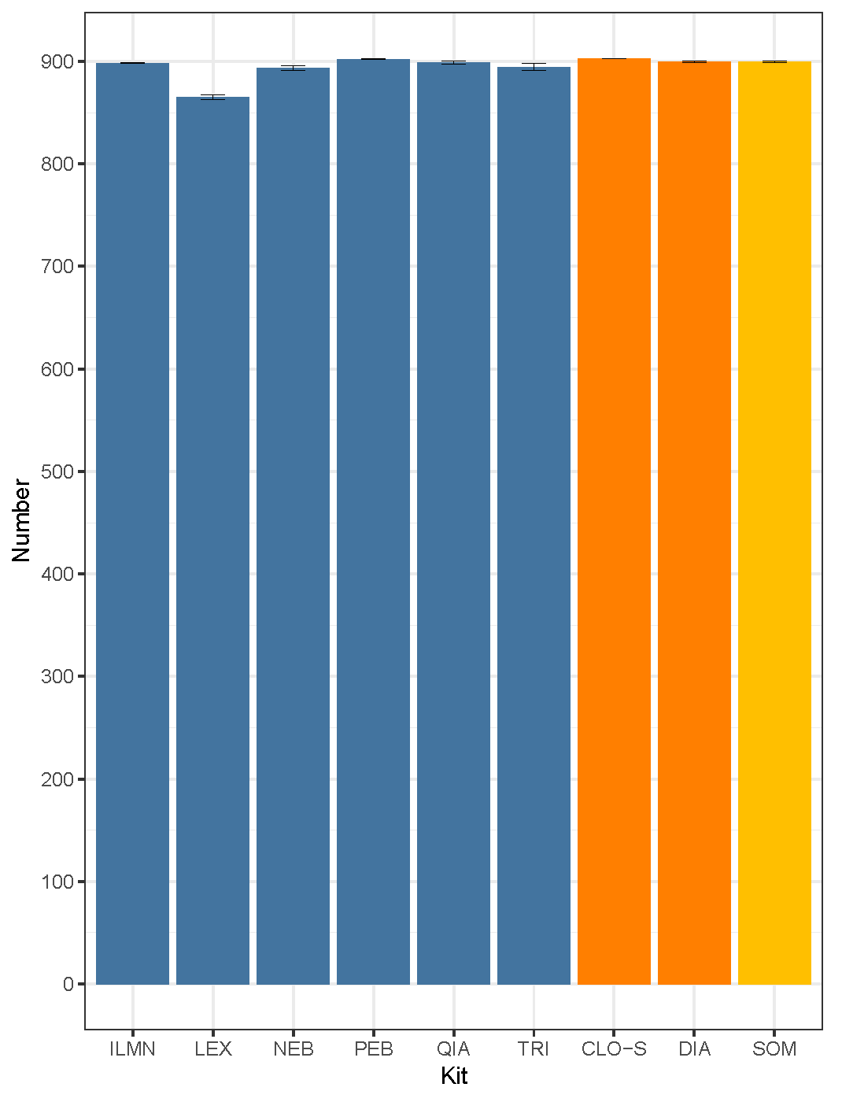
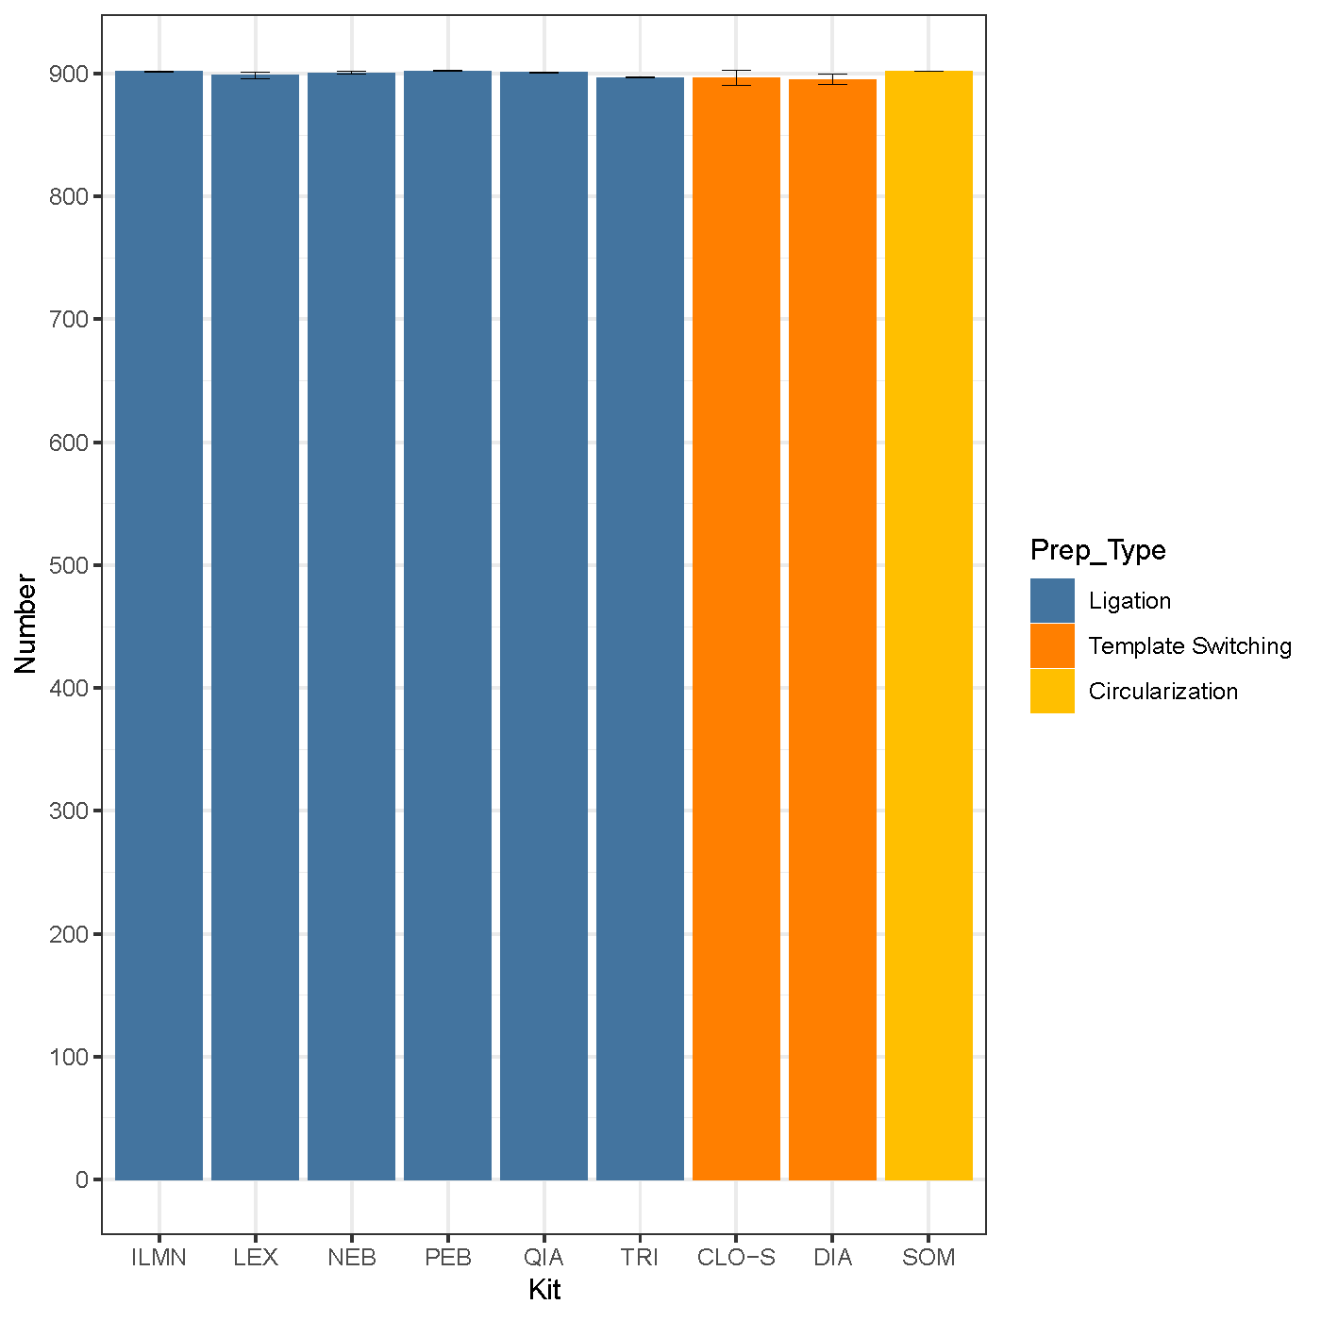
FIGURE S1: Number of spike in miRNAs detected in each kit with CPM > 0
MUR
MUR_D

Slide 2
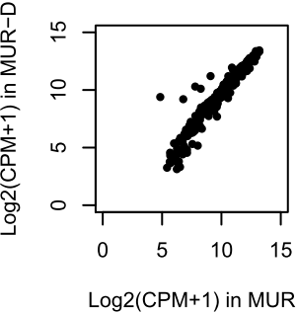
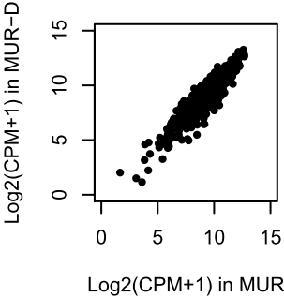
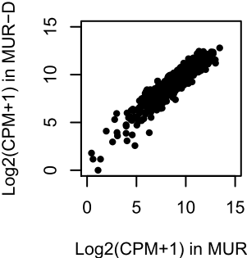
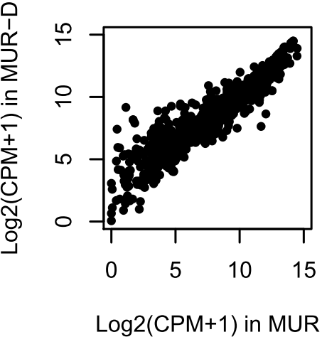
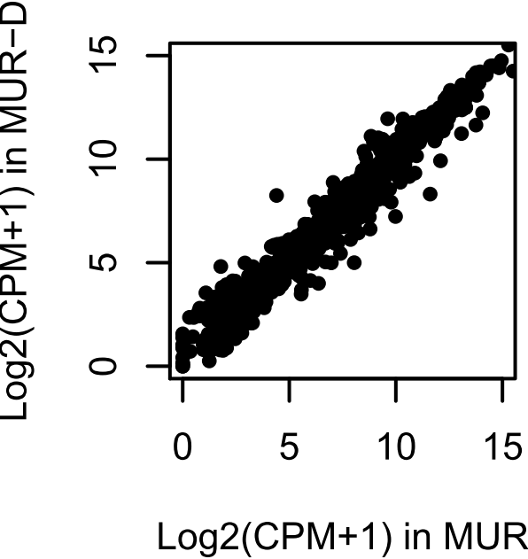
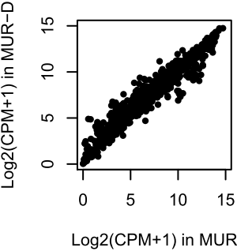
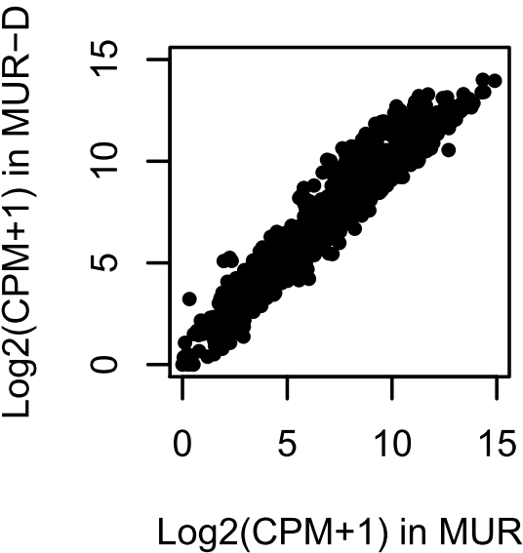
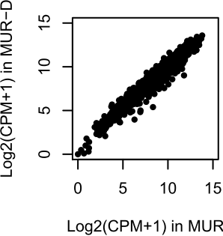
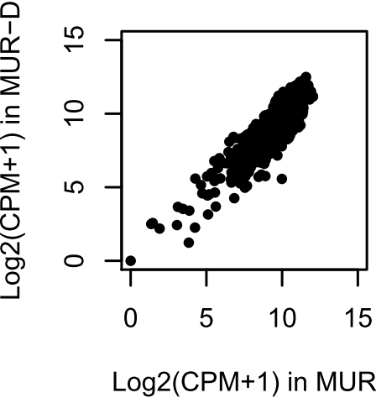
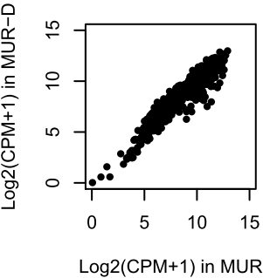
Figure S2: Correlation of MUR-D and MUR samples for all methods
Nano
CLO-S
DIA
ILMN
LEX
NEB
TRI
QIA
SOM
PEB

Slide 3
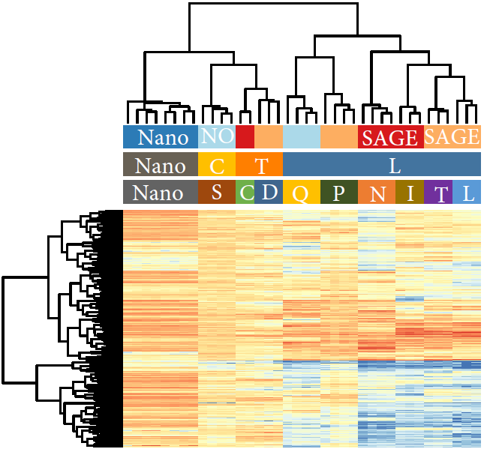

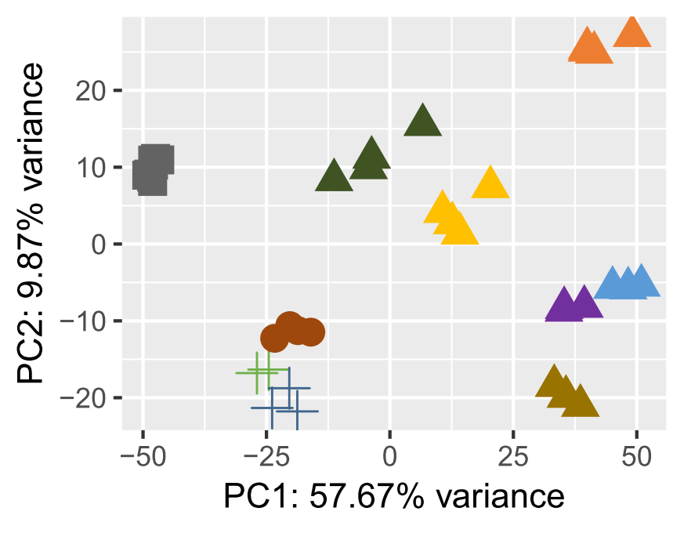
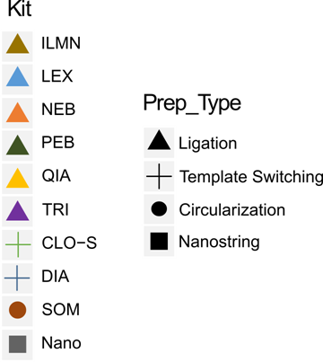

Figure S3: Correlation of miRNA expression observed among different methods with MUR sample
MUR
SPRI
Notes:
Please check the table below for the corresponding information used to generate this figure:
miRNA_expr_mat_stemloop_92samplse.CPM.MUR_MUR_D.xlsx

