Slide 1
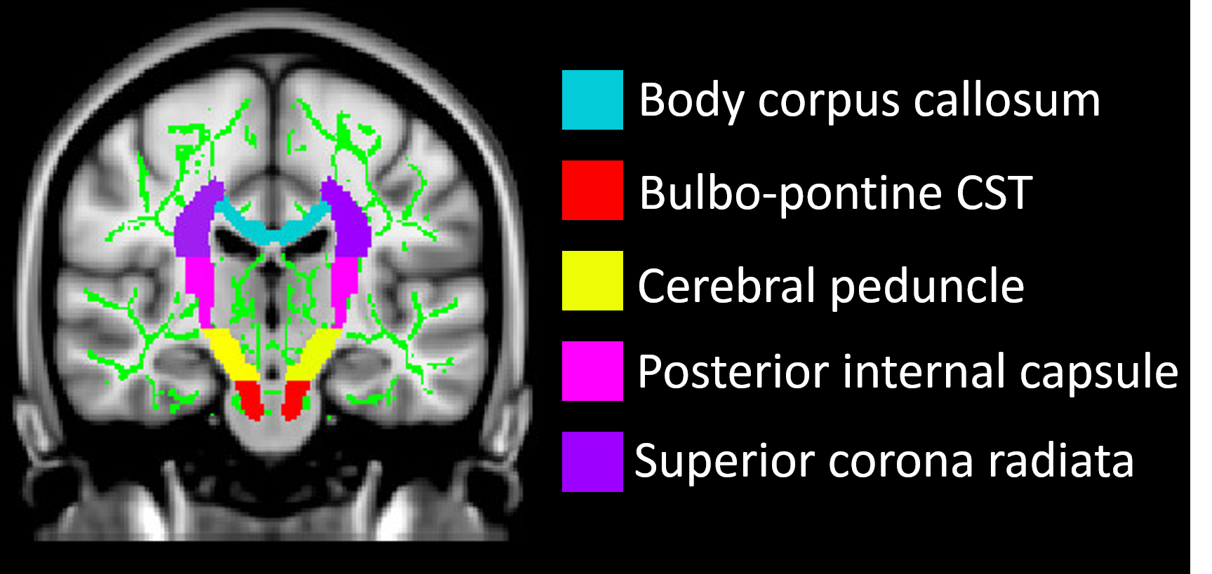
Supplementary figure 2. Regions of interest (ROIs) selected from the Johns Hopkins University (JHU) white-matter tractography atlas, superimposed on the Montreal Neurological Institute (MNI) template (in the top left corner), and plots showing the longitudinal evolution of radD for each selected ROI over follow-up time from baseline, together with the corresponding nonlinear mixed-effects model. Individual radD values are represented in grey for male patients and in orange for female patients, whereas the curves represent the estimated models by varying the values of some covariates in the model. When not specified, the covariates were set equal to the median value. Abbreviations: CC= corpus callosum; CST= corticospinal tract; DT= diffusion tensor; radD = radial diffusivity; ROI= region of interest; WM= white matter.

