Slide 1

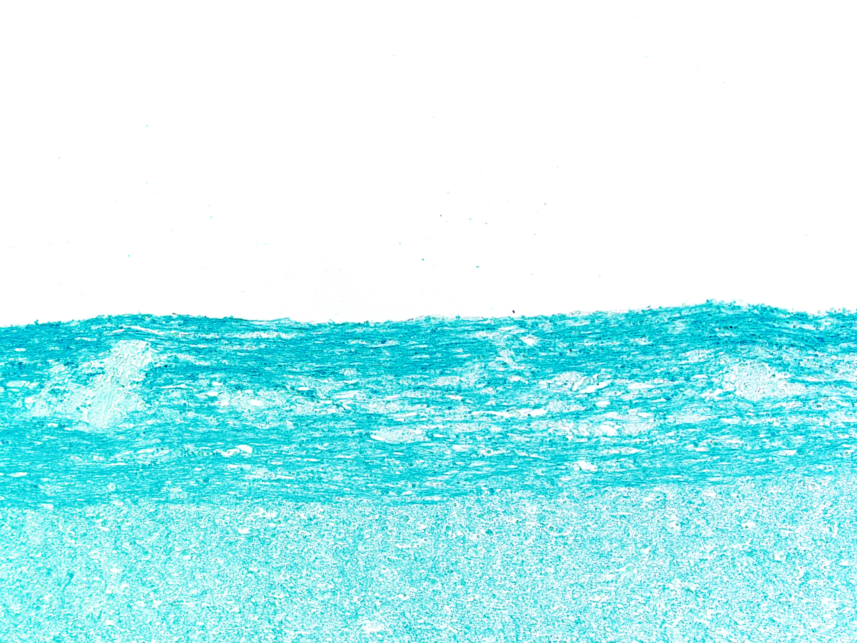

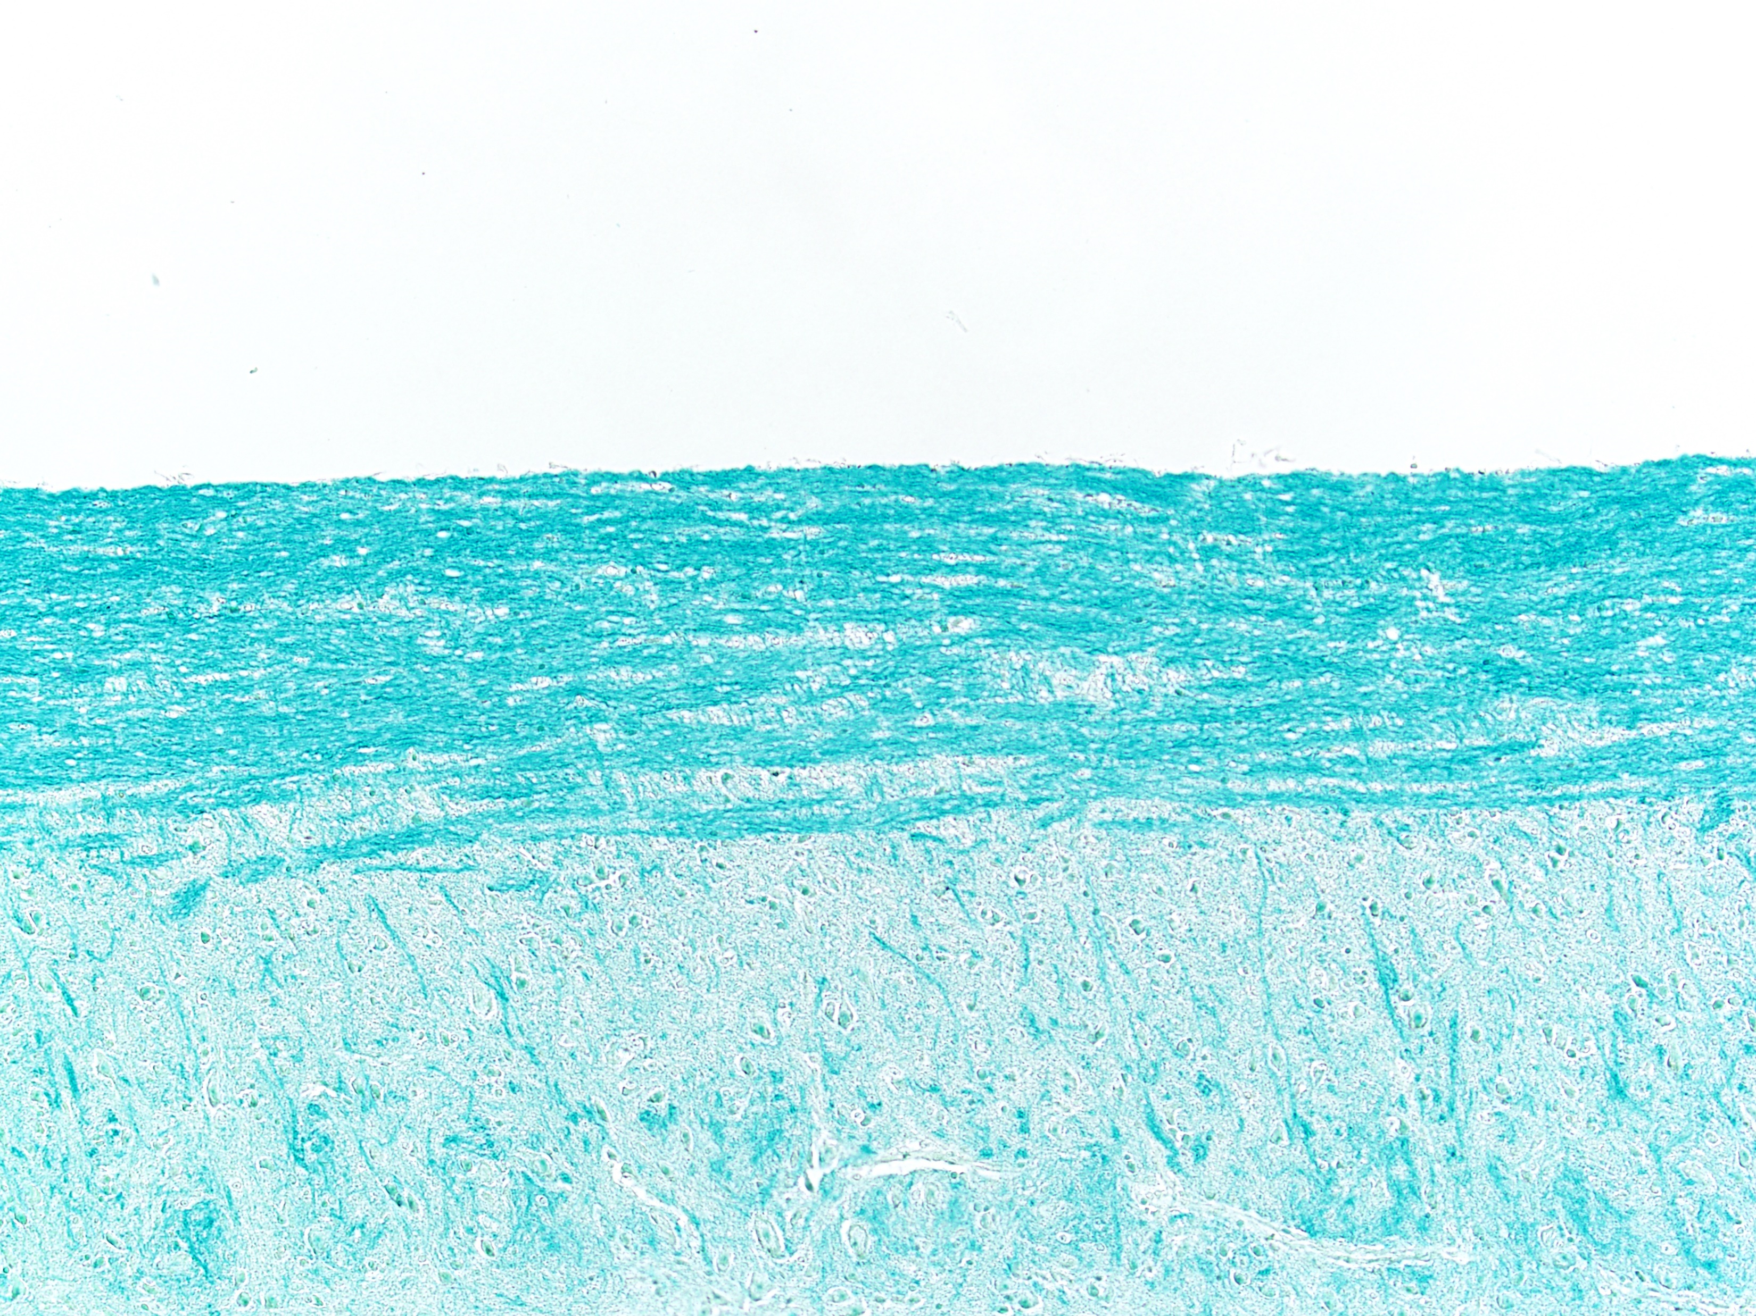
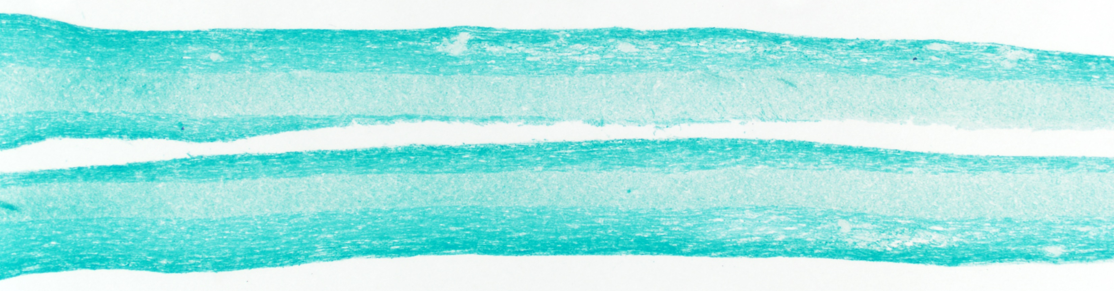
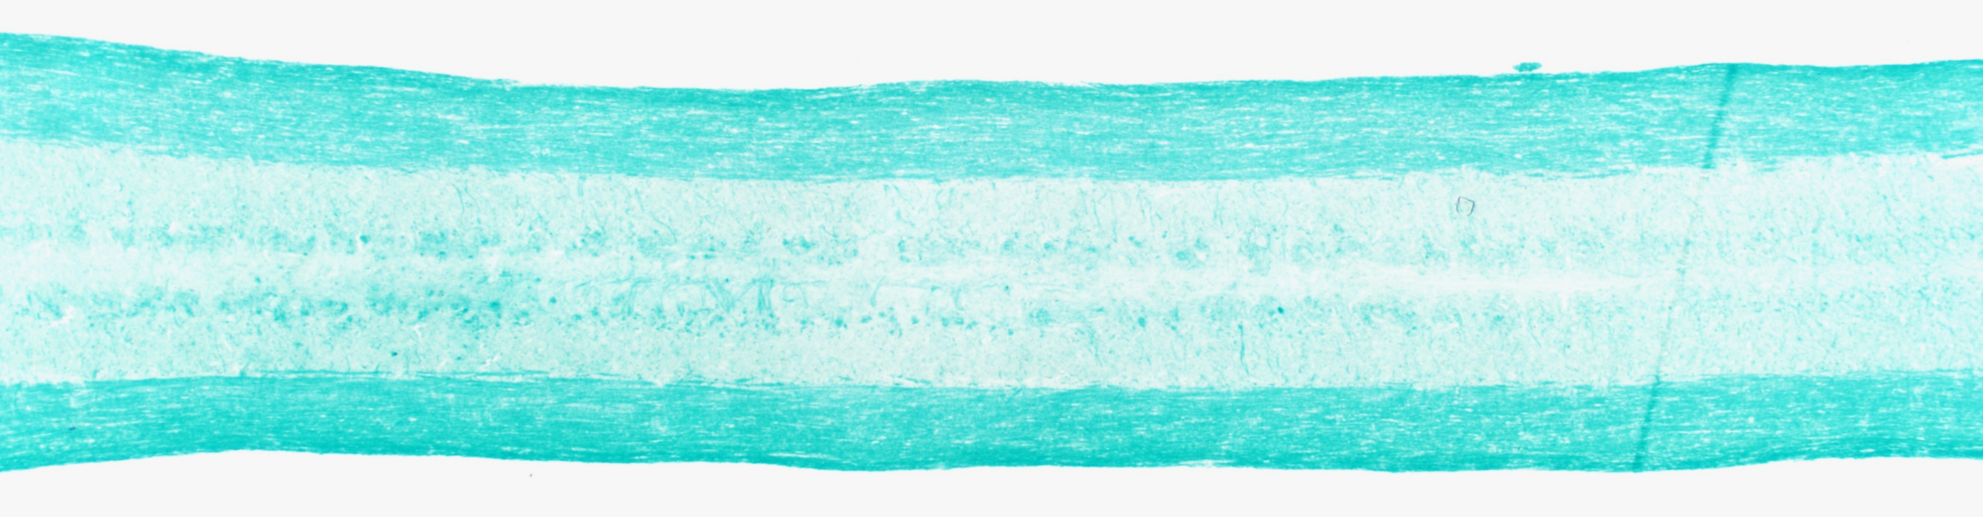
A
B
C
MOG₃₅₋₅₅ peptide in CFA
5
P<0.01
140
P<0.01
s.c.
4
130
3
120
B6
Disease score
110
PTGDR^{-/-}
D0 D2
2
% original weight
4-5wk B6/PTGDR^{-/-}
i.v.
100
Pertussis toxin
1
90
0
0
10
20
30
40
80
0
10
20
30
40
E
Day 10, 10×
Day 20, 10×
Days post immunization
Day 20, 10×
D
Days post immunization
WM
Day 10, 10×
WM
*
WM
WM
GM
100
GM
*
*
GM
*
80
GM
60
WM
% survival
Day 20, 2×
Day 20, 2×
GM
WM
GM
40
P<0.05
20
0
0
10
20
30
40
F
B6
G
PTGDR^{-/-}
Day 20
Days post immunization
*
B6
*
2
50
PTGDR^{-/-}
12
*
40
*
9
30
*
Cell number/SC×10⁶
6
% demyelination
1
Cell number/SC×10⁶
20
1.0
10
0.5
0
10
20
0
Microglia
Activated microglia
0.0
PMN
CD3
NK
Treg
B
Days post immunization
MΦ
Figure 1. PTGDR^{-/-} mice exhibit resistance to EAE induced by active immunization.

Slide 2
A
B6-CD3
*
PTGDR^{-/-}-CD3
B6-CD4
PTGDR^{-/-}-CD4
B6-CD8
PTGDR^{-/-}-CD8
3.0
*
*
3.0
3.0
2.0
2.0
*
*
2.0
*
LNs
Cell number×10⁶
*
*
1.0
1.0
1.0
0
0
10
15
20
30
40
70
0
0
10
15
20
30
40
70
0
0
10
15
20
30
40
70
8.0
*
8.0
8.0
6.0
*
*
*
6.0
*
6.0
CNS
Cell number×10⁶
4.0
4.0
4.0
*
*
2.0
2.0
2.0
0
10
15
20
30
40
70
0
0
10
15
20
30
40
70
0
0
10
15
20
30
40
70
B
Days post immunization
LNs
*
6
n.s.
0.06
*
B6
B6-EAE
*
PTGDR^{-/-}
4
n.s.
n.s.
0.04
*
*
PTGDR^{-/-}-EAE
% of CD4 T cells
n.s.
n.s.
2
CD4 T cell number×10⁶
n.s.
0.02
0
IL-2
IFN-γ
IL-17A
IL-17F
TNF
0
IL-2
IFN-γ
IL-17A
IL-17F
TNF
C
CNS (Brain+SC)
D
Brain
B6
PTGDR^{-/-}
15
0.3
B6
5
9.8
2.1
5
10.2
1.7
PTGDR^{-/-}
10
10
10
0.2
4
4
10
10
IFN-γ
3
% of CD4 T cells
CD4 T cell ×10⁶
3
10
10
0.8
0.9
5
0.1
2
2
10
10
0
2
0
2
0
-10
3
4
5
-10
3
4
5
0
IFN-γ
IL-17A
IL-17F
0
10
10
10
0
10
10
10
IFN-γ
IL-17A
IL-17F
IL-2
15
SC
5
1.2
1.7
5
0.4
1.5
0.3
10
10
4
4
10
10
10
IL-17F
0.2
3
3
% of CD4 T cells
CD4 T cell ×10⁶
10
10
5
0.1
2
0.9
0.6
10
2
0
10
2
0
2
-10
0
3
4
5
3
4
5
10
10
10
0
10
10
10
0
0
E
IL-17A
F
IFN-γ
IL-17A
IL-17F
IFN-γ
IL-17A
IL-17F
Evans blue
0.15
n.s.
Untreated
4-5wk B6/PTGDR^{-/-}
i.v.
0.10
Pertussis toxin
D0 D2 D5 D7 D10
OD630
0.05
i.v.
Pertussis toxin
0.00
B6
PTGDR^{-/-}
Figure 2. Dynamics and function of T cells.

Slide 3
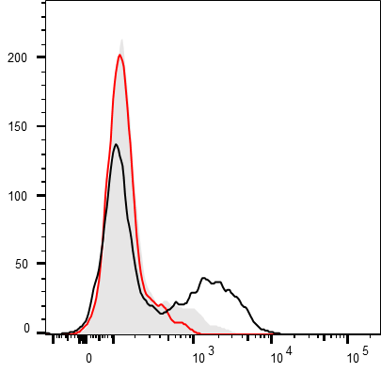
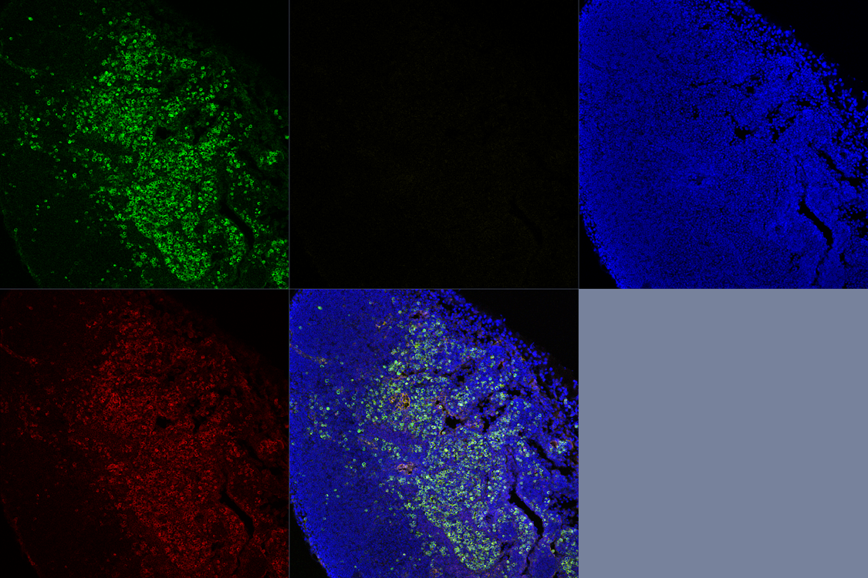
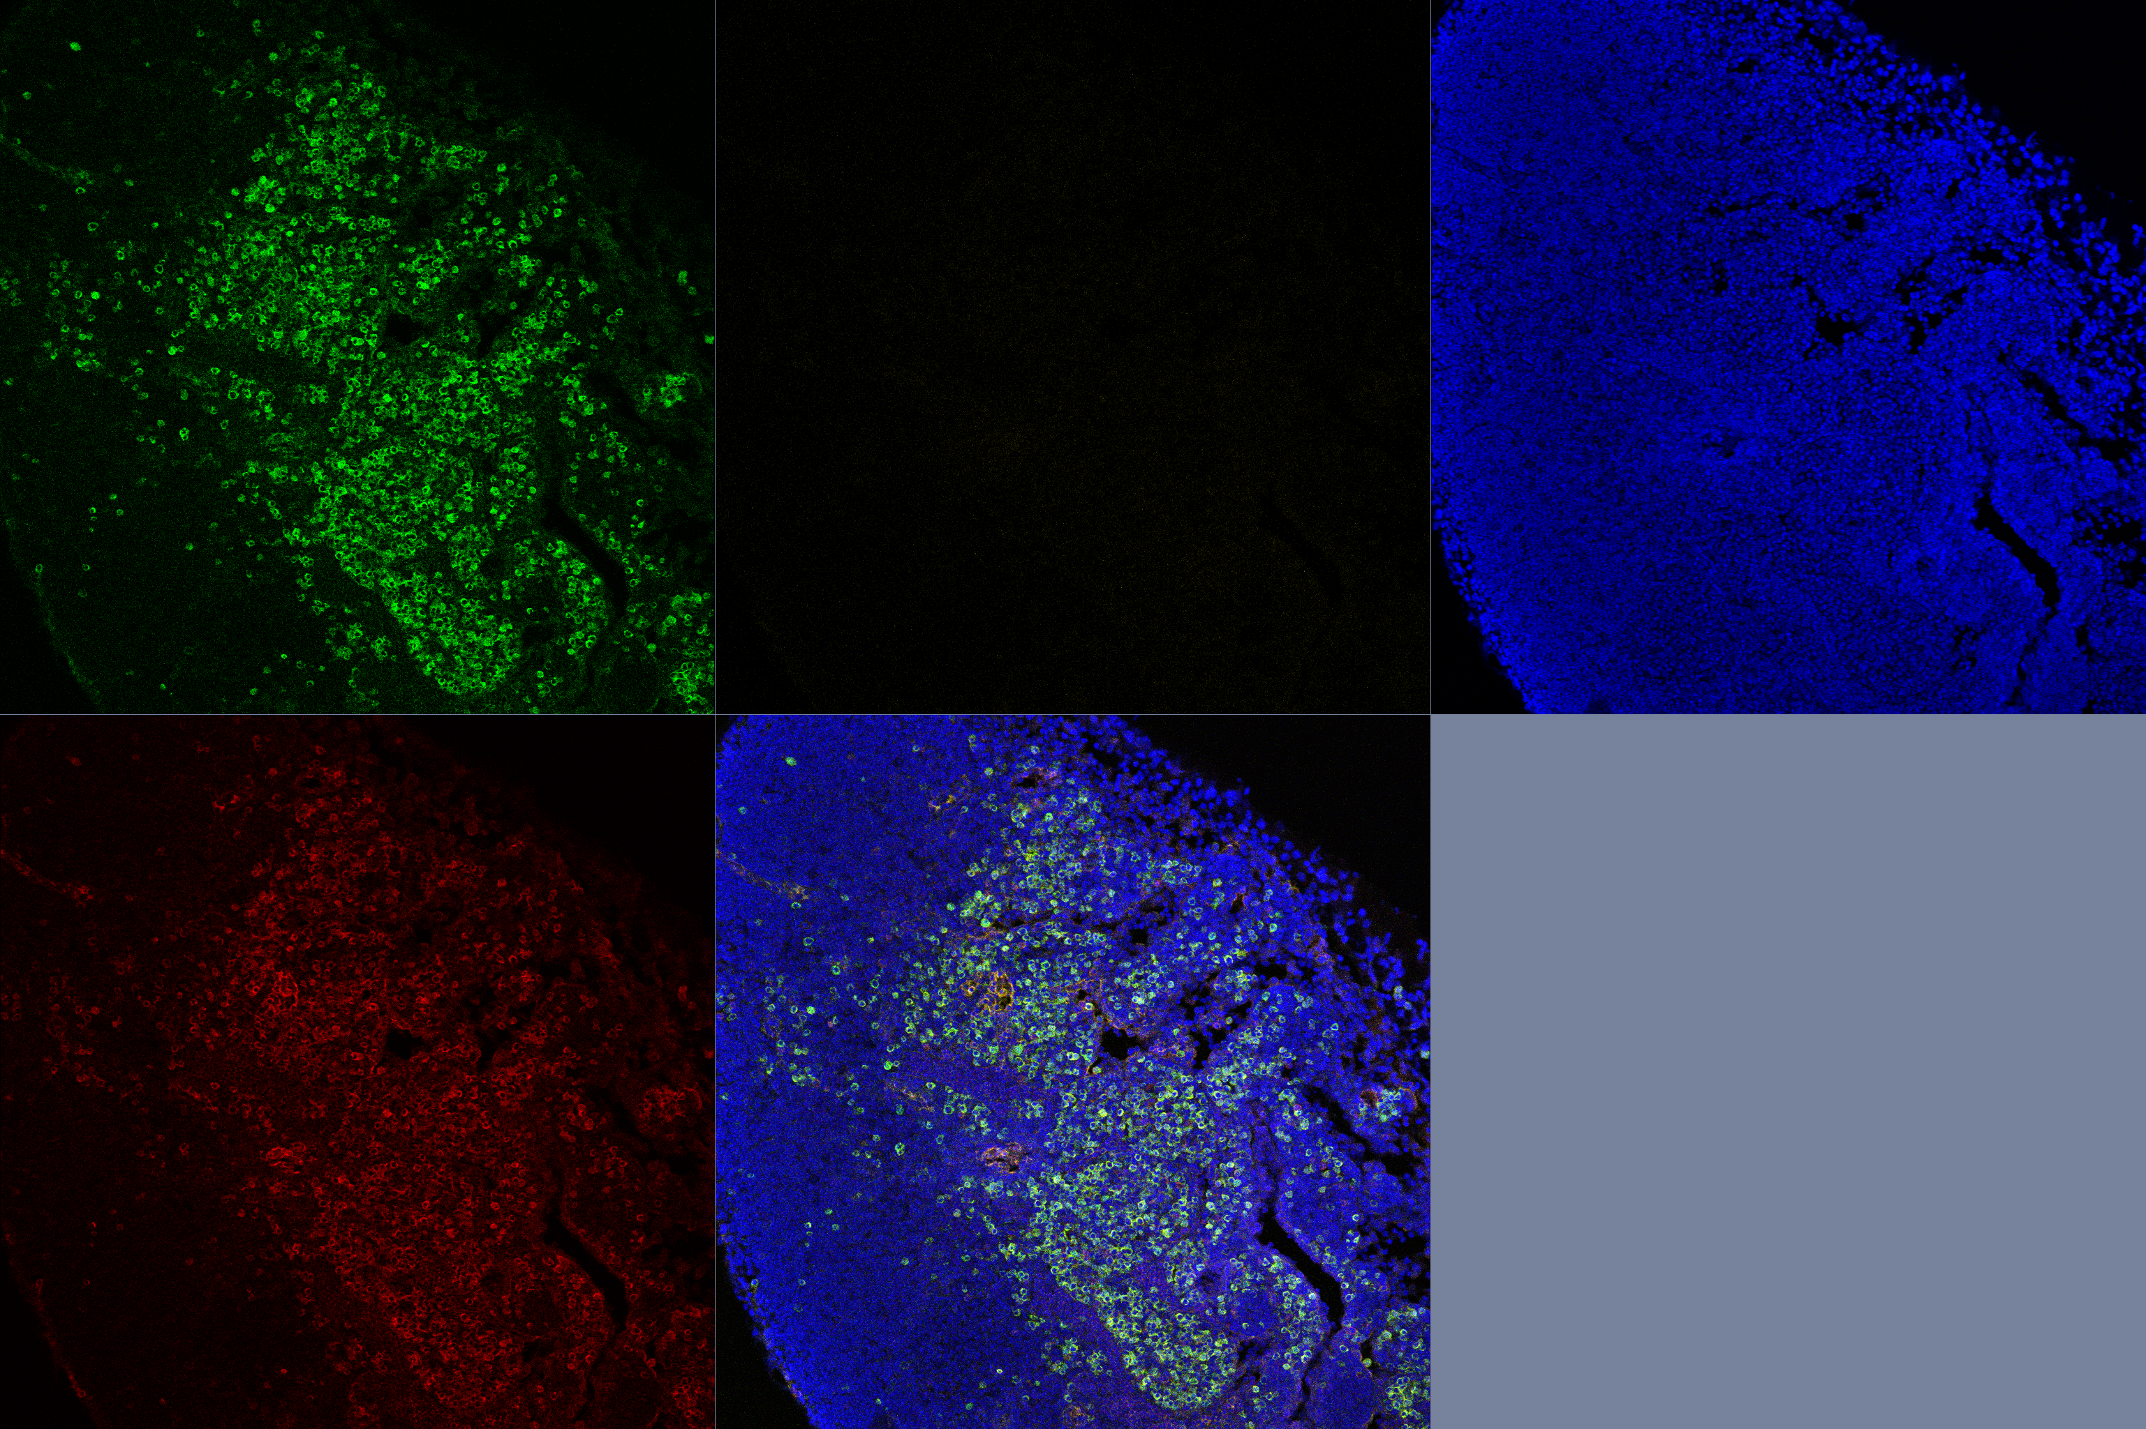
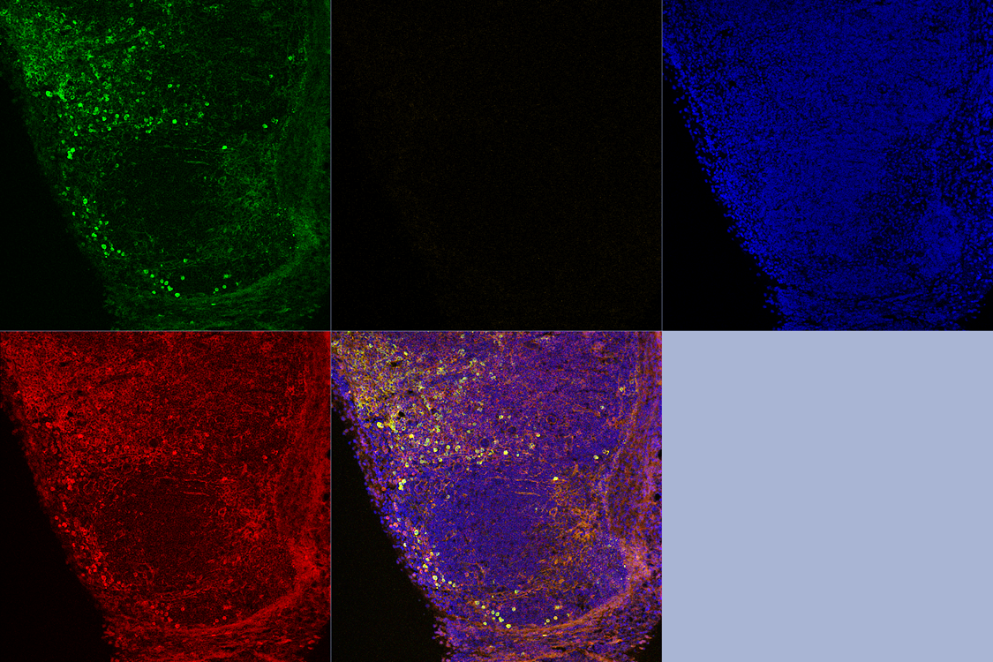
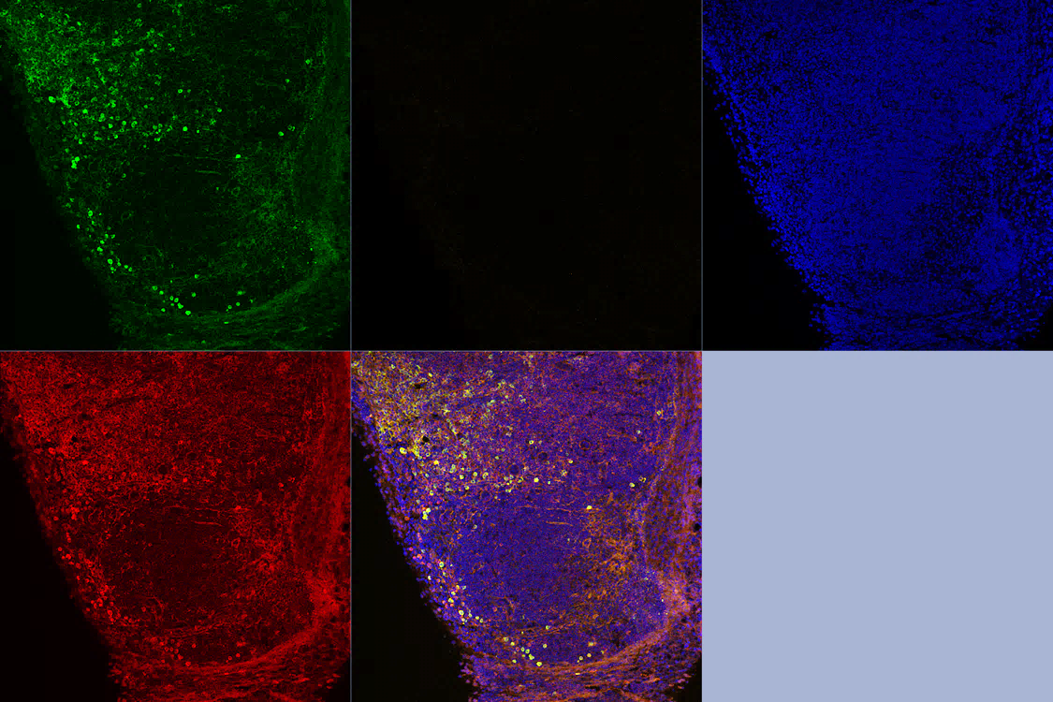
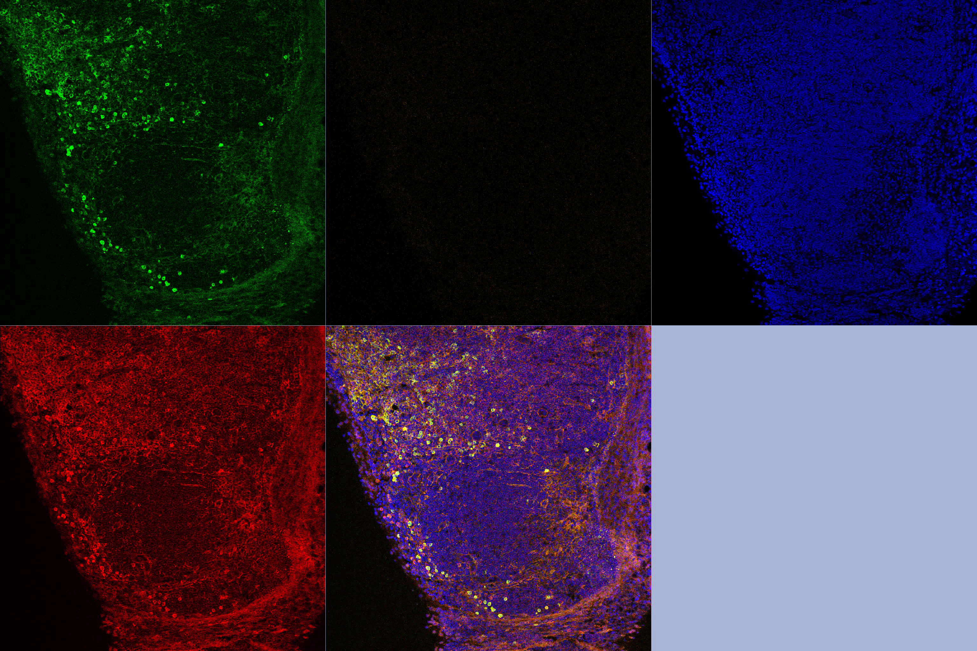
*
A
2.5
LN-CD4
*
LN-CD8
*
B6
2.0
*
2.5
PTGDR^{-/-}
MOG₃₅₋₅₅ peptide in CFA
*
2.0
s.c.
1.5
*
1.5
Cell number×10⁶
D0
1.0
1.0
4-5wk B6/PTGDR^{-/-}
0.5
0.5
0
0
5
10
0
0
5
10
B
Days post immunization
C
Days post immunization
B6
Isotype ctrl
DAPI
caspase-3
CD3
Merge
B6-CD3
PTGDR^{-/-}-CD3
caspase-3
*
caspase-3
PTGDR^{-/-}
30
CD4
*
CD8
*
DAPI
CD3
Merge
*
25
B6
20
20
PTGDR^{-/-}
% caspase-3+ cells
15
10
10
5
0
5
10
15
0
5
10
15
D
CD4
CD8
Days post immunization
4.73
5.27
4.2
7.7
*
CD4
CD8
0
10
5
10
5
40
*
40
B6
B6
4
PTGDR^{-/-}
10
4
10
30
30
3
10
3
20
20
10
% KLRG1+ cells
0
29.5
KLRG1
38.7
3
10
10
-10
3
-10
3
0
10
3
10
4
10
5
-10
-10
3
0
10
3
10
4
10
5
0
0
5
10
15
5
10
15
*
10
5
14.8
11.7
5
15.7
9.18
*
10
80
*
60
4
4
*
*
10
10
60
PTGDR^{-/-}
% BrdU+ cells
40
10
3
10
3
40
20
0
11.9
6.9
-10
3
-10
0
3
20
-10
3
0
10
3
10
4
10
5
-10
3
0
10
3
10
4
10
5
0
5
10
15
0
5
10
15
BrdU
Days post immunization
Figure 3. Activation-induced apoptosis of T cells in LN of PTGDR^{-/-} mice at early times after immunization.

Slide 4
A
MOG₃₅₋₅₅ peptide in CFA
Splenocytes
MOG₃₅₋₅₅
IL-1α+IL-23+α-IFN-γ 96h
Th17 CD4 T cells
s.c.
i.p.
4-5wk B6/PTGDR^{-/-}
D0 D10
4-5wk B6/PTGDR^{-/-}
B
Recipient-B6
5
Recipient-PTGDR^{-/-}
B6→PTGDR^{-/-}
5
B6→B6
PTGDR^{-/-}→PTGDR^{-/-}
4
PTGDR^{-/-}→B6
4
3
3
Disease score
Disease score
2
P<0.001
2
1
1
0
0
5
10
15
0
0
5
10
15
C
Days post transfer
Days post transfer
2.5
Recipient-B6
B6→B6
2.5
Recipient-PTGDR^{-/-}
B6→PTGDR^{-/-}
2.0
P<0.01
PTGDR^{-/-}→B6
2.0
PTGDR^{-/-}→PTGDR^{-/-}
1.5
1.5
Donor T cells×10⁴
Donor T cells×10⁴
1.0
1.0
0.5
0.5
0
0
3
6
9
12
0
0
3
6
9
12
Days post transfer
Days post transfer
Figure 4. PTGDR in recipient mice is required for development of EAE.

Slide 5
A
MOG₃₅₋₅₅ peptide in CFA
B
5
B6
CX3CR1-Cre
PTGDR^{flox} mice
s.c.
4
PTGDR^{-/-}
CX3CR1-PTGDR^{-/-}
3 wk CX3CR1-PTGDR^{-/-}
3
Disease score
D0 D2 D28
D28+0 D28+2
2
p.o.
i.v.
1
CX3CR1-Cre
Tamoxifen
Pertussis toxin
0
0
10
20
30
40
C
MOG₃₅₋₅₅ peptide in CFA
D
B6
Days post immunization
PTGDR^{flox} mice
s.c.
5
PTGDR^{-/-}
B6 vs. LysM-PTGDR^{-/-}: n.s.
4
LysM-PTGDR^{-/-}
4-5 wk LymS-PTGDR^{-/-} or zDC-PTGDR^{-/-}
3
D0 D2
Disease score
i.v.
2
LysM-Cre or zDC-Cre
Pertussis toxin
1
0
0
10
20
30
40
E
B6
F
LNs
Days post immunization
CNS
5
PTGDR^{-/-}
*
*
4.0
2.0
*
*
*
*
*
4
zDC-PTGDR^{-/-}
*
*
3
B6 vs. DC-PTGDR^{-/-} p<0.01
1.5
3.0
*
*
Disease score
CD4 T cells×10⁶
CD4 T cells×10⁶
2
1.0
2.0
1
0.5
1.0
0
0
10
20
30
40
0
0
10
15
20
30
0
0
10
15
20
30
Days post immunization
Days post immunization
Days post immunization
Figure 5. Conditional deletion of PTGDR in DCs, but not CX3CR1⁺ or LysM⁺ cells reduced severity of EAE.

Slide 6
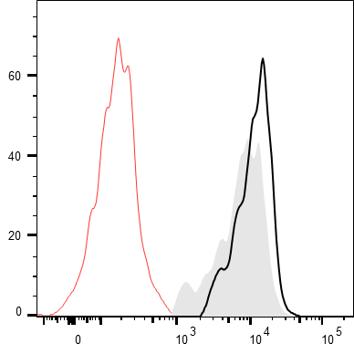
A
B
DC-immunized model
MOG₃₅₋₅₅
5
B6→B6
5
B6→PTGDR^{-/-}
4
PTGDR^{-/-}→B6
4
PTGDR^{-/-}→PTGDR^{-/-}
DC
i.v.
3
P<0.001
3
4-5wk B6/PTGDR^{-/-}
Disease score
Disease score
P<0.05
2
2
4-5wk B6/PTGDR^{-/-}
D0 D2 D5
1
1
i.v.
0
0
10
20
30
0
0
10
20
30
Pertussis toxin
Days post immunization
Days post immunization
C
Isotype ctrl
D
*
*
E
*
*
2.0
*
B6
B6-DC
60
n.s.
8.0
PTGDR^{-/-}
PTGDR^{-/-}-DC
CD4
6.0
1.5
40
CD8
CD4 T cells×10⁴
1.0
% PD1+ Tcells
4.0
IL17F+ CD4 T cells×10⁴
20
2.0
0.5
F
PD-L1
0
B6
PTGDR^{-/-}
0
ctrl
α-PD-1
0
ctrl
α-PD1
G
6
MOG₃₅₋₅₅ peptide in CFA
α-PD-1
5
B6-ctrl
s.c.
i.p.
B6-α-PD-1
4
PTGDR^{-/-}-ctrl
3
PTGDR^{-/-}-α-PD-1
D0 D2 D3 D6 D9
2
4-5wk B6/PTGDR^{-/-}
Disease score
P<0.05
i.v.
1
Pertussis toxin
0
0
5
10
15
20
25
30
Days post immunization
*
H
LN
0.4
I
CNS
0.20
*
4.0
*
0.3
*
3.0
*
*
0.15
*
3.0
*
Cytokine-expressing
CD4 T cell×10⁶
2.0
*
Cytokine-expressing
CD4 T cell×10⁶
CD4 T cell×10⁶
0.2
*
0.10
2.0
CD4 T cells×10⁶
1.0
0.1
1.0
0.05
0
0
10
15
20
30
0
IFN-γ
IL-17F
0
0
10
15
20
30
0
IFN-γ
IL-17F
J
Days post immunization
Days post immunization
DC-treated model
K
B6
L
*
*
MOG₃₅₋₅₅-DC
5
B6-DC
20
MOG₃₅₋₅₅ peptide in CFA
4
PTGDR^{-/-}-DC
15
s.c.
i.v.
3
10
Disease score
% caspase3+ cells
4-5wk B6
D0 D2 D9 D12 D15
2
5
i.v.
1
Pertussis toxin
0
0
10
20
30
0
CD4
CD8
Days post immunization
Figure 6. PTGDR^{-/-} DC ameliorates EAE by decreasing MOG₃₅₋₅₅-specific T cell response via enhanced PD-1 signaling.

Slide 7
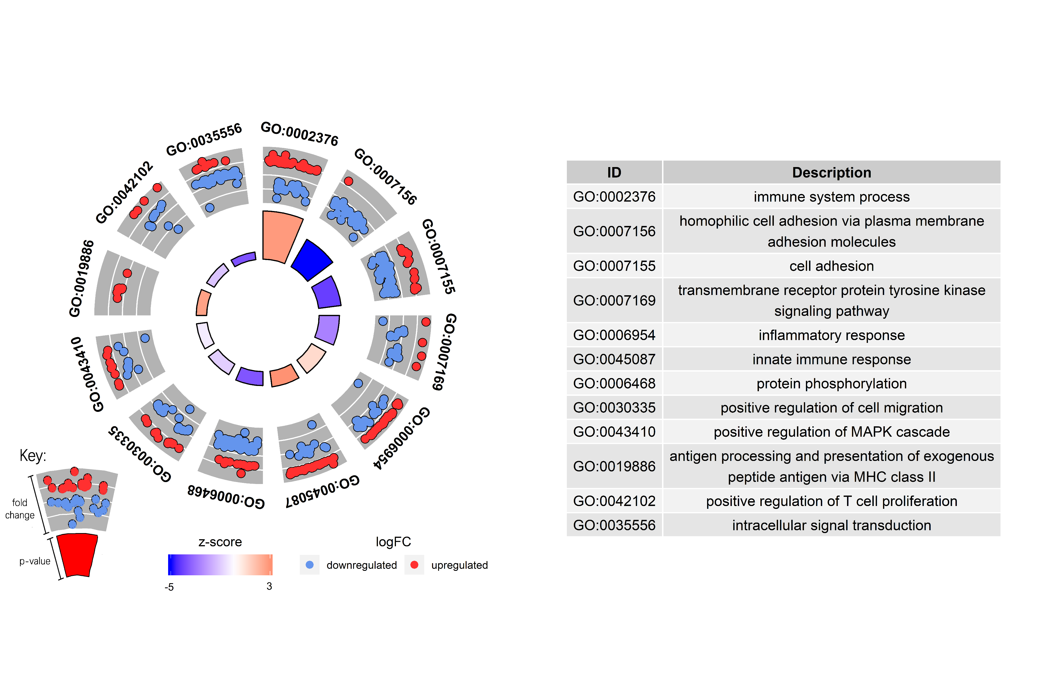
A
B6
PTGDR^{-/-}
B
Pydc3
C
P=1.36E-16
D
*
E
MOG₃₅₋₅₅ peptide in CFA
5
25
B6
s.c.
4
P=0.077
20
PTGDR^{-/-}
D0 D1 D2 D3 D4 D5
3
15
4-5wk B6/PTGDR^{-/-}
Fold of change (log10)
% of DC
i.v.
2
10
Pertussis toxin
1
5
i.p.
0
Pydc3
IL-1β
IL-6
IL-10
IL-12
TNF
0
IL-1β
IL-6
IL-10
IL-12
TNF
Anakinra
F
B6-ctrl
n.s.
G
LNs
B6-ctrl
CNS
*
*
6
B6-Anakinra
*
*
3.0
B6-Anakinra
*
*
PTGDR^{-/-}-ctrl
P<0.05
2.0
*
*
PTGDR^{-/-}-ctrl
5
PTGDR^{-/-}-Anakinra
1.5
2.0
PTGDR^{-/-}-Anakinra
4
CD4 T cells×10⁶
3
1.0
Disease score
1.0
2
0.5
1
0
0
0
0
3
6
9
12
15
18
21
24
27
30
33
0
10
15
20
30
0
10
15
20
30
Days post immunization
Days post immunization
*
Days post immunization
H
I
Ctrl plasmid
CRISPR-Cas9
Ctrl plasmid/
PTGDR-KO plasmid
25
PTGDR-KO plasmid
20
*
LPS
15
*
14d culture
72h culture
Expression relative to HPRT
Human PBMC
MDDCs
10
5
0
PTGDR
IL-1β
IL-6
IL-10
IL-12
TNF
Figure 7. Increased IL-1β in PTGDR-deficient DCs contribute to resistance of PTGDR^{-/-} mice to EAE.

