Slide 1





Rationale and Design of the Quantification of Myocardial Blood Flow using Dynamic PET/CTA Fused Imagery (DEMYSTIFY) to Determine Physiological Significance of Specific Coronary Lesions
Journal of Nuclear Cardiology | Official Journal of the American Society of Nuclear Cardiology
Ahmed AlBadri, MD*¹; Marina Piccinelli, PhD*²; Sang-Geon Cho, MD³; Joo Myung Lee, MD, PhD⁴, Wissam Jaber MD¹, Carlo N De Cecco MD, PhD², Habib Samady, MD¹; Bon-Kwon Koo, MD, PhD⁵; Hee-Seung Bom, MD, PhD³, Ernest V Garcia, PhD²
¹Division of Cardiology, Department of Medicine, ²Department of Radiology and Imaging Sciences, Emory University School of Medicine, Atlanta, GA; ³Department of Nuclear Medicine, Chonnam National University, Gwangju, Korea; ⁴Heart Vascular Stroke Institute, Samsung Medical Center, Seoul, Korea; ⁵Department of Internal Medicine and Cardiovascular Center, Seoul National University Hospital, Seoul, Korea. *contributed equally to the manuscript
Copyright American Society of Nuclear Cardiology

Slide 2
BACKGROUND
Journal of Nuclear Cardiology | Official Journal of the American Society of Nuclear Cardiology
1- Coronary physiology assessments have been shown by multiple trials to add clinical value in detecting significant coronary artery disease and predicting cardiovascular outcomes.
2- FFR obtained during invasive coronary angiography (ICA) has become the new reference standard for hemodynamic significance detection.
3- Absolute MBF quantification by means of dynamic PET has high diagnostic and prognostic values.
4- FFR is an invasive measure and as such cannot be applied broadly.
5- MBF quantification is commonly performed on standard vascular territories intermixing normal flow from normal regions with abnormal flow from abnormal regions and consequently limiting its diagnostic power.
6- Objective: to provide physicians with reliable software tools for the non-invasive assessment of lesion-specific physiological significance for the entire coronary tree by combining PET-derived absolute flow data and CTA-derived anatomy and coronary centerlines.
Copyright American Society of Nuclear Cardiology

Slide 3
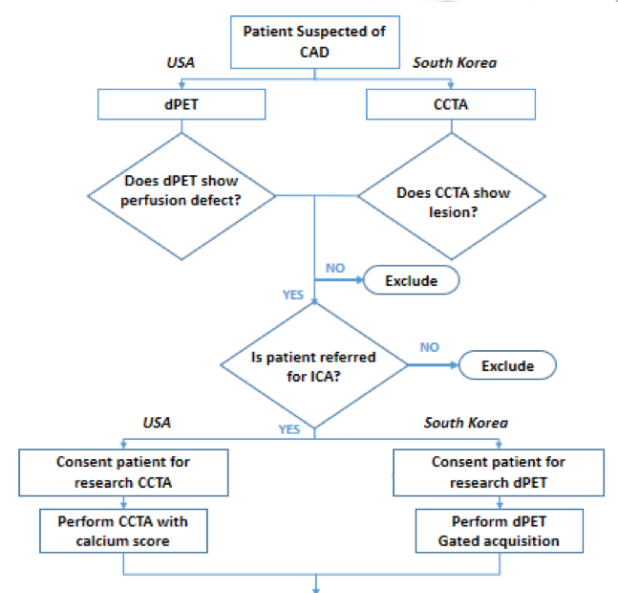
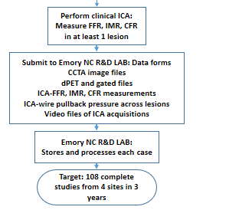
Methods 1 – Study flow chart detailing patient enrollment in US and South Korea
Journal of Nuclear Cardiology | Official Journal of the American Society of Nuclear Cardiology
Copyright American Society of Nuclear Cardiology

Slide 4
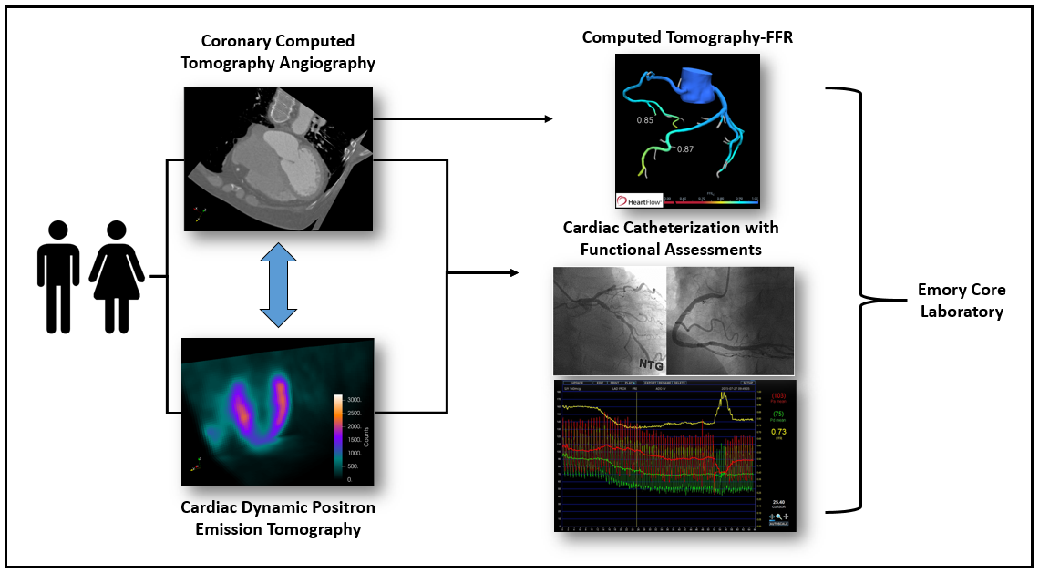
Methods 2- . Imaging data and functional assessments collected per patient in the DEMYSTIFY study.
Journal of Nuclear Cardiology | Official Journal of the American Society of Nuclear Cardiology
Copyright American Society of Nuclear Cardiology

Slide 5
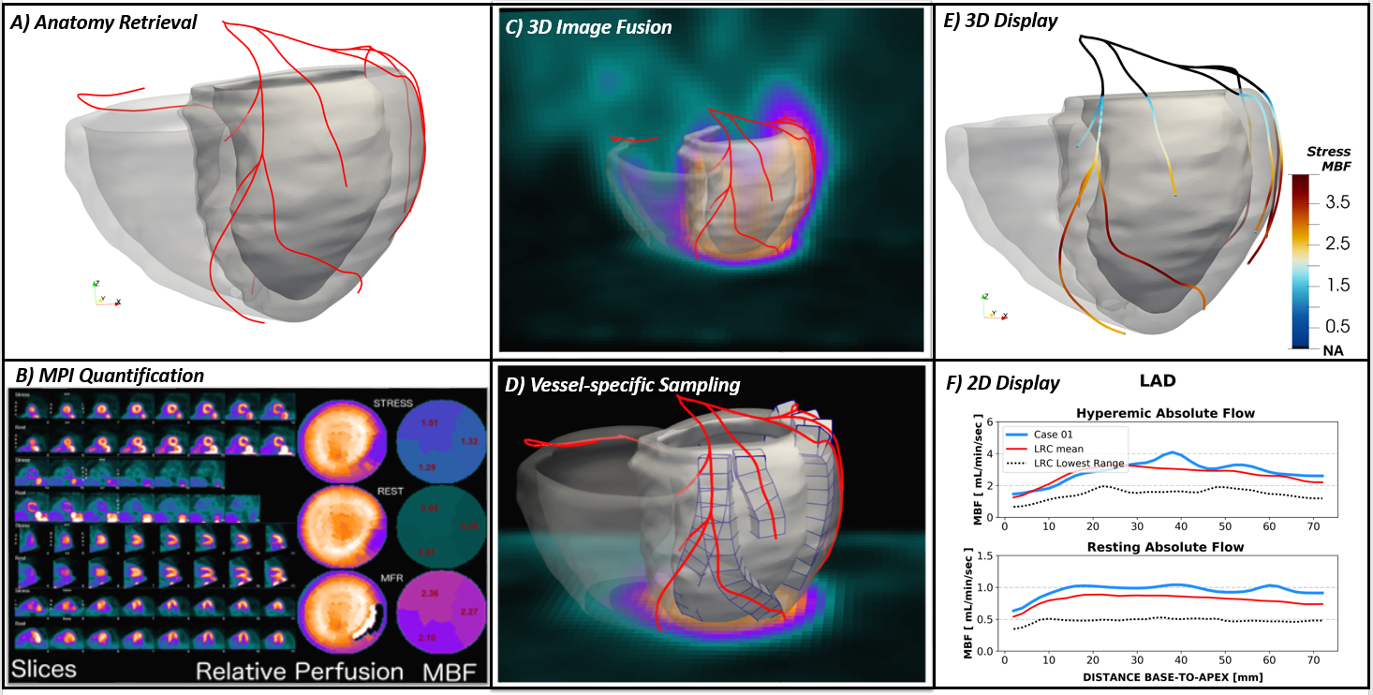
Methods 3 - Image Processing, Fusion Procedure and 3D Modeling.
Journal of Nuclear Cardiology | Official Journal of the American Society of Nuclear Cardiology
A) Coronary computed tomography angiography (CTA)-derived anatomy in terms of biventricular myocardium and coronary centerlines; B) Standard MPI quantification include polar maps of relative perfusion assessment, polar maps of rest/stress myocardial blood flow (MBF) [mL/min/g] and myocardial flow reserve (MFR) on standard vascular territories; C) Fusion display showing the CTA-derived anatomy superimposed to the MPI; D) identification of volumes of interest along the specific 3-dimensional trajectories of coronary arteries. Creation of column of contiguous volumetric elements within the CTA-derived myocardium along each vessel; E) 3-dimensional display of CTA-derived anatomy with the coronary centerlines color-coded with the computed vessel-specific hyperemic MBF; F) 2-dimensional plot of vessel-specific quantification of the left anterior descending artery (LAD) compared to normal ranges of MBF from base-to-apex.
Copyright American Society of Nuclear Cardiology

Slide 6
CONCLUSIONS & FUTURE DIRECTIONS
Journal of Nuclear Cardiology | Official Journal of the American Society of Nuclear Cardiology
1- PET flow measurements have been developed by others, but their single modality approaches are not lesion-specific, which is the main innovation of our fused dPET/CTA non-invasive approach.
2- We anticipate that this project will develop a non-invasive method to localize physiologically significant coronary lesions suitable for revascularization anywhere in the coronary tree.
3- We anticipate that our lesion-specific approach will be significantly more diagnostically accurate compared to a) the traditional database relative perfusion quantification and b) absolute MBF assessment that relies on generic vascular territories that will likely mix normal and abnormal vascular areas reducing the accuracy of the flow measurements.
4- Our main direction following the proposed dPET/CTA MBF methodology development and collection of the 108 complete dPET, CTA, and ICA patients’ imagery and required measurements is to prospectively validate the technique.
Copyright American Society of Nuclear Cardiology

