Slide 1
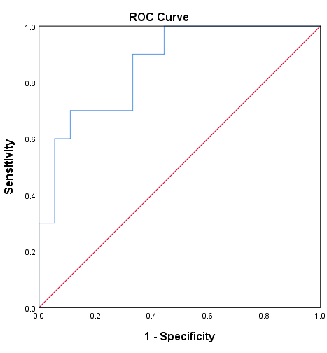
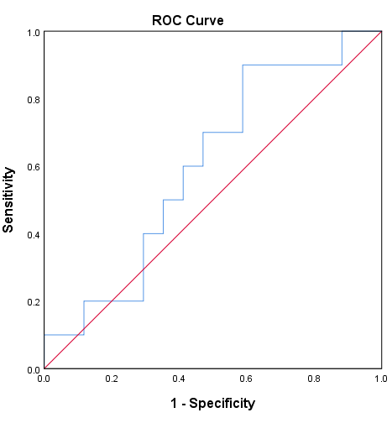
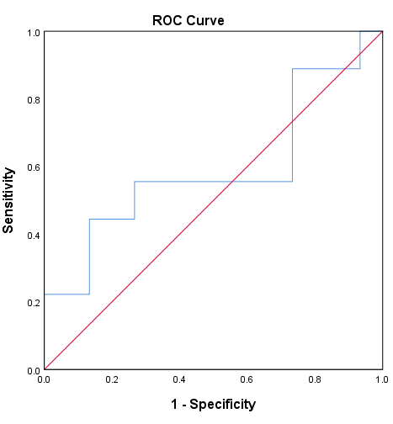
Circulating Proteomic Signature for Detection of Biomarkers in Bladder Cancer Patients
Taoufik Nedjadi, Hicham Benabdelkamal, Nada Albarakati, Afshan Masood, Ahmed Al-sayyad, Assim A. AlFadda, Ibrahim O. alanazi, Adel Al-Ammari and Jaudah Al-Maghrabi
A
B
C
AUC: 0.87, p=0.002
AUC: 0.68, p=0.39
AUC: 0.68, p= 0.45
Haptoglobin
Component C6
Ceruloplasmin
Supplementary figure 5.

