Slide 1

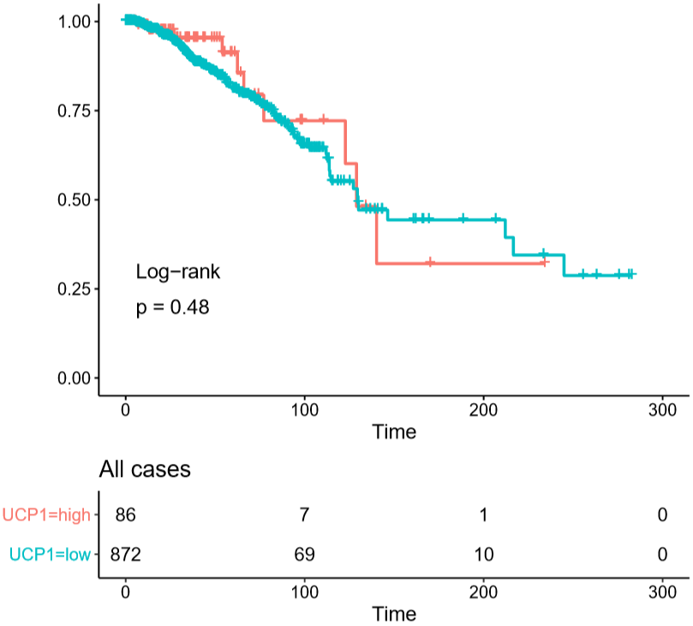
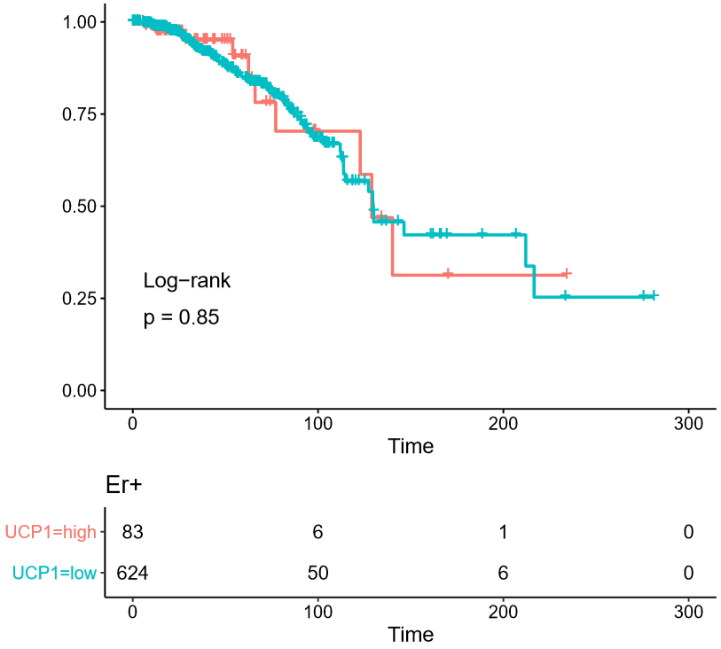
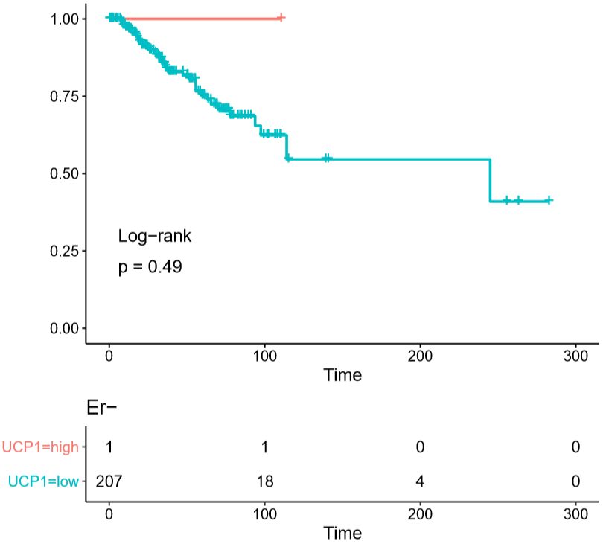
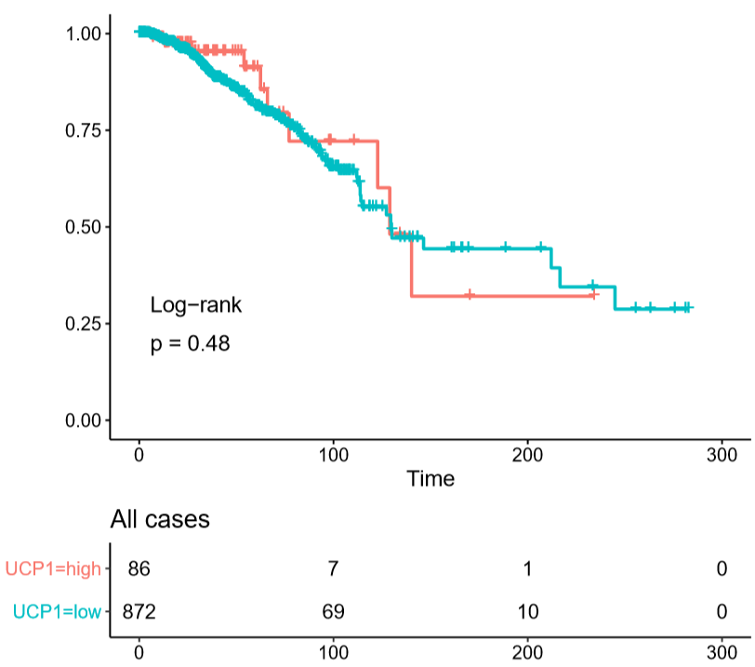
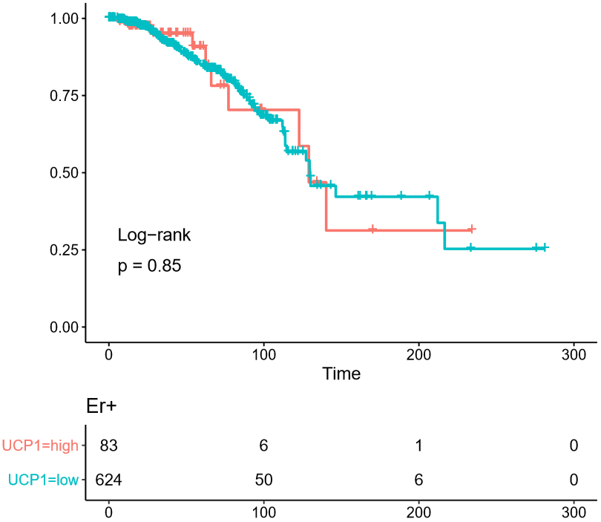
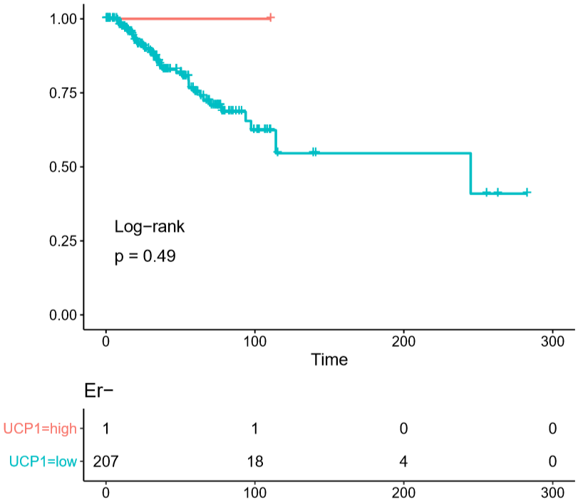
Fig. S6
a
All cases
ER+
ER-
Probability of survival
Time (months)
Time (months)
Time (months)
b
Time (months)
Time (months)
Time (months)
All cases
ER+
ER-
Probability of survival
Time (months)
Time (months)
Time (months)
Time (months)
Time (months)
Time (months)
a Association of UCP1 mRNA expression in tumors with overall survival assessed through the METABRIC breast cancer cohort. Kaplan meier estimates using all cases (left), ER-positive cases (middle), ER-negative (right) were shown. UCP1-high and low were defined by k-means clustering (k=2). b the same analyses through the TCGA breast cancer cohort.

