Slide 1
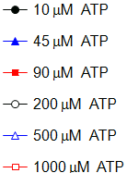
Supporting Figure S1.
A
B
C
JAK3 activity (% of control)
EC₅₀ (nM)
Activity (U/mg)
Tubulosine (nM)
ATP (μM)
ATP (μM)

Slide 2
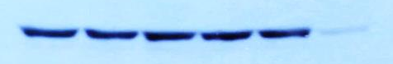
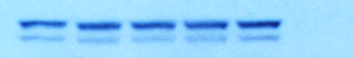
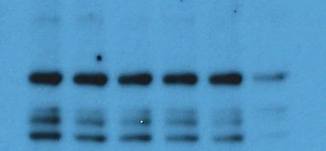
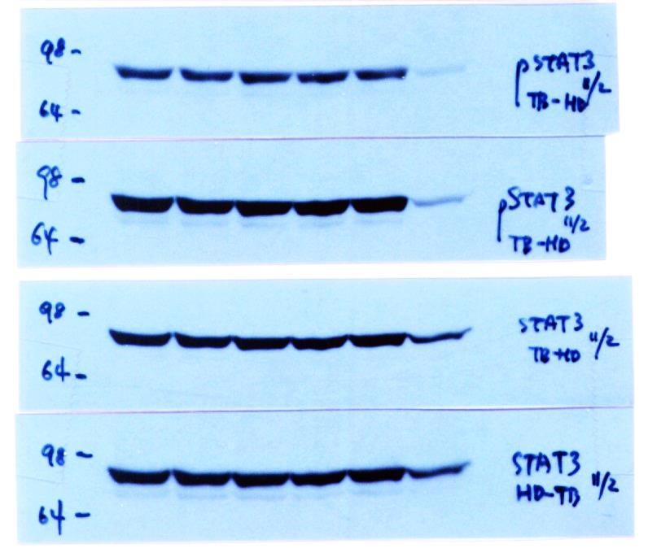

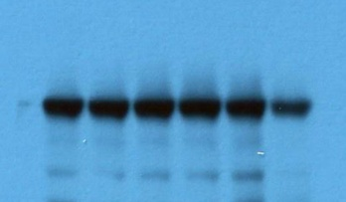


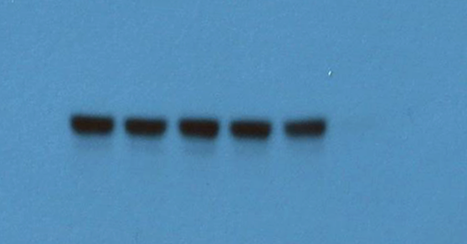


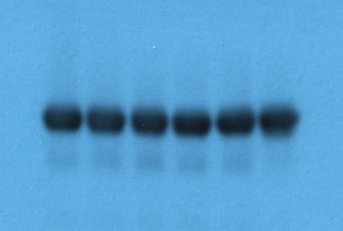


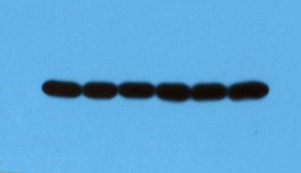








Supporting Figure S2.
A
B
Tubulosine
Tubulosine
Tubulosine
0
AG
0
AG
0
AG
pY-STAT3
pY-JAK2
STAT3
JAK2
pY-JAK1
pY-STAT5
JAK1
STAT5
pY-JAK2
GAPDH
JAK2
BaF3/TEL-JAK2
pY-JAK3
JAK3
GAPDH
HDLM-2
DU145

Slide 3














Supporting Figure S3.
A
B
Tubulosine (μM)
Tubulosine (μM)
0
0.1
0.2
0.4
0.6
0.8
1
AG
0
0.1
0.2
0.4
0.6
0.8
1
AG
pY-JAK1
pY-JAK2
JAK1
JAK2
pY-JAK2
pY-STAT5
JAK2
STAT5
pY-TYK2
GAPDH
TYK2
BaF3/TEL-JAK2
pY-STAT3
STAT3
GAPDH
HDLM-2

