Slide 1
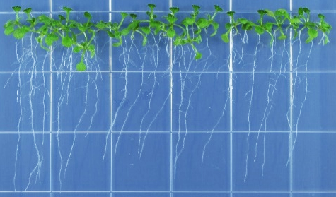
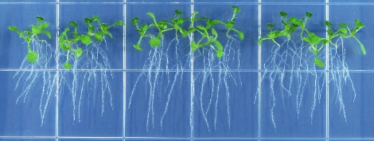
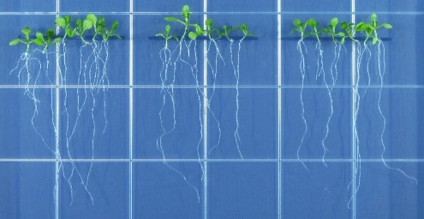
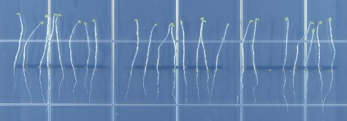
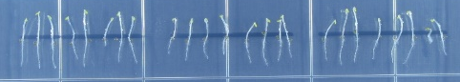
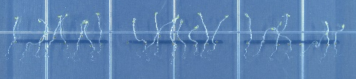
Supplemental Fig. S1
A
B
C
WT
abci19/20/21-1
abci19/20/21-2
WT
abci19/20/21-1
abci19/20/21-2
WT
abci19/20/21-1
abci19/20/21-2
0.2 µM IAA
½ MS
1 µM ABA
D
E
WT
abci19/20/21-1
F
G
WT
abci19/20/21-1
abci19/20/21-2
abci19/20/21-2
WT
abci19/20/21-1
abci19/20/21-2
1 µM ACC
100 nM BL
½ MS
Supplemental Figure S1. Seedling growth of abci19 abci20 abci21 mutants did not differ from that of the wild type upon treatment with IAA, ABA, GA, ACC, or BR.
(a-c) The wild type (WT) and abci19 abci20 abci21 mutants were germinated and grown on ½ MS-agar medium (a), 0.2 µM IAA-containing (b), or 1 µM ABA-containing (c) ½ MS-agar medium for 12 days. Scale bar = 1 cm.
(d) Seed germination of WT and abci19 abci20 abci21 observed on ½ MS-agar media supplemented or not with 1 µM GA. Data (mean values ±SD) of a representative experiment are given (n=3).
(e-g) WT and abci19 abci20 abci21 were grown on ½ MS-agar medium (e) or ½ MS-agar media supplemented with 1 µM ACC (f) or 100 nM brassinolide (BL, g) for 5 days under darkness. Scale bar = 1 cm.

Slide 2
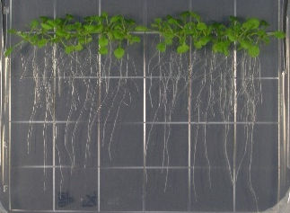
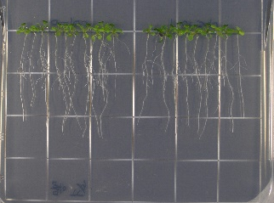
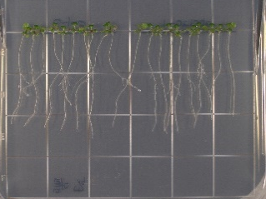
Supplemental Fig. S2
WT
abci20-1
WT
abci20-1
WT
abci20-1
½ MS
20 nM tZ
0.1 µM tZ
Supplemental Figure S2. abci20 single knockout mutant did not exhibit altered cytokinin sensitivity during seedling growth.
The wild type (WT) and abci20 knockout mutant (abci20-1) were grown in the absence or presence of cytokinin (20 nM and 0.1 µM tZ). Scale bar = 1cm.

Slide 3
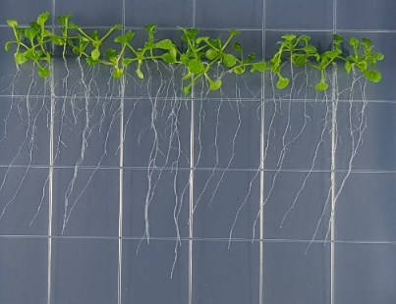
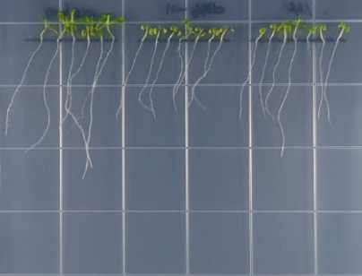
Supplemental Fig. S3
A
WT
abci20-1/21
abci20-2/21
WT
abci20-1/21
abci20-2/21
B
½ MS
C
0.1 µM tZ
D
*
*
*
*
*
E experiment in progress

Slide 4
Supplemental Figure S3. Enhanced cytokinin sensitivity of abci20 abci21 mutants.
(a) Twelve-day-old seedlings grown on ½ MS-agar plates without (½ MS) or with 0.1 µM tZ supplementation. Scale bar = 1 cm.
(b, c) Total shoot fresh weight per plate (b) and the primary root length (c) quantified from 12-day-old seedlings. Combined data of three independent experiments (7 biological replicates) are presented. Asterisks indicate statistically significant differences from the wild type (WT) value (*; p < 0.03, Student’s t test).
(d) Number of cortical cells in root apical meristem (RAM) counted from root tip images of 8-day-old seedlings. Representative data (mean values ±SD) are given (n=3). Asterisks indicate statistically significant differences (*; p < 0.03, Student’s t test).
(e) Comparison of seedling growth between abci20 abci21 (abci20-1/21) and abci19 abci20 abci21 (abci19/20/21-1) in the absence or presence of 20 nM tZ. Values of shoot fresh weight and primary root length were normalized by those of WT grown on ½ MS-agar. Combined data (mean values ±SD) of two independent experiments (6 biological replicates) are given. Asterisks indicate statistically significant differences from WT under each condition (*; p < 0.05, Student’s t test).

Slide 5
Supplemental Fig. S4
Bright field
YFP-ABCI20
BiP-RFP
Merge
Supplemental Figure S4. ER localization of ABCI20.
YFP-AtABCI20 and BiP-RFP (ER marker) are co-localized when expressed together transiently in Arabidopsis leaf protoplasts. Scale bars = 5 µm.

Slide 6
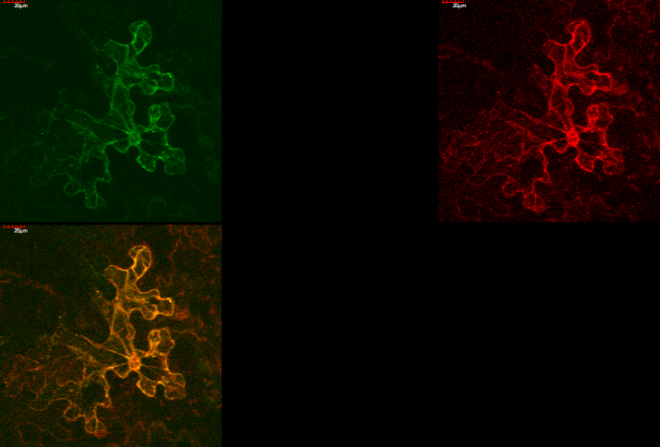
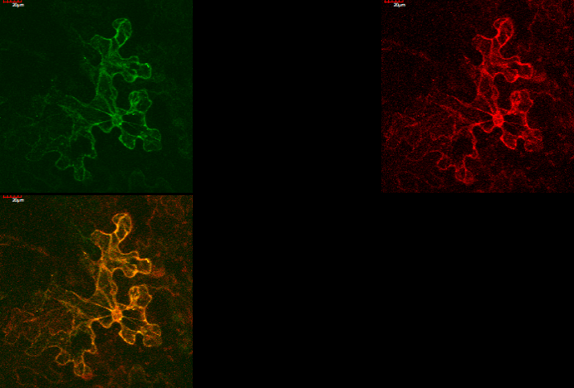
Supplemental Fig. S5
Bright field
ABCI20-GFP
RFP-ABCI21
Merge
Supplemental Figure S5. Co-localization of ABCI20 and ABCI21 at the ER.
ABCI20-GFP and RFP-ABCI21 were co-expressed in tobacco leaf epidermal cells using particle bombardment. Scale bars = 20 µm.

Slide 7
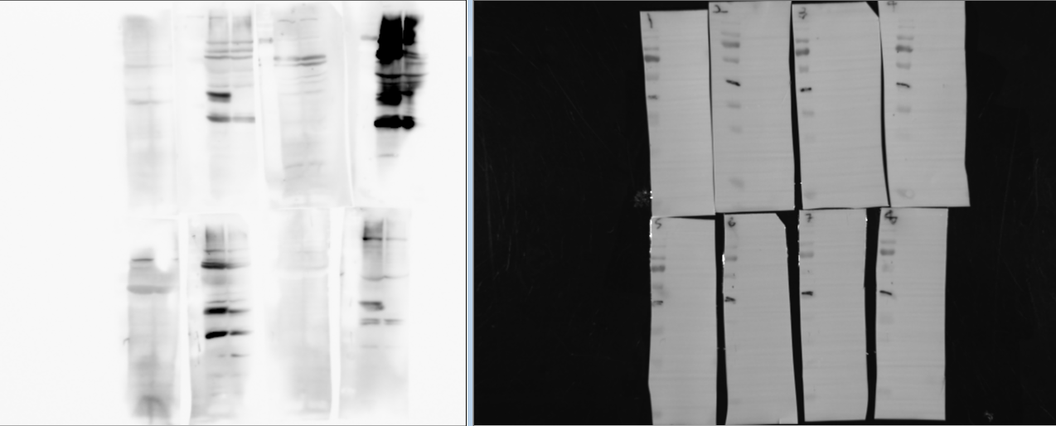
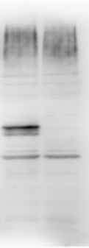
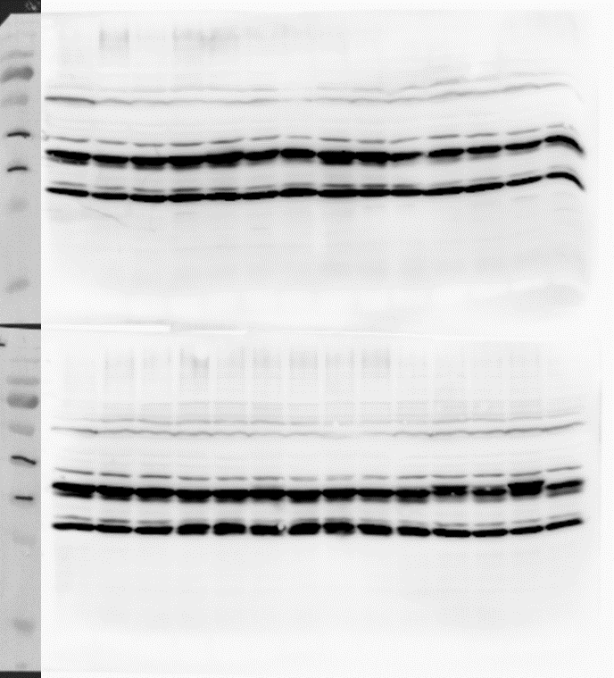
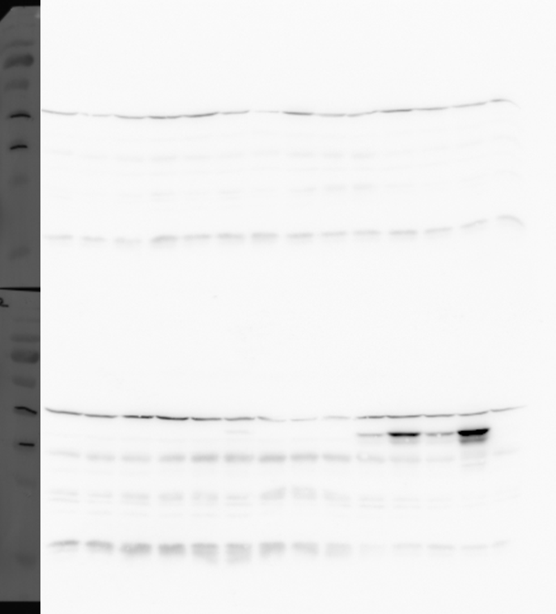
Supplemental Fig. S6
A
WT
abci20-3
WT
abci20-3
WT
abci20-1
70
70
70
55
55
55
40
40
40
35
35
35
Preimmune serum
Immunized serum
Purified Anti-ABCI20 antibody
B
WT
T2 35S:V5:ABCI20
C
WT
T2 35S:V5:ABCI20
1
2
1
2
40
40
35
35
anti-ABCI20
anti-V5
Supplemental Figure S6. Quality assessment of anti-ABCI20 antibody.
(a) Rabbit serum immunized with ABCI20 antigens detected native ABCI20 at the expected size (37 kDa, red arrowheads) in the wild type but not in abci20 knockout mutants (abci20-3; SALK_051857 or abci20-1). Western blot results with preimmune serum (left), immunized serum (center), and purified antibody (right) are presented.
(b, c) Western blot analyses of A. thaliana plants that stably express V5-tagged ABCI20 proteins with anti-ABCI20 antibody (b) and anti-V5 antibody (c). The membrane used for immunoblot with anti-ABCI20 was stripped off and re-probed with anti-V5 antibody. Note that anti-ABCI20 antibody detected native ABCI20 protein band in wild type (red arrowhead), while anti-V5 antibody did not (black arrowhead).

Slide 8
Supplemental Table S1
Supplemental Table 1. Primers used in this study.
Primer name | Primer sequence (5′-3′)
SALK_064144_LP | ACTGCTGGTTCTGCTGTGAG
SALK_064144_RP | CAAAATTGTCCCAATTGAAGC
ABCI21_RT_Fw | GTTCAAGGTATTACTACTGGATGAAG
ABCI21_RT_Rv | TAGACGACATAAATGGAGAGGTAAC
ABCI20 GT1 | TCCATTGGCAATGCTAACTGC
ABCI20 GT2 | CGGGATCGAAACCACTTATTG
ABCI20 GT3 | CCCAGAACCCTAACCATATGC
ABCI19 GT1 | GTATGACGTGGATTTAGCGTTG
ABCI19 GT2 | TCTATGGAAAATAACGACTGGT
ABCI19_RT_Fw | TGACGCCATTAGAGTTAGCG
ABCI19_RT_Rv | CGATTGTAGCTCCTCTCTGATC
TUB8_Fw | GCCAGCAAAAACGCCATAATGGTG
TUB8_Rv | GACGAAGTGGAAGTGCAGGAGGAGC
ACT1_Fw | CATCAGGAAGGACTTGTACGG
ACT1_Rv | GATGGACCTGACTCGTCATAC
HY5_Fw | CAAGCAGCGAGAGGTCATCA
HY5_Rv | CATCGCTTTCAATTCCTTCTTTG

Slide 9
Supplemental Table S2
Supplemental Table 2. Lists of Co-expression genes of ABCI20 and ABCI21.
ABCI20 co-expression gene list
Rank | Locus | Gene name | Function
1 | At5g44110 | ABCI21 | P-loop containing nucleoside triphosphate hydrolases superfamily protein
2 | At3g15090 | dehydrogenase | GroES-like zinc-binding alcohol dehydrogenase family protein
3 | At2g25530 | ATPase | AFG1-like ATPase family protein
4 | At3g19450 | CAD4 | GroES-like zinc-binding alcohol dehydrogenase family protein
5 | At3g51240 | TT6 | flavanone 3-hydroxylase
6 | At5g17050 | UGT78D2 | UDP-glucosyl transferase 78D2
7 | At5g15910 | Rossmann-fold | NAD(P)-binding Rossmann-fold superfamily protein
8 | At4g01660 | ATH10 | ABC transporter 1
9 | At5g11260 | TED 5 | Basic-leucine zipper (bZIP) transcription factor family protein
10 | At3g29200 | CM1 | chorismate mutase 1
11 | At1g06000 | transferase | UDP-Glycosyltransferase superfamily protein
12 | At1g78570 | ROL1 | rhamnose biosynthesis 1
13 | At3g24170 | GR1 | glutathione-disulfide reductase
14 | At1g12370 | UVR2 | photolyase 1
15 | At5g37550
16 | At3g57010 | phosphotriesterase | Calcium-dependent phosphotriesterase superfamily protein
17 | At5g08640 | FLS1 | flavonol synthase 1
18 | At4g36640 | Sec14p-like phosphatidylinositol transfer | Sec14p-like phosphatidylinositol transfer family protein
19 | At5g24850 | CRY3 | cryptochrome 3
20 | At5g05270 | CHIL | Chalcone-flavanone isomerase family protein
180 | At1g03905 | ABCI19 | P-loop containing nucleoside triphosphate hydrolases superfamily protein

Slide 10
Supplemental Table S2 continued
ABCI21 co-expression gene list
Rank | Locus | Gene name | Function
1 | At5g02270 | NAP9 (ABCI20) | non-intrinsic ABC protein 9
2 | At2g25530 | ATPase | AFG1-like ATPase family protein
3 | At5g08640 | FLS1 | flavonol synthase 1
4 | At3g51240 | TT6 | flavanone 3-hydroxylase
5 | At1g12370 | UVR2 | photolyase 1
6 | At2g47460 | PFG1 | myb domain protein 12
7 | At5g05270 | CHIL | Chalcone-flavanone isomerase family protein
8 | At5g02280 | SNARE-like | SNARE-like superfamily protein
9 | At5g15910 | Rossmann-fold | NAD(P)-binding Rossmann-fold superfamily protein
10 | At5g24850 | CRY3 | cryptochrome 3
11 | At5g20070 | NUDX19 | nudix hydrolase homolog 19
12 | At1g06000 | transferase | UDP-Glycosyltransferase superfamily protein
13 | At5g17050 | UGT78D2 | UDP-glucosyl transferase 78D2
14 | At1g65060 | 4CL3 | 4-coumarate:CoA ligase 3
15 | At5g37550
16 | At3g55120 | TT5 | Chalcone-flavanone isomerase family protein
17 | At3g52740
18 | At5g13930 | TT4 | Chalcone and stilbene synthase family protein
19 | At3g15090 | dehydrogenase | GroES-like zinc-binding alcohol dehydrogenase family protein
20 | At4g15480 | UGT84A1 | UDP-Glycosyltransferase superfamily protein
254 | At1g03905 | ABCI19 | P-loop containing nucleoside triphosphate hydrolases superfamily protein

Slide 11
Supplemental Table S3
Supplemental Table 3. List of candidate components of ABCI20 complex
Detected proteins in LTQ-MS | Locus | Peptide Coverage (%)
Transporter activity
ABC transporter C family member 3 | At3g13080 | 33
Importin subunit beta-1 | At5g53480 | 50.5
ABC transporter F family member 1 | At5g60790 | 44.5
ABC transporter I family 19 | At1g03905 | 75.5
ABC transporter I family 20 | At5g02270 | 47
ABC transporter I family 21 | At5g44110 | 90.1
Signal transducer activity
Receptor for activated C kinase 1B | At1g48630 | 53.7
Receptor for activated C kinase 1A | At1g18080 | 42.2
Catalytic activity
Alba DNA/RNA-binding protein | At1g20220 | 40.6
Cysteine proteinase RD21A | At1g47128 | 39
Adenosylhomocysteinase 1 | At4g13940 | 85.8
S-adenosylmethionine synthase 1 | At1g02500 | 61.3
Brefeldin A-inhibited guanine nucleotide-exchange protein 5 | At3g43300 | 46.1
DNA-directed RNA polymerase II subunit 1 | At4g35800 | 34.9
Pre-mRNA-processing-splicing factor 8A | At1g80070 | 57.9
Protein disulfide isomerase-like 1-2 | At1g77510 | 45.3
Peroxisomal (S)-2-hydroxy-acid oxidase GLO2 | At3g14415 | 43.9
Putative uncharacterized protein | At1g32220 | 28
S-adenosylmethionine synthase 3 | At2g36880 | 53.1
Aspartate aminotransferase, cytoplasmic isozyme 1 | At5g19550 | 60.7
Pyridoxal 5'-phosphate synthase subunit PDX1.1 | At2g38230 | 45
UDP-glucuronic acid decarboxylase 4 | At2g47650 | 41.5
DExH-box ATP-dependent RNA helicase DExH12 | At3g46960 | 39.2
26S proteasome non-ATPase regulatory subunit 2 homolog A | At2g20580 | 55.3
40S ribosomal protein S3-1 | At2g31610 | 68
Probable mediator of RNA polymerase II transcription subunit 37c | At3g12580 | 53.2
40S ribosomal protein S3-2 | At3g53870 | 70.3

Slide 12
Supplemental Table S3 continued
Detected proteins in LTQ-MS | Locus | Peptide Coverage (%)
Catalytic activity
Enoyl-CoA delta isomerase 3 | At4g14440 | 46.2
Enoyl-CoA delta isomerase 1, peroxisomal | At1g65520 | 66.7
Delta-1-pyrroline-5-carboxylate synthase B | At3g55610 | 56.9
DNA-directed RNA polymerases IV and V subunit 3B | At2g15400 | 59.2
DNA-directed RNA polymerase subunit beta′′ | AtCg00170 | 37.3
DNA-directed RNA polymerase II subunit 2 | At4g21710 | 28.8
Serine/threonine-protein kinase TOR | At1g50030 | 43.2
S-adenosylmethionine synthase 4 | At3g17390 | 65.9
Phosphoglycerate kinase 3, cytosolic | At1g79550 | 36.4
Adenosylhomocysteinase 2 | At3g23810 | 78.4
Nitrilase 1 | At3g44310 | 73.4
Flavone 3′-O-methyltransferase 1 | At5g54160 | 71.6
Peroxisomal (S)-2-hydroxy-acid oxidase GLO1 | At3g14420 | 52.9
Serine/threonine-protein kinase SRK2B | At1g60940 | 51.5
Mediator of RNA polymerase II transcription subunit 37f | At5g42020 | 52.2
Membrane
Calcium-dependent lipid-binding family protein | At1g48090 | 38.7
Coatomer subunit alpha-1 | At1g62020 | 58.6
Coatomer subunit alpha-2 | At2g21390 | 52.8
Coatomer subunit beta-1 | At4g31480 | 45.6
Coatomer subunit beta′-1 | At1g79990 | 48.8
Coatomer subunit beta-2 | At4g31490 | 58.9
Coatomer subunit beta′-3 | At3g15980 | 45.3
Coatomer subunit epsilon-1 | At1g30630 | 54.8
Coatomer subunit gamma | At4g34450 | 41
Importin subunit beta-1 | At5g53480 | 50.5
Protein transport protein SEC31 homolog B | At3g63460 | 42.1
Putative GTP-binding protein ara-3 | At5g59840 | 65.3

