Slide 1
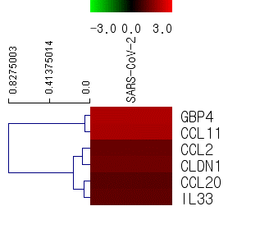
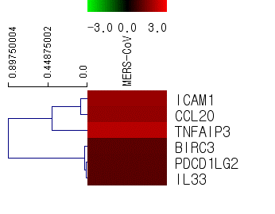
Fig. S1
MERS-CoV
SARS-CoV-2
Gene title |  | fold change
 |  | SARS-CoV-2
Anti-viral related gene | GBP4 | 4.14
 | CCL2 | 2.36
 | CCL11 | 3.97
 | CCL20 | 2.10
 | CLDN1 | 2.50
 | IL33 | 2.20
Gene title |  | fold change
 |  | SARS-CoV-2
Anti-viral related gene | BIRC3 | 2.13
 | ICAM1 | 3.51
 | CCL20 | 3.32
 | TNFAIP3 | 4.50
 | PDCD1LG2 | 2.08
 | IL33 | 2.07

Slide 2
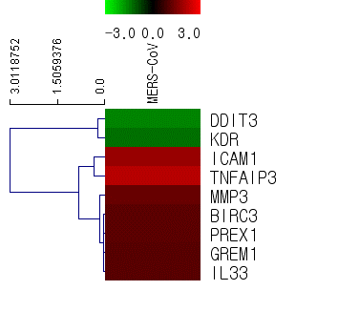
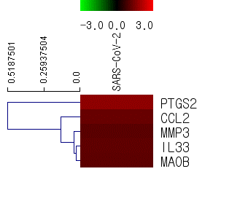
Fig. S2
MERS-CoV
SARS-CoV-2
Gene title |  | fold change
 |  | SARS-CoV-2
Cell damage related gene | BIRC3 | 2.13
 | MMP3 | 2.36
 | DDIT3 | 0.34
 | GREM1 | 2.06
 | ICAM1 | 3.51
 | PREX1 | 2.13
 | KDR | 0.40
 | TNFAIP3 | 4.50
 | IL33 | 2.07
Gene title |  | fold change
 |  | SARS-CoV-2
Cell damage related gene | PTGS2 | 3.23
 | MMP3 | 2.11
 | CCL2 | 2.36
 | IL33 | 2.20
 | MAOB | 2.16

Slide 3
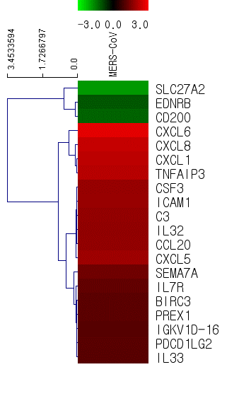

Fig. S3
MERS-CoV
SARS-CoV-2
Gene title |  | fold change
 |  | SARS-CoV-2
Immune response related gene | BIRC3 | 2.13
 | EDNRB | 0.49
 | SLC27A2 | 0.29
 | SEMA7A | 2.51
 | IL32 | 3.29
 | CSF3 | 3.46
 | ICAM1 | 3.51
 | C3 | 3.36
 | IGKV1D-16 | 2.04
 | CCL20 | 3.32
 | PREX1 | 2.13
 | CD200 | 0.44
 | CXCL8 | 5.03
 | CXCL6 | 6.50
 | CXCL1 | 4.69
 | CXCL5 | 3.68
 | IL7R | 2.25
 | TNFAIP3 | 4.50
 | PDCD1LG2 | 2.08
 | IL33 | 2.07
Gene title |  | fold change
 |  | SARS-CoV-2
Immune response related gene | GBP4 | 4.14
 | TNFSF18 | 2.77
 | CCL2 | 2.36
 | CCL11 | 3.97
 | CCL20 | 2.10
 | CLDN1 | 2.50
 | CXCL8 | 3.76
 | CXCL6 | 8.63
 | CXCL5 | 4.89
 | IL33 | 2.20

Slide 4
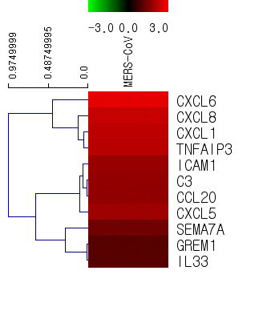
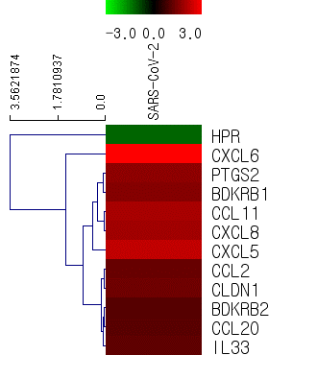
Fig. S4
MERS-CoV
SARS-CoV-2
Gene title |  | fold change
 |  | SARS-CoV-2
Inflammatory response related gene | PTGS2 | 3.23
 | BDKRB2 | 2.04
 | BDKRB1 | 2.99
 | HPR | 0.44
 | CCL2 | 2.36
 | CCL11 | 3.97
 | CCL20 | 2.10
 | CLDN1 | 2.50
 | CXCL8 | 3.76
 | CXCL6 | 8.63
 | CXCL5 | 4.89
 | IL33 | 2.20
Gene title |  | fold change
 |  | SARS-CoV-2
Inflammatory response related gene | GREM1 | 2.06
 | SEMA7A | 2.51
 | ICAM1 | 3.51
 | C3 | 3.36
 | CCL20 | 3.32
 | CXCL8 | 5.03
 | CXCL6 | 6.50
 | CXCL1 | 4.69
 | CXCL5 | 3.68
 | TNFAIP3 | 4.50
 | IL33 | 2.07

