Slide 1
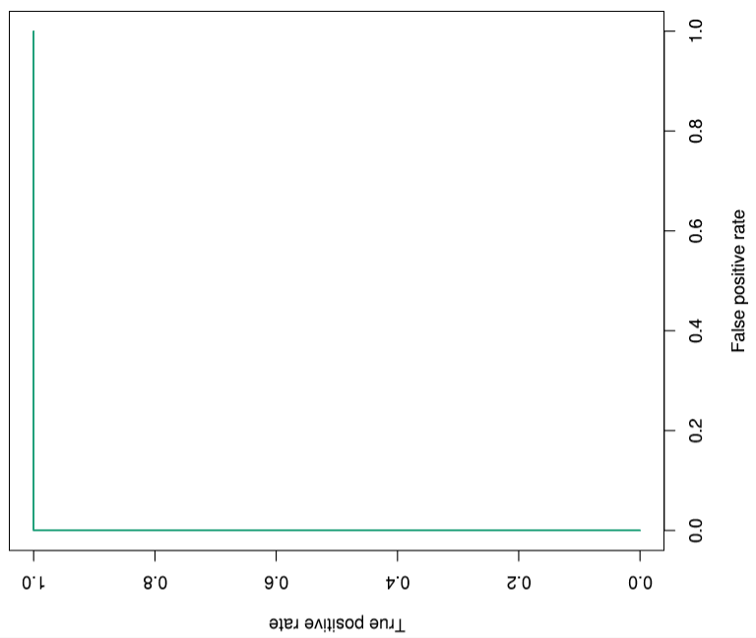

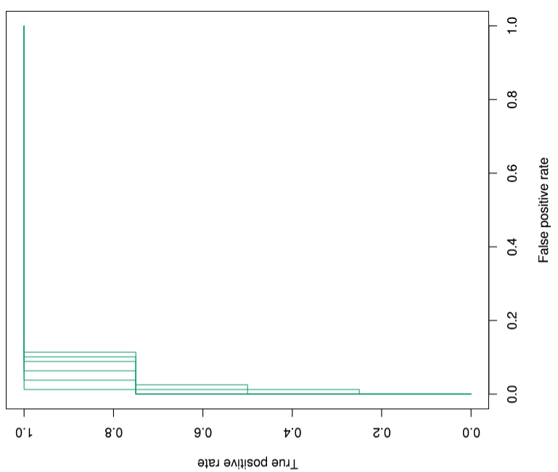

Additional file 2. Area under curve (AUC) analysis of the marker probes for four category of tumors
HGNET-MN1
NB-FOXR2
HGNET-BCOR
EFT-CIC

