Slide 1
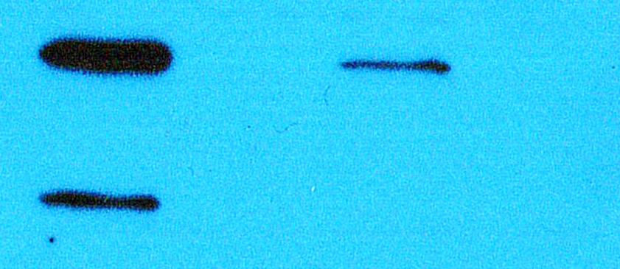
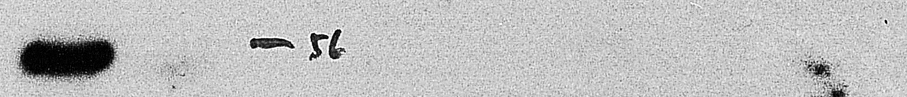
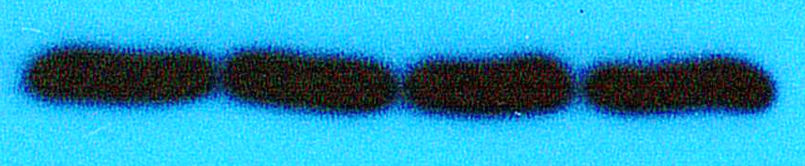
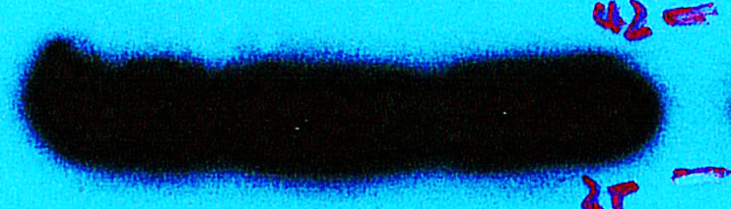
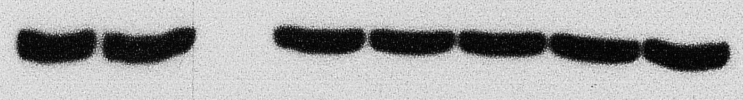
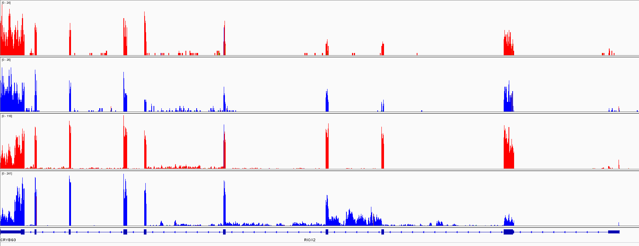
Fig. 1
B.
BEAS-2B A549
A.
CRISPR-cas9 sgRNA 1 sequence:
AATGTGTACATAACTCCCGCAGG
sgRNA-1
sgRNA-1
sgRNA-1
CRISPR-cas9 sgRNA 3 sequence:
1 2 3 4
1 2 3
Ctrl 4 9 10 11 12 13
CATCATCATAATGGGGCGGCAGG
Mdig
ATG
sgRNA-1
GAPDH
Mdig locus
1
2
3
4
sgRNA-3
Human Mdig gene
C.
D.
Beas-2B
A549
WT
KO
WT
KO
Exon 10 9 8 7 6 5 4 3 2 1
Notes:
Fig 1. Knockout of mdig by sgRNAs. A. Sequence and schematic of sgRNAs targeting on the third exon of Mdig gene. The red arrow indicated the sgRNA-1, and the green arrow pointed sgRNA-3. B. Western blotting showing the mdig protein expression in BEAS-2B clones and A549 clones. C. Normalized mdig value from RNA sequencing (RNA-seq) of WT (red) and KO (blue) of BEAS-2B and A549 clones. D. RNA-seq showing the reads of mdig in WT (red) and KO (blue) of BEAS-2B and A549 clones. Green arrow indicated the exon 3 of midg. The triangle indicated the intron 3.

Slide 2
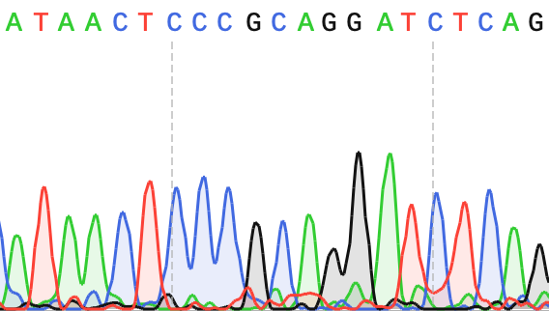
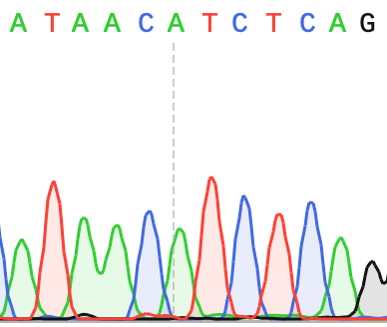
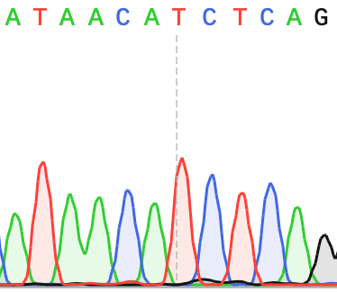
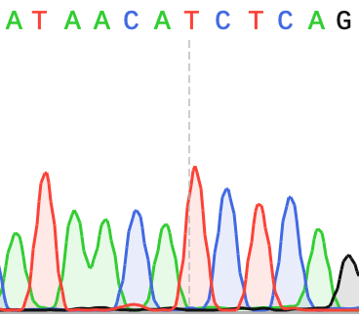
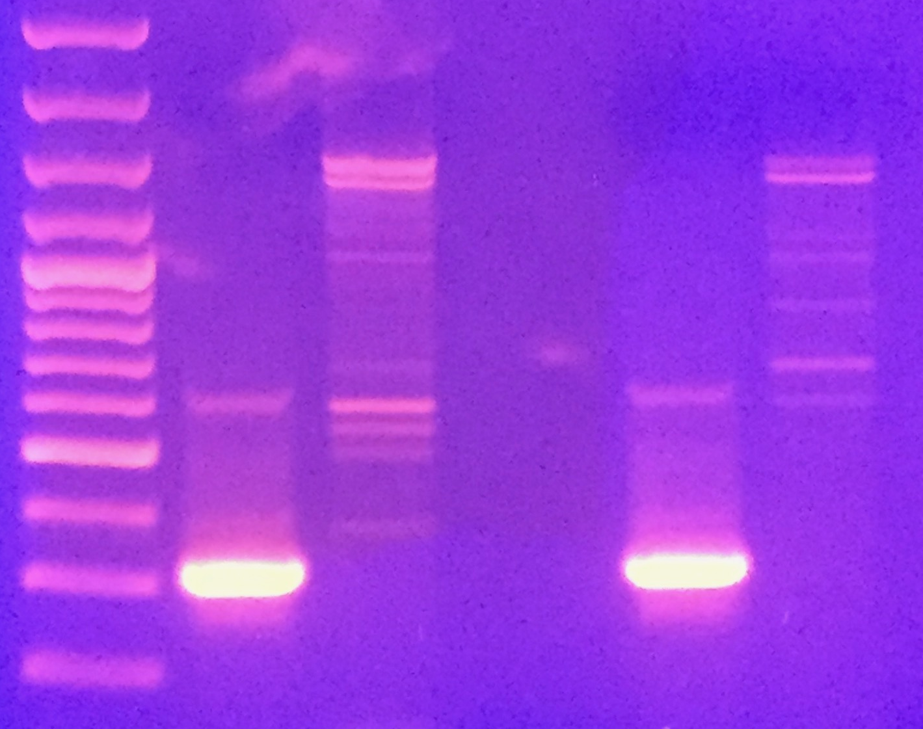
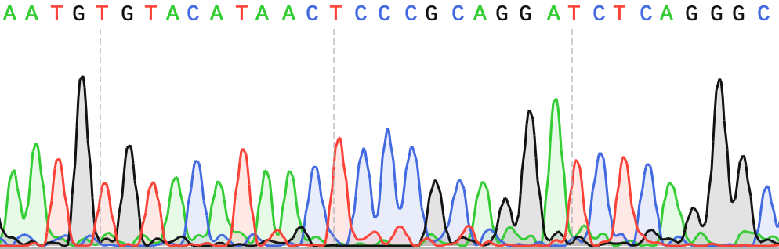
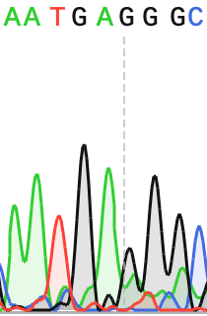
Fig. 2
A.
C
Ile Thr Pro Ala Gly Ser Gln
Ile Thr Ser Gln
Ile Thr Ser Gln
Ile Thr Ser Gln
BEAS-2B clones
M KO-2 KO-4
3000
mdig
1000
500
300
GAPDH
Mdig WT
B2B KO-2
B2B KO-3
A549 KO-4
200
B.
A549 clones
Asn Val Tyr Ile Thr Pro Ala Gly Ser Gln Gly
Asn Glu Gly
M W-1 KO-2 3B-1
3000
mdig
1000
500
Mdig WT
A549 KO-2
Notes:
Fig 3. CRISPR-Cas9 causes alternative splicing of mdig mRNA. A. Typical image showing the PCR product of mdig in BEAS-2B and A549 clones. B. Chromatograms showing the entire exon three skipping of mdig by sanger sequencing in clones compared to mdig WT. C. Chromatograms of the new alternative spliced form of mdig in KO colonies compared to Mdig WT.

Slide 3
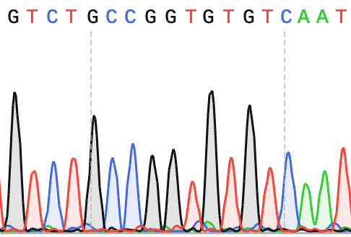
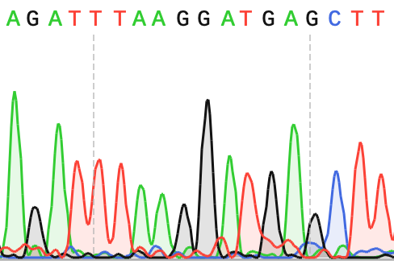
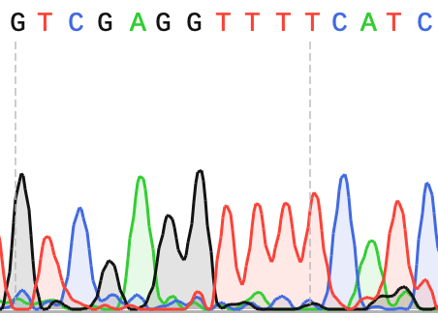
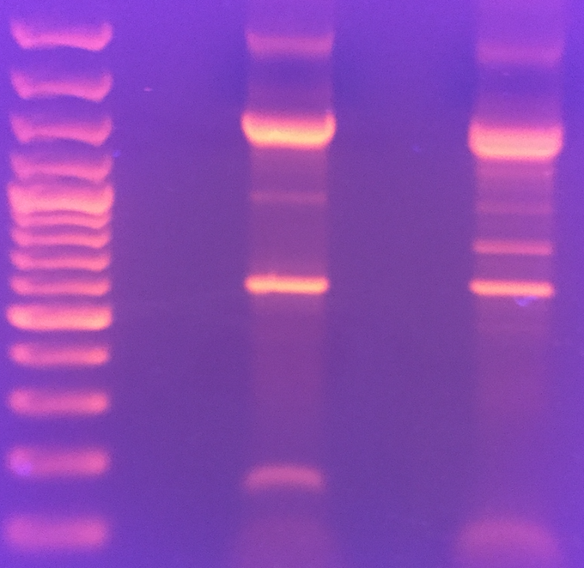
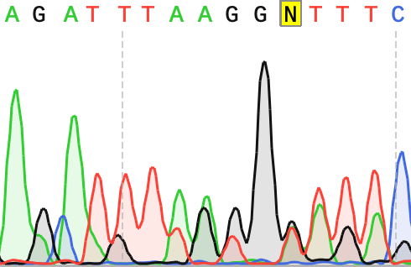
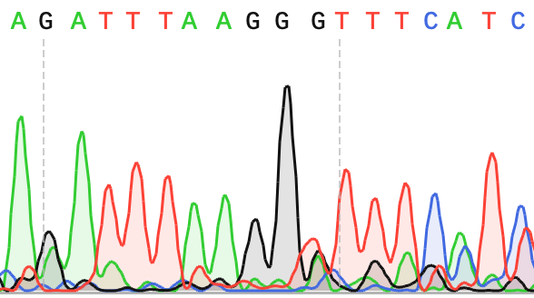
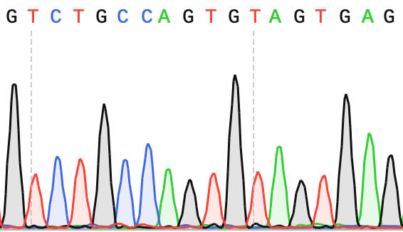
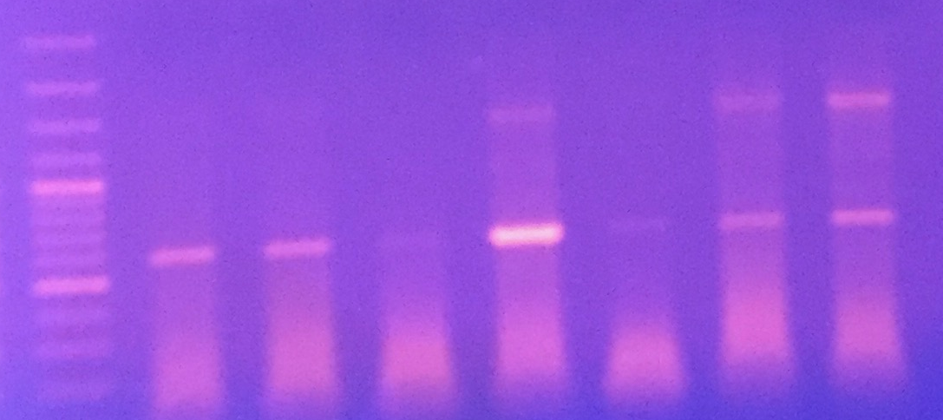
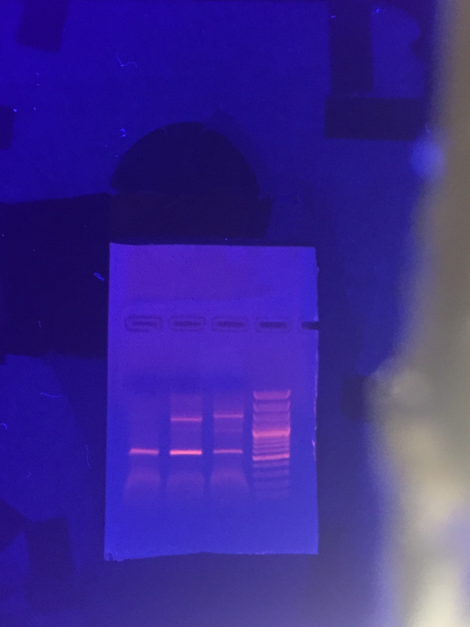
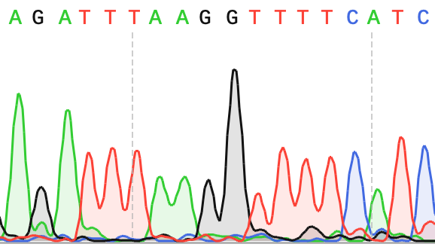
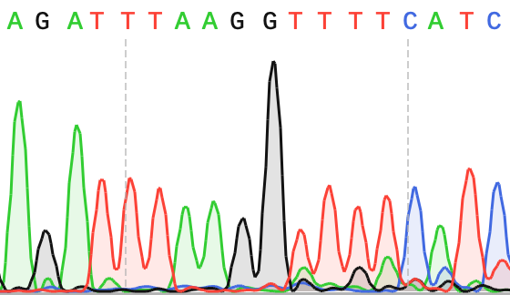
Fig. 3
A.
B.
Exon 2
BEAS-2B clones
Exon 2
Exon 3
Exon 3
Exon 4
C.
M WT-1 KO-3
Val
3000
2000
mdig
1500
1000
spliced form
500
Mdig WT
Mdig WT
Mdig WT
300
100
A549 clones
Exon 2
Exon 4
Exon 2
Exon 4
Exon 2
Exon 8
3B-1 3B-2
3000
Gly
mdig
1000
500
B2B KO-3
B2B KO-4
New alternative spliced form
A549 clones
KO-3 KO-4 M
Exon 2
Exon 4
Exon 2
Exon 4
3000
mdig
Val
Val
1000
500
A549 KO-3
A549 3B-1
Notes:
Fig 3. CRISPR-Cas9 causes alternative splicing of mdig mRNAs. A. RT-PCR product of mdig in BEAS-2B clones. B. Chromatograms showing the missing of the third exon of mdig in mdig mRNAs in KO clones. C. Chromatograms of the new alternative spliced form of mdig in KO-3 BEAS-2B clone compared to mdig WT.

Slide 4
Fig. 4
A.
sgRNA-1
Mdig locus
sgRNA-3
Deletions
Alternative splicing
in KO clones
New stop codon
B.
MPKKAKPTGSGKEEGPAPCKQMKLEAAGGPSALNFDSPSSLFESLISPIKTETFFKEFWEQKPLLIQRDD PALATYYGSLFKLTDLKSLCSRGMYYGRDVNVCRCVNGKKKVLNKDGKAHFLQLRKDFDQKRATIQFHQP QRFKDELWRIQEKLECYFGSLVGSNVYITPAGSQGLPPHYDDVEVFILQLEGEKHWRLYHPTVPLAREYS VEAEERIGRPVHEFMLKPGDLLYFPRGTIHQADTPAGLAHSTHVTISTYQNNSWGDFLLDTISGLVFDTA KEDVELRTGIPRQLLLQVESTTVATRRLSGFLRTLADRLEGTKELLSSDMKKDFIMHRLPPYSAGDGAEL STPGGKLPRLDSVVRLQFKDHIVLTVLPDQDQSDEAQEKMVYIYHSLKNSRETHMMGNEEETEFHGLRFP LSHLDALKQIWNSPAISVKDLKLTTDEEKESLVLSLWTECLIQVV 465
WT
KO
MPKKAKPTGSGKEEGPAPCKQMKLEAAGGPSALNFDSPSSLFESLISPIKTETFFKEFWEQKPLLIQRDD
PALATYYGSLFKLTDLKSLCSRGMYYGRDVNVC
-------------------------------------
E
G
----------------------------------------------------------------------
----------------------------------------------------------------------
----------------------------------------------------------------------
-----------
QCSETAV∗ 109
Notes:
Fig 4. Summary of the deletion and alternative splicing in mdig mRNA from KO clones. A. Schematic of deletions and alternative splicing in KO clones. White bars represent exons and blank lines are introns. Red slash bars represent deletion or alternative spliced nucleotides. The red and green arrow indicate where the sgRNA-1 and sgRNA-3 are targeted respectively. B. Corresponding protein sequence. Mdig protein sequence is in black. The third exon protein sequence is shaded in pink. The nine and twenty-four nucleotides are corresponding to amino acids shown in black underlines or red underlines respectively. The amino acid substitute in KO cells are marked with bold. The sequence in red is the new alternative spliced form with new stop codon (*).

Slide 5
Fig. 5
A.
BEAS-2B Exon 5 A to C (NM_032778, 1330T to G)
B.
A549 Exon 5 A to C (NM_032778, 1330T to G)
C.
BEAS-2B Exon 2 C to G (NM_032778, 626G to C)
D.
A549 Exon 9 C to T (NM_032778 1730G to A)
Notes:
Fig 5. Single nuclear polymorphisms (SNPs) of mdig gene identified from RNA-seq. A. and B. The SNP of A to C of the exon 5 of mdig in both WT and KO of BEAS-2B and A549 cells. This is comparable to the exchange of 1330T to G in NM_032778 sequence. C. The substitution of C to G of the exon 2 in WT and KO BEAS-2B cells which is equal to the substitution of 626G to C in NM_032778 sequence. D. The SNP of C to T in exon 9 in WT and KO A549 cells. This is equal to the exchange of 1730G to A in NM_032778 sequence.

Slide 6
sFig 1
BEAS-2B A549
CCTGCGGGA
CCTGCGGGA
GCGGGAGTTATGTACACATT
GCGGGAGTTATGTACACATT
Notes:
sFig 1. Transcripts of mdig from BEAS-2B and A549 clones from RNA-seq. The Lower panel shows transcripts of the third exon. The double black arrow indicates the deletion of sequence 5’-CCTGCGGA-3’, reverse complementary to sequence 5’-TCCCGCAGG-3’ around DSBs. The red dotted lines indicate the sgRNA-1 sequence.

