Slide 1
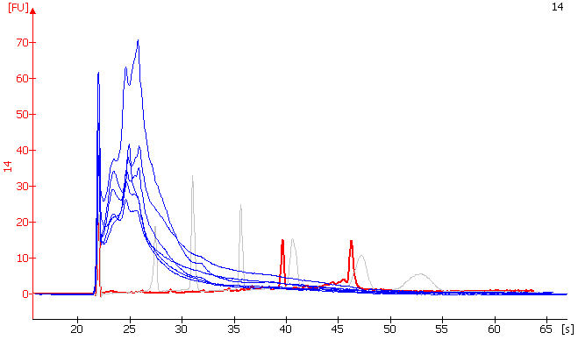
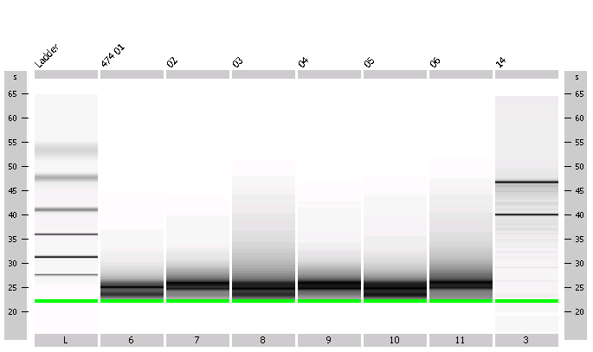
Supplementary Figure 1
RNA ladder
#1 OCL
#1 CCL
#2 OCL
#2 CCL
#3 OCL
#3 CCL
Control RNA
Total RNA electropherograms
6.0
4.0
28S
Mouse #1 OCL
Mouse #1 CCL
Mouse #2 OCL
Mouse #2 CCL
Mouse #3 OCL
Mouse #3 CCL
Control RNA
Absorbance
2.0
18S
1.0
0.5
0.2
kb
0.2
0.5
1.0
2.0
4.0
6.0
kb
Size in kb

Slide 2
Supplementary Figure 2

Slide 3
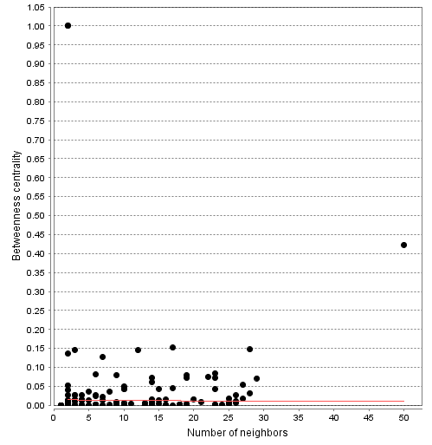
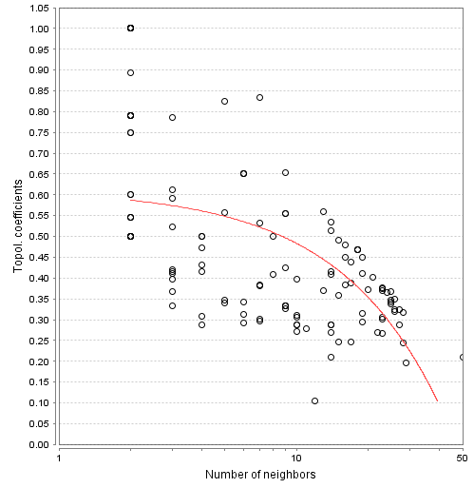
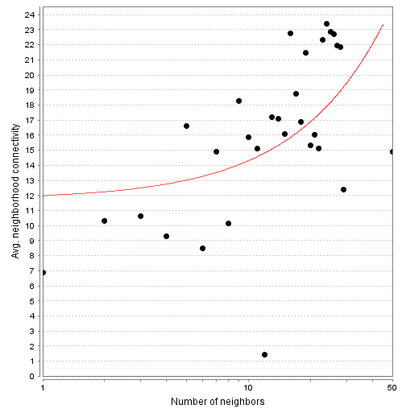
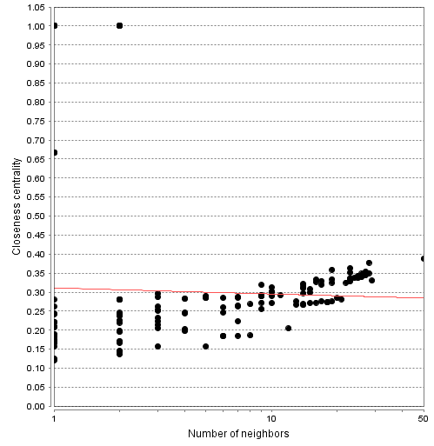
Supplementary Figure 3
A
B
Betweeness Centrality
Topological Coefficient
C
D
Neighborhood Connectivity Distribution
Closeness Centrality

