Slide 1
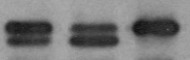
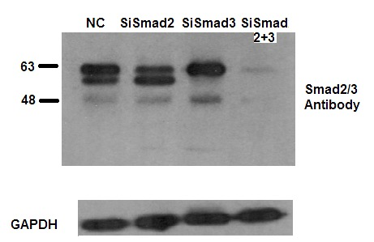
Brkic et al., Fig. S2
A
NC siSmad2 siSmad3
B
NC
siSmad2
siSmad3
Smad2
Smad3
GAPDH
C
Fig. S2. Smad2 and Smad3 exert opposing effects on cell migration. A first trimester trophoblast cell line Swan-71 was transfected with siRNAs targeting Smad2 or Smad3 or a non-targeting control (NC). A) Western blotting confirms the knockdown of Smad2 and Smad3 by their specific siRNAs. B) Representative pictures from a cell migration assay performed using the IncuCyte live cell imaging system. C) Summary graph showing the wound closure over a 48h period. Data present mean ± SEM (n=24). Data were analyzed by two-way ANOVA, followed by Turkey’s multiple comparison tests. *p<0.05; **p<0.01; ***, p<0.001, and **** p<0.0001 vs NC at the same time point . Knockdown of Smad2 accelerated wound closure when knockdown of Smad3 inhibited wound closure.

