Slide 1
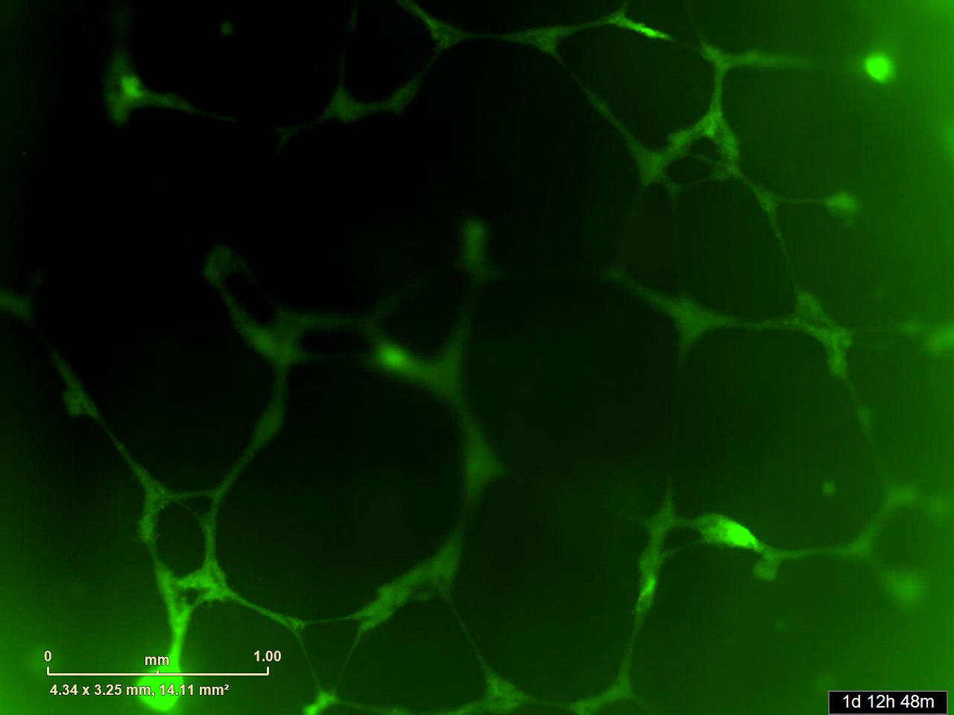
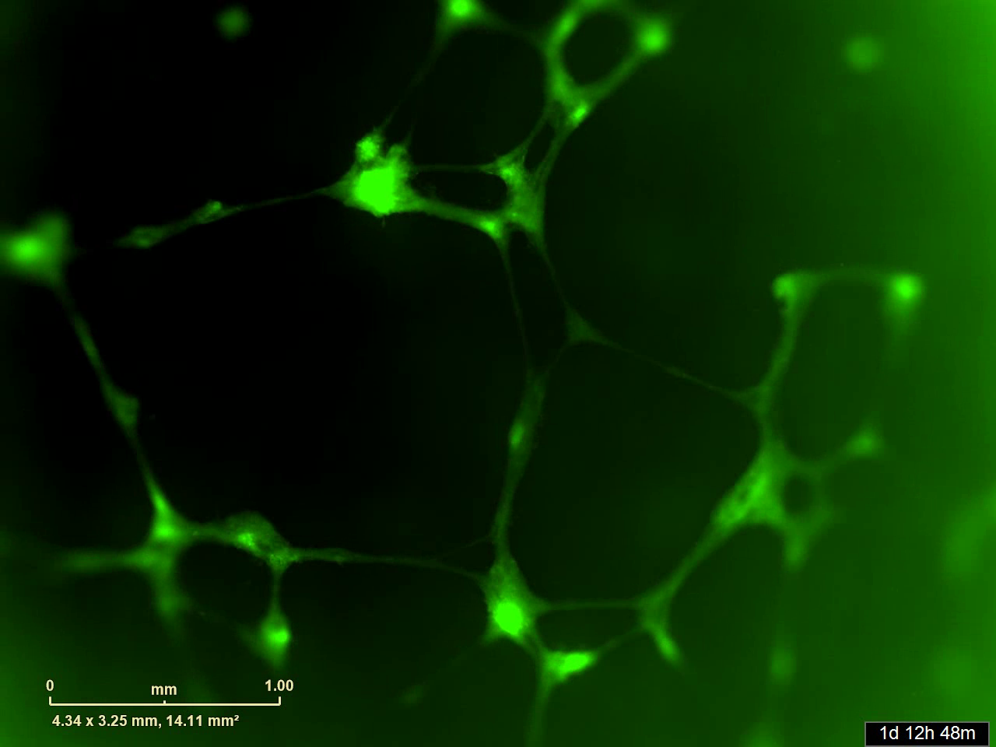
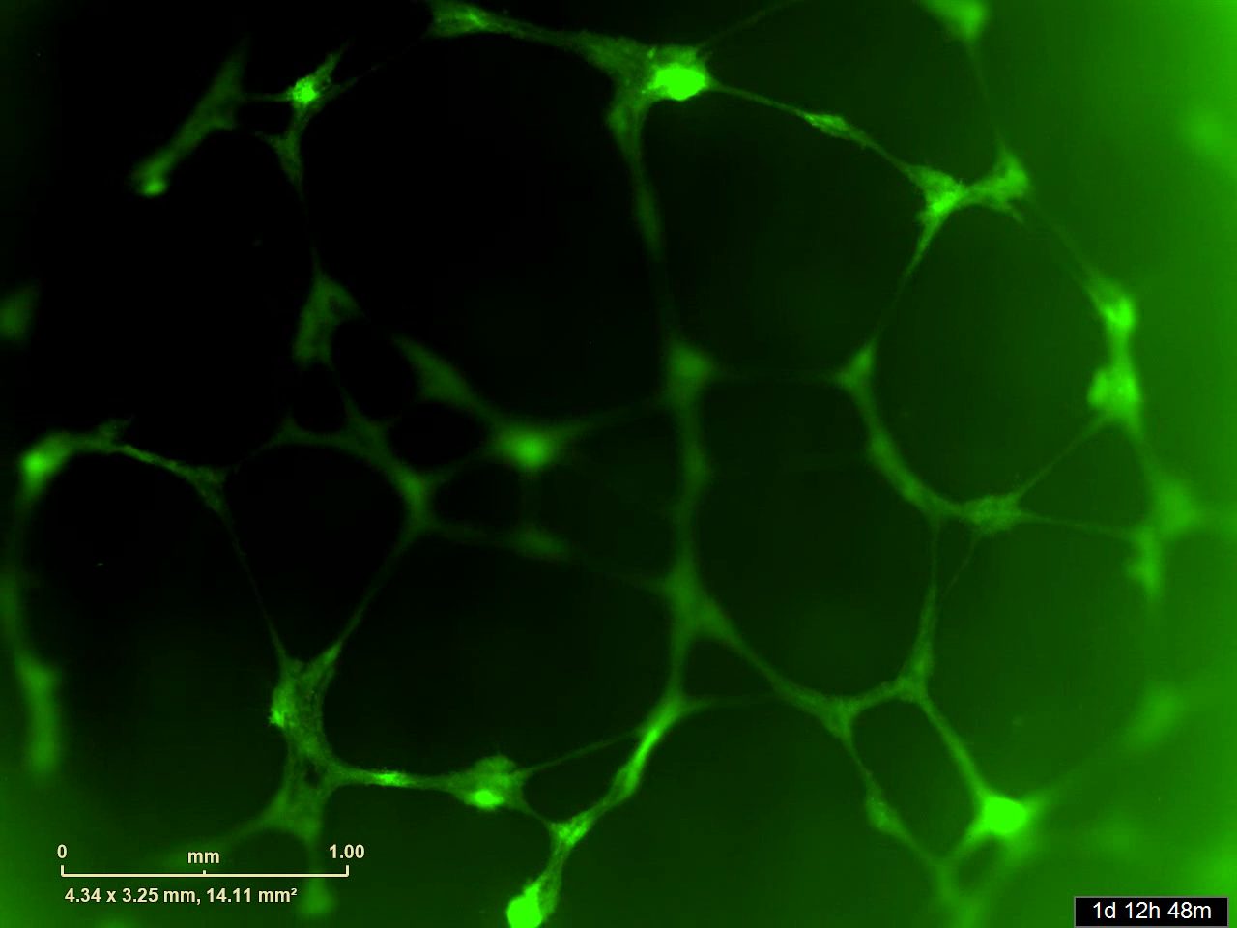
Brkic et al., Fig. S3
A
EV
Smad2
Smad3
B
Fig. S3. Effects of Smad2 and Smad3 on the formation of network-like structure. HTR-8/Svneo trophophoblasts were transiently transfected with 1μg of Smad2, Smad3, or their empty vector (EV) control. At 5h after transfection, cells were collected and seeded onto a 96-well plate coated with growth factor reduced matrigel. Formation of network-like structure was monitored using the Incucyte. A) Representative movie files showing the dynamics of network formation. B) Summary graph showing the total network length at 48h (mean±SEM, n=3).

