Slide 1
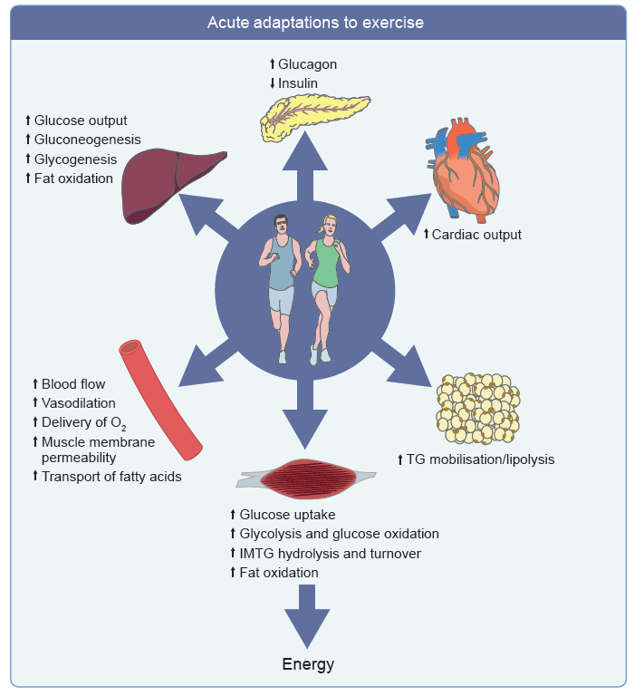
Thyfault and Bergouignan (2020) Diabetologia DOI 10.1007/s00125-020-05177-6
© Springer-Verlag GmbH Germany, part of Springer Nature 2020

Slide 2
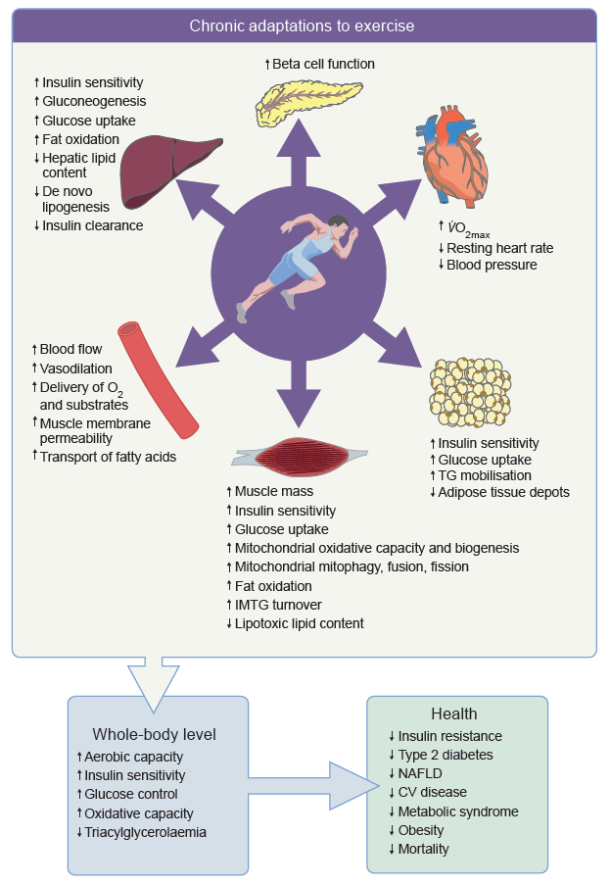
Thyfault and Bergouignan (2020) Diabetologia DOI 10.1007/s00125-020-05177-6
© Springer-Verlag GmbH Germany, part of Springer Nature 2020

Slide 3
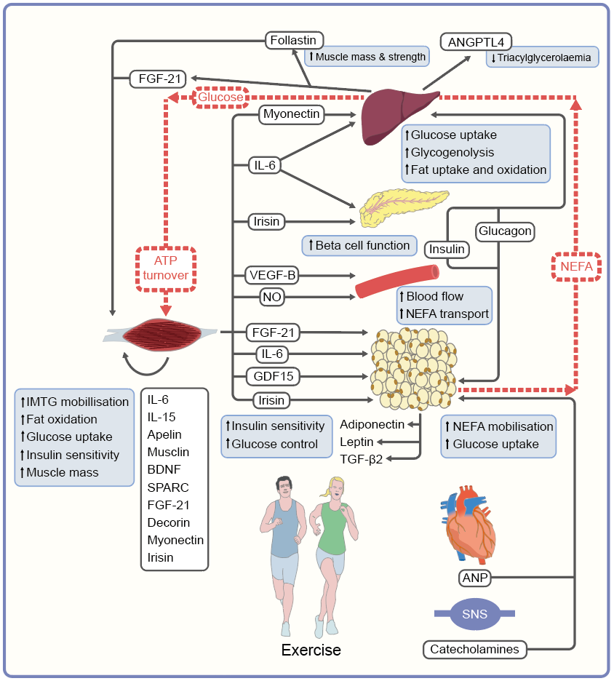
Inter-organ crosstalk and substrate fluxes during exercise
Thyfault and Bergouignan (2020) Diabetologia DOI 10.1007/s00125-020-05177-6
© Springer-Verlag GmbH Germany, part of Springer Nature 2020

