Slide 1
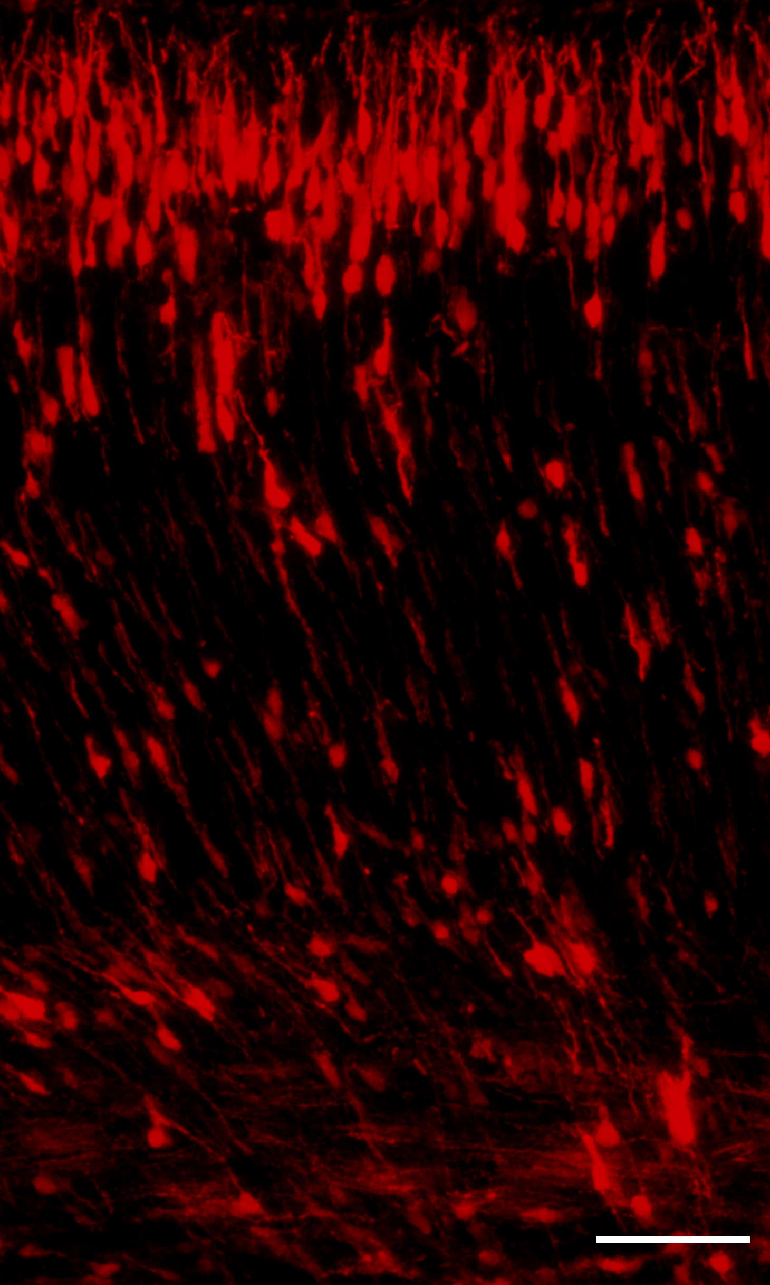
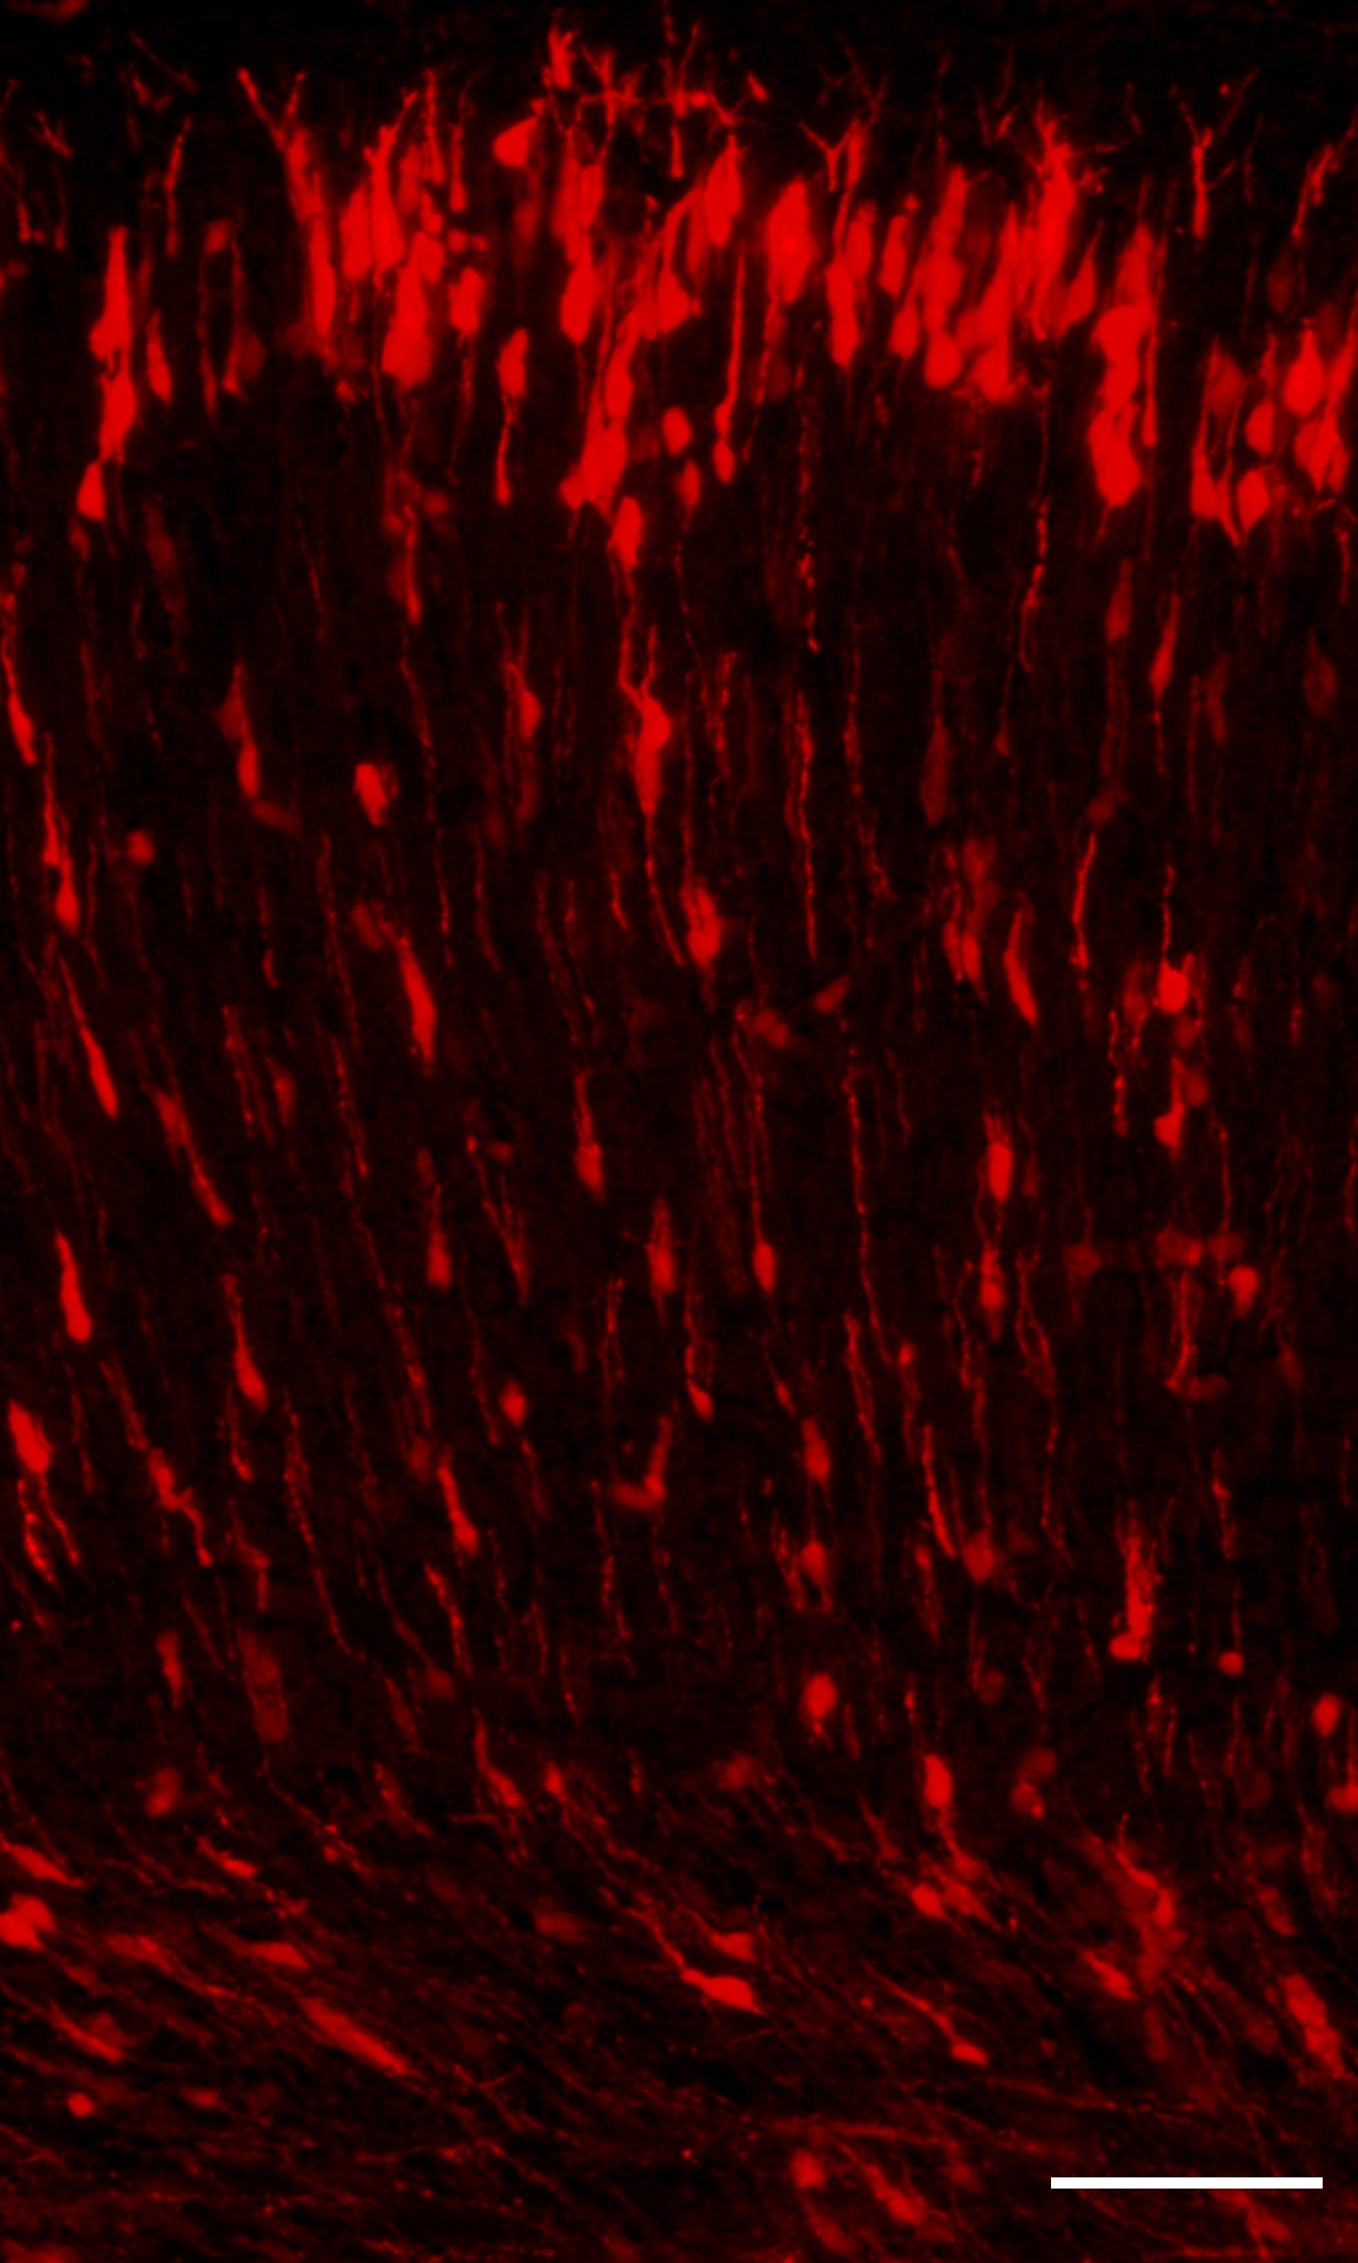
a
control
HDAC6 KD
b
NS
NS
NS
NS
NS
Additional file 1. HDAC6 knockdown alone does not affect neuronal migration in vivo. HDAC6 knockdown neurons properly migrated into cortical plate. (a) HDAC6 knockdown neurons migrate into the pial surface. Scale bar, 50 µm. (b) Graph represents the percent of transfected cells in the cortical layer. Error bar means ± S.D. in all graphs.

