Slide 1
S1: Visualization of the Notional Electric Motor Supply Chain Disruption and Recovery Timeline
Supplementary material to
Mimicking Nature for Resilient Resource and Infrastructure Network Design
Abheek Chatterjee, Astrid Layton

Slide 2
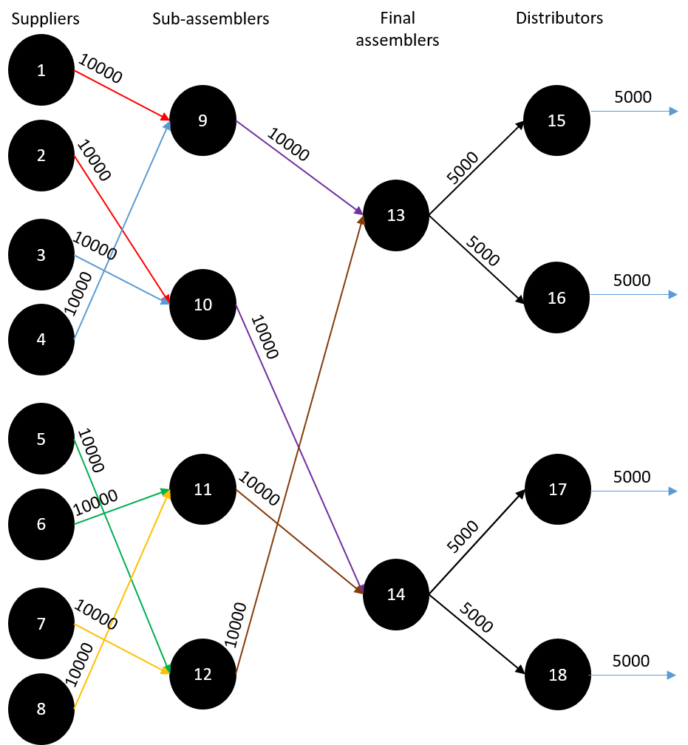
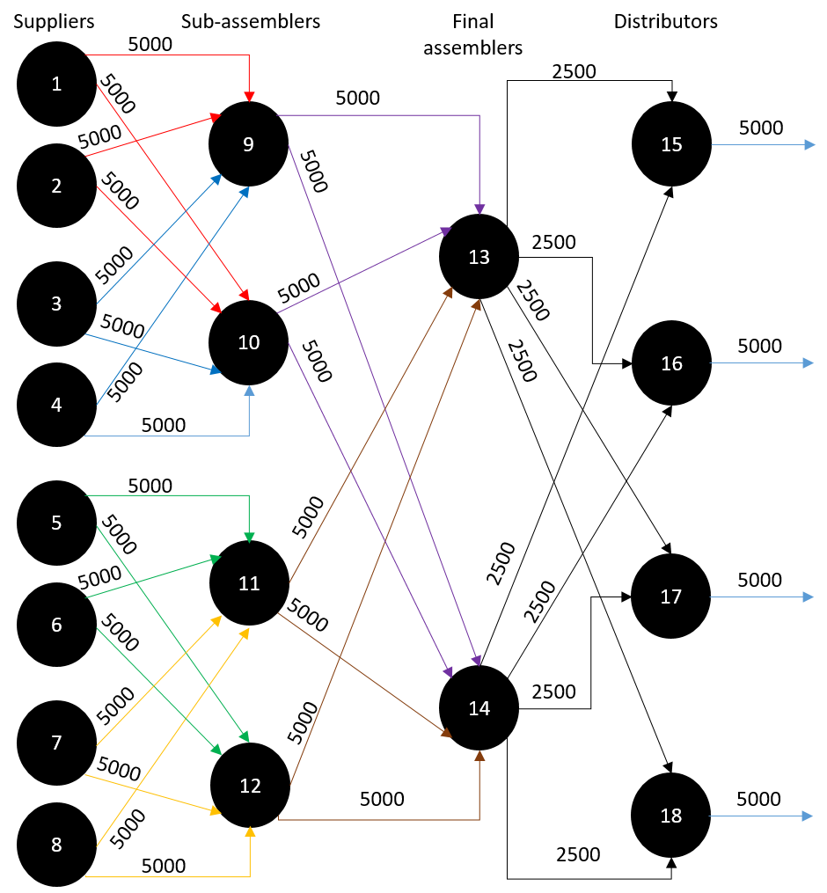
Week 0-1 Snapshot (Undisrupted state)
Design for minimum shipping cost
Bio-inspired design
Performance curves
Rotor
Stator
Shield
Base
Drive-assembly
Case-assembly
Assembled Motor
Exports

Slide 3
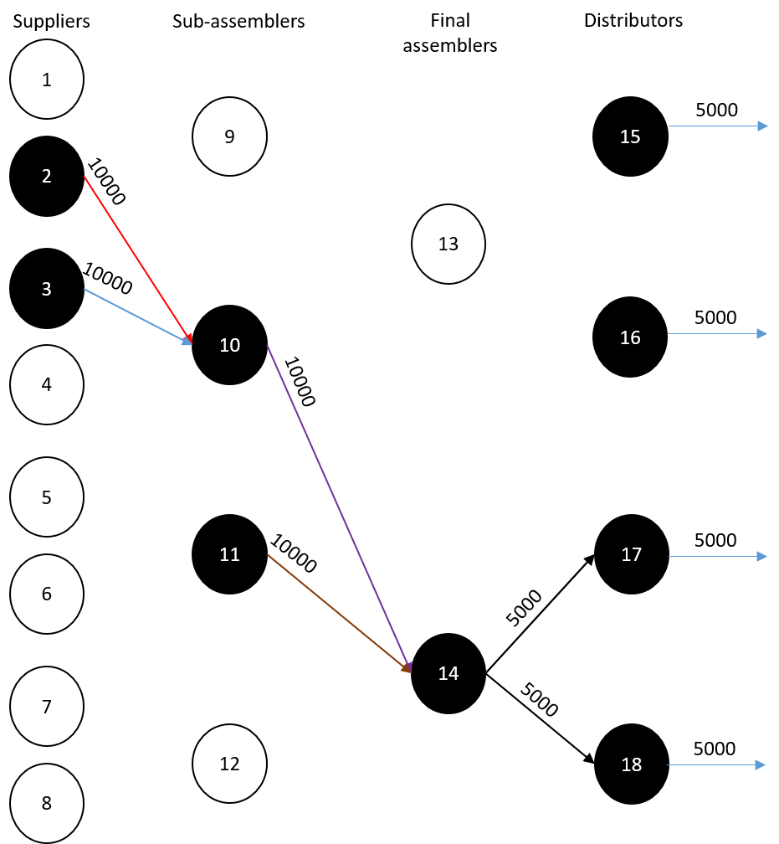
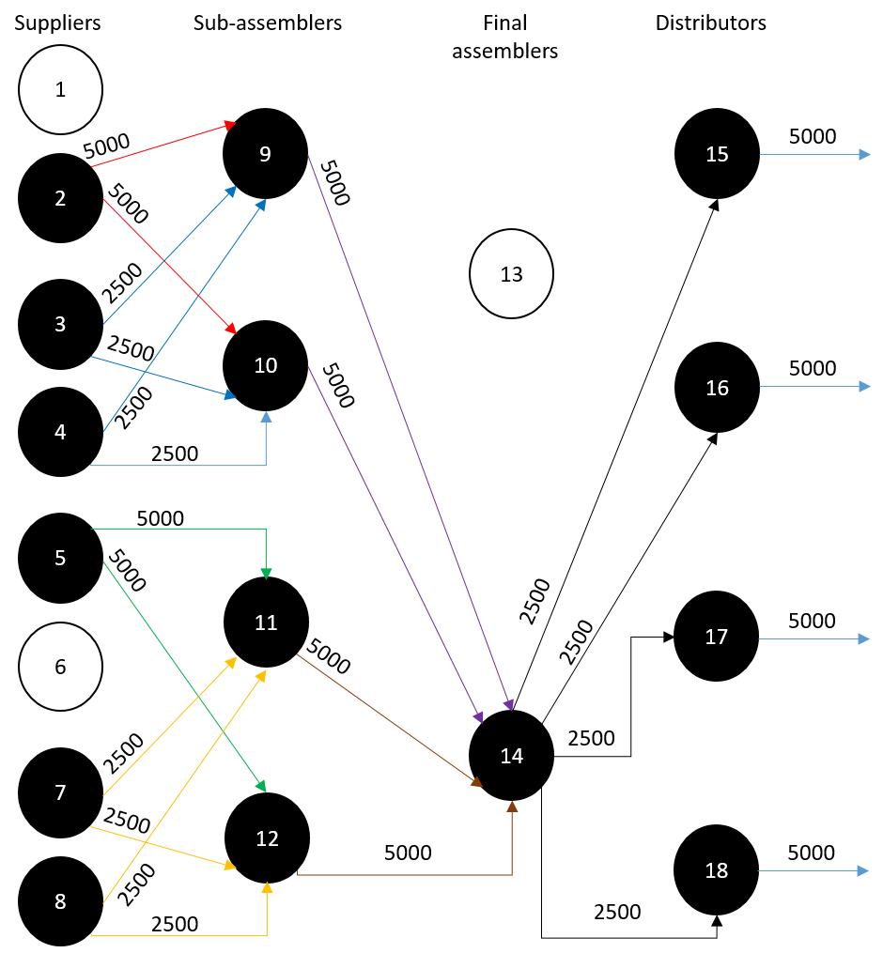
Week 1-2 Snapshot (Disruption)
Design for minimum shipping cost
Bio-inspired design
Performance curves
Rotor
Stator
Shield
Base
Drive-assembly
Case-assembly
Assembled Motor
Exports

Slide 4
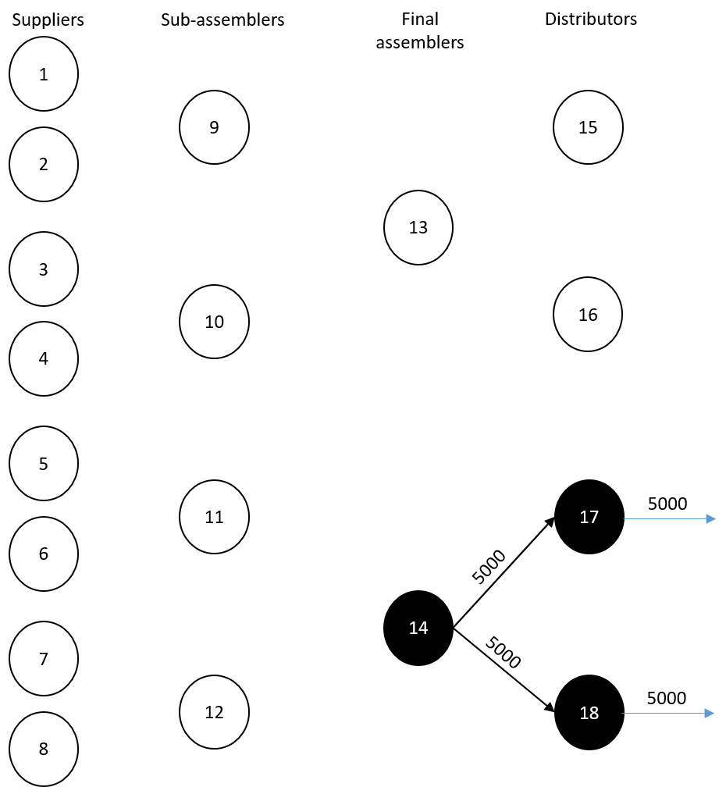

Week 2-3 Snapshot
Design for minimum shipping cost
Bio-inspired design
Performance curves
Rotor
Stator
Shield
Base
Drive-assembly
Case-assembly
Assembled Motor
Exports

Slide 5
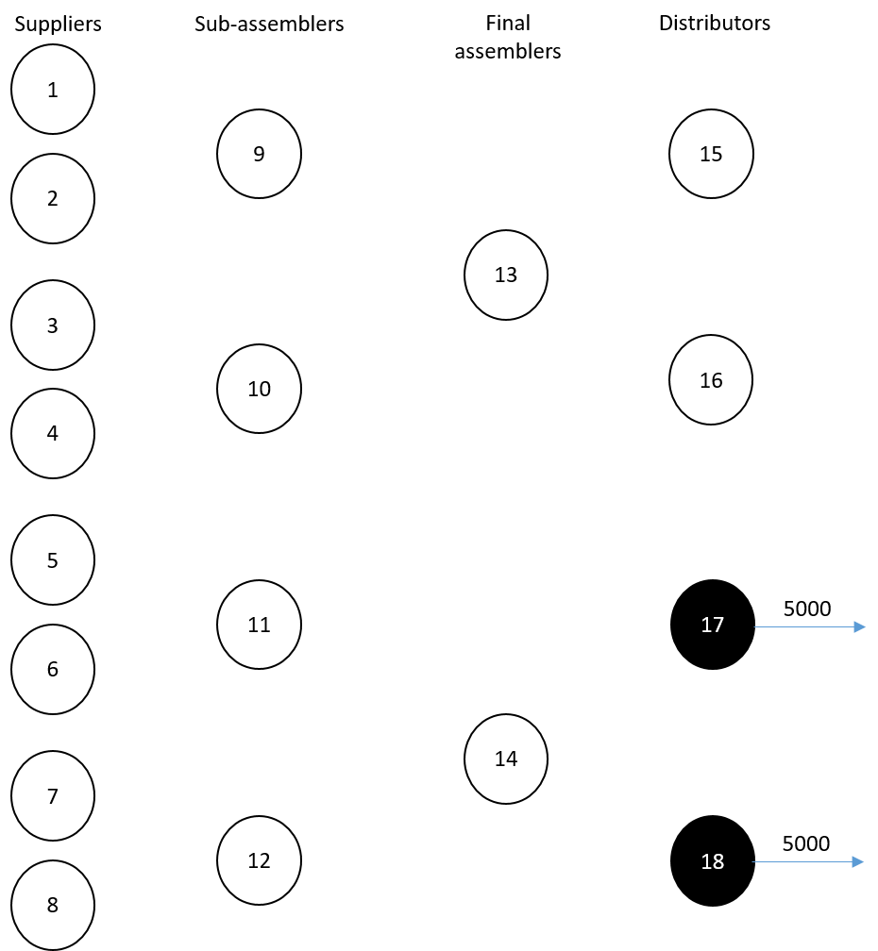
Week 3-4 Snapshot
Design for minimum shipping cost
Bio-inspired design
Performance curves
Rotor
Stator
Shield
Base
Drive-assembly
Case-assembly
Assembled Motor
Exports

Slide 6
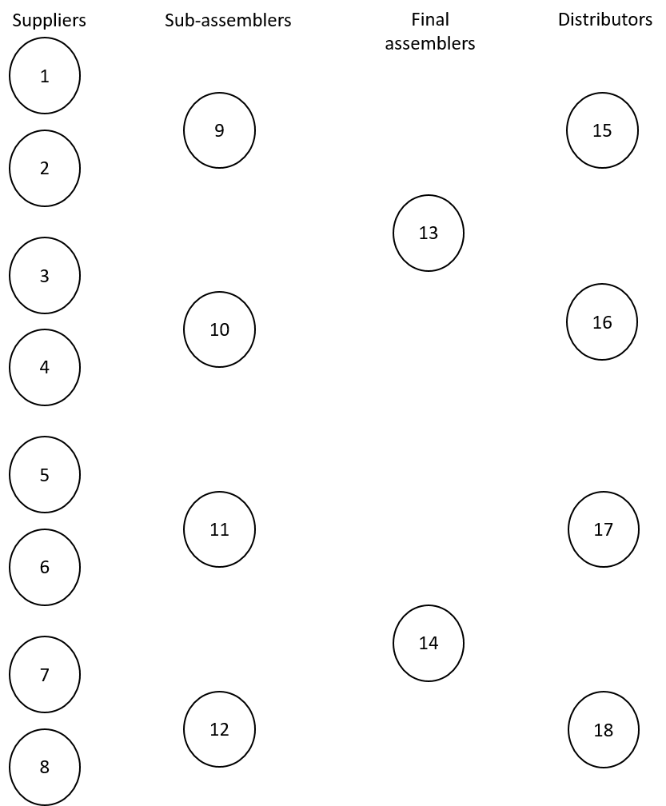
Week 4-5 Snapshot
Design for minimum shipping cost
Bio-inspired design
Performance curves
Rotor
Stator
Shield
Base
Drive-assembly
Case-assembly
Assembled Motor
Exports

Slide 7
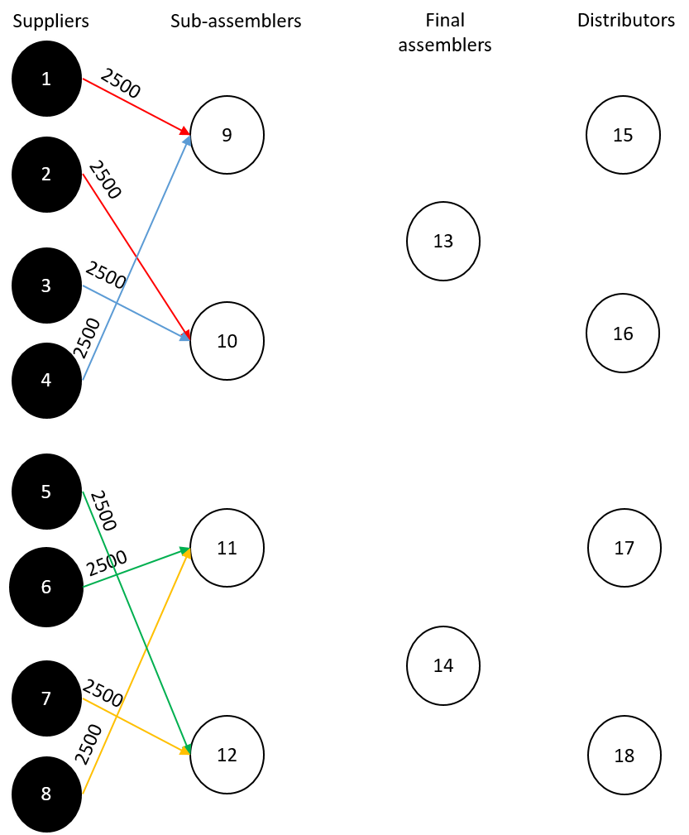
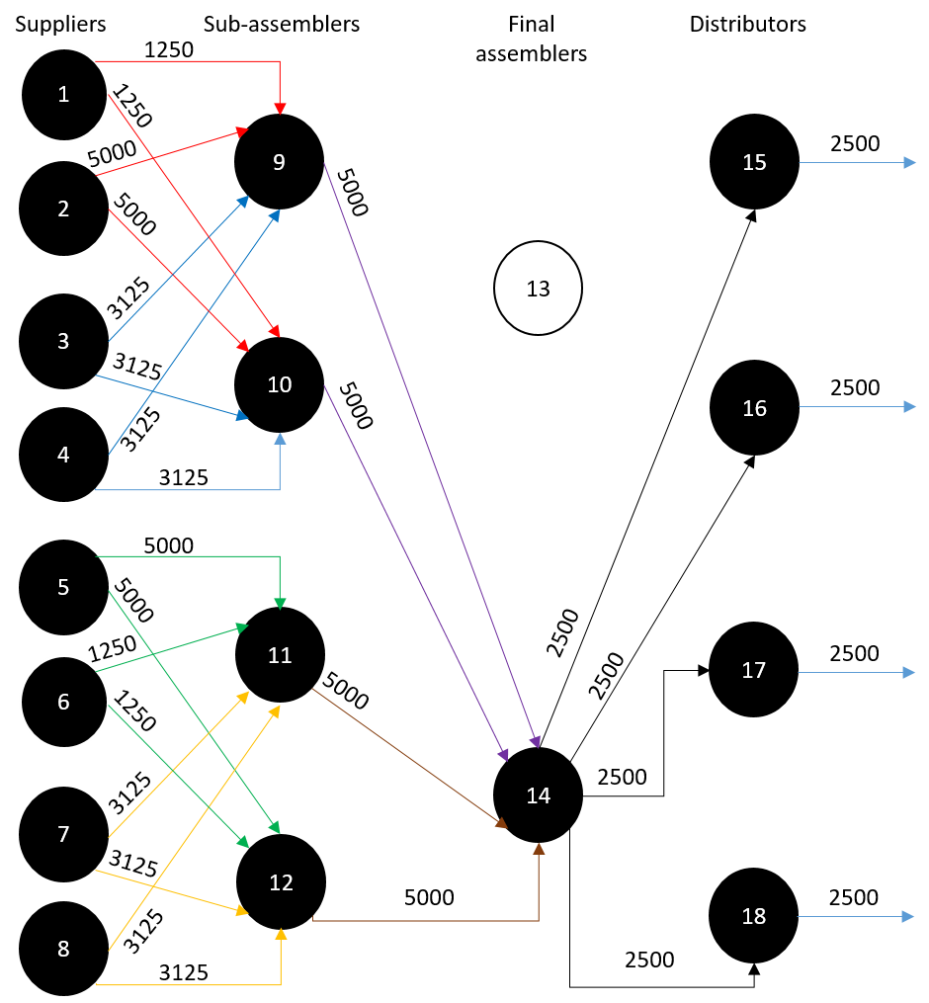
Week 5-6 Snapshot
Design for minimum shipping cost
Bio-inspired design
Performance curves
Rotor
Stator
Shield
Base
Drive-assembly
Case-assembly
Assembled Motor
Exports

Slide 8
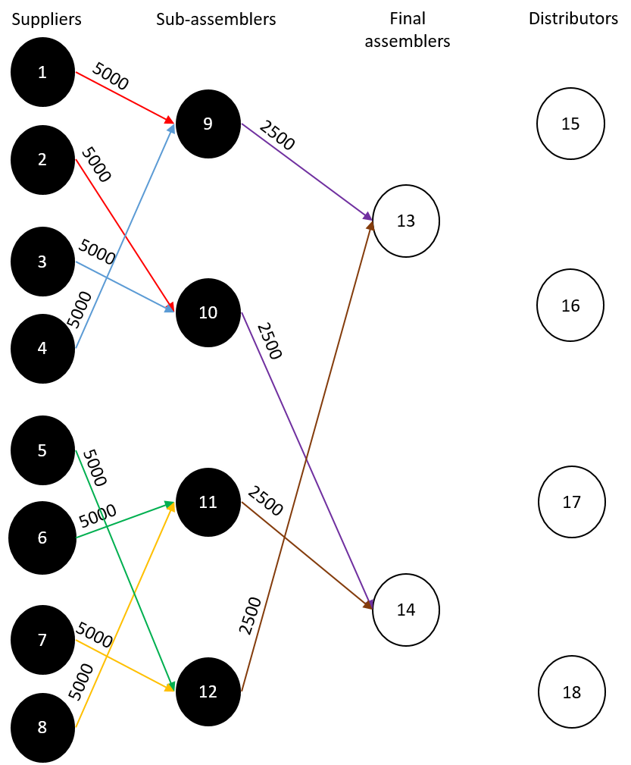
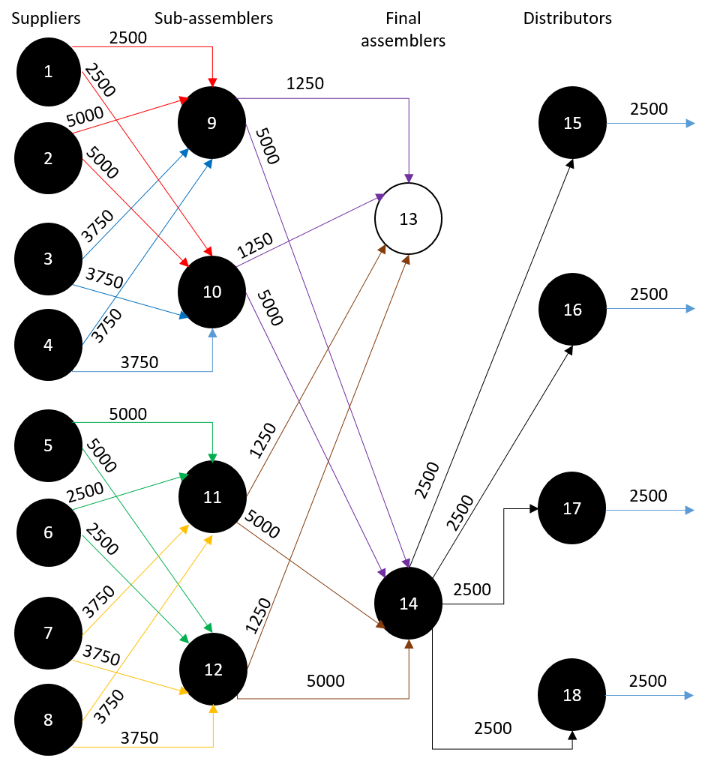
Week 6-7 Snapshot
Design for minimum shipping cost
Bio-inspired design
Performance curves
Rotor
Stator
Shield
Base
Drive-assembly
Case-assembly
Assembled Motor
Exports

Slide 9
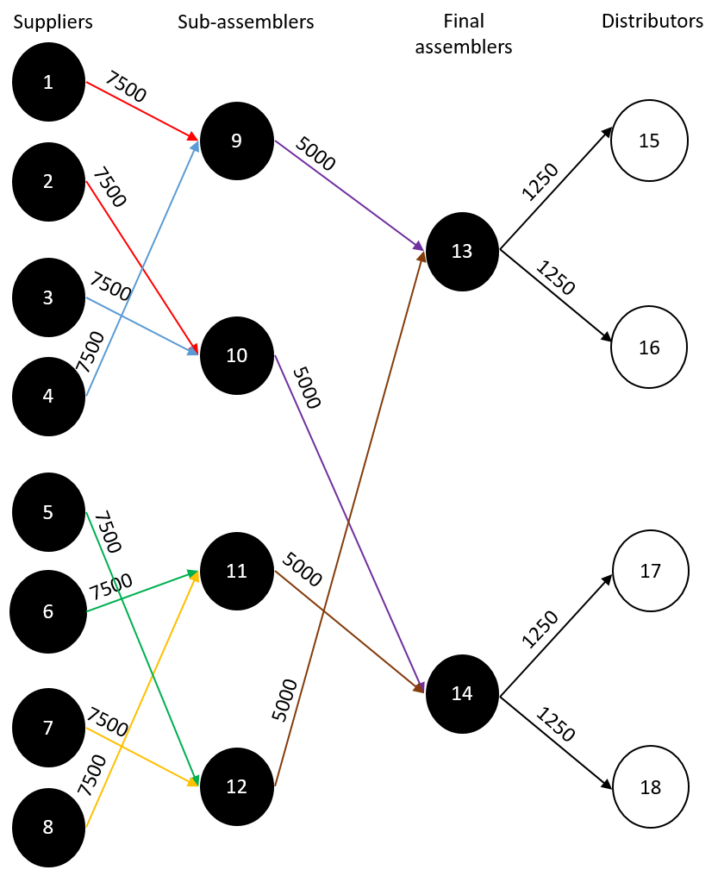
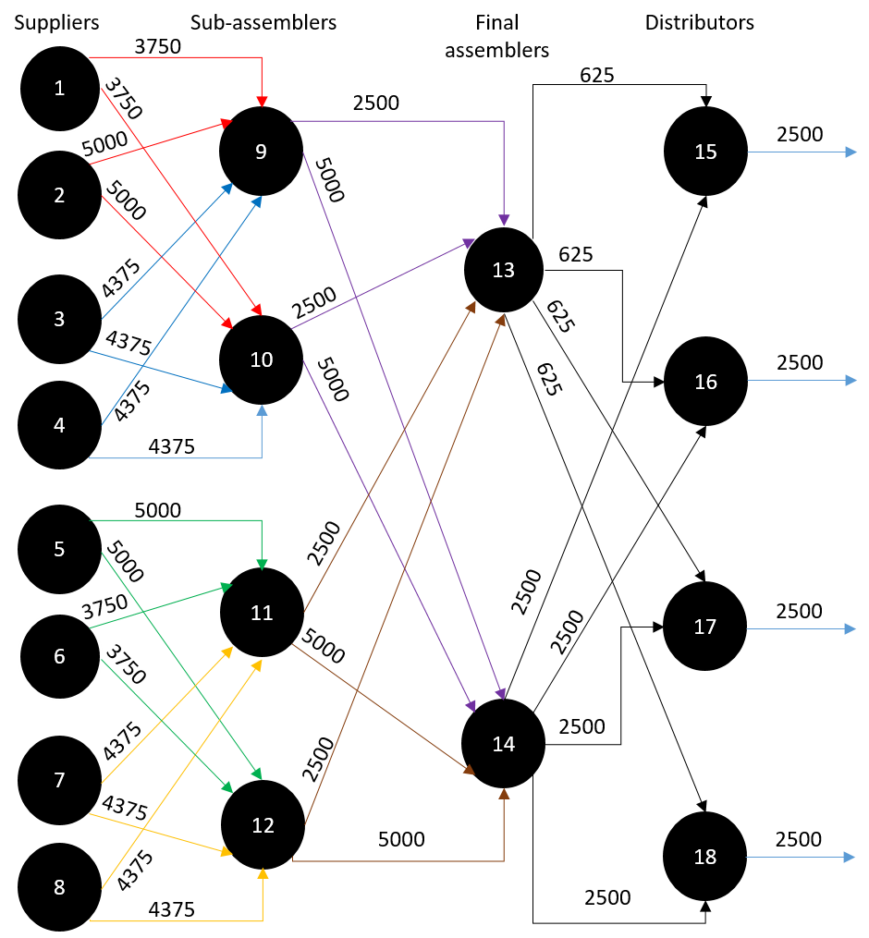
Week 7-8 Snapshot
Design for minimum shipping cost
Bio-inspired design
Performance curves
Rotor
Stator
Shield
Base
Drive-assembly
Case-assembly
Assembled Motor
Exports

Slide 10
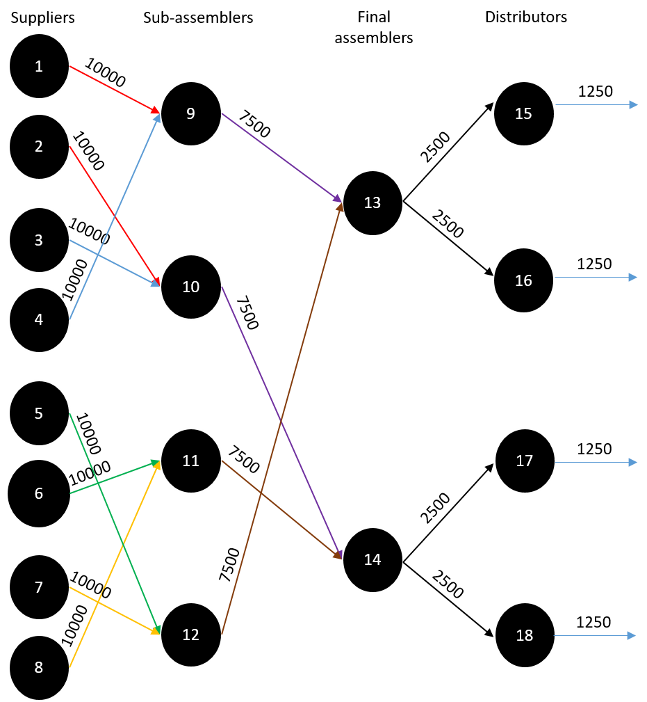

Week 8-9 Snapshot
Design for minimum shipping cost
Bio-inspired design
Performance curves
Rotor
Stator
Shield
Base
Drive-assembly
Case-assembly
Assembled Motor
Exports

Slide 11


Week 9-10 Snapshot
Design for minimum shipping cost
Bio-inspired design
Performance curves
Rotor
Stator
Shield
Base
Drive-assembly
Case-assembly
Assembled Motor
Exports

Slide 12


Week 10-11 Snapshot
Design for minimum shipping cost
Bio-inspired design
Performance curves
Rotor
Stator
Shield
Base
Drive-assembly
Case-assembly
Assembled Motor
Exports

Slide 13


Week 11-12 Snapshot
Design for minimum shipping cost
Bio-inspired design
Performance curves
Rotor
Stator
Shield
Base
Drive-assembly
Case-assembly
Assembled Motor
Exports

