Slide 1
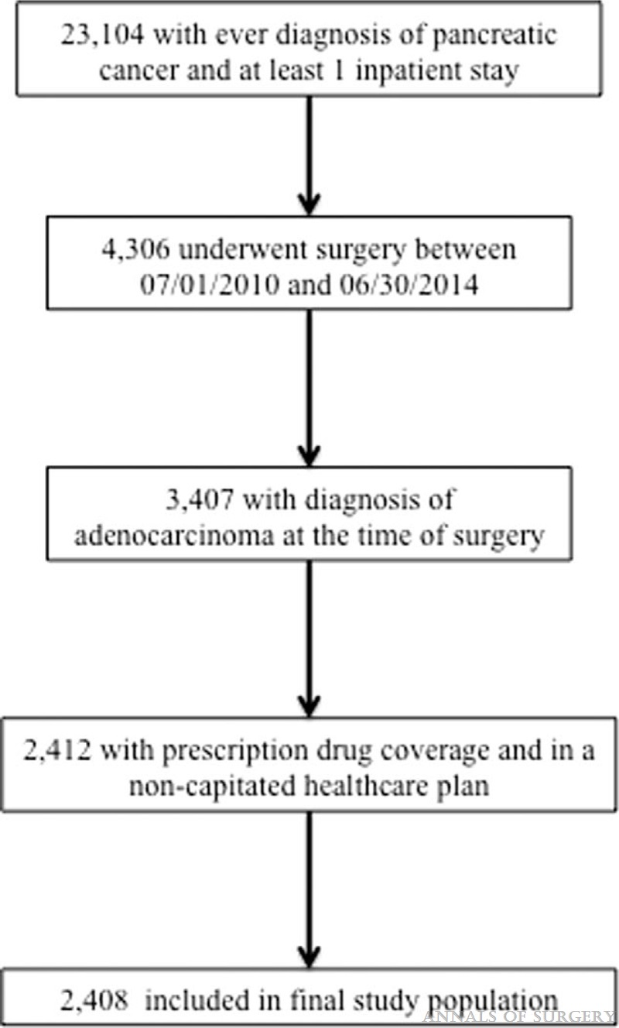
FIGURE 1
Assessing the Financial Burden Associated With Treatment Options for Resectable Pancreatic Cancer
Cerullo, Marcelo; Gani, Faiz; Chen, Sophia Y.; Canner, Joseph K.; Herman, Joseph M.; Laheru, Daniel; Pawlik, Timothy M.
Annals of Surgery267(3):544-551, March 2018.
doi: 10.1097/SLA.0000000000002069
Flow diagram detailing study population selection.

Slide 2
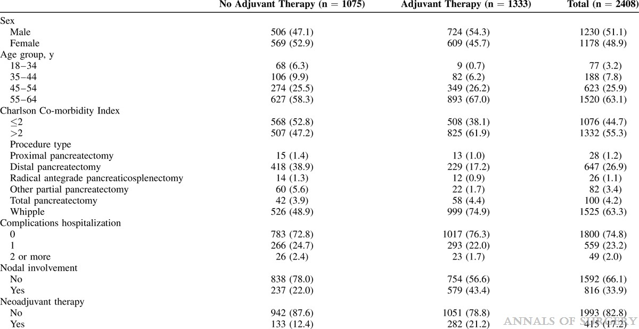
TABLE 1
Assessing the Financial Burden Associated With Treatment Options for Resectable Pancreatic Cancer
Cerullo, Marcelo; Gani, Faiz; Chen, Sophia Y.; Canner, Joseph K.; Herman, Joseph M.; Laheru, Daniel; Pawlik, Timothy M.
Annals of Surgery267(3):544-551, March 2018.
doi: 10.1097/SLA.0000000000002069
Demographic and Clinical Characteristics Among All Patients Stratified By Receipt of Adjuvant Therapy

Slide 3
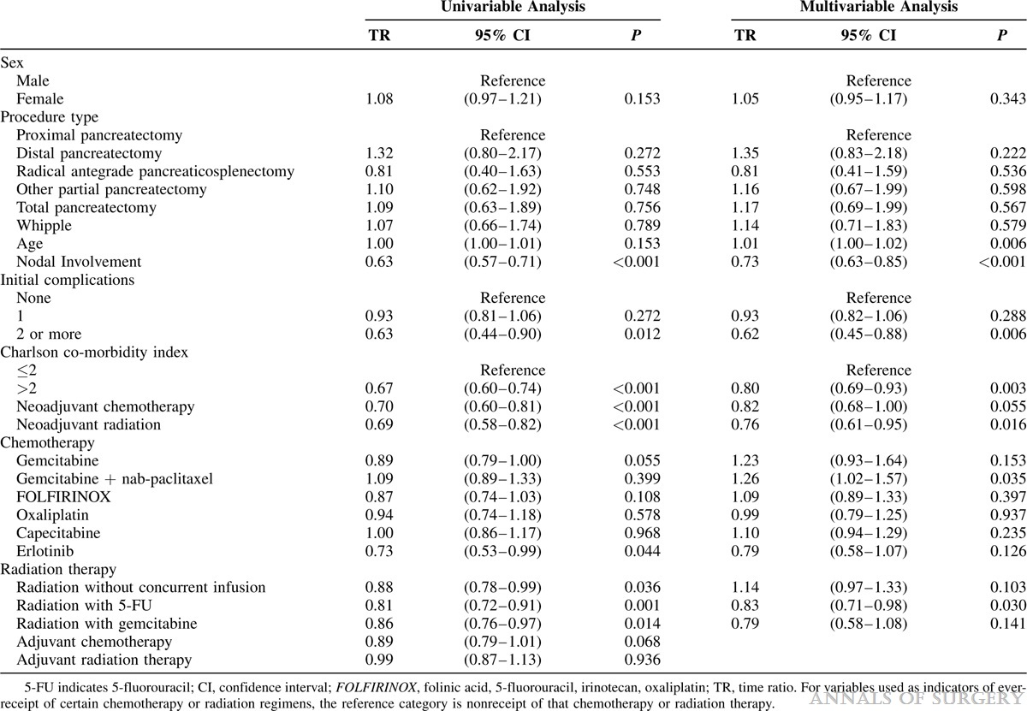
TABLE 2
Assessing the Financial Burden Associated With Treatment Options for Resectable Pancreatic Cancer
Cerullo, Marcelo; Gani, Faiz; Chen, Sophia Y.; Canner, Joseph K.; Herman, Joseph M.; Laheru, Daniel; Pawlik, Timothy M.
Annals of Surgery267(3):544-551, March 2018.
doi: 10.1097/SLA.0000000000002069
Results From Univariable and Multivariable Analysis of Factors Associated With Survival

Slide 4
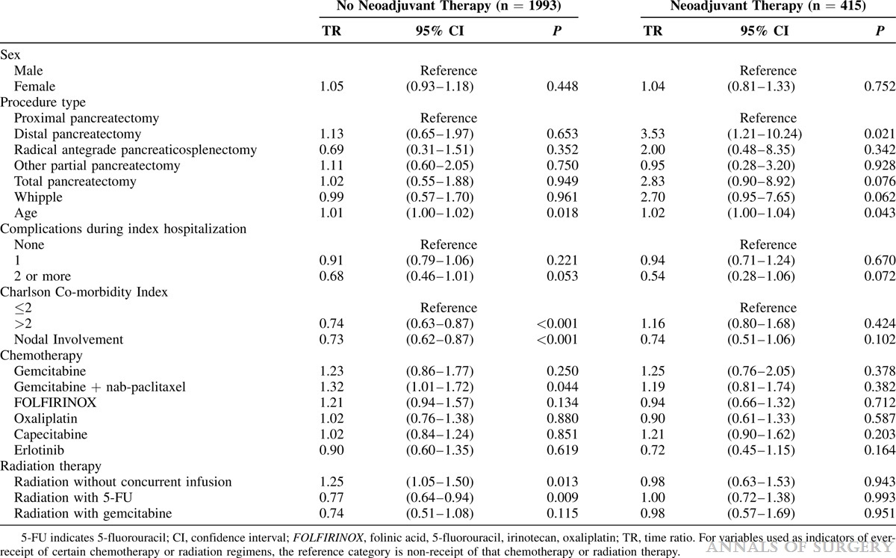
TABLE 3
Assessing the Financial Burden Associated With Treatment Options for Resectable Pancreatic Cancer
Cerullo, Marcelo; Gani, Faiz; Chen, Sophia Y.; Canner, Joseph K.; Herman, Joseph M.; Laheru, Daniel; Pawlik, Timothy M.
Annals of Surgery267(3):544-551, March 2018.
doi: 10.1097/SLA.0000000000002069
Stratified Analysis by Receipt of Neoadjuvant Therapy

Slide 5
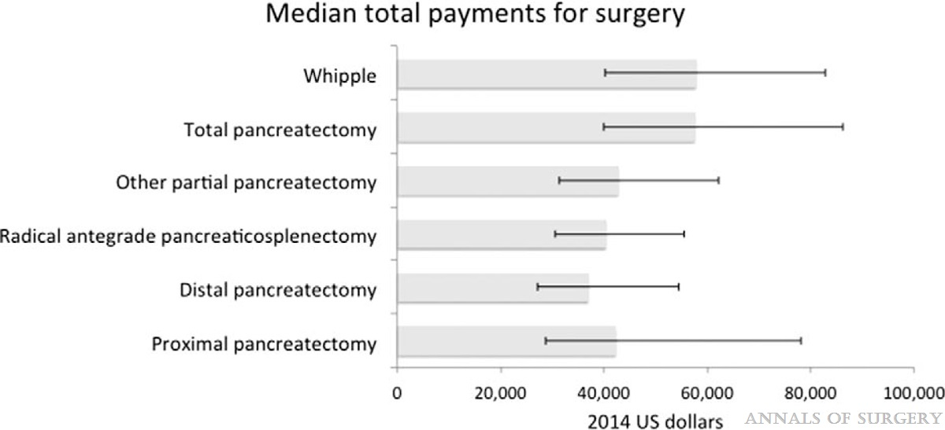
FIGURE 2
Assessing the Financial Burden Associated With Treatment Options for Resectable Pancreatic Cancer
Cerullo, Marcelo; Gani, Faiz; Chen, Sophia Y.; Canner, Joseph K.; Herman, Joseph M.; Laheru, Daniel; Pawlik, Timothy M.
Annals of Surgery267(3):544-551, March 2018.
doi: 10.1097/SLA.0000000000002069
Median total payments for index surgical procedure, with interquartile range.

Slide 6
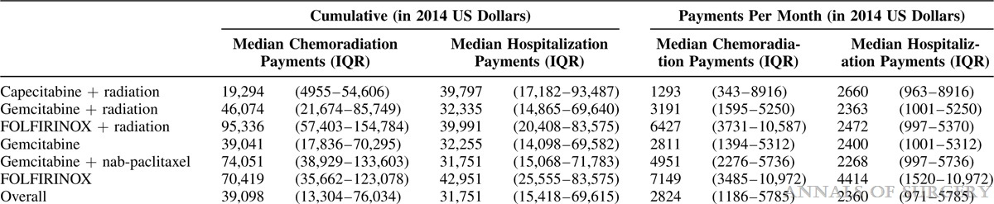
TABLE 4
Assessing the Financial Burden Associated With Treatment Options for Resectable Pancreatic Cancer
Cerullo, Marcelo; Gani, Faiz; Chen, Sophia Y.; Canner, Joseph K.; Herman, Joseph M.; Laheru, Daniel; Pawlik, Timothy M.
Annals of Surgery267(3):544-551, March 2018.
doi: 10.1097/SLA.0000000000002069
Cumulative and Per-month Calculated Payments, by Chemoradiation Regimen

Slide 7
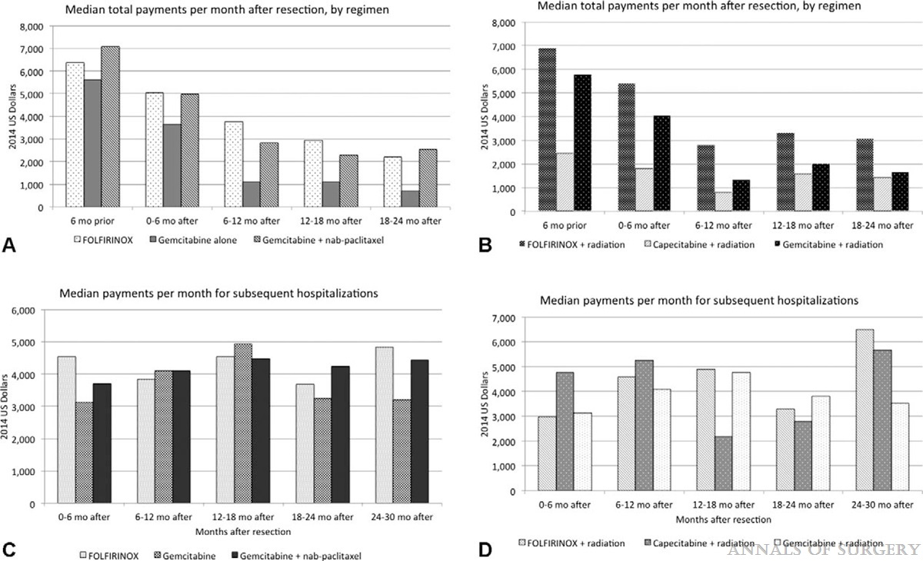
FIGURE 3
Assessing the Financial Burden Associated With Treatment Options for Resectable Pancreatic Cancer
Cerullo, Marcelo; Gani, Faiz; Chen, Sophia Y.; Canner, Joseph K.; Herman, Joseph M.; Laheru, Daniel; Pawlik, Timothy M.
Annals of Surgery267(3):544-551, March 2018.
doi: 10.1097/SLA.0000000000002069
(A) Median payments (calculated per-month) for adjuvant therapy, by chemoradiation regimen, all patients, and (B) median payments (calculated per-month) monthly payments for adjuvant therapy, by chemoradiation regimen, in patients receiving radiation therapy. (C) Median payments (calculated per-month) for subsequent hospitalization, by chemoradiation regimen, all patients, and (D) median payments (calculated per-month) for subsequent hospitalization, by chemoradiation regimen, in patients receiving radiation therapy.

