Slide 1
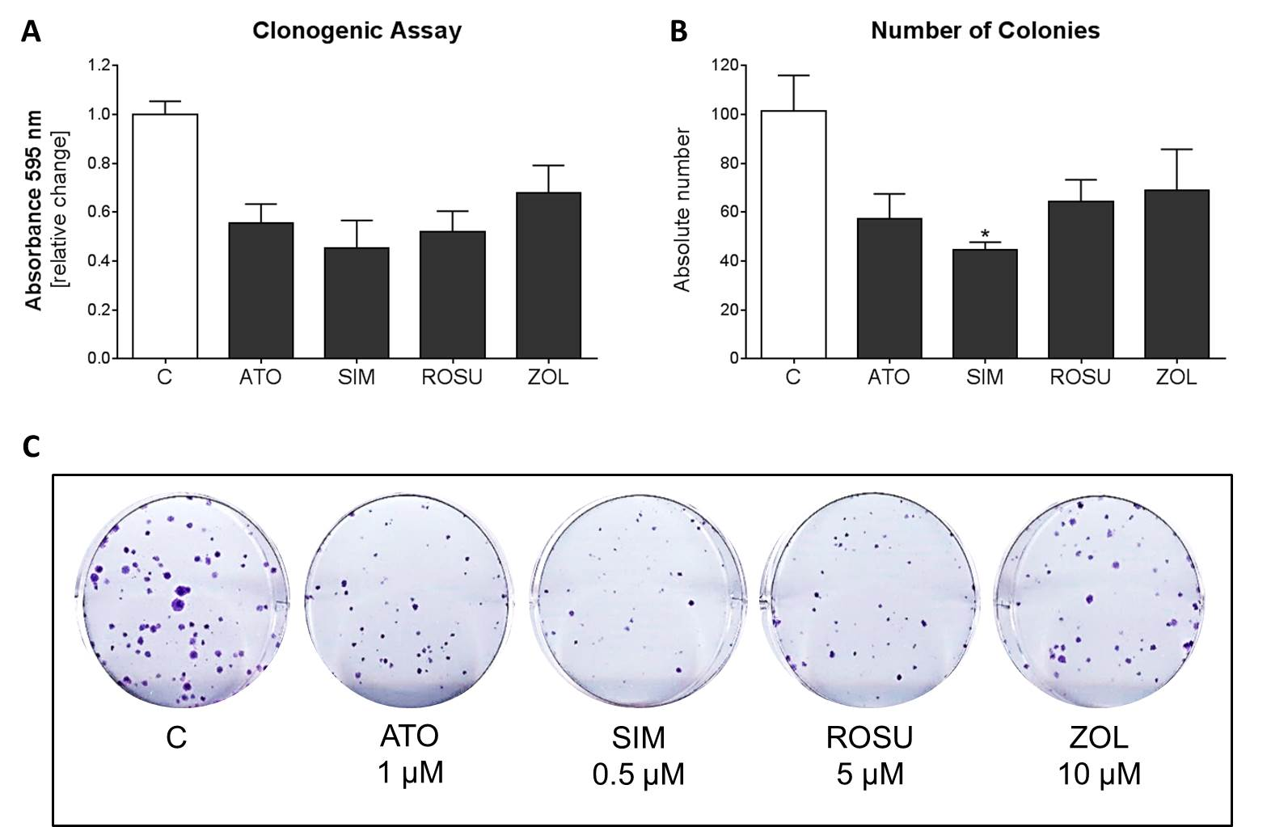
Suppl.Fig.1
a)
b)
Absorbance
Number of colonies
c)

