Slide 1
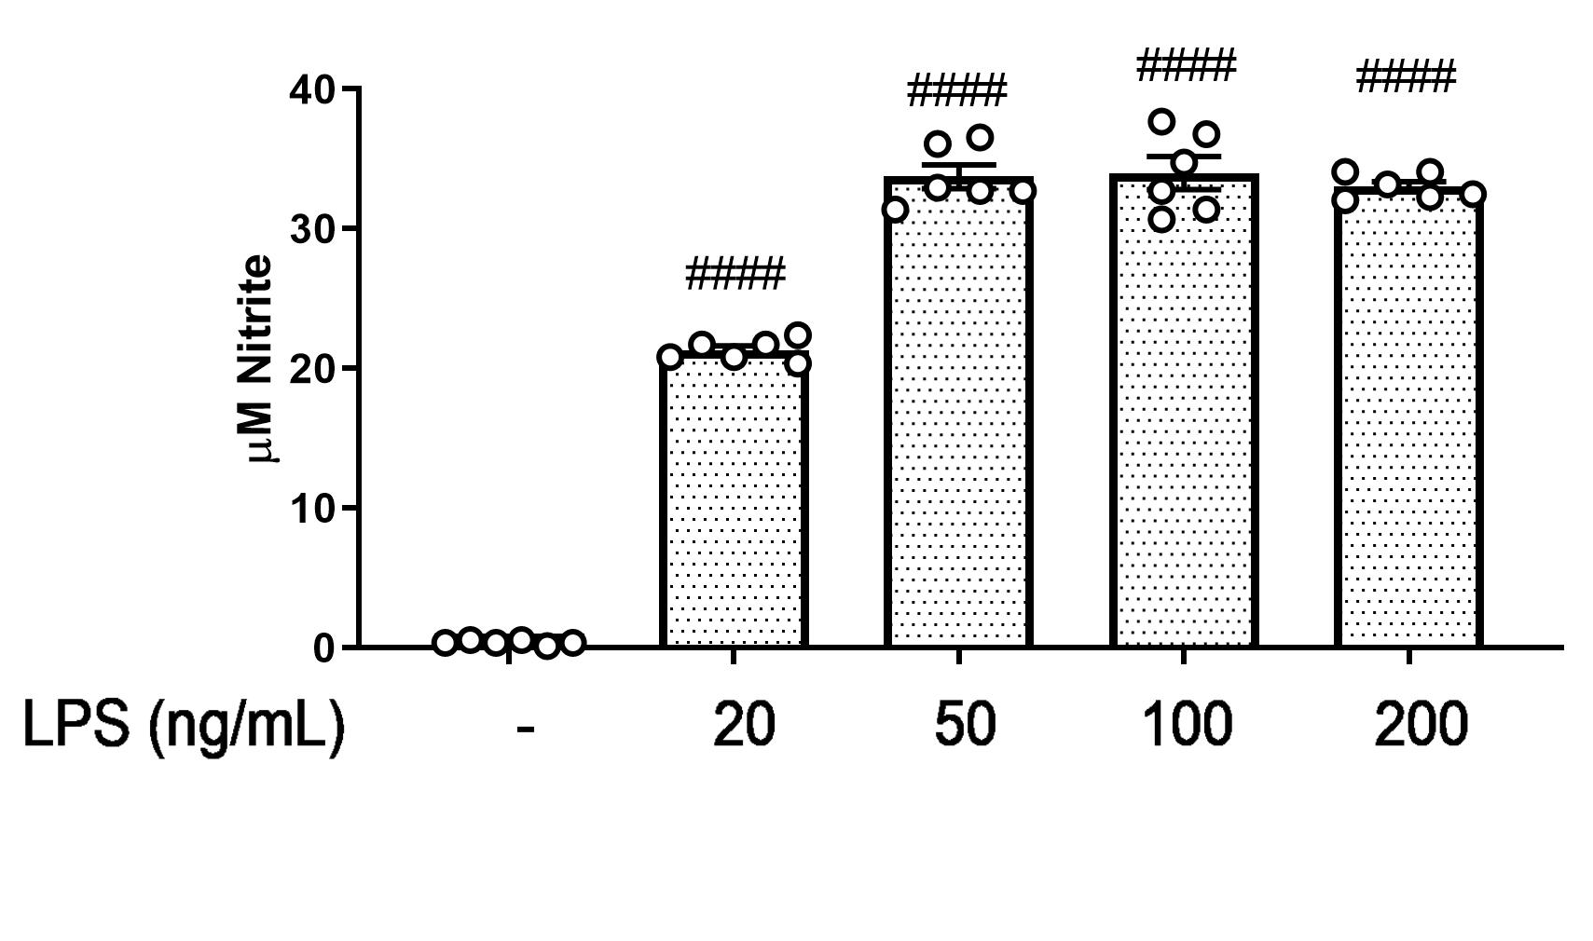
Supplementary Fig. 1
A.

Slide 2
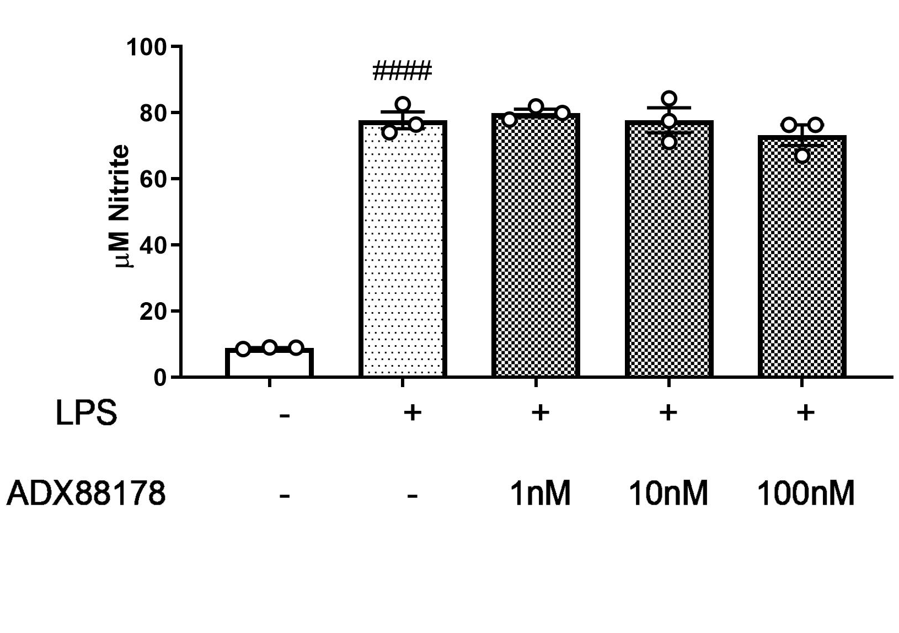
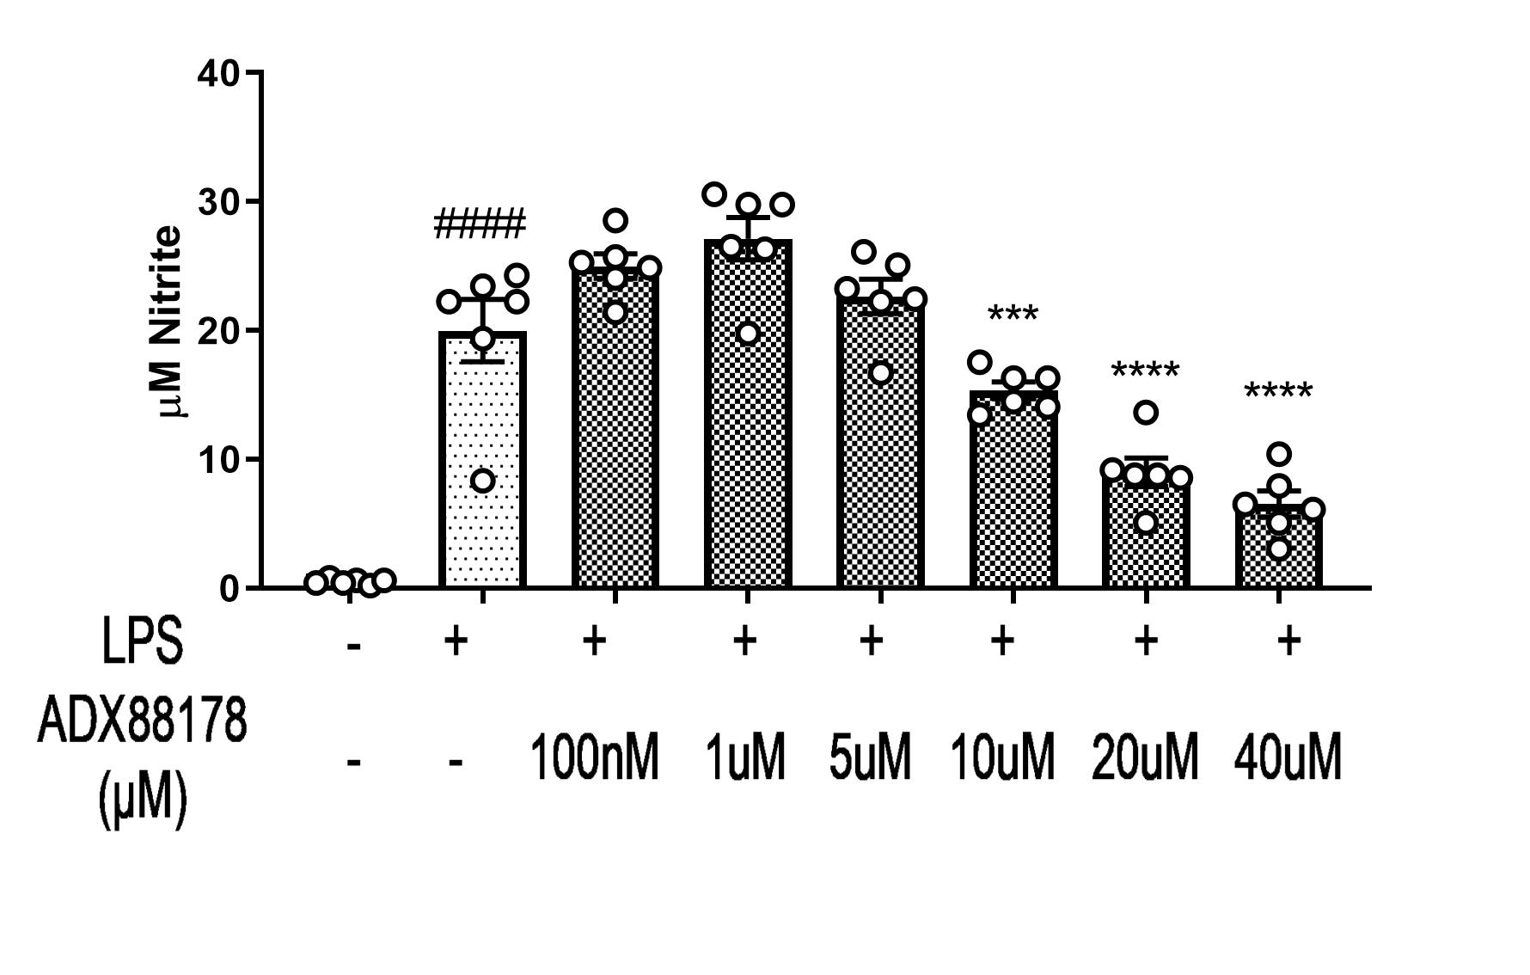
Supplementary Fig. 2
A.
B.

Slide 3
Supplementary Fig. 3
A.
Control
B.
LPS
C.
LPS+ADX88178

Slide 4
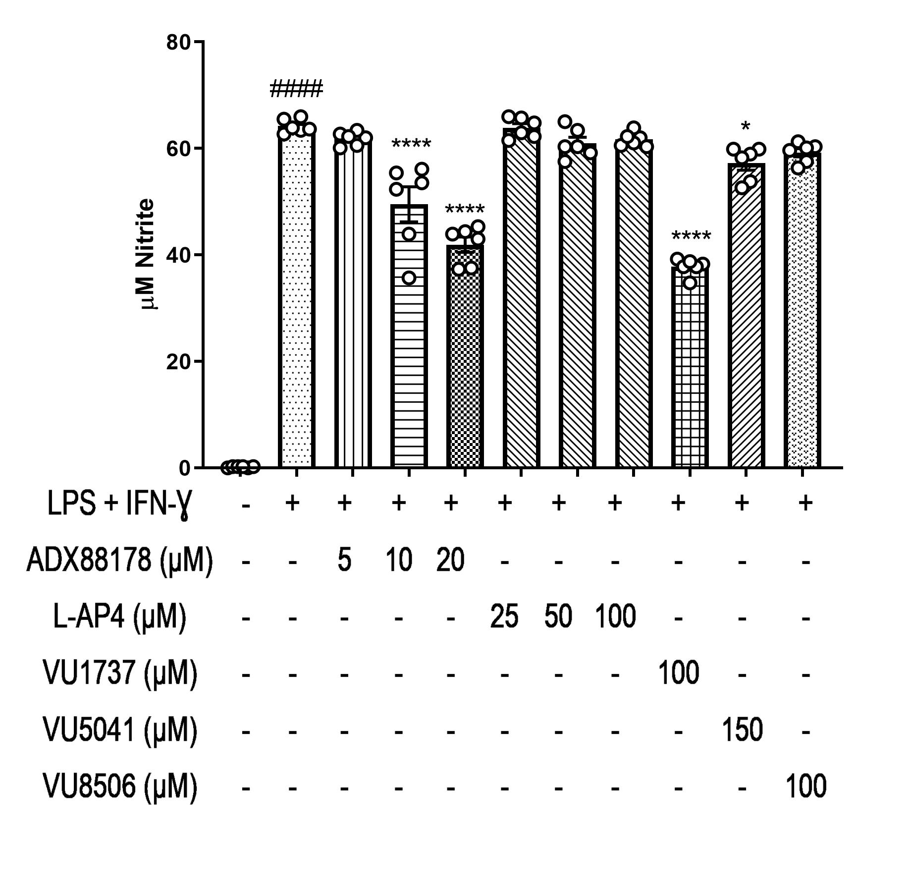
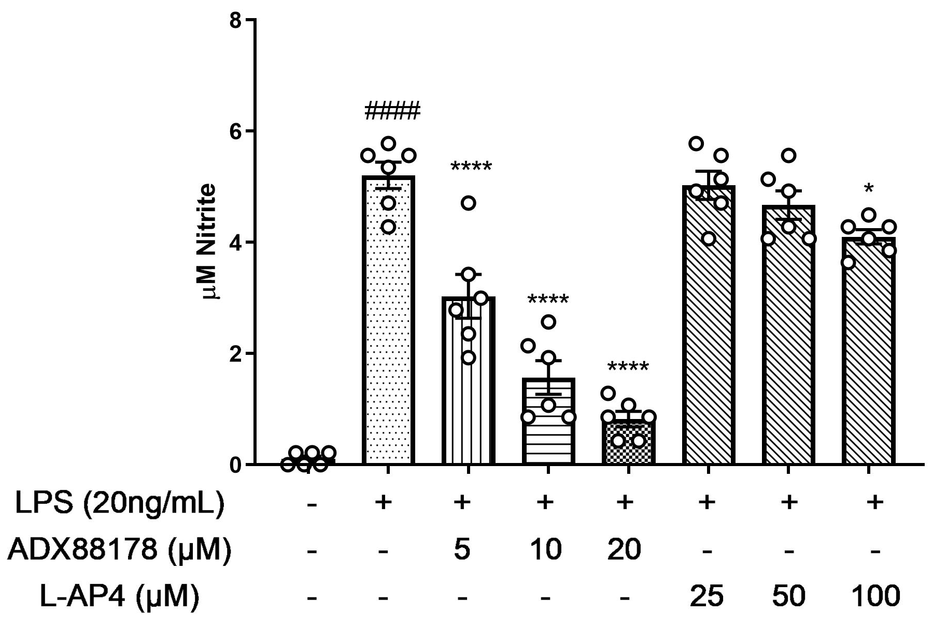
Supplementary Fig. 4
A.
B.

Slide 5
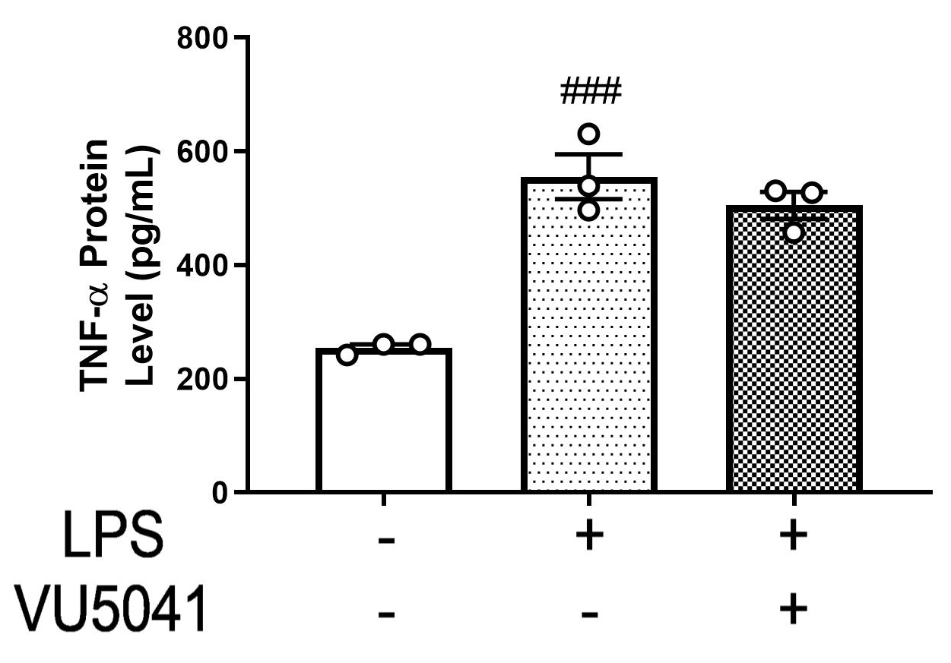
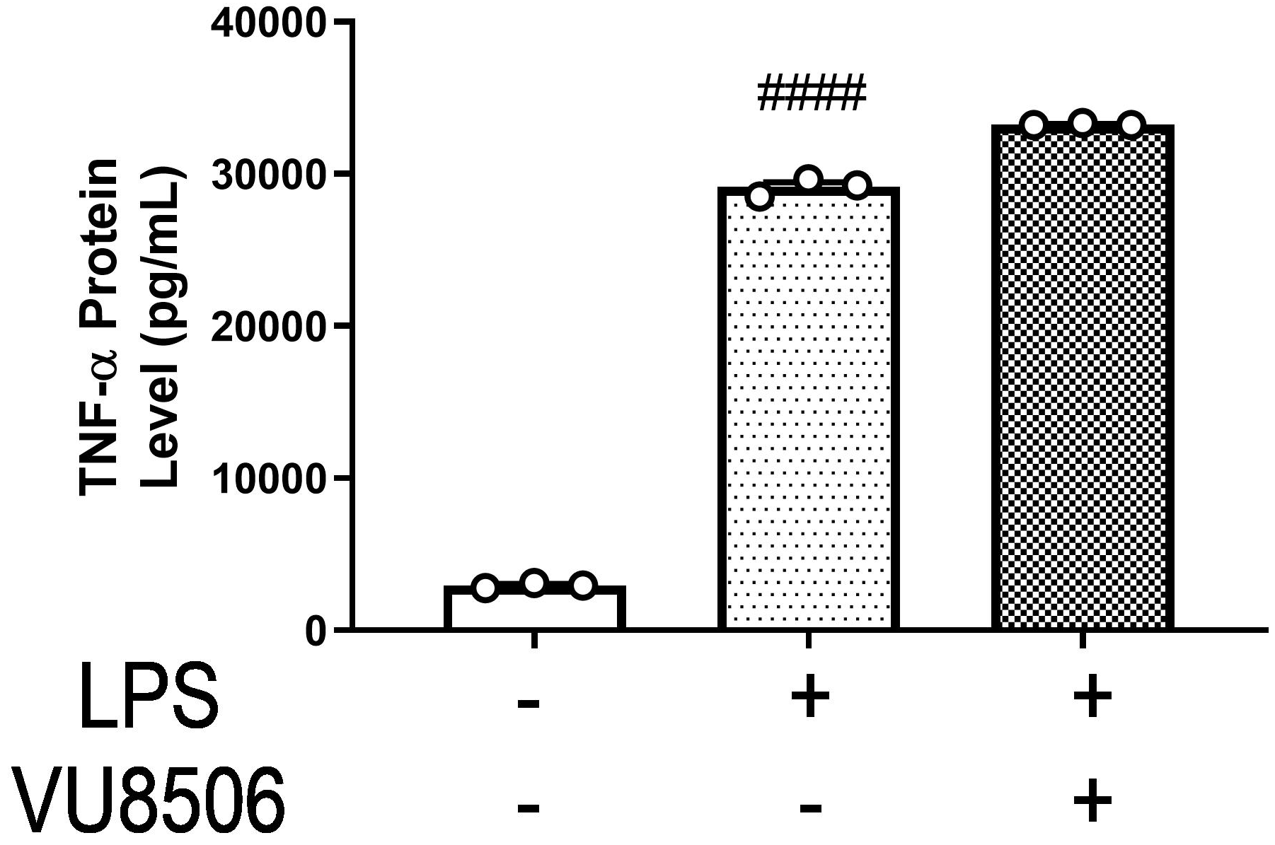
Supplementary Fig. 5
A.
B.

Slide 6
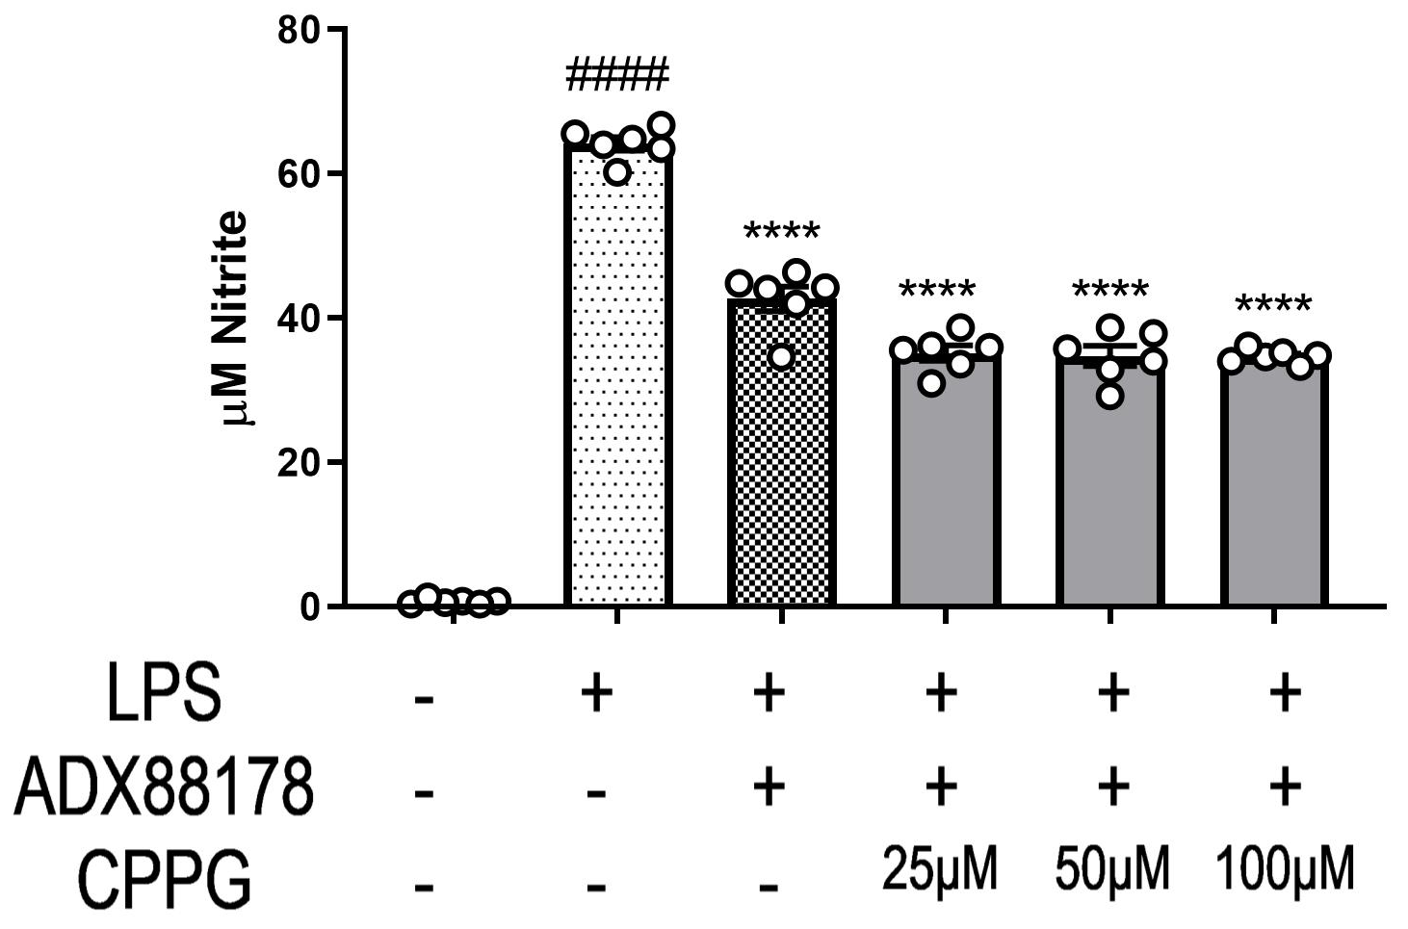
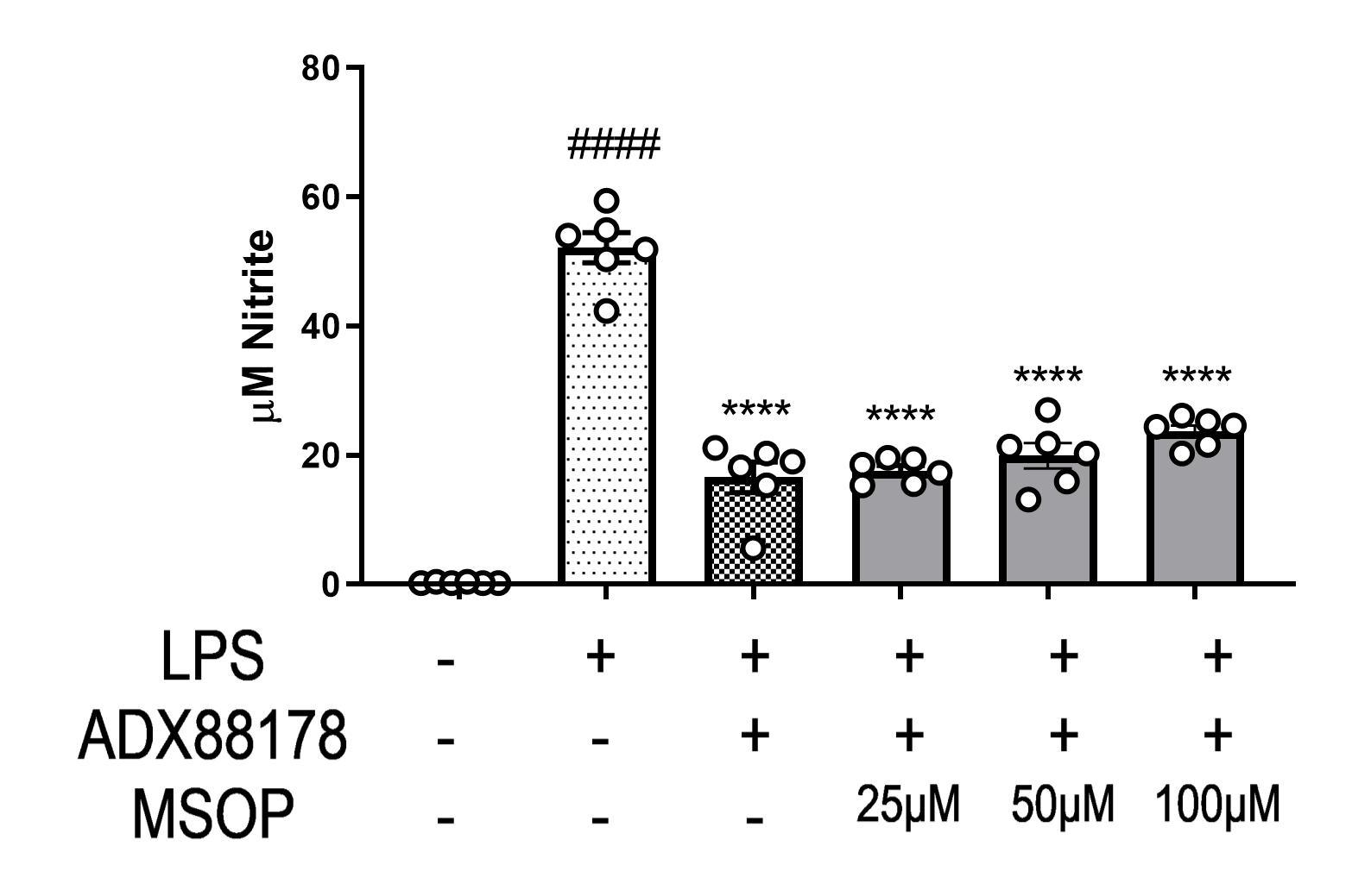
Supplementary Fig. 6
A.
B.

