Slide 1
Cleavage of proteoglycans, plasma proteins and the platelet-derived growth factor receptor in the hemorrhagic process induced by snake venom metalloproteinases.
Amanda F. Asega, Milene C. Menezes, Dilza Trevisan-Silva, Daniela Cajado-Carvalho, Luciana Bertholim, Ana K. Oliveira, André Zelanis, and Solange M. T. Serrano.
Supplementary Figure S1. Interaction of HF3 with decorin and aggrecan by SPR, using a Biacore T100 system.
Supplementary Figure S2. Degradation of proteoglycans in the mouse skin injected with HF3, as shown by Western blot analysis.
Supplementary Figure S3. SDS-PAGE profiles of mouse skin proteins and full-length blots of Western blots shown in Figure 7B.
Supplementary Figure S4. SDS-PAGE analysis of protein extracts from the mouse skin.

Slide 2
Decorin on HF3
HF3 on aggrecan
Supplementary Figure S1. Interaction of HF3 with decorin and aggrecan by SPR, using a Biacore T100 system, as described in Materials and Methods.

Slide 3
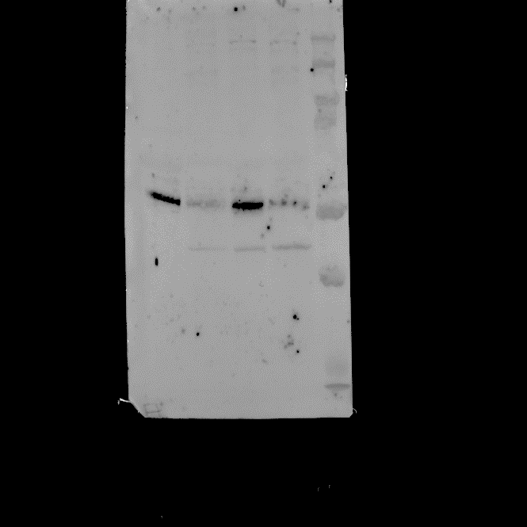
2 h 6 h
2 h 6 h
2 h 6 h
kDa
C H C H
kDa
C H C H
C H C H
250-
150-
250-
150-
kDa
250-
150-
100-
100-
100-
75-
75-
75-
50-
50-
50-
37-
37-
37-
Anti-aggrecan
Anti-brevican
Anti-mimecan
Supplementary Figure S2. Degradation of proteoglycans in the mouse skin injected with HF3, as shown by Western blot analysis. Protein samples (30 μg) from control skin (C) or skin injected with HF3 (H), as described in Materials and Methods, were immunostained with anti-aggrecan, anti-brevican, and anti-mimecan antibodies. Red rectangles indicate main protein bands recognized by the antibodies.

Slide 4
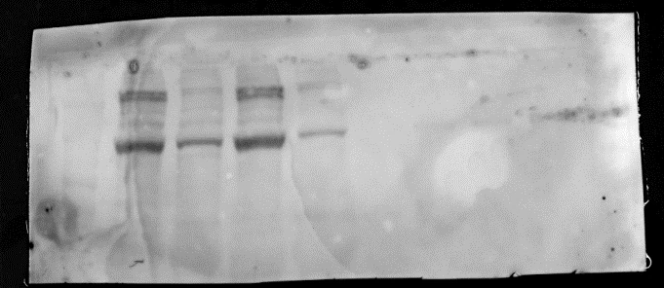
PDGF β
H – 6 h
PDGF α
C – 6 h
H – 2 h
A
C – 2 h
250-
250-
150-
150-
100-
100-
75-
75-
50-
50-
37-
37-
25-
25-
20-
20-
B
M C H C H PDGFR-⍺
170-
130-
100-
70-
Anti-PDGFR-⍺
55-
40-
35-
25-
15-
2 h 2 h 6 h 6 h
C H C H PDGFR-β
Anti-PDGFR-β
2 h 2 h 6 h 6 h
Supplementary Figure S3. (A) SDS-PAGE profile of mouse skin proteins (30 μg), control (C) and injected with HF3 (H), and of PDGFR alpha and beta. Proteins were stained with Coomassie blue. (B) Full-length blots of Western blotting shown in Figure 7B. The cropped parts indicate by the red dashed lines are shown in Figure 7B.

Slide 5
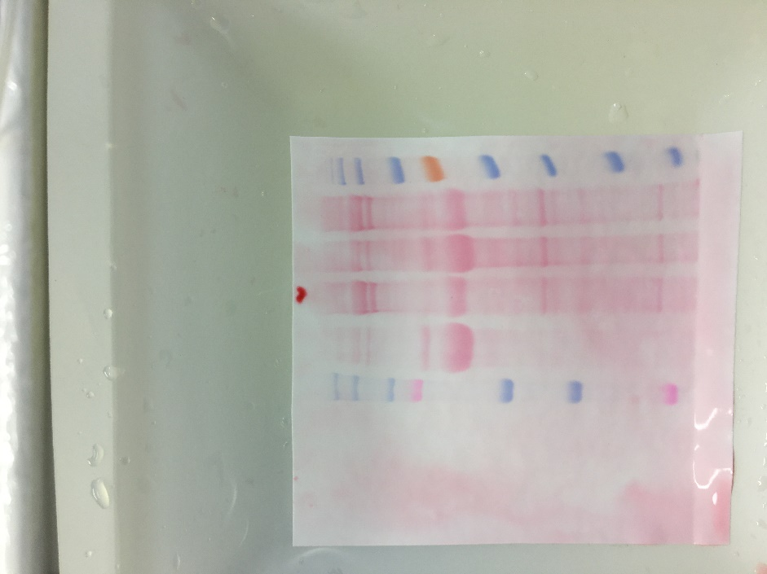
A
B
2 h 6 h
kDa
C H C H
170-
2 h 6 h
130-
kDa
C H C H
100-
180-
-250
70-
130-
-150
55-
100-
-100
70-
-75
40-
55-
-50
35-
40-
25-
35-
-37
15-
25-
-25
10-
Supplementary Figure S4. SDS-PAGE analysis of protein extracts from the mouse skin. Protein samples (30 μg) from control skin (C) or skin injected with HF3 (H) were submitted to SDS-PAGE (10% polyacrylamide gel) under reducing conditions and gels were stained with Coomassie Blue (A) or Ponceau S (B).

