Slide 1
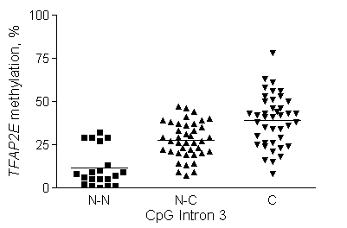
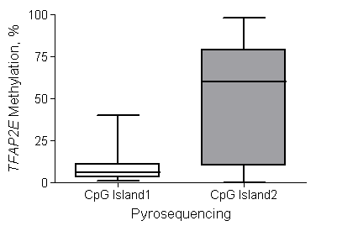
eFigure 2
Methylation analysis of TFAP2E CpG islands in CRC tissues. Calculation of cutoff value of TFAP2E Intron 3 methylation.
A
*p<0.0001
B
*p<0.0001
*p<0.0001
C
D
80
ROC analysis: Matched samples C and NC
70
P<0.0001
100
60
80
50
60
TFAP2E methylation, %
40
Within subject sensitivity, %
30
40
20
20
AUC::0.7340; 95%CI:0.624-0.826
10
0
0
0
20
40
60
80
100
N-C INT3
C INT 3
Within subject false positive rate, %

