Slide 1
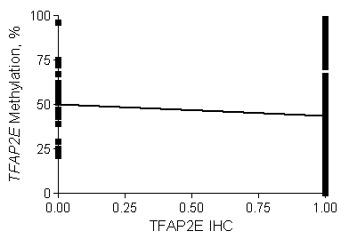
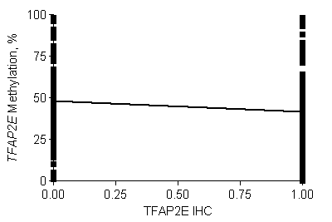
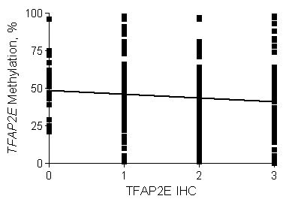
eFigure 3
Correlation between TFAP2E intron 3 methylation and IHC expression
A
B
C
p=0.1639
p=0.015*
p=0.065
D
 | TFAP2E protein IHC
TFAP2E Methylation | Positive (Strong staining) | Negative (lost and/or weak staining)
Positive | 216 | 141
Negative | 184 | 66
p=0.017 by Fisher’s exact test
%(95%CI)
Se | Sp | PPV | NPV
68.2 (61.2-74.5) | 46.0 (40.9-51.1) | 39.6 (34.4-45.0) | 73.6 (67.5-79.0)
Abbreviations: OR: Odds Ratio; CI : Confidence Interval; Se:sensitivity; Sp: Specificity; PPV: Positive Predictive Value; NPV: Negative Predictive Value

