Slide 1
Table S1. Antibiogram of P. aeruginosa 4158-02 Ps4
Antibiotics |  | Susceptibility ¹
β-lactams
 | Ampicilin/sulbactam | R
 | Aztreonam | R
 | Imipenem | S
 | Meropenem | S
 | Piperacilin | R
 | Piperacilin/tazobactam | R
 | Ticarcilin | R
 | Ticarcilin/Clavulanic | R
Cephalosporins
 | Cefepim | I
 | Cefoxitin | R
 | Ceftazidim | R
 | Ceftriaxon | R
 | Cefpirome | I
Aminoglycosides
 | Amikacin | S
 | Gentamicin | S
 | Tobramicin | S
Fluoroquinolones
 | Ciprofloxacin | R
 | Levofloxacin | R
 | Pefloxacin | R
Others
 | Colistin | S
¹ Resistant (R); Sensitive (S); Intermediate (I) according to EUCAST breakpoints

Slide 2
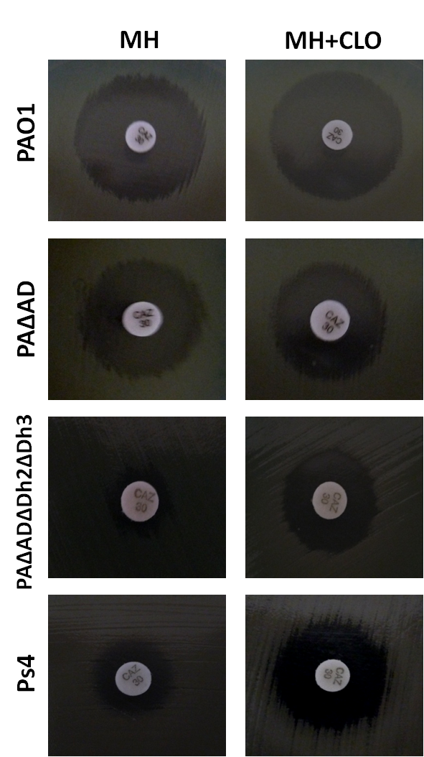
Figure S1

Slide 3
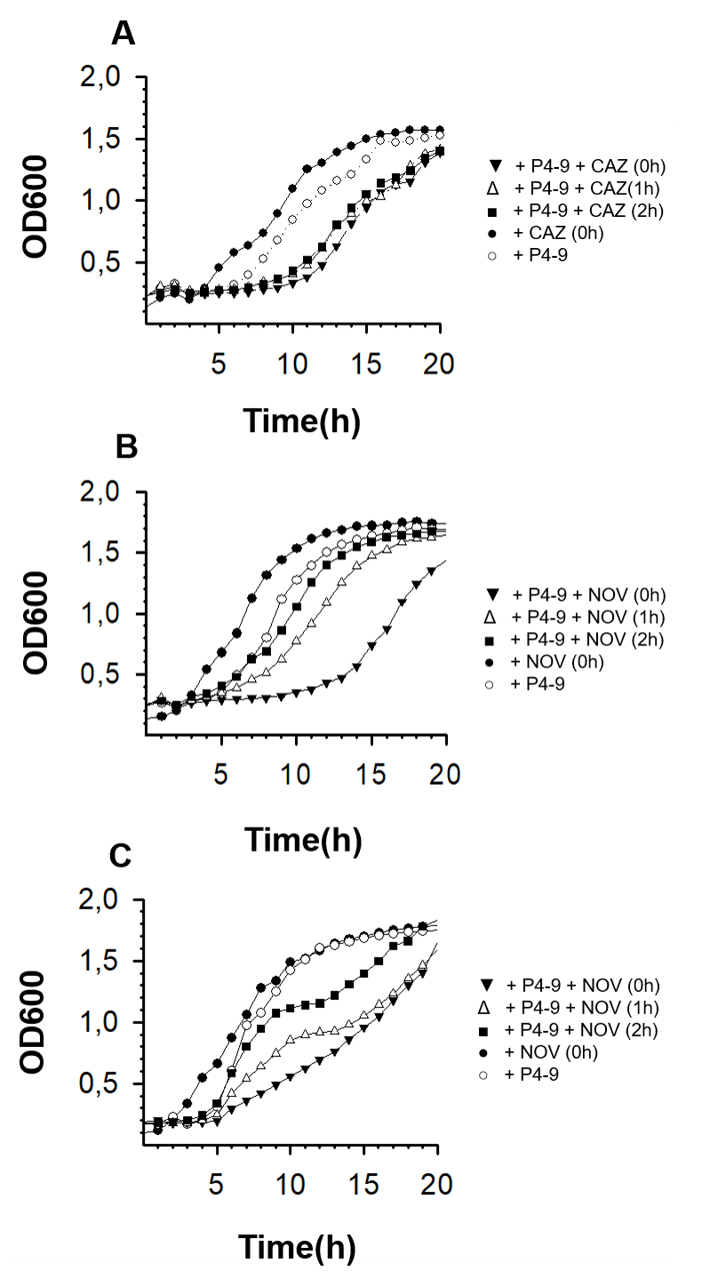
Figure S2
PAΔADΔDh2Dh3
PAO1
PAOLC1-6

Slide 4
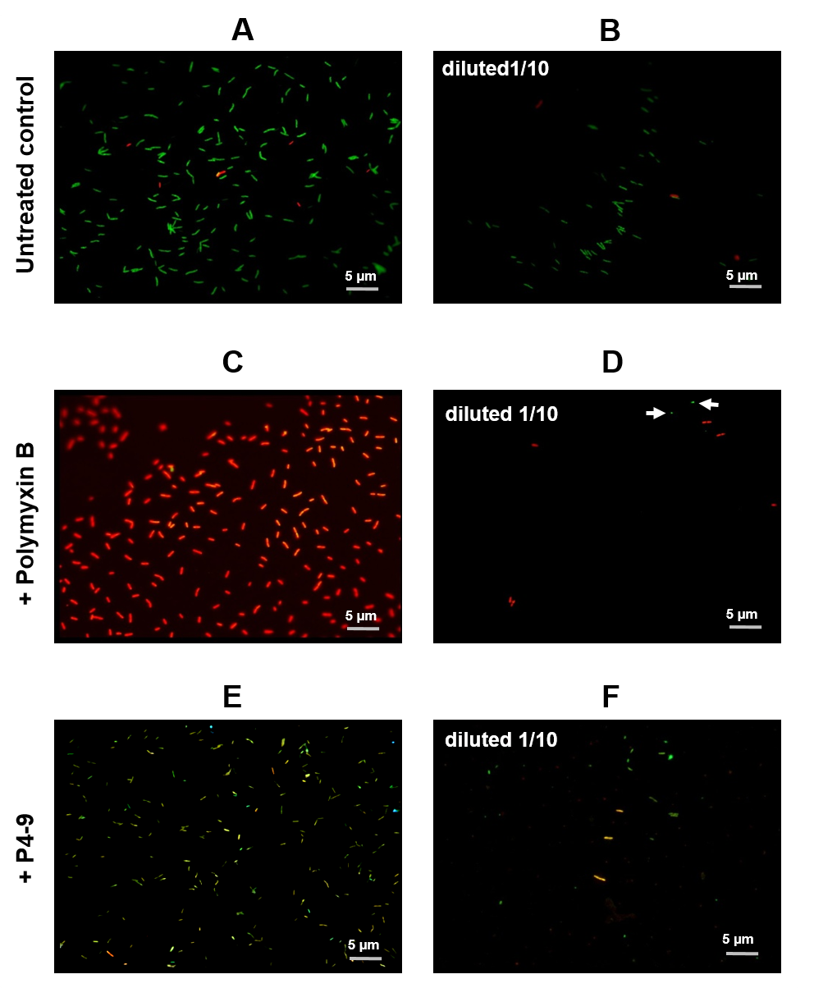
Figure S3

Slide 5
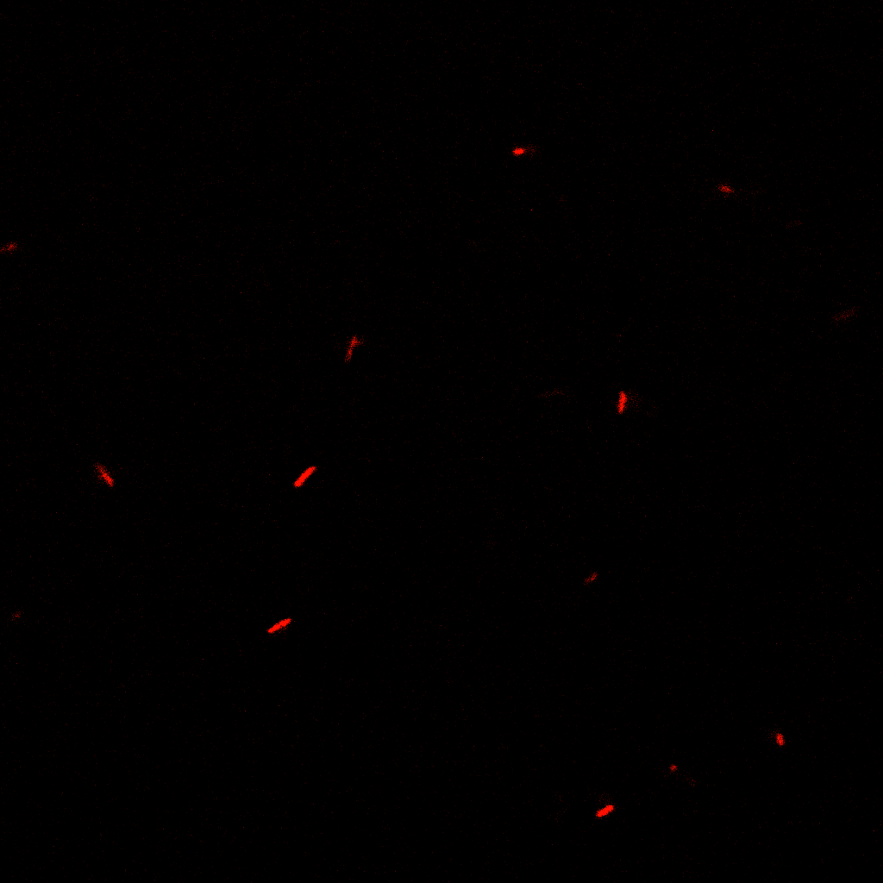
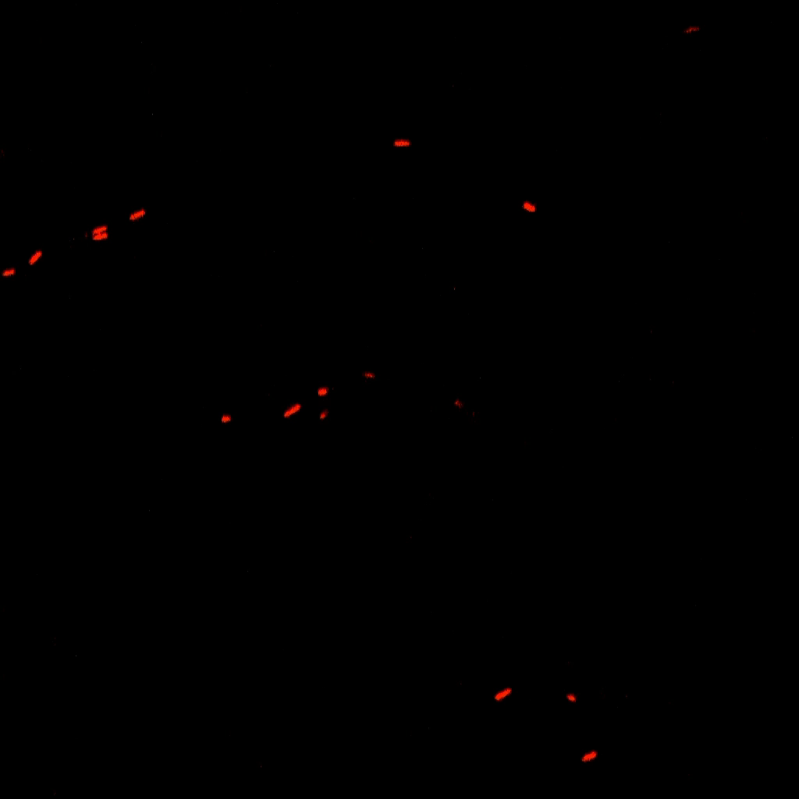
Figure S4
A
B

Slide 6
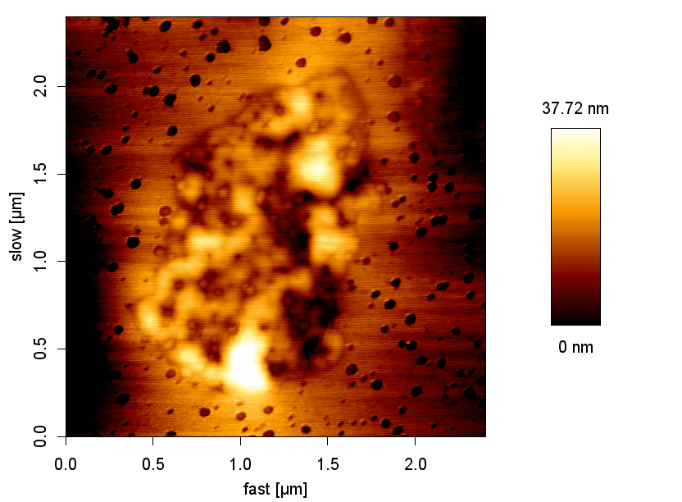
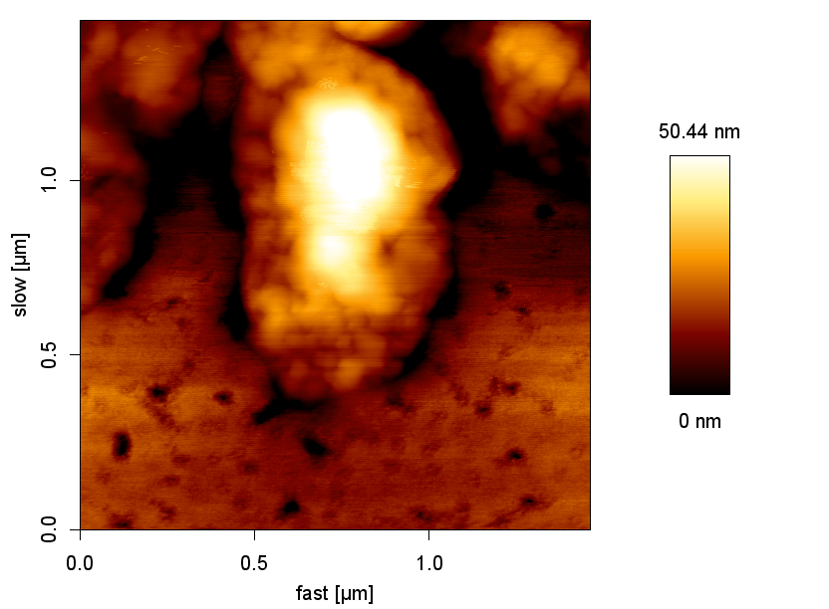
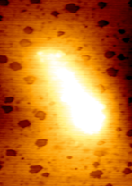
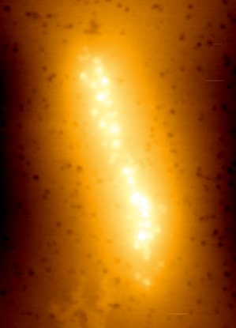
Figure S5
A
B
1 µm
1 µm
C
D
1 µm
1 µm

