Slide 1
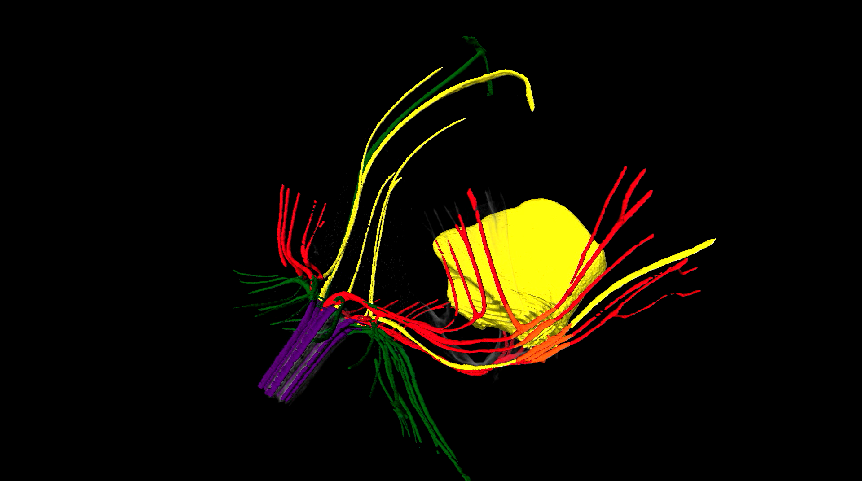
Movie S1. 3D visualization of vascular bundle patterns in a mature flower of P. equestris based on micro μCT scanning. Color code representation: red=vascular bundles of petaloid origin; yellow=vascular bundles of staminodal origin; green=vascular bundles of sepaloid origin.

Slide 2
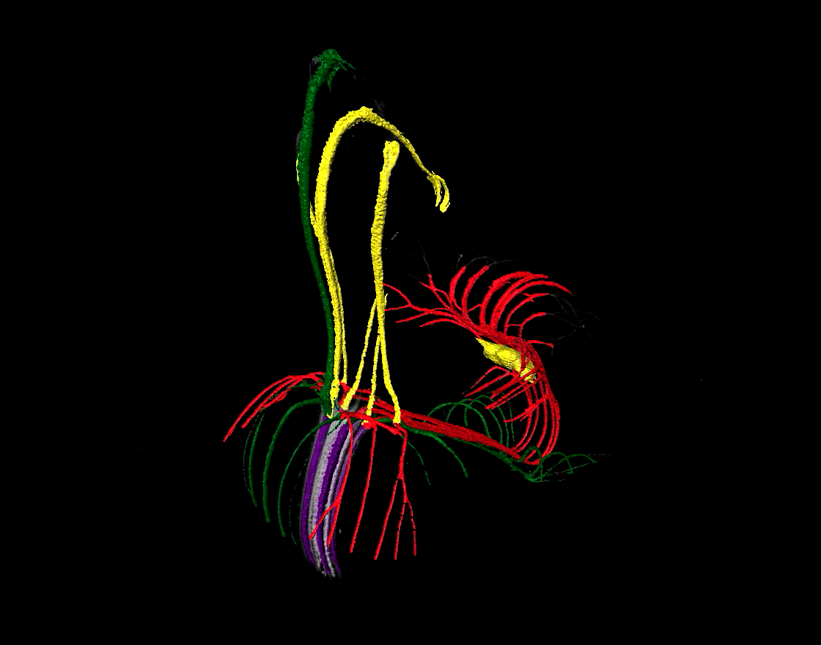
Movie S2. 3D visualization of vascular bundle patterns in a mature flower of P. pulcherrima based on micro μCT scanning. Color code representation: red=vascular bundles of petaloid origin; yellow= vascular bundles of staminodal origin; green=vascular bundles of sepaloid origin.

