Slide 1
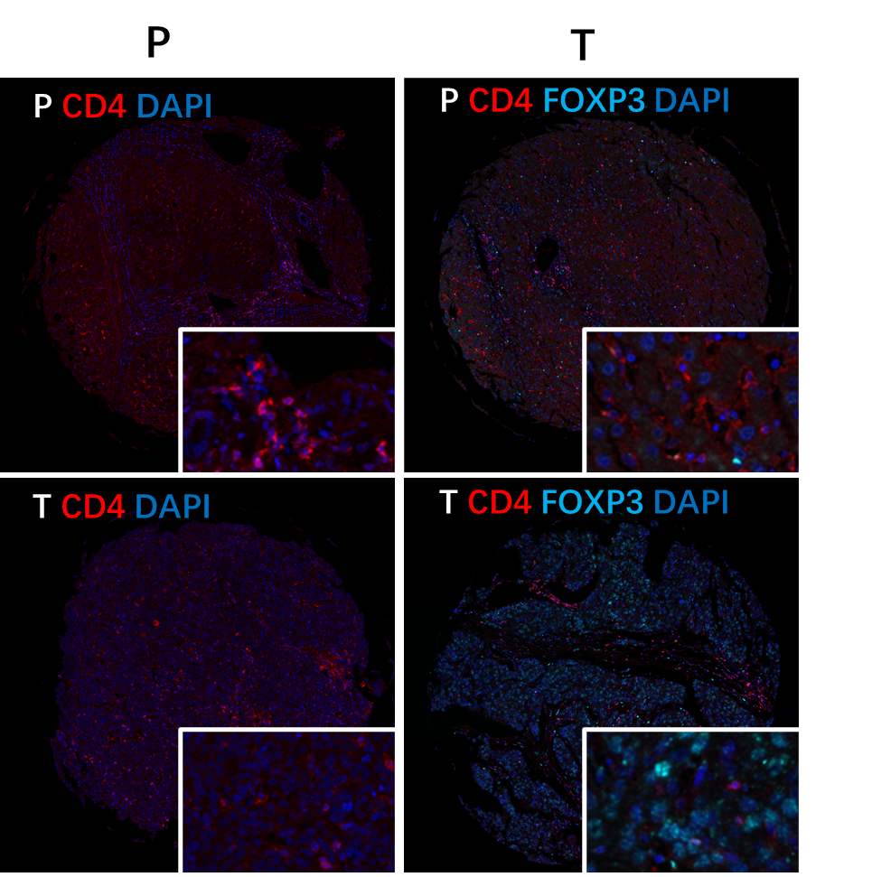
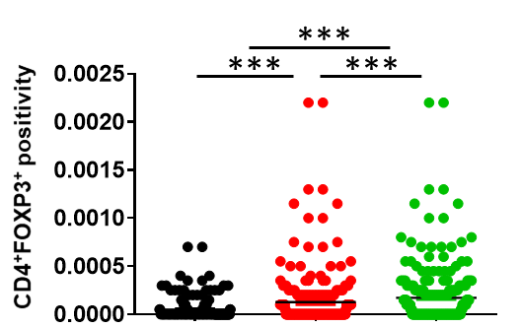
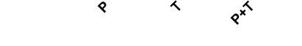
Supplemental Fig.1
a
b

Slide 2
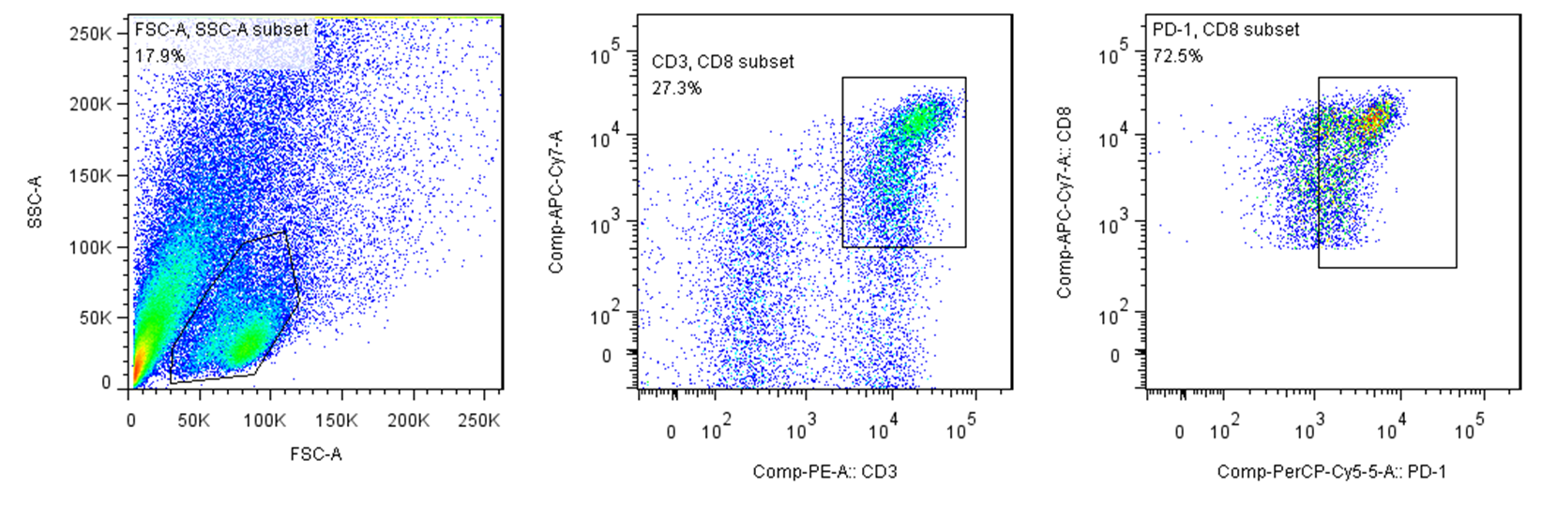
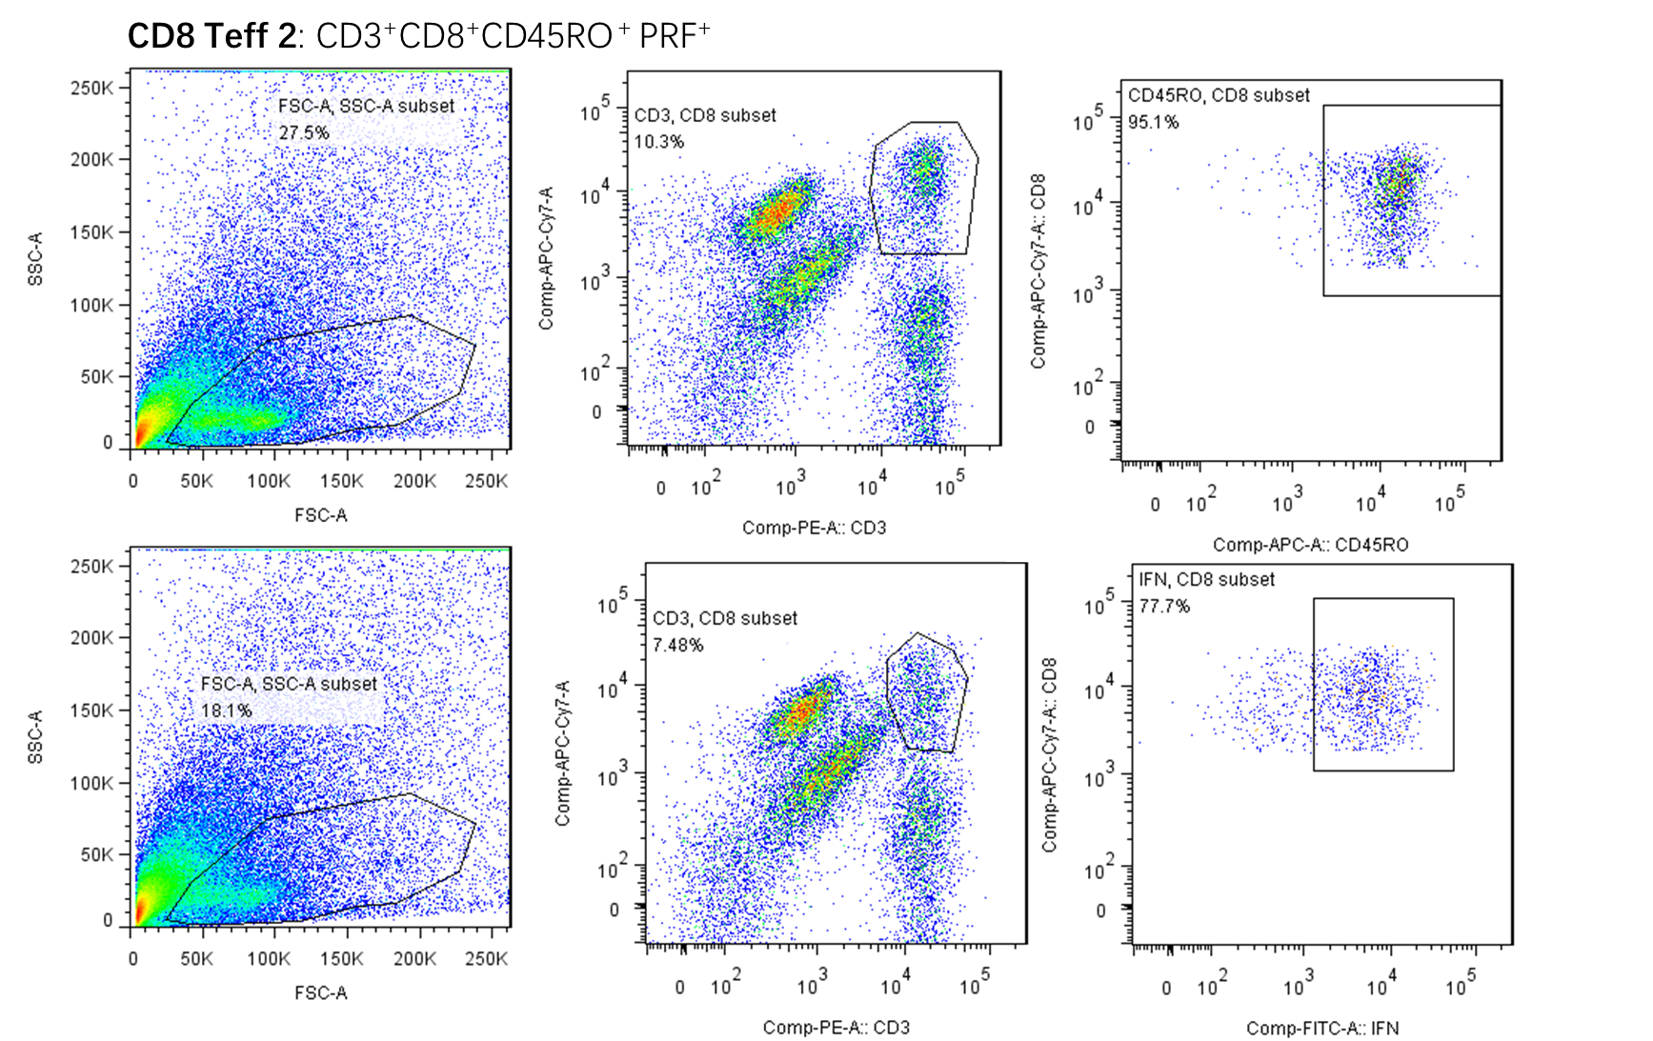
Supplemental Fig.2
Tex：CD3⁺CD8⁺PD-1⁺

Slide 3
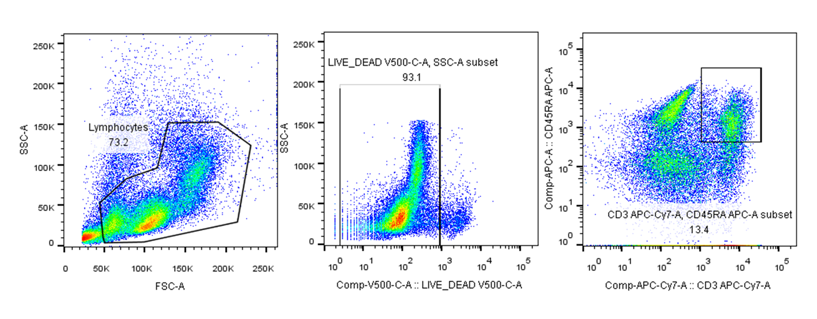
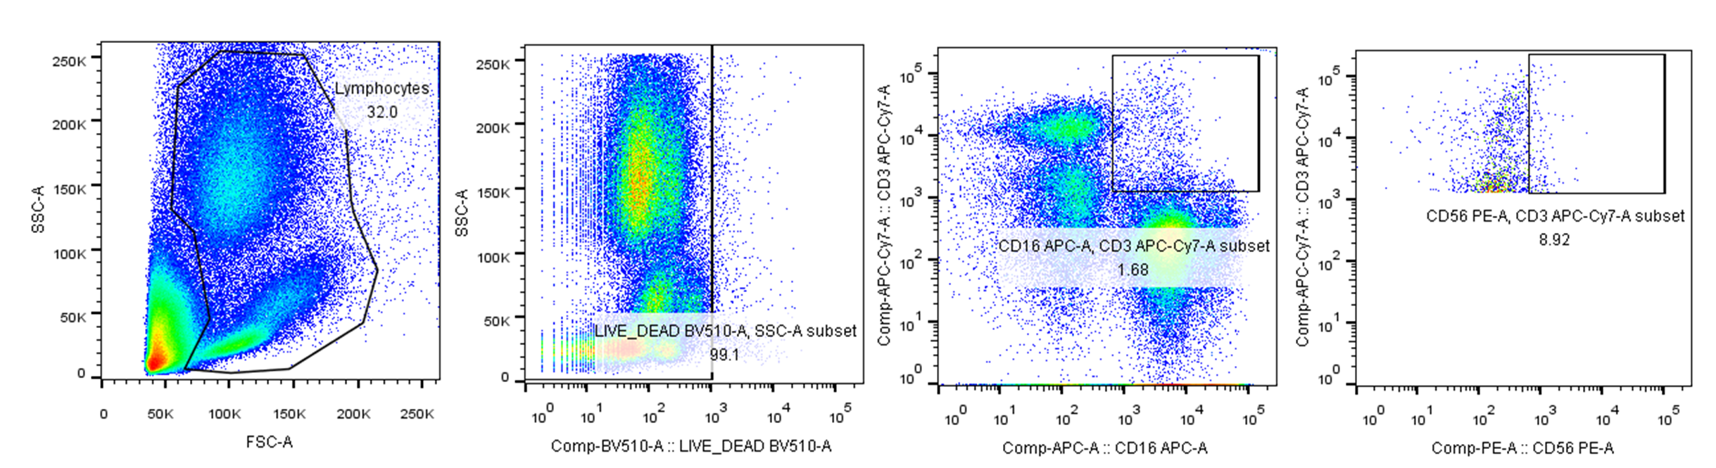
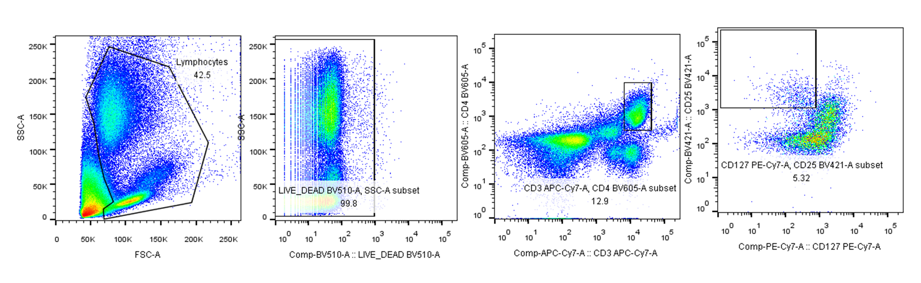
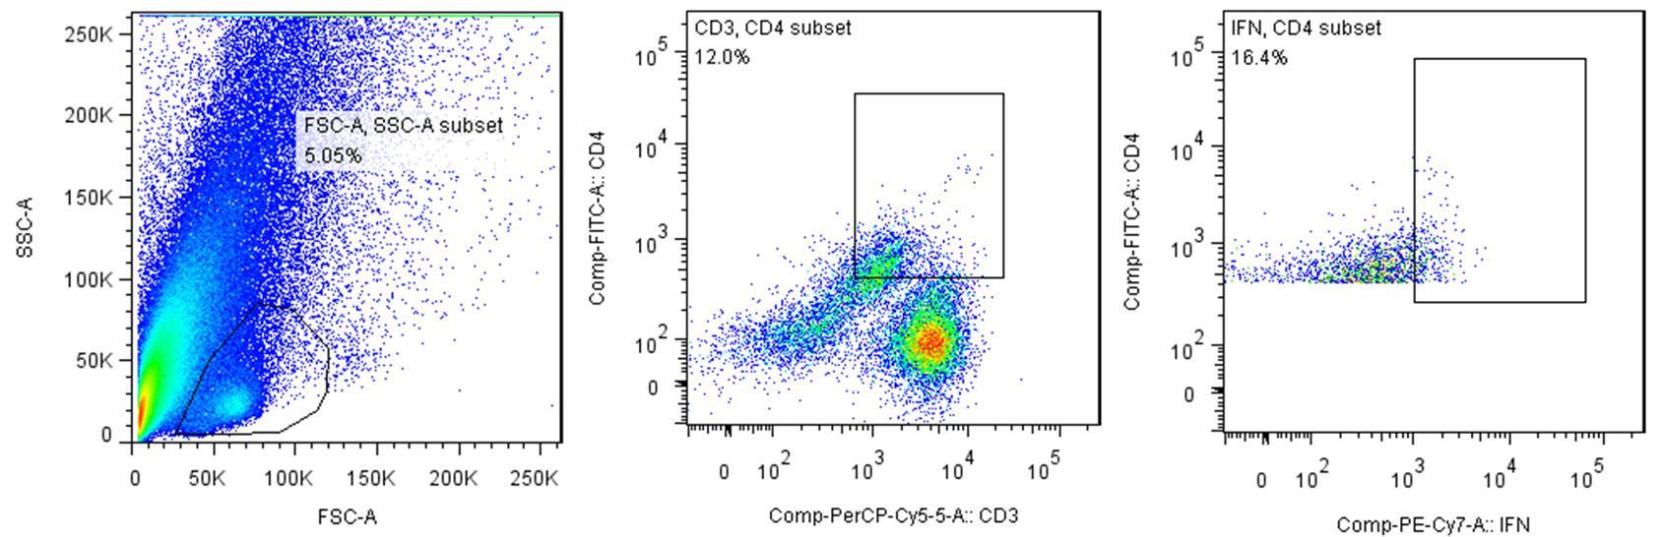
Supplemental Fig.3
naive: CD3⁺CD45RA⁺
NKT: CD3⁺CD16⁺CD56⁺
Treg : CD3⁺CD4⁺CD25^{hi}CD127^{lo}
CD4 Teff: CD3⁺CD4⁺ IFNγ⁺

